Slide 1
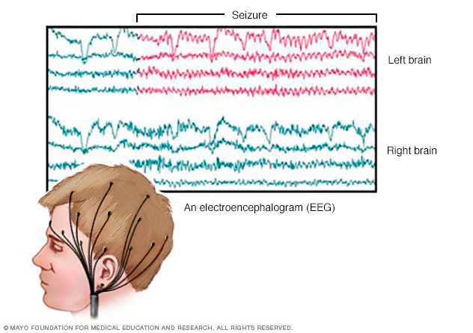
Optimization of ConvNet for EEG data Andre Bajorat, Konstantina Galani, Pablo de Andres
Project goals
Find the best configuration for a Convolutional Network built for seizure detection
Focused on the deep architecture
Optimized over ________ parameters
Tasks
Define a configuration space.
Modify training to take a configuration and output validation error.
Find the best configuration.
Plot the improvement.
About the network
Two architectures, a deep network and a shallow one.
Available on git.io/vNh8p
Schirrmeister, R. T., Springenberg, J. T., Fiederer, L. D. J., Glasstetter, M., Eggensperger, K., Tangermann, M., Hutter, F., Burgard, W. & Ball, T. (2017). Deep learning with convolutional neural networks for EEG decoding and visualization. Human brain mapping.
…
…
Results
Blaaaaa
Bla bla bla
Bla blaaaa
Bla bla bla
Bla.

