Slide 1
SCHOOL TECHNOLOGY ASSOCIATES
Every answer takes
longer than it should.
E
Searching email for
the right response to send
R
Recalling a procedure
or policy from memory
W
Rewriting the same
message for the fifth time
There is a faster way — and you already have access to it.

Slide 2
Here is what changes.
The same work — done faster, with less digging.
D
Draft any email in under a minute
A
Get answers without digging
Your tone. Their situation. Done — without starting from a blank page.
No more hunting through old emails or asking someone to pull up the policy.
W
Turn rough notes into clear writing
F
Ask what you would normally save for later
Paste your bullet points in. Get a polished draft back in seconds.
How does this work? What is the right process for this? Get the answer now.

Slide 3
Here is what we are covering today.
40 min total
1
Getting in and getting started
10 min
How to log in, find your projects, and send your first message.
2
What is available right now
10 min
What the AI Advisor does, what the screen shows, and what is coming next.
3
How to get good results
15 min
The three-ingredient formula and how to fix it when the answer is not right.
No install. No setup. Your work email and a browser is all you need.

Slide 4
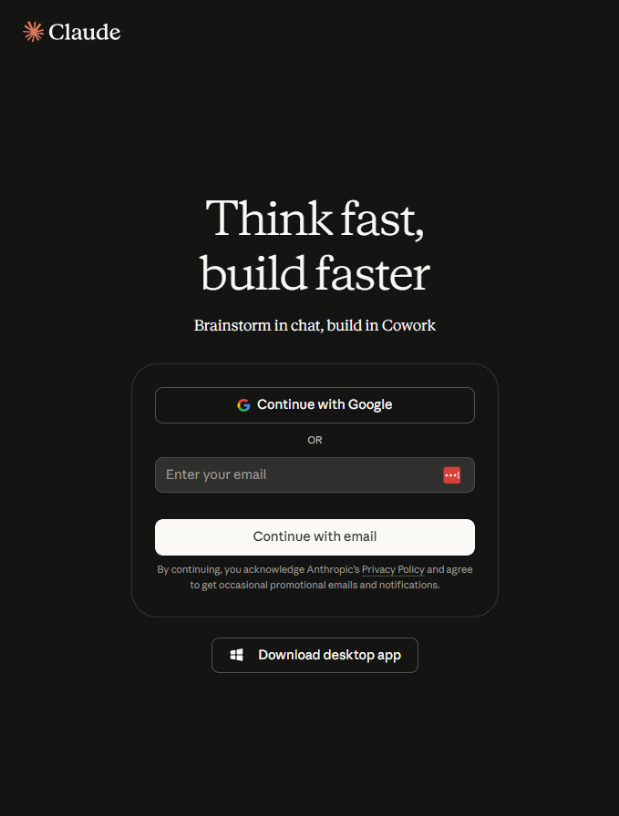
How to Get In
STEP 1 OF 2 - LOG IN AT CLAUDE.AI
1
Go to claude.ai
Sign in with your @k12sta.com work email
NOT your personal Gmail.
NOT the Google sign-in button. If you have not received an invite, check spam or contact Adam.
Common gotcha:
Seeing "Personal" instead of School Tech? Wrong account. Log out and use your work email.
Sonnet for almost everything - it is faster. Opus thinks longer, so save it for the hard ones.

Slide 5
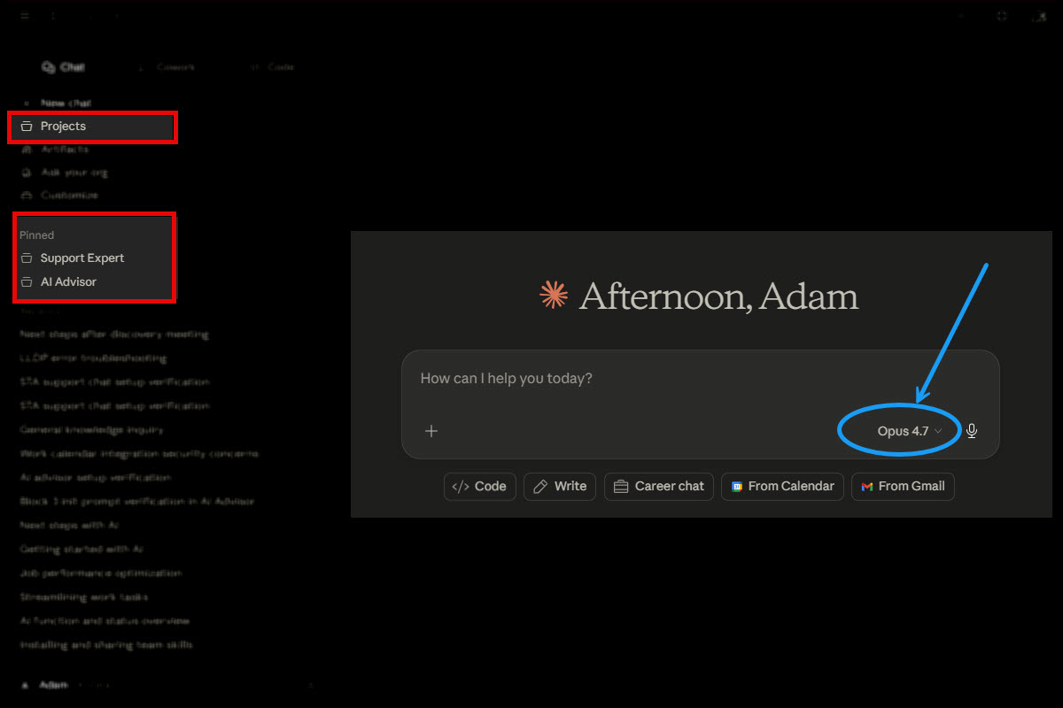
How to Get In
STEP 2 OF 2 - FIND YOUR PROJECTS
2
Find Projects in the left sidebar
Click a project name. Start typing. That is it.
Pre-configured
Every tool is already set up. No settings, no onboarding inside the tool.
Just open and ask
Do not explain School Tech. Do not set context. Just type your question.
No setup needed
Each Project already knows our products, customers, and workflows.

Slide 6
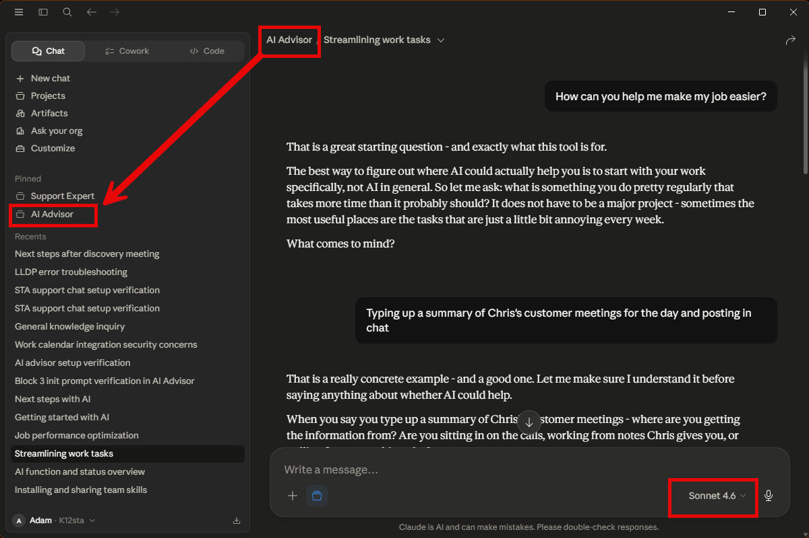
What's Live Right Now
LIVE
AI Advisor - All Staff
Your starting point for AI at School Tech.
Explore where AI could fit your daily work
Find out what tools are built or coming
Frame an idea to bring to Adam
Get plain-language answers about the AI program
Projects > AI Advisor > start typing
ALSO LIVE - cohort tools
STA Support Chat (Chris, Tyler) | STA Salesforce Cohort (Tanya, Joanie, Kelsey, Adam) - see Staff AI Tools Reference for details.

Slide 7
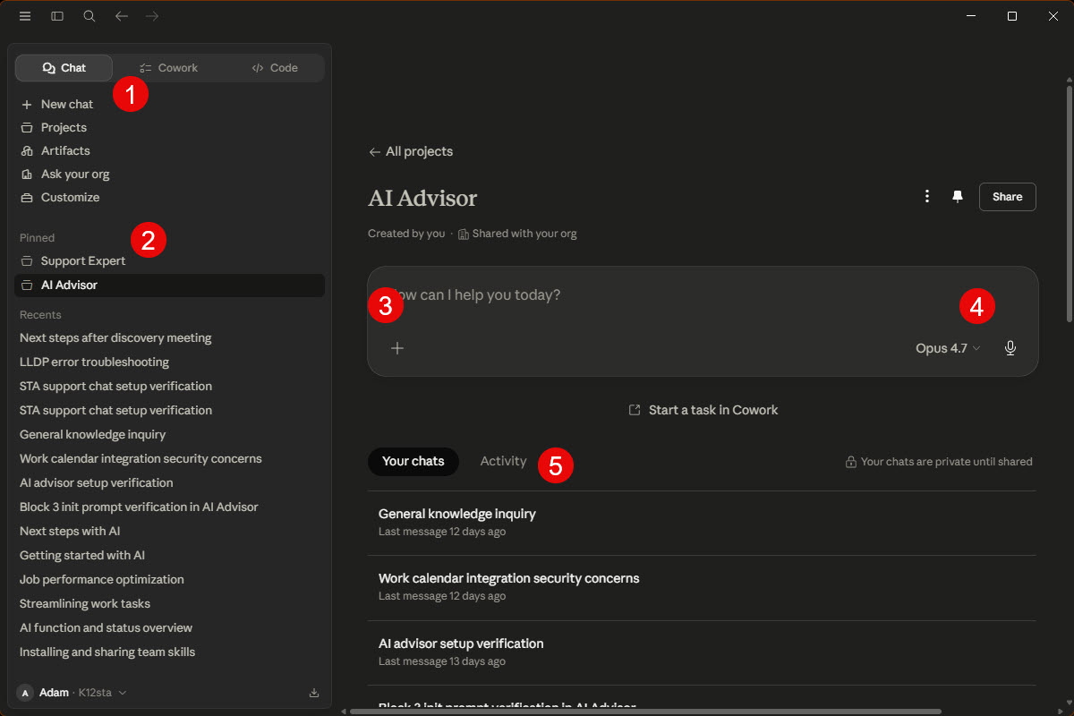
What You Are Looking At
1
Navigation tabs
Chat, Cowork, Code. Start in Chat.
2
Pinned Projects
Your pre-built tools — AI Advisor lives here.
3
Message box
Type your question here. No setup needed.
4
Model selector
Set to Sonnet. Switch to Opus only for the hard ones.
5
Your chats
Past conversations with this project.

Slide 8
Better input = better output.
Hit all three ingredients for a useful first draft.
1
2
3
WHAT
CONTEXT
FORMAT
The actual task
The relevant situation
What you want back
"Draft a response to this customer complaint."
Not "I was wondering if you could maybe help me..."
Paste the actual email, error message, or case note. The real thing beats a description every time.
"Keep it under 3 sentences." "Formal — for a superintendent." "Use bullet points."

Slide 9
See the Difference
WEAK PROMPT
STRONG PROMPT
Help me write a response
to a customer complaint.
A customer emailed saying their time
clock stopped syncing after last
Tuesday's update. They're frustrated
- second time reporting. Draft a calm
response that acknowledges the issue,
gives a realistic timeline (still
diagnosing), and keeps it professional.
Here's their email: [paste]
The tool has to guess:
- What the customer complained about
- Which product or service
- What outcome you want
- What tone is appropriate
The tool has to work with:
Result: a generic template that needs significant rework.
P
Product, issue, and timeline
M
Customer mood and history
T
Tone goal and desired outcome
E
The actual email to respond to

Slide 10

The One Rule
Never paste information you would not share outside the company.
Student data
Personal / HR data
Keys and credentials
Names, IDs, grades, attendance,
test scores — anything from Skyward.
This includes photos and contact info.
SSNs, payroll, performance reviews,
medical information, employee records
or any identifiable personal detail.
Passwords, API keys, tokens, login
credentials for any platform,
internal account numbers.
When in doubt - do not paste it. Check the Restricted Data Reference Guide or ask Adam first. Connecting a tool to another system? Ask IT first.

Slide 11
When It's Wrong - Don't Start Over
Stay in the same conversation. The tool remembers everything from this session - context is still there.
Name exactly what's wrong
Add what you left out
Do not say "that's not right."
"Too formal - this customer is
casual. Rewrite just the
opening paragraph."
Generic response = missing detail.
"Should have mentioned - this
district is 3 months in. They
do not know our process yet."
1
2
Keep what's working
Ask for options
If 80% is right, say so.
"First two paragraphs are good.
Just rewrite the closing - it
sounds like we're making excuses."
Not sure what tone you want?
"Give me two versions: one
short and direct, one that
walks through the resolution."
3
4

Slide 12
Before you leave this room.
1
What you can do right now
2
Your first task (do it today)
Draft emails. Get answers. Turn rough notes into clear writing. You have access today — no waiting.
Open claude.ai. Find something from this week's work. Ask it to help. That is it.
3
Your reference card
4
Questions and help
Quick Reference Card lives on the Training Hub, in the header. Keep it open for the first week.
Adam Baker - adamb@k12sta.com
Tool wrong or says it does not know? It does not know it YET. Tell Adam.
If a tool does not know the answer - it does not know it YET. Tell Adam. That is how the system gets better.

