Slide 1
Expedia Hotel Recommendation
Anandan Balaji
17 June 2016

Slide 2
Overview
Problem Definition
Dataset
EDA / Model
Manual Feature Engineering
Results

Slide 3
Problem Definition
Predict the hotel cluster for an Expedia customer.
Hotels are grouped on many parameters and is called hotel cluster.
The hotel clusters are numbered from 1 to 100.

Slide 4
Dataset
The following are the datasets provided and they are available at Kaggle, www.kaggle.com/c/expedia-hotel-recommendations/data
train.csv - the training dataset
test.csv - the test dataset
destinations.csv - hotel search latent attributes
sample_submission.csv - the sample submission file in the correct format

Slide 5
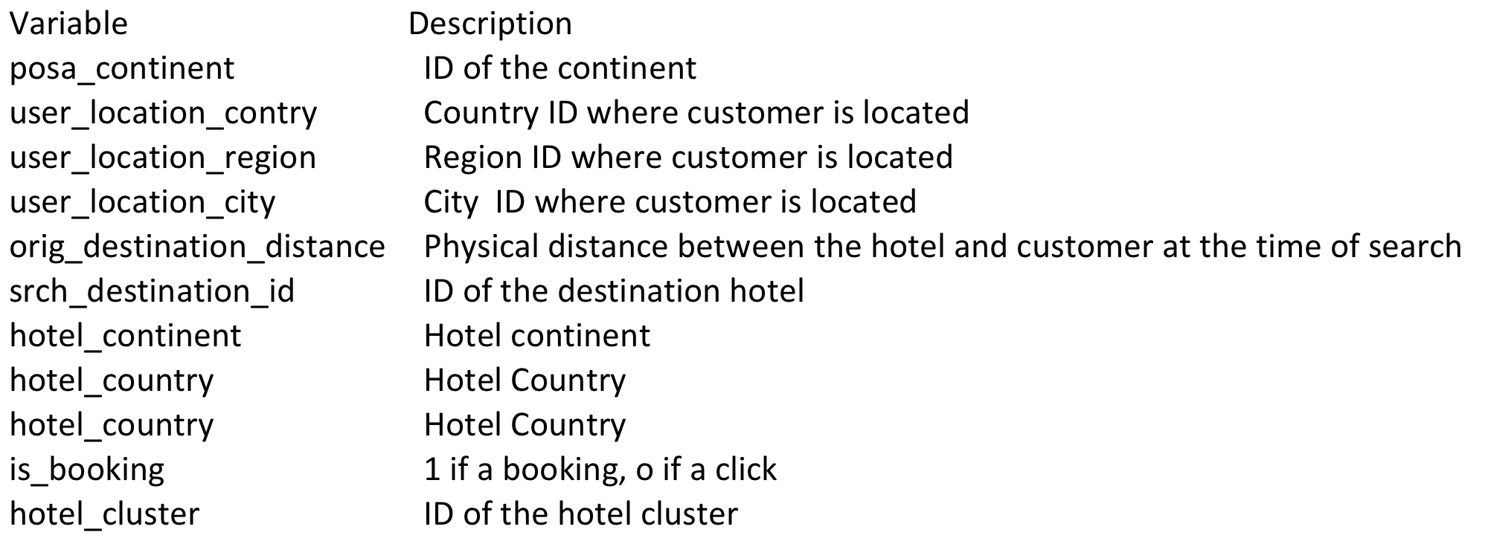
Dataset – Important Variables

Slide 6
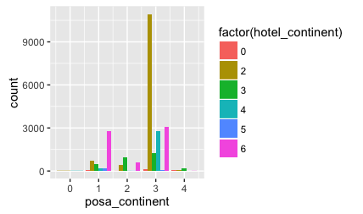
EDA
Source and Destination continent spread

Slide 7
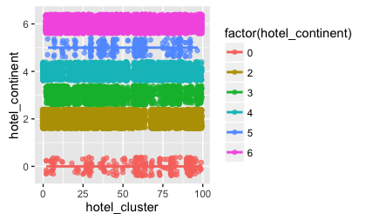
EDA (2)
Hotel Cluster spread

Slide 8
EDA, Model
By plotting, no pattern/ correlation was found between the dependent and independent variables.
Linear Regression Model
The R-squared value was negligible = 0.005
However, the dependent variables is_booking, and is_package had coefficients which were significant .

Slide 9
EDA, Model (2)
CART ( Classification And Regression Tree)
Unable to build tree beyond root node
The CP ( Complexity factor) was negligible 0.006
The detailed analysis report is available at https://github.com/abalaji-blr/CapstoneProject/tree/master/Deliverables/ExpediaHotelReco.pdf.

Slide 10
Manual Feature Engineering
The basic Machine Language algorithms were not suitable for this problem.
However, we have identified some dependent variables which are significant.
Let’s derive features using them and predict the hotel cluster.

Slide 11
Feature #1
Identify often used hotel clusters
For a given destination, identify the often used top five hotel clusters
Also, give importance to is_booking
If is_booking is 1, give weightage as 1
If is_booking is 0, give weightage as 0.15

Slide 12
Feature #2
Use orig_destination_distance
There are few records match between test and training dataset based on orig_destination_distance
Predict top five clusters using that
Give preference to this feature result as they are appropriate match when compared with feature 1 results.

Slide 13
Results
Combine results from Feature #1 and Feature #2
Pick 5 hotel clusters
Make sure they are unique.
The complete R script is available at this https://github.com/abalaji-blr/CapstoneProject/tree/master/Deliverables/ExpediaScript.R

Slide 14
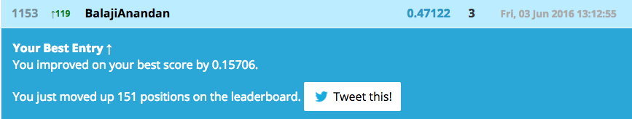
Results (2)
The Manual Feature Engineering approach yielded the Mean Average Precision Score at 5 ( MAP@5) of 0.47122!

Slide 15
Future Work
Explore advanced Machine Language algorithms like Random Forest, XGBoost etc.

Slide 16
Thank You

