Slide 1
OS Development 3. Programming model of the x86_64 processor architecture
Prof. Dr. Michael Schöttner
Dr. Fabian Ruhland

Slide 2
Preview
History
x86 programming model
Address translation
Protection
Tasks
Summary

Slide 3
History
8086 (1978) - Prime father of the PC processor
80286 (1982) - Segmentation based memory protection
80386 (1985) - Paging → Memory protection based on pages
Pentium (1993) - superscalar, 64-bit data bus, MMX, APIC
Pentium II (1997) - RISC-like micro instructions
Pentium III (1999) - SSE
Pentium 4 (2000) - SSE2, Hyperthreading, Intel 64 / EM64T
Core (2005) - Dual Core
Core 2 (2006) - Quad Core, 64 bit (x86_64)
Has-/Broad-well (2013) - AVX2, TSX, FMA3
Rocket / Tiger Lake (2021) - DL-Boost, Memory encryption
Alder Lake (2021) - Division in P- and E-cores (max. 8 + 8)
Advanced Vector Extensions (based on SSE)
Transactional Synchronozation Extensions
Fuse-Multiply-Add Instructions
Deep-Learning (DL) Boost → AVX extension
P = Performance E = Efficiency Hybrid Cores
3.1 History

Slide 4
Preview
History
x86 programming model
Address translation
Protection
Tasks
Summary

Slide 5
8086
16-bit architecture, little endian
20-bit address bus → 1 MiB max. physical memory
Few registers (from todays standpoint)
123 instructions (1-4 byte length)
Segmented memory (64 KiB segments)
Stil relevant today
On multicore systems, other cores startup in real moe
3.2 x86 programming model

Slide 6
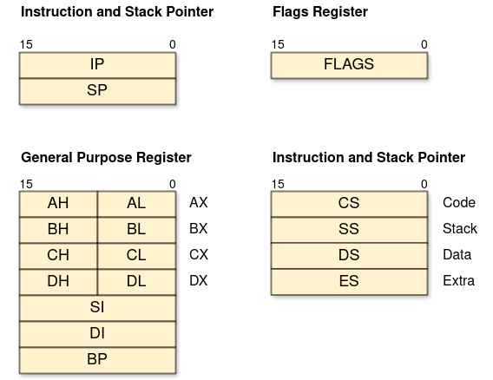
8086: Registers
Picture based on: Volkmar Sieh / Daniel Lohmann, University Erlangen
3.2 x86 programming model

Slide 7
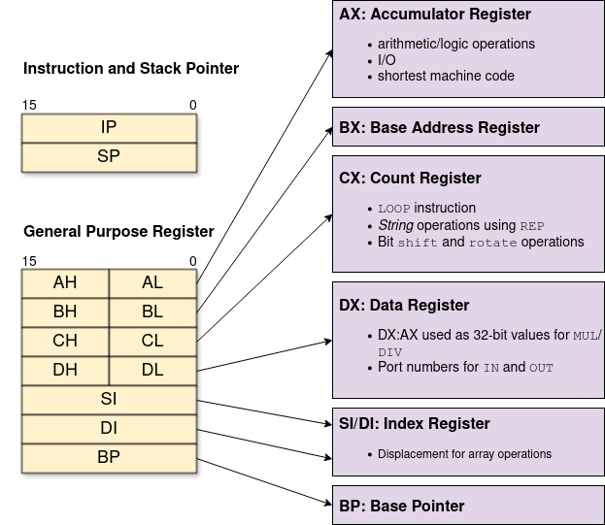
8086: Registers
3.2 x86 programming model
Picture based on: Volkmar Sieh / Daniel Lohmann, University Erlangen

Slide 8
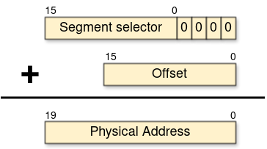
8086: Segmented Memory
Logical addresses consist of:
Segment selector (determined by a segment register)
Offset (usually given by a general purpose register or directly encoded into the instruction)
Physical address calculation:
3.2 x86 programming model
Picture based on: Volkmar Sieh / Daniel Lohmann, University Erlangen

Slide 9

8086: Segmented Memory
640K ought to be enough for anybody.
3.2 x86 programming model

Slide 10
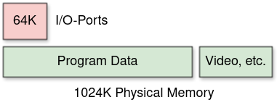
8086: I/O-Port vs. Memory Addresses
I/O-port and memory addresses:
Differentiation through CPU pin M/IO.
16 address lanes for I/O → 16-bit
Still supported today (even in Protected Mode and Long Mode)
Additionally: Memory Mapped I/O (e.g., for video cards)
Memory access goes to a device instead of memory
3.2 x86 programming model

Slide 11
IA-32 – The 32-bit Intel Architecture
First IA-32 CPU was the Intel 80386
The term IA-32 was introduced much later
32-bit technology: register, data und address bus
From Pentium Pro: 64 Bit data und 36 bit address bus
Complex protection and multitasking support
Protected Mode
Originally introduced with the 80286 (16-Bit)
Compatibility
With older operating systems through Real Mode
With older applications through Virtual 8086 Mode
Segmentation based memory model (mostly used as Flat Memory)
Page based Memory Management Unit (MMU)
3.2 x86 programming model

Slide 12
x86-64: 64-bit processor architecture
x86-64: Original name of 64 bit extension by AMD
Sometimes abbreviated as x64
Later replaced by AMD64
Intel licensed x86-64 from AMD
Intel 64 is Intel’s own label (for the same architecture)
Minimal differences in instruction set compared to AMD64
Completely different than the own IA-64 (Itanium) architechture
3.2 x86 programming model

Slide 13
x86-64: 64-bit processor architecture
Additional registers (all 64 bit long)
Paging must be enabled
Segmentation strongly restricted
New feature (among others): No Execute protection per page
3.2 x86 programming model

Slide 14
x86-64: CPU modes
Real Mode = 16 bit addressing
Protected Mode = 32 bit addressing (also called IA-32)
Long Mode = 64 Bit addressing (also called IA-32e)
e meaning extension
Used in the Intel manuals
To differentiate against IA-64
(Compatibility Mode)
Supporting Protected Mode applications in Long Mode
3.2 x86 programming model

Slide 15
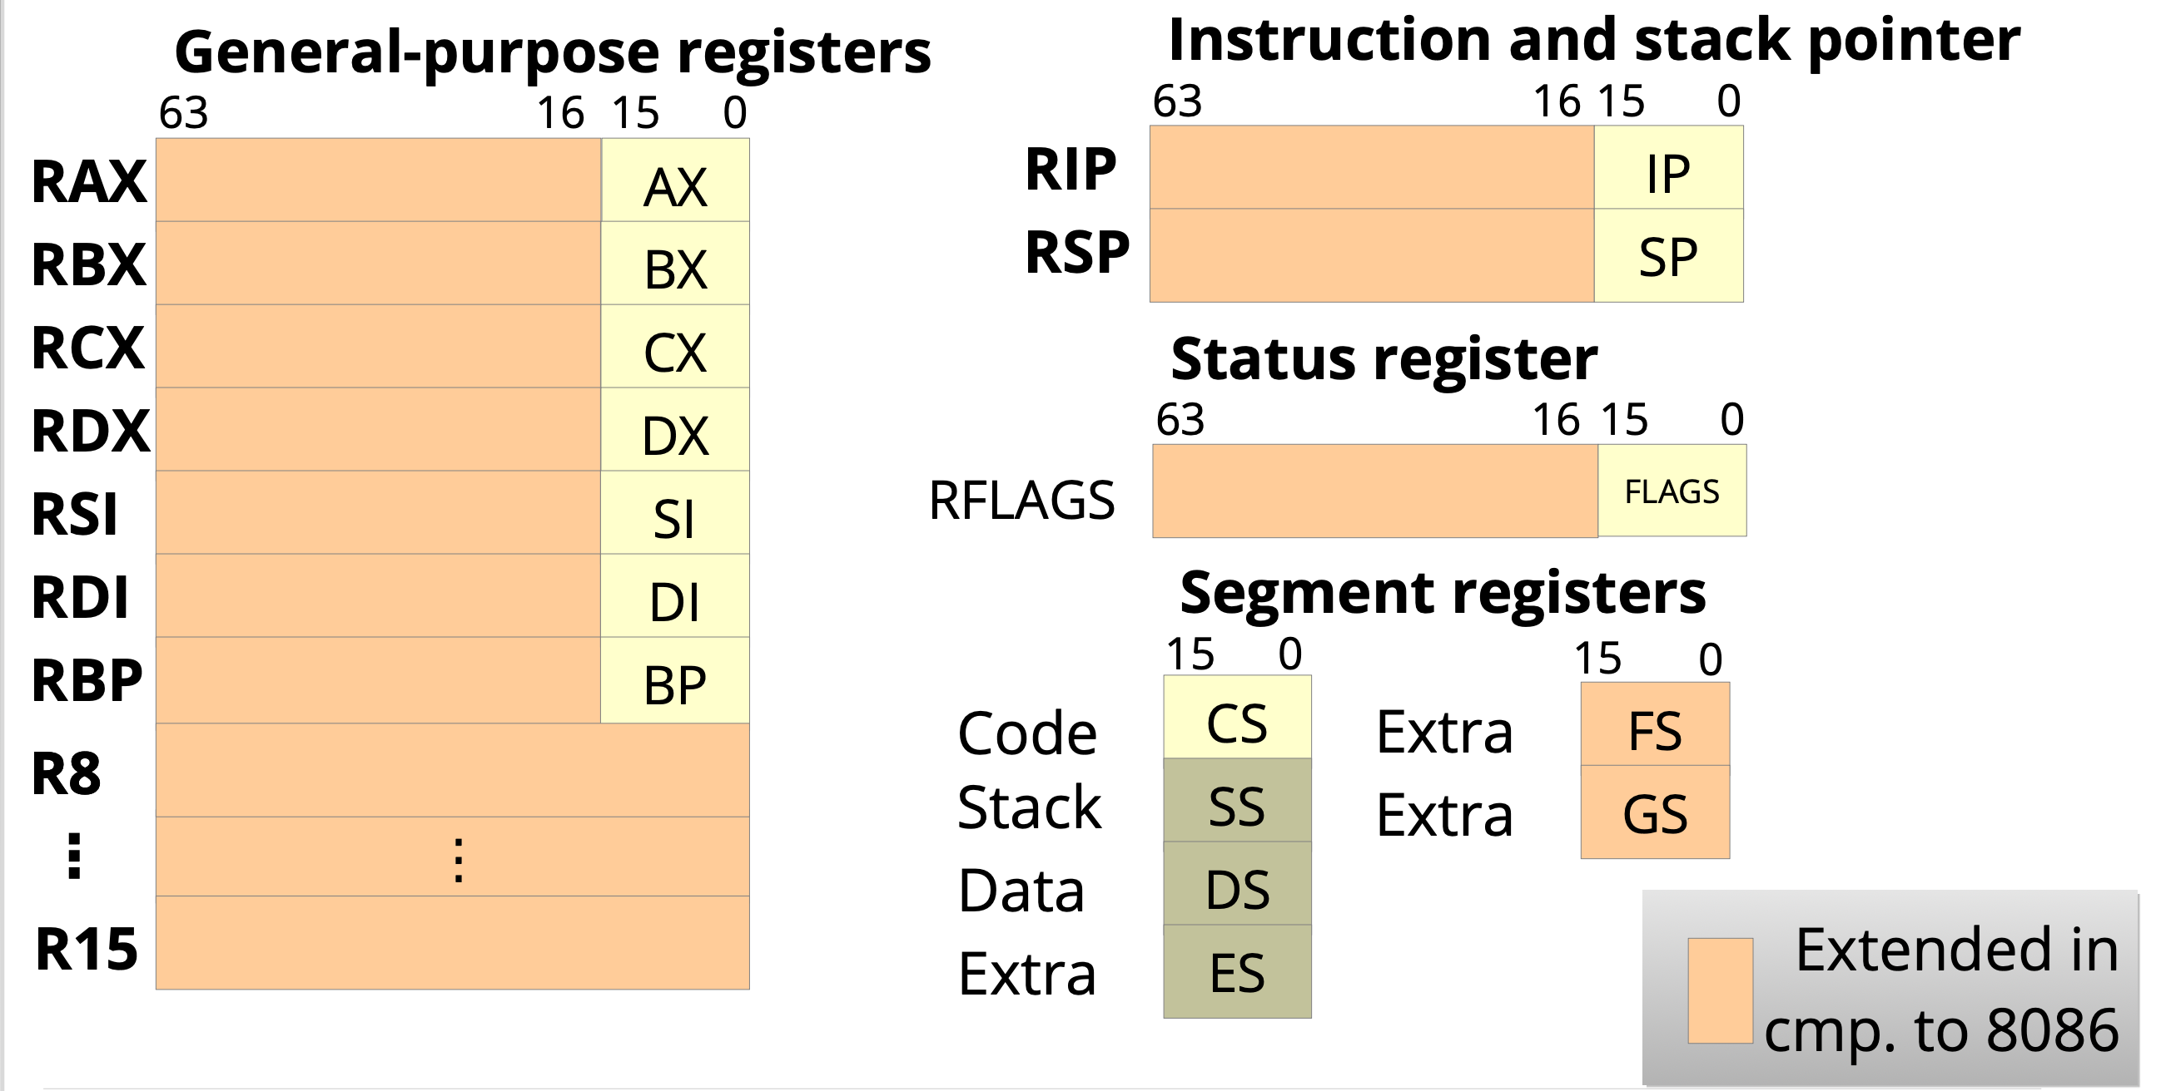
x86-64: Registers
Picture: Horst Schirmeier, TU Dresden
3.2 x86 programming model

Slide 16
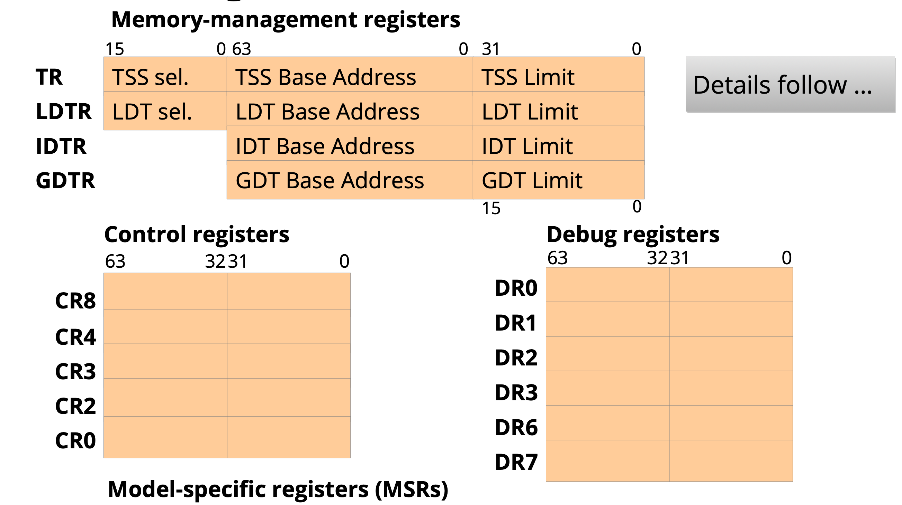
x86-64: Registers (2)
Picture: Horst Schirmeier, TU Dresden
3.2 x86 programming model

Slide 17
Preview
History
x86 programming model
Address translation
Protection
Tasks
Summary

Slide 18
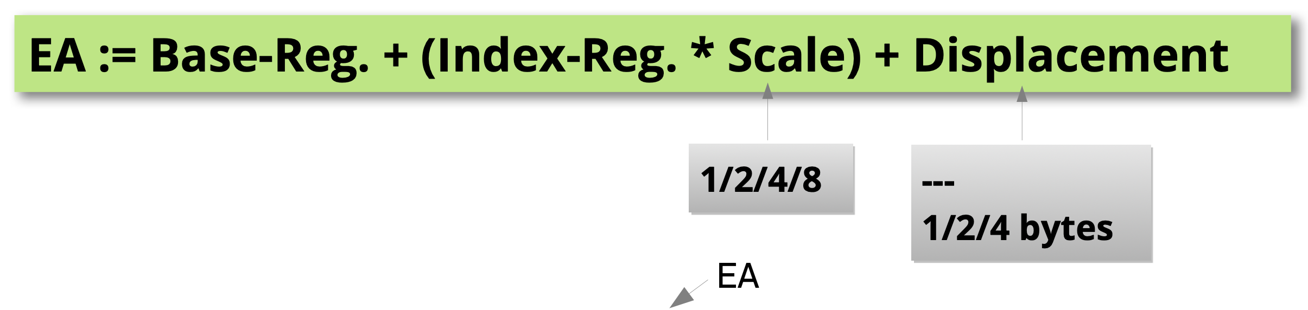

x86-64: Addressing
Effective addresses (EA) are calculated using the following scheme
All general purpose registers can be used
Example: MOV RAX, array[RSI * 4]
Lesen aus einem Array mit 4 Byte großen Elementen und RSI als Index
New in x86-64: Addressing relative to instruction pointer
Picture: Horst Schirmeier, TU Dresden

Slide 19
Protected Mode – Segments
Each segment has a start address and a length
Segment registers store segment selectors = Index into the GDT/LDT
LDT was rarely used by operating systems
A program (in execution) consists of multiple memory segments
At least CODE, DATA and STACK
Linear address is segment start address + effective address
Effective address = Value in a general purpose register
Linear address = physical address, if the paging unit is turned off
3.3 Address Translation

Slide 20
Protected Mode – Segments (2)
Flat memory:
Practically all modern 32-bit operating systems set all segments to start address 0
This way, segments do not influence address calculation
Furthermore, only four GDT entry are used (CODE + DATA, each for User and Kernel Mode); LDT remains completely unused
Segmentation cannot be turned off (because of protection), but Paging is not required in IA-32 Protected Mode
3.3 Address Translation

Slide 21
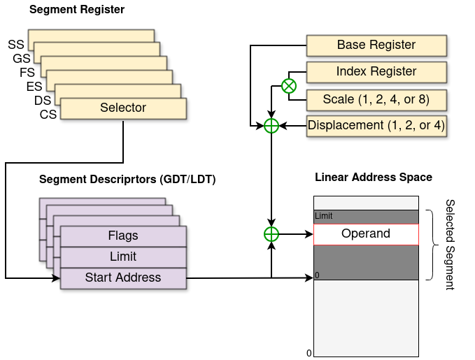
Protected Mode – Segments (3)
3.3 Address Translation
Picture based on: Volkmar Sieh / Daniel Lohmann, University Erlangen

Slide 22
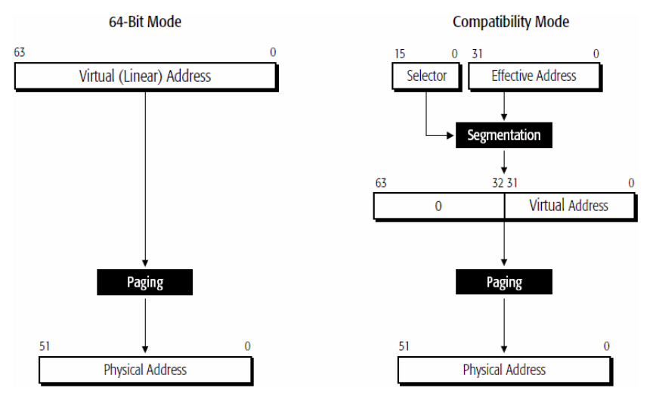
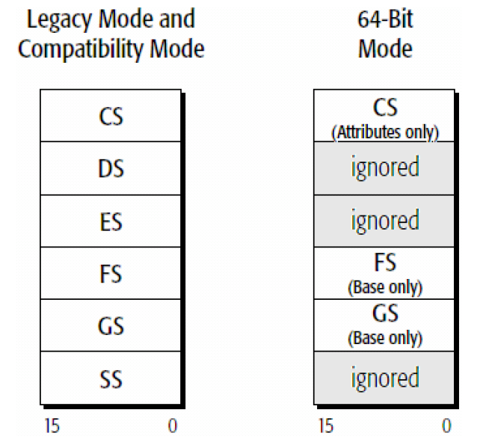
Long Mode: Segmentation
16-bit Selectors
Start addresses are ignored in almost all segments, except FS and GS
No limit check; essentially only the ring number in CS remains relevant (= CPL)
3.3 Address Translation

Slide 23
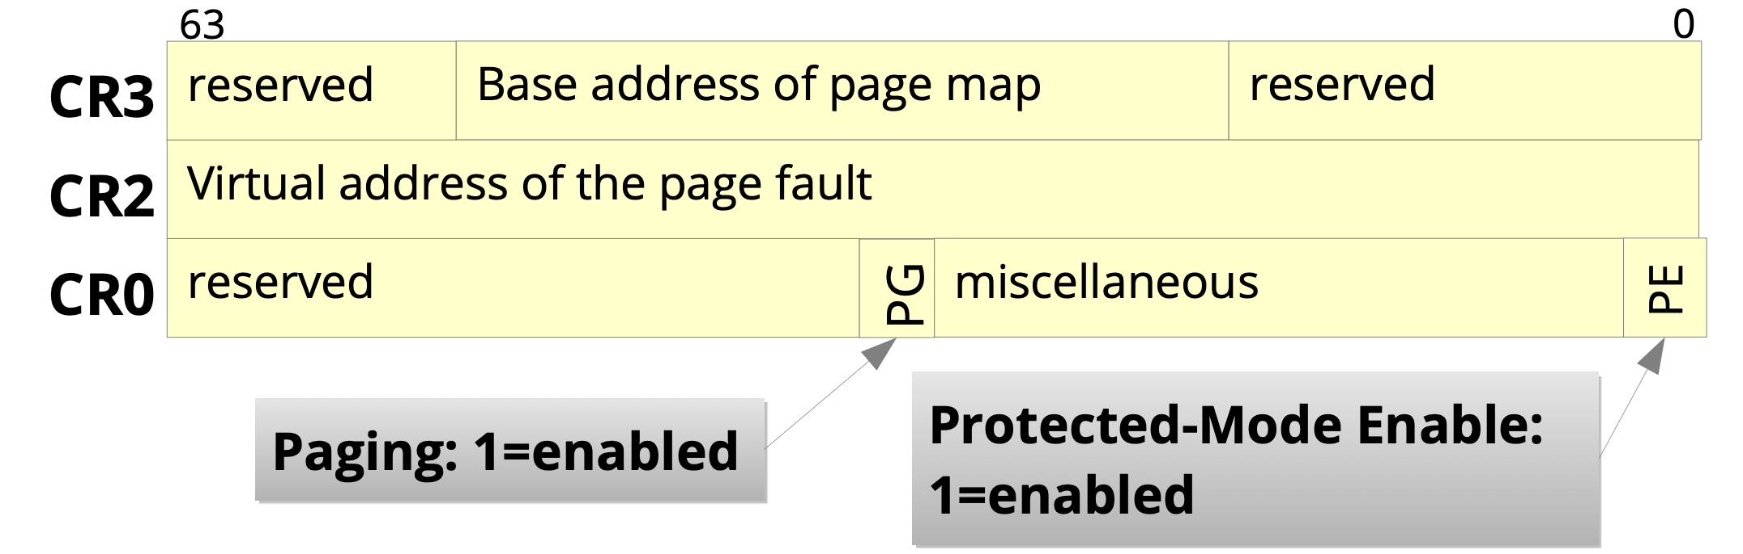
Long Mode: Paging
Paging is required in Long Mode
The basic paging configuration is handled by the CRx Control Registers
Physical Address
3.3 Address Translation
Picture: Horst Schiermeier, TU Dresden

Slide 24
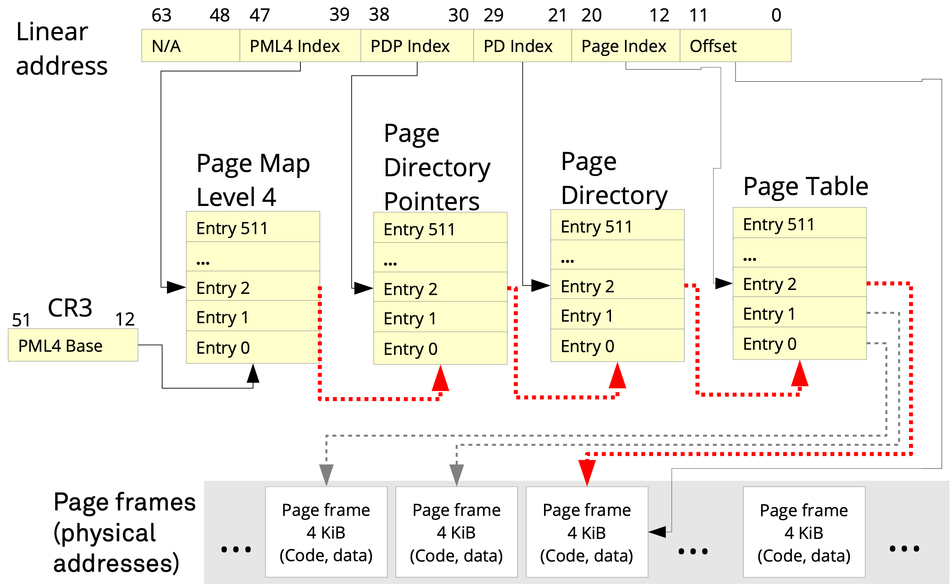
Long Mode: Page Tables
Four or five levels of page tables
3.3 Address Translation
Picture: Horst Schiermeier, TU Dresden

Slide 25
Long Mode: TLB
Problem: Paging slows down memory accesses, since the page tables need to be accessed each time
Solution: Translation Lookaside Buffer (TLB):
Fully associative cache
Tag: consists of page table indices
Data: Page Frame address
Size (80386): 32 entries
With normal applications, the TlB reaches a hit rate of ~98%
Remarks:
Writing the CR3 register invalidates the TLB
Not anymore since Intel Westmere (2010) → TLB Tag has additional 12-bit Process Context ID (PCID)
When protection/access bits in a page table entry are modifired, the corresponding TLB entry must be deleted (INVLPG instruction)
3.3 Address Translation

Slide 26
Preview
History
x86 programming model
Address translation
Protection
Tasks
Summary

Slide 27
Protection
Goals:
Protection against unauthorized memory accesses and code execution
Protection against kernel crashes or crashes of other processes
Requirements: Coda and Data...
are classified in regard to their trustability
and this classification is enforce by the operating system, with the help of the process

Slide 28
Protection Rings
Each segment descriptor (Code/Data) has two bits, determining which privilege level the segment is assigned to
Up to four privilege levels possible
In practice, only two are used
Code
Code
Code
Code
3
2
1
0
Daten
Daten
Daten
Daten

Slide 29
Protection Rings
Smaller ring numbers grant more privileges
Ring 3 is meant for applications
= User Mode
Ring 0 is meant for the OS
= Kernel/Supervisor Mode
Application
OS
3
2
1
0

Slide 30
Protection Rings and Gates
Accessing memory of an inner ring is forbidden and such accesses are prohibited by the MMU
General Protection Fault
Code of an inner ring can only be called via Gates
Allow direct calls from ring 3 to ring 0
Memory accesses and calls to outer rings are always allowed
Gate
3
2
1
0

Slide 31
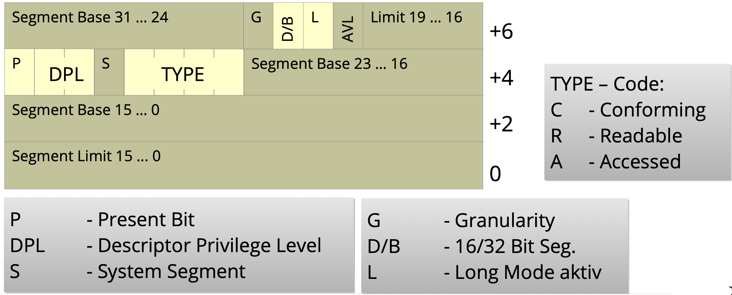
Segment Descriptors
Are entries in the Global Descriptor Table (GDT) and allow code protection
(IA-32: additional protection via limit (= end of segment))
8 byte per entry (Exception: system segments use 16 byte in x86_64)
TYPE
Code/Data
Read/Write
Non-/Conforming
System Segments (Call-Gate, Task State Segment)
Picture: Volkmar Sieh / Daniel Lohmann, University Erlangen

Slide 32
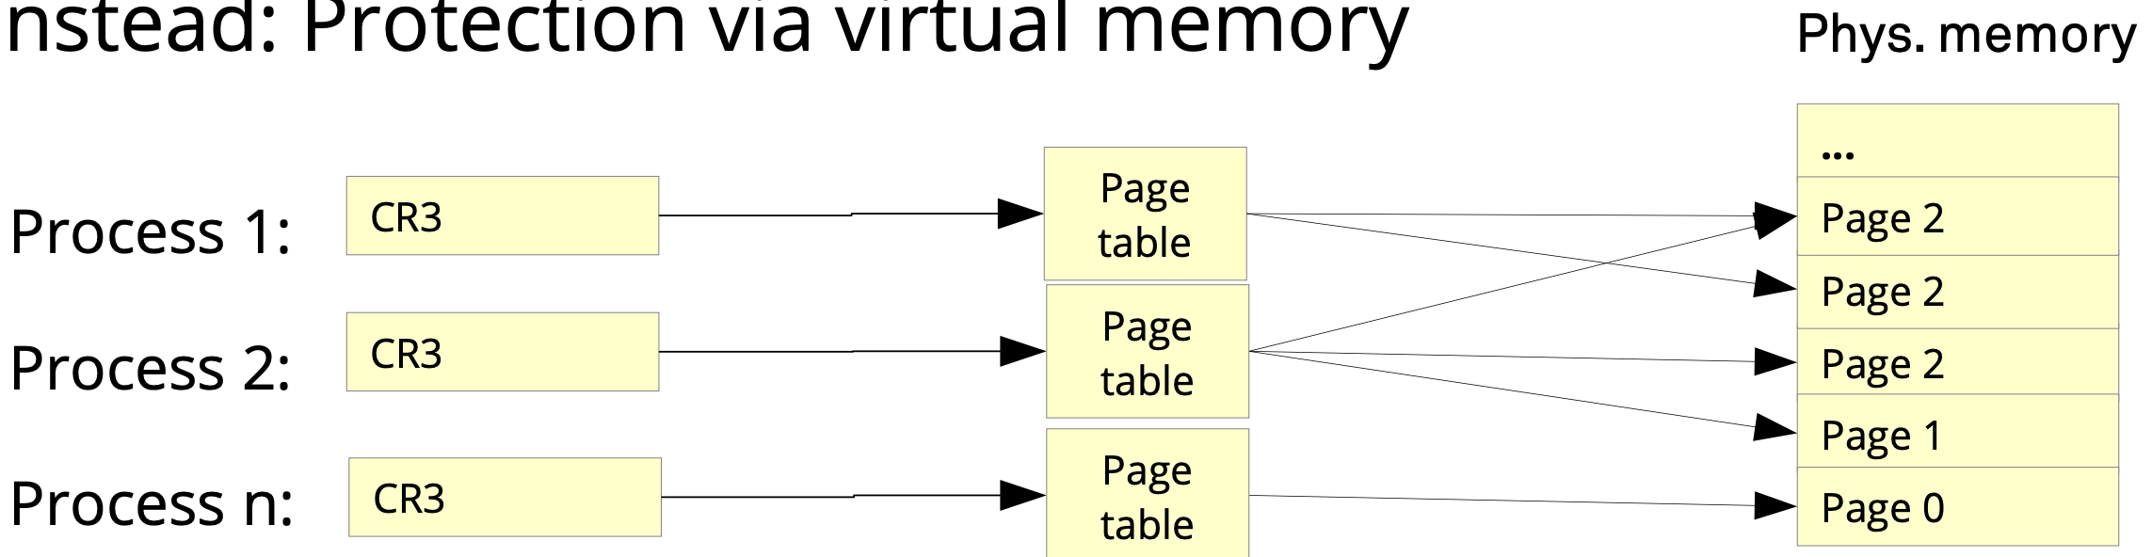
Flat Memory Model
Most 32-bit PC operating systems have not used segmentation
32-bit effective address = linear address
In Long Mode (64 bit) the segment base address is ignored by the processor
Protection via Paging:
Each process only sees its own virtual address space
Page level access control (see next slides)
Picture: Horst Schirmeier, TU Dresden

Slide 33
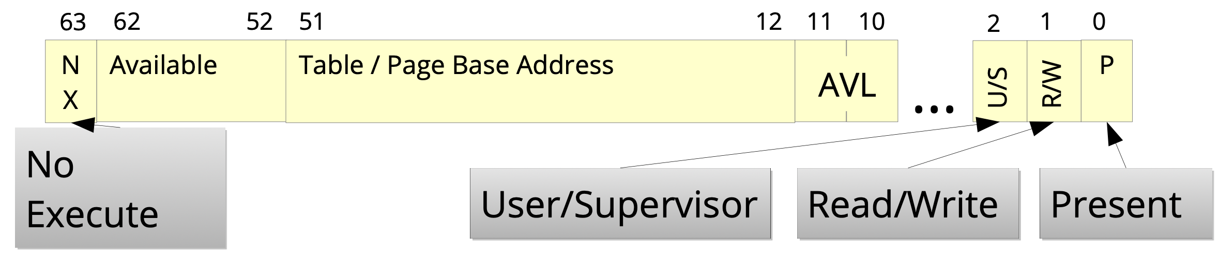
Page Table Entry
Flags are settable on all levels of the page table hierarchy
Protection bits:
R/W = Read/Write → Protection agains write accesses
NX = No eXecute → Do not execute code inside data
U/S = User/Supervisor → Access allowed for all or only in ring 0
Available = AVL = These bits are free to use by the operating system
Picture: Horst Schirmeier, TU Dresden

Slide 34
x86_64: Summary - Protection
Modern 64-bit operating systems only need the followin GDT entries
One data segment descriptor
Two code segment descriptors (one with DPL = 0 and one with DPL = 3)
Protection is enforced via Paging
Protection bits (NX, U/S, R/W)
Page Tables:
Which pages are present/accessible?

Slide 35
Preview
History
x86 programming model
Address translation
Protection
Tasks
Summary

Slide 36
IA-32: HW Support for Multitasking
State of a task is stored in a Task State Segment (TSS)
Stores all registers
Stack pointer for each ring
CR3 register
I/O permission bitmap (see next slides)
Current TSS determined by Task Register (TR) of a CPU core
Each core has its own TR
Task switch with hardware support via a Task Gate
Not used in most operating systems and instead implemented in software
3.5 Tasks

Slide 37
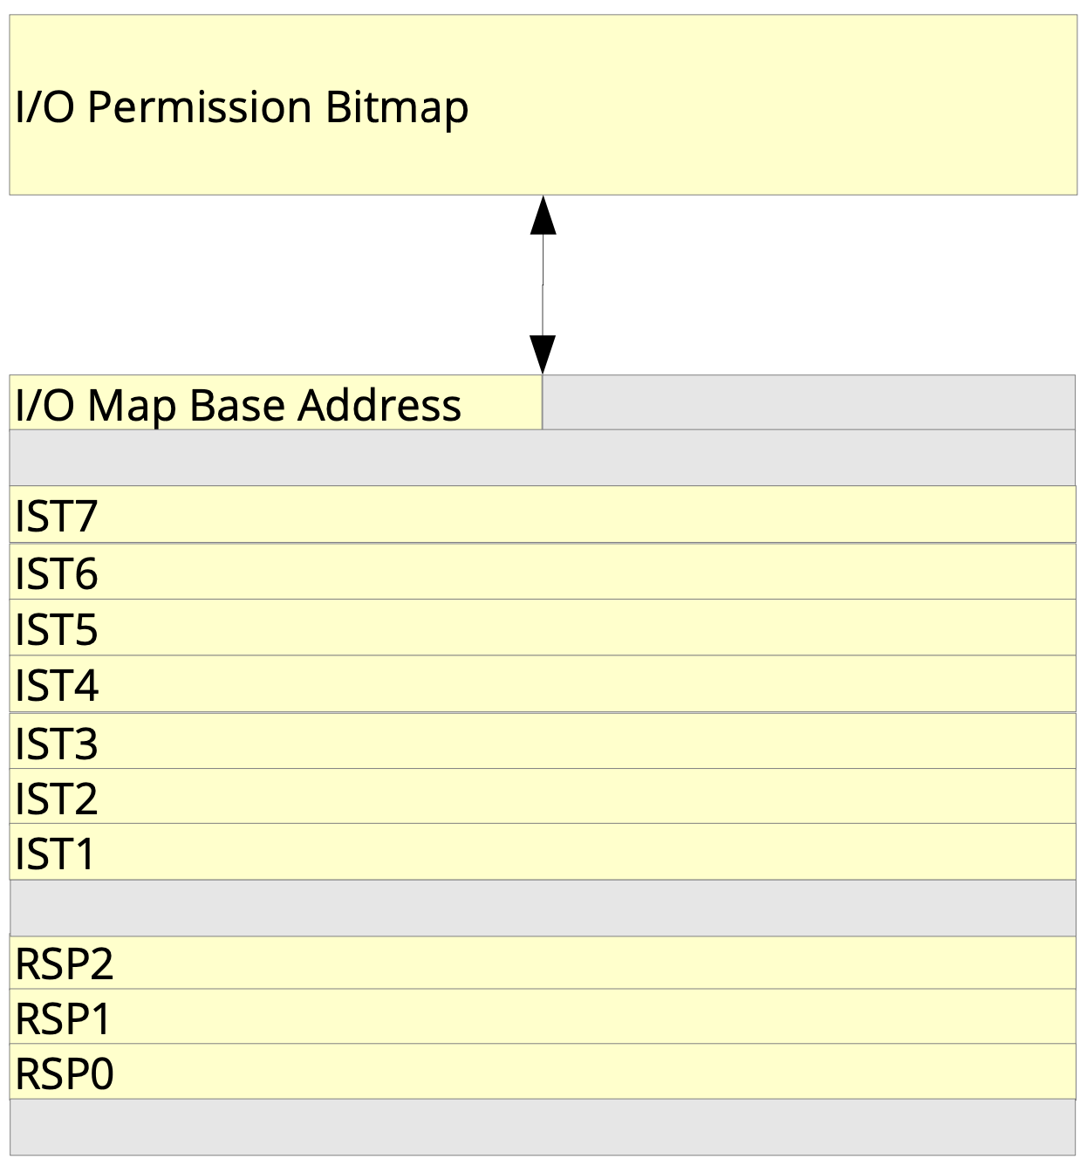
Long Mode: Multitasking
No HW support for task switching
TSS existent, but only stores:
Stack pointer per ring
IST = Interrupt Stack Table
I/O permission bitmap (see next slide)
IST allows separate stacks for interrupt handlers
IST number can be specified in entries inside the Interrupt-Descriptor Table (IDT)
Picture: Horst Schirmeier, TU Dresden
3.5 Tasks

Slide 38
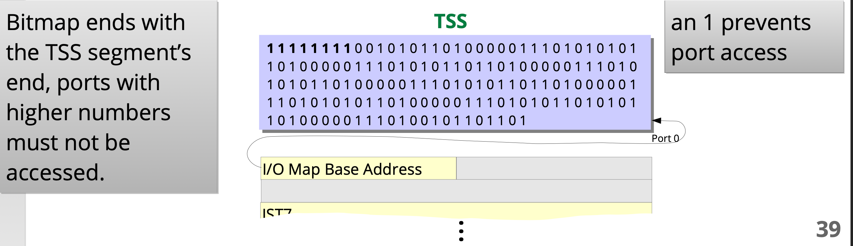
Long Mode: I/O Permission Bitmap
Access protection for I/O-ports (only little relevance nowadays)
I/O privilege level (IOPL) represented by two bits inside the RFLAGS register
Port access is granted if CPL ≤ IOPL
Otherwise, the IO permission bitmap is used
One bit for each port; if a bit is set, access is denied
Access protection for memory mapped I/O via page tables
Picture: Horst Schirmeier, TU Dresden
3.5 Tasks

Slide 39
Preview
History
x86 programming model
Address translation
Protection
Tasks
Summary

Slide 40
Zusammenfassung
x86-64 architecture is highly complex
Virtual memory with four or five level paging
Page based memory protection
I/O-port access protection per task
Can execute 16-bit code in IA-32 Protected Mode or 32-bit code in Long Mode
Rarely used features were removed
Segmentation (mostly)
Hardware support for task switching
Still backwards compatible
Processor and cores still start up in Real Mode
3.6 Summary

Slide 41
More Features
Virtualization
Virtual 8086 Mode
16-bit application
Intel-VT, AMD-V
HW support for VMware, VirtualBox, etc.
Hypervisor runs in ring -1
AVX: Advanced Vector Extensions
TSX: Transactional Synchronozation Extensions
Hybrid Cores
3.6 Summary

