Slide 1
OS Development 4. Interrupts
Prof. Dr. Michael Schöttner
Dr. Fabian Ruhland

Slide 2
Preview
Basics
Interrupt Handling in x86_64
Programmable Interrupt Controller
Advanced Programmable Interrupt Controller
Interrupt Handling in Operating Systems
Summary

Slide 3
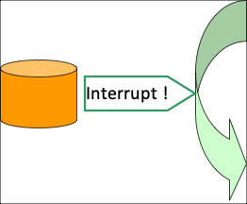
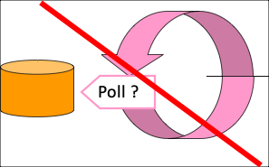
4.1 Basics
Interrupts were introduced, to allow overlapping execution of input/output operations
Instead of actively waiting for an I/O-operation to end, the affected thread is blocked and another thread is executed → This way, the CPU is used in a meaningful way
Furthermore, interrupts form the basis of preemptive multithreading
Programme Interval Timer (PIT) generates periodic interrupts (see PC Speaker)
Preemtpive multithreading is discussed (and implemented) later
4.1 Basics

Slide 4
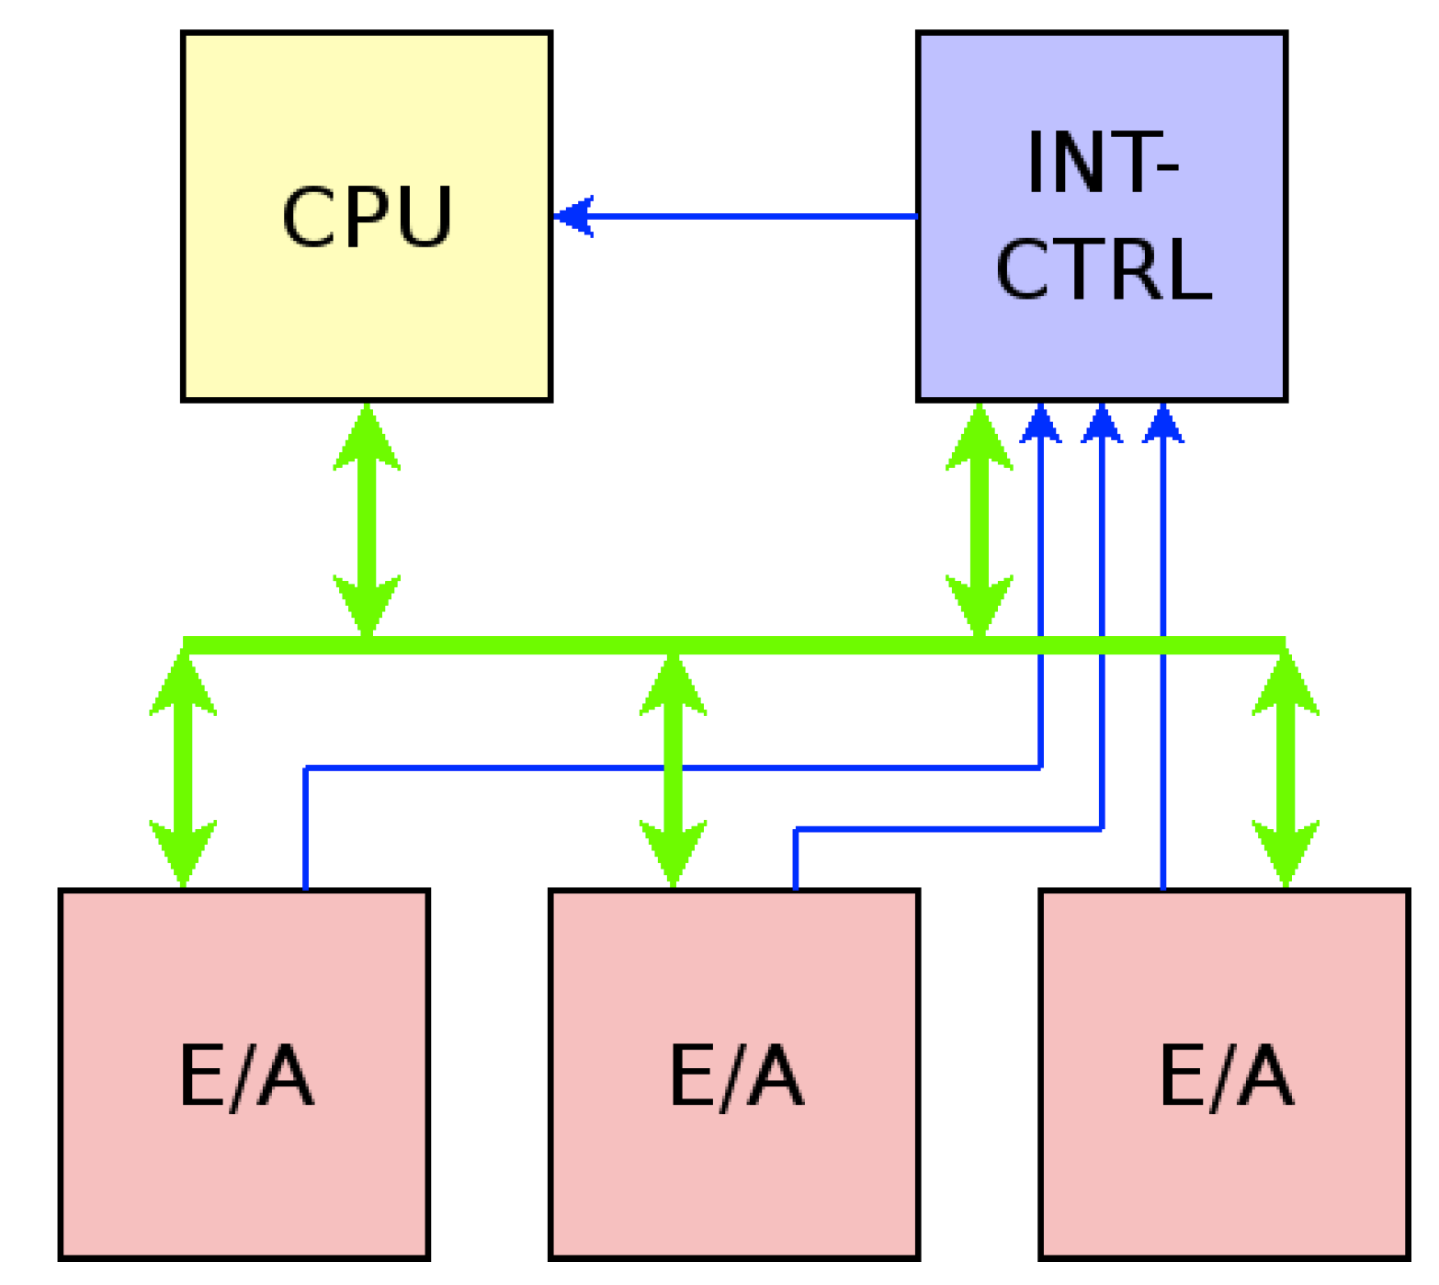
Interrupt Hardware: Single Core
4.1 Basics
Picture: Volkmar Sieh / Daniel Lohmann, University Erlangen

Slide 5
Priorization
Background
Multiple interrupts may be signaled at the same time → Which one is more important?
While the CPU is handling an interrupt, further interrupts may be signaled
Priorization mechanism
In software: The CPU only has a single IRQ (interrupt request) input
In hardware: A priorization circuit assigns a priority to each device and only forwards the most important IRQ to the CPU
Modern interrupt controllers allow dynamic priorities
4.1 Basics

Slide 6
Assignment of Interrupt Handlers
Problem:
Software should know which device has triggered an interrupt as fast as possible
We do not want to ask all devices manually
Solution: Interrupt Vector
Assign a unique vector number to each interupt, that is used as an index into a vector table
The vector number does not necessarily correlate with its priority
In practice, multiple device might have to share the same vector number (Shared Interrupts)
Structure of the interrupt vector table depends on the CPU architecture
Oftentimes only contains function pointers
4.1 Basics

Slide 7
Storing the System State
Problem:
After executing an interrupt handler, the CPU must return to the thread context
The interrupt handler should be "slid in" unnoticed
Solution: Store the system state
By Hardware:
Only the essentials: e.g. return address and flags register
Restoring is done via a special instriction (e.g, iret, ...)
By Software:
Because interrupts may occur any time, the handler must store and restore all registers it uses
4.1 Basics

Slide 8
Nested Interrupts
Problem:
To handle important events as fast as possible, interrupt handlers should also be interruptible
Infinite nesting depth must be avoided
Solution:
The CPU only allows interrupts with a higher priority
Rarely implemented, since it introduces complexity and is usually not needed in practice
4.1 Basics

Slide 9
Multicore Systems
Problems:
Which core handles an interrupt?
Handling inter-processor interrupts (IPI)
Solution: Additional hardware for interrupt handling
Routing interrrupts to CPU cores is controllable via software
Fixed or random assignment
Assignment with respect to the thread priorities on the respective CPU core
4.1 Basics

Slide 10
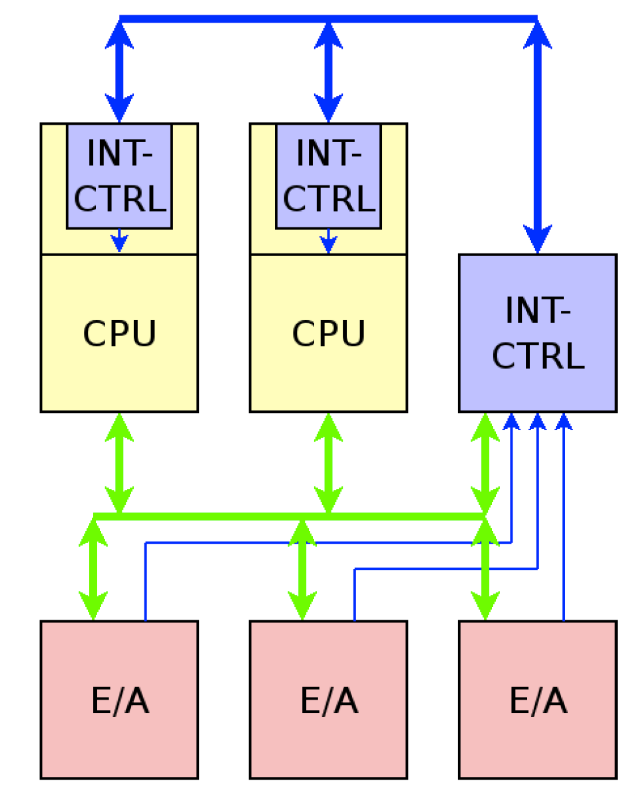
Interrupt Hardware: Multicore
Picture: Volkmar Sieh / Daniel Lohmann, University Erlangen
4.1 Basics

Slide 11
Danger: Spurious Interrupts
Problem: Wrong interrupt request, because of
Hardware faults
Incorrectly programmed devices
Solution:
Avoid hard- and software errors
"Defensive" programming in operating systems
Expect spurious interrupts
4.1 Basics

Slide 12
Danger: Interrupt Storms
Problem:
Highly frequent interrupt request can paralyze an operating system
Either caused by real interrupts, or the CPU is unable to cope with the I/O-load
Can easily be confused with Page Thrashing
Solution (in the operating system):
Detect interrupt storms
Deactivate the affected device
4.1 Basics

Slide 13
Preview
Basics
Interrupt Handling in x86_64
Programmable Interrupt Controller
Advanced Programmable Interrupt Controller
Interrupt Handling in Operating Systems
Summary

Slide 14
External vs. Internal Interrupts
External/Hardware interrupts
Triggered by a device (e.g., timer)
Come from the outside (from the CPU’s point of view)
Internal/Software interrupts
Triggered by the CPU itself
Exceptions (see next slides)
Assembly instruction INT <nr>
Used for System Calls (Linux, Windows NT, MacOS, MSDOS)
4.2 Interrupt Handling in x86_64

Slide 15
Exceptions
Fault
Operating system can handle and recover from faults (e.g., Page Fault)
CPU state and the address of the fault triggering instruction are stored
Trap
Triggered by a special instruction (e.g., INT 3 - Breakpoint)
Program can be continued
Abort
Unrecoverable error
Triggers are hard to localize exactly
Cause a reboot (e.g., Double Fault)
4.2 Interrupt Handling in x86_64

Slide 16
Vectors
Interrupts and exceptions are identified via a Vector Number
0 – 31 are reserved for exceptions
32 – 255 are freely available
Examples for exceptions:
Vector | Exception | Vector | Exception
0 1 2 3 4 5 6 8 | Division by 0 Debug NMI Break Overflow Bounds range exceeded Illegal instruction Double fault | 11 12 13 14 16 18 … | Segment not present Stack overflow General protection fault Page fault - Machine check . . .
4.2 Interrupt Handling in x86_64

Slide 17
Assigning Handlers to Vectors
Interrupt Descriptor Table (IDT)
IDT start address is stored in IDTR (1 per core)
255 entries map each vector to an address (function pointer)
This function is the Interrupt Handler / Interrupt Service Routine / ...
8 byte per entry (either Interrupt Gate or Trap Gate)
Interrupt-Gate: Describes an interrupt handler
When this entry is used, all interrupts on the CPU core are masked (deactivated) → Interrupt Enable bit in RFLAGS is unset
Trap-Gate: Describes a trap handler
Works the same as and interrupt gate, but without masking interrupts
For example used for system calls via software interrupts
4.2 Interrupt Handling in x86_64

Slide 18
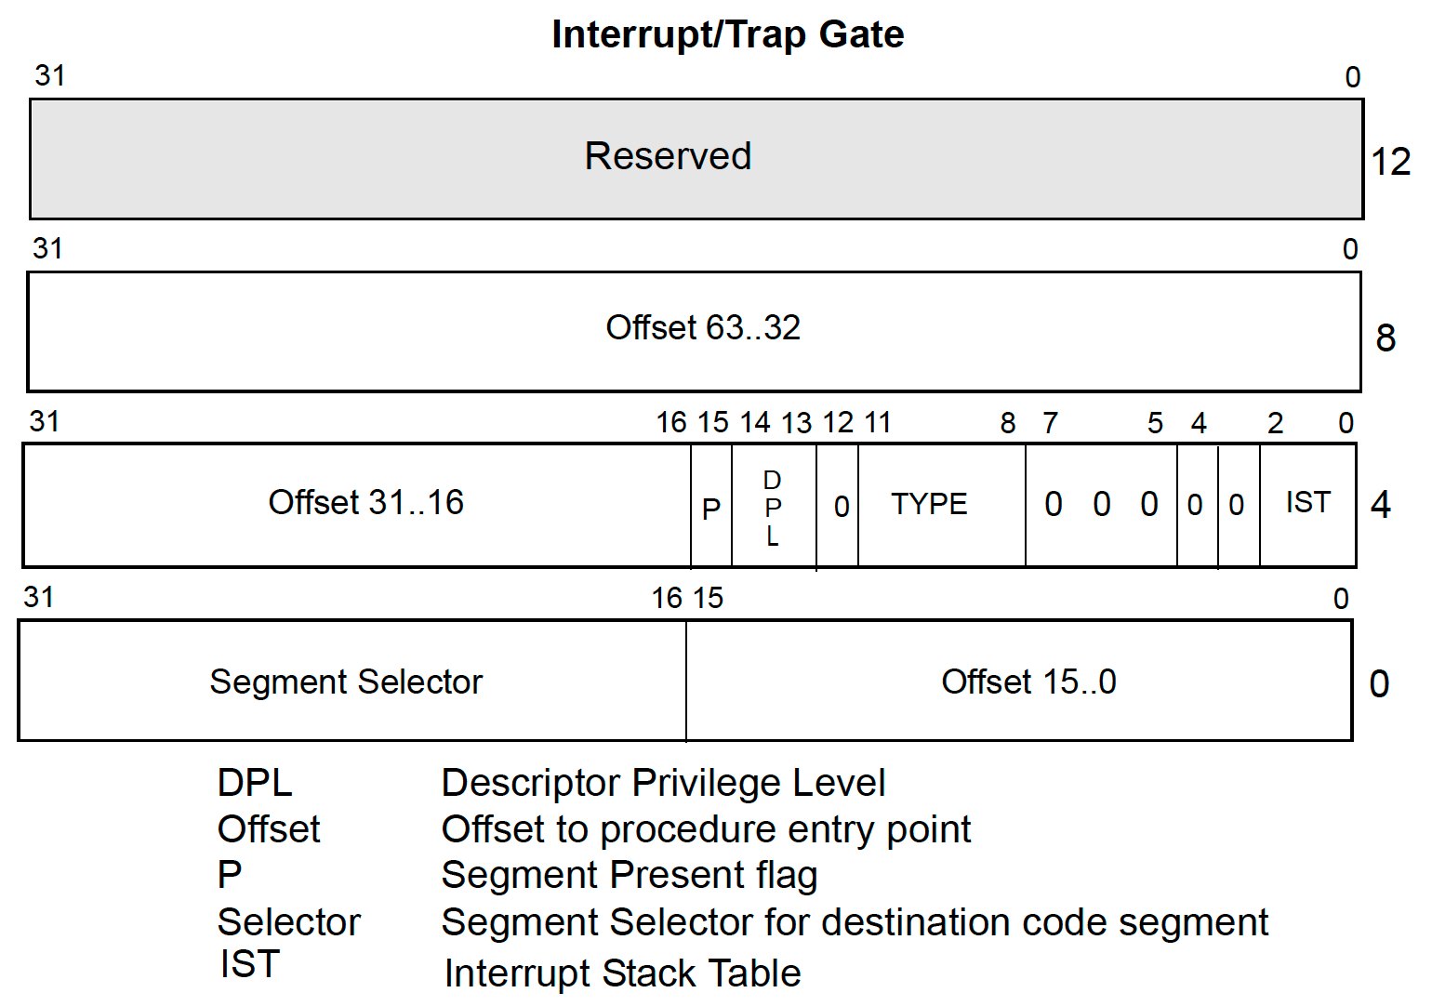
Assigning Handlers to Vectors
Interrupt table entry format in Long Mode
Segment selector is index into the GDT
4.2 Interrupt Handling in x86_64

Slide 19
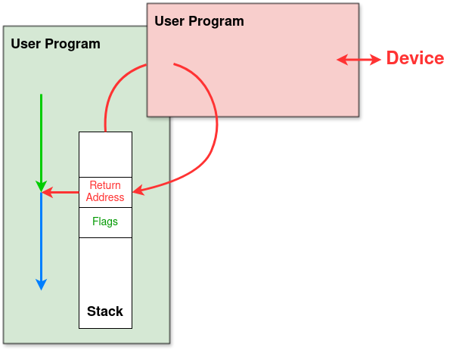
Stack Buildup during Interrupts
Program is interrupted after execution of the last instruction
4.2 Interrupt Handling in x86_64

Slide 20
Stackup Buildup without Ring Change
If the privilege level is not changed, the CPU does not switch the stack
The interrupt handler operates on the stack of the interrupted thread
This happens in HeineOS (all our code runs in ring 0)
Only some exceptions push an error code
Stack of the interrupted thread
RSP before transferring control to handler
RFLAGS
CS
RIP
(error code)
RSP after transferring control to handler
4.2 Interrupt Handling in x86_64

Slide 21
Stack Buildup with Ring Change
New stack is read from Task State Segment (see last chapter)
Stack of the interrupted thread
Handler Stack
SS
RSP before transferring control to handler
RSP
RFLAGS
CS
RIP
(error code)
RSP after transferring control to handler
4.2 Interrupt Handling in x86_64

Slide 22
IDT: Typical Example
Entries 0-31 are reserved for x86 CPU exceptions
Either DPL=0 or DPL=3, depending on use case
Entries for external interrupts
IRQs have DPL=0
System calls via trap gate (Windows & Linux)
DPL=3
Replaced by SYSENTER/SYSEXIT in modern operatings systems → faster, avoids interrupt overhead
Since HeineOS runs completely in ring 0, we do not need trap gates
4.2 Interrupt Handling in x86_64

Slide 23
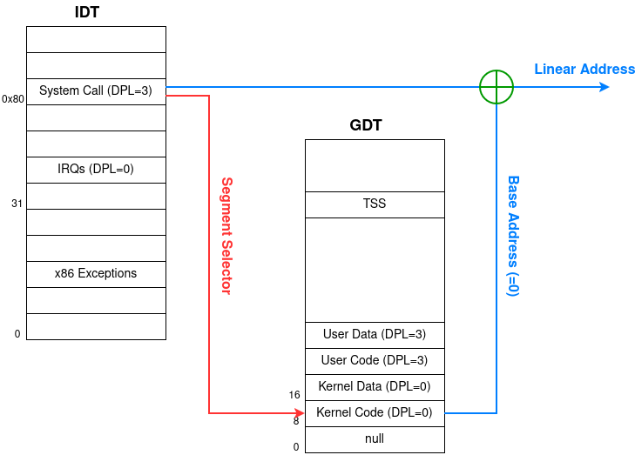
System Call via Trap Gate
4.2 Interrupt Handling in x86_64

Slide 24
Preview
Basics
Interrupt Handling in x86_64
Programmable Interrupt Controller
Advanced Programmable Interrupt Controller
Interrupt Handling in Operating Systems
Summary

Slide 25
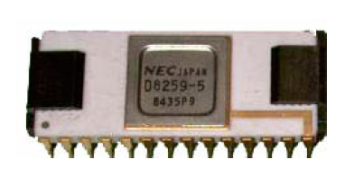
Interrupts in x86 CPUs
Upto and including the i486 x86 CPUs only had a single input for IRQs
External hardware was tasked with Priorization and vector number generation
Through a chip alled PIC 8259A
8 interrupt inputs
15 input by cascading two PICs
4.3 Programmable Interrupt Controller

Slide 26
PIC Architecture
Master controller can handle up to 8 slaves (CAS0..2 = Cascade Lines)
In PCs only one slave is used (IRQ2)
4.3 Programmable Interrupt Controller

Slide 27
PIC Architecture
Typical IRQ assignment in PCs:
Priorities
IRQ0 has highest priority
Default IRQ priorities: 0, 1, 8...15, 3... 7 (because of cascading)
Interrupts with a higher priority can interrupt ones with lower priorities (provided that the IE-bit (=Interrupt Enable) allows interrupts)
IRQ# | Device
0 1 2 8 … 12 … 3 … | Programmable Interval Timer Keyboard Controller Slave PIC Real Time Clock … PS/2 Mouse … COM2 ...
4.3 Programmable Interrupt Controller

Slide 28
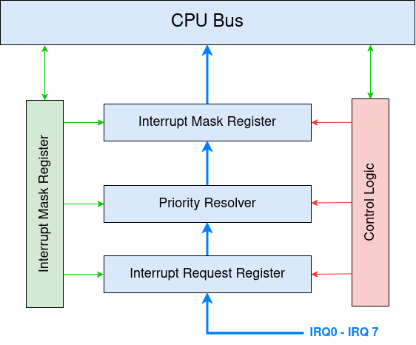
PIC Register
8 bit per register (1 bit per IRQ)
Interrupt Mask Register (IMR)
Enable/Disable interrupts (0=enable, 1=masked).
Interrupt Request Register (IRR):
Stores pending interrupts
Priority Resolver:
Forwards IRQ with highest priority in IRR to ISR
In Service Register (ISR):
Contains IRQs, that are currently being serviced
4.3 Programmable Interrupt Controller

Slide 29
Interrupt Flow: PIC <-> CPU
IRQ line is activated → Corresponding bit in IRR is set
PIC sends INTR signal to CPU (slave PIC sends to master PIC instead)
CPU answers with INTA pulse, if IE bit is set in RFLAGS.
Most significant bit in IRR is unset and set in ISR.
CPU sends second INTA pulse
PIC puts vector pointer (8 bit = 3 bit IRQ + 5 bit offset) on data bus.
Interrupt handler sends EOI to PIC when finished → deletes ISR bit
Remark: If interrupt came from slave PIC → also send EOI for IRQ2 to master PIC
EOI not necessary in HeineOS, since we use the PIC’s automatic EOI mode
4.3 Programmable Interrupt Controller

Slide 30
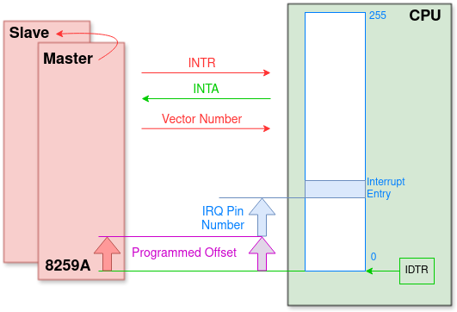
Interrupt Flow: PIC <-> CPU
Internal interrupts:
Fixed vector numbers 0 – 31
External interrupts:
Vector = IRQ + Offset
Offset > 31 and IRQ != vector
Offset must map IRQs to vector number > 31
4.3 Programmable Interrupt Controller

Slide 31
Preview
Basics
Interrupt Handling in x86_64
Programmable Interrupt Controller
Advanced Programmable Interrupt Controller
Interrupt Handling in Operating Systems
Summary

Slide 32
Advanced Programmable Interrupt Controller
APIC offers more interrupts than PIC and supports multicore and multiprocessor systems
Interrupts can be distributed to specific cores with respect to thread priorities
Inter-processor interrupts (IPI) between CPU cores (e.g, for bootstrapping other cores)
Backwards compatible with PIC (8259)
If existent, the APIC is activated after booting, but runs in PIC compatible mode
APIC registers are found via Model Specific Registers (MSR)
4.4 Advanced Programmable Interrupt Controller

Slide 33
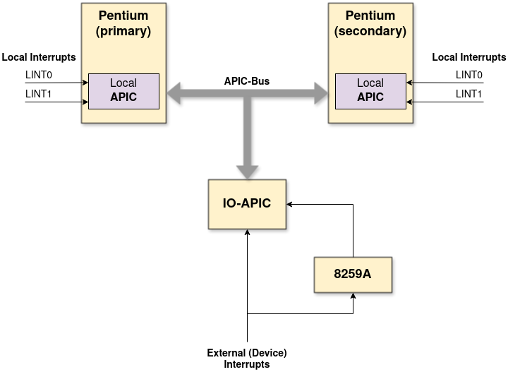
APIC Architecture
An APIC interrupt system consists of a Local APIC per core and usually one I/O-APIC (may be more than one)
4.4 Advanced Programmable Interrupt Controller

Slide 34
Local APIC (per CPU/Core)
Receives interrupt request as messages from the APIC bus
Can additionally process two local interrupts directly
Via CPU pins: LINT0 and LINT1 (LINT = Local Interrupt)
Allow backwards compatibility with the PIC
Local APICs are addressable via an ID
Local APICs contain further function units
Builtin timer (dependent on system bus clock → divisible)
Interrupt command register
Used to send APIC messages → Needed for inter-processor interrupts (IPI)
4.4 Advanced Programmable Interrupt Controller

Slide 35
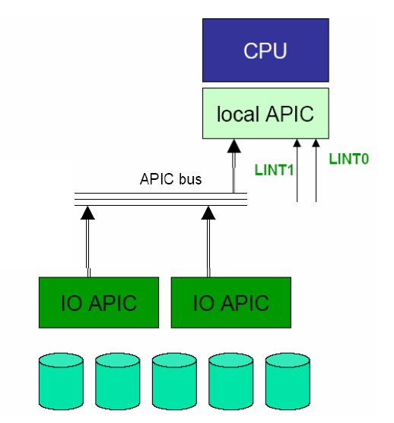
Interrupt Sources (1)
External device interrupts are signaled by anIO-APIC via the APIC bus
Default behaviour, once the APIC has been activated by the OS
4.4 Advanced Programmable Interrupt Controller

Slide 36
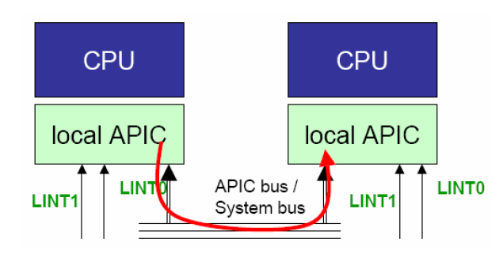
Interrupt Sources (2)
IPI – Inter-Processor Interrupt
Generated by another Local APIC → for multicore/multiprocessor systems
Are sent as messages via the APIC
For example use to coordinate startup/shutdown, or TLB flush after page tables have been altered
4.4 Advanced Programmable Interrupt Controller

Slide 37
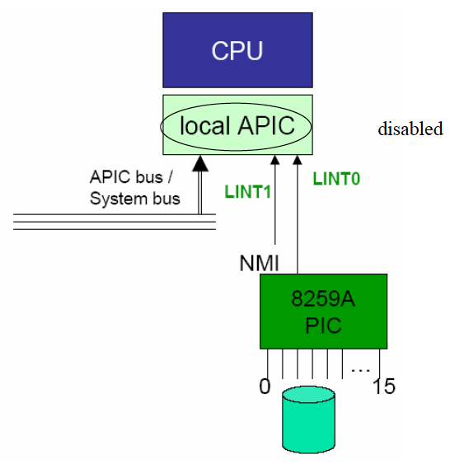
Interrupt Sources (3)
Local device interrupts:
Via a CPU pin: LINT0, LINT1 (not via the APIC bus)
Used for PIC compatibilty mode, if the APIC has note been activated
Examples:
Temperature sensor interrupt
8259A (if existing)
4.4 Advanced Programmable Interrupt Controller

Slide 38
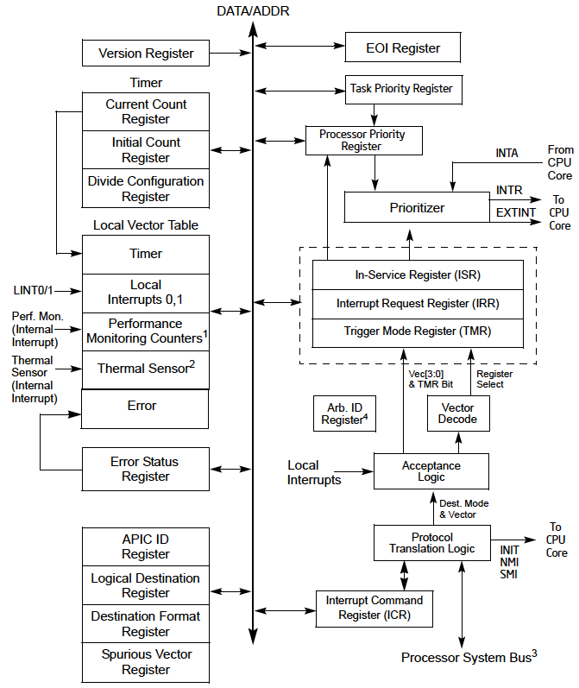
Local APIC Registers
Task Priority Register (TPR)
Stores thread priority
Managed by the OS
Processor Priority Register
Managed by the CPU
Results from TPR & ISR
EOI Register
End-Of-Interrupt
Must be written before iret
Interrupt Command Register
For Inter-processor interrupts
4.4 Advanced Programmable Interrupt Controller

Slide 39
Delivering Interrupts to an APIC
Flat model addressing → Static interrupt delivery
No arbitration; Delivery to addressed Local APIC; Wait if necessary
Dynamic interrupt delivery
After determining the group of addressed CPUs/APICs a „Lowest Priority Arbitration“ is performed
Goal: CPU that is currently processing the lowest priority task should handle the interrupt
Respect Processor Priority Register und Task Priority Register
4.4 Advanced Programmable Interrupt Controller

Slide 40
I/O-APIC
Nowadays typically integrated in the Southbridge of a PC chipset
24 interrupt inputs
Cyclic querying done by the chip
Every interrupt input has a 64-bit entry in the Interrupt Redirection Table
Describes the interrupt signal
Determines the vector number and to which CPU core an interrupt is sent (used for generating the APIC bus message)
Interrupt Redirection Table (IRT) has 24 entries
4.4 Advanced Programmable Interrupt Controller

Slide 41
Interrupt Redirection Table Entry
63:56 | Destination Field (R/W) | 8 bit target address → APIC ID (physical mode) or CPU group (logical mode)
55:17 | Reserved
16 | Interrupt Mask (R/W) | Enable/Disable interrupts
15 | Trigger Mode (R/W) | Edge/Level triggered interrupts
14 | Remote IRR (RO)
13 | Interrupt Pin Polarity (R/W) | Signal polarity
12 | Delivery Status (RO) | Interrupt message still in transit?
11 | Destination Mode (R/W) | Logical Mode or Physical Mode
10:8 | Delivery Mode (R/W) | 000 – Fixed → Deliver signal to all target processors 001 – Lowest Priority → Deliver to CPU with lowest priority task 010 – SMI → System Management Interrupt 100 – NMI → Non-Maskable Interrupt 101 – INIT → Initialize (reset) target CPU 111 – ExtINT → Answer to 8259A
7:0 | Interrupt Vector (R/W) | 8 bit vector number (16-254)
4.4 Advanced Programmable Interrupt Controller

