Slide 1
Betriebssysteme und Systemprogrammierung 4. Rust (Part 2)
Michael Schöttner

Slide 2
4.1 Outline
Basics
Advanced stuff
Unsafe stuff

Slide 3
4.2 Advanced stuff
Memory regions
Traits & Generics
Printing structs
Option & Error handling
Modules & cargo
Slices
String vs str
Life times
Unsafe

Slide 4
Memory regions
Data memory
For data that is fixed in size and static (i.e. always available through life of program).
Compilers make lots of optimizations with this kind of data, and they are generally considered very fast to use since locations are known and fixed.
Stack memory
For data that is declared as variables within a function.
The location of this memory never changes for the duration of a function call; because of this compilers can optimize code so stack data is very fast to access.
Heap memory
For dynamically created data
Data in this region may be added, moved, removed, resized, etc.
Because of its dynamic nature it's generally considered slower to use

Slide 5
Example: data & stack memory
Example: instantiating a struct Person on the stack
The string literal "Rust" is read only, placed in data memory region
The function call String::from creates a struct String that is placed in the stack
struct Person {
name: String,
}
fn main() {
// data is on stack
let person = Person {
// String struct is also on stack,
// but holds a reference to data on heap
name: String::from("Rust"),
};
}

Slide 6
Example: data & stack memory (2)
Example 2: instantiating a struct Person on the stack using an own new function
struct Person {
name: String,
}
impl Person {
// Function for creating a new Person on the Stack
fn new(name: String) -> Person {
Person { name }
}
}
// fn main(), see previous slide

Slide 7
Example: heap memory
Box is a data structure that allows us to move our data from the stack to the heap.
struct Person {
name: String,
}
fn main() {
// instantiate Person and put it in a Box, stored in heap
let person_boxed = Box::new( Person { name: String::from("BS-E"), } );
println!("Name: {}", person_boxed.name);
}

Slide 8
Example: heap memory (2)
The same example, this time with an own new function
struct Person {
name: String,
}
impl Person {
// Function for creating a new boxed Person stored in heap
fn new(name: String) -> Box<Person> {
Box::new(Person { name })
}
}

Slide 9
Traits
trait Greet {
fn hello(&self);
}
struct Person {
name: String,
}
A trait is a collection of methods that a type can implement
Traits:
One type can implement many traits
Describe behaviour but do not define a type
Traits allow defining shared behaviour between different types
impl Greet for Person {
fn hello(&self) {
println!("Hello, I'm {}", self.name);
}
}
fn main() {
let person = Person { name: String::from("ABC"), };
person.hello();
}
trait.rs

Slide 10
Traits
Traits describe behaviour but do not define a type
trait Greet {
fn hello(&self);
}
struct Person {
name: String,
}
fn main() {
let person = Person { name: String::from("ABC"), };
let greet: Greet = person;
greet.hello();
}
trait.rs

Slide 11
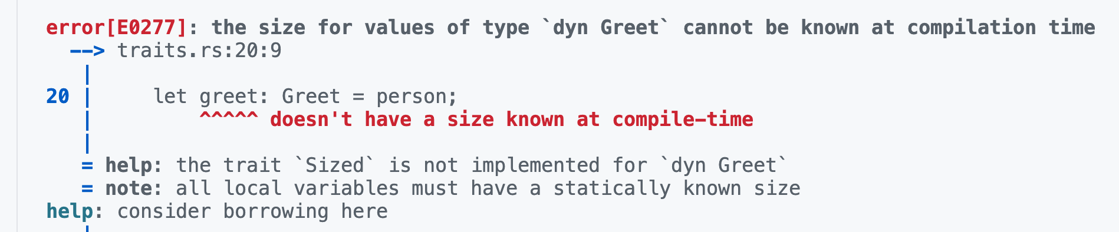
Traits
Traits describe behaviour but do not define a type
trait Greet {
fn hello(&self);
}
struct Person {
name: String,
}
fn main() {
let person = Person { name: String::from("ABC"), };
let greet: Greet = person;
greet.hello();
}
Rust needs to know at compile time how much space any variable takes. But a trait alone doesn’t tell Rust anything about the size.
trait.rs

Slide 12
Borrowed Trait Object
&dyn Trait → borrowed trait object
You can’t use a trait as a bare type.
You must use dyn Greet to make a trait object.
The size for values of type dyn Greet cannot be known at compilation time. → Can’t store dyn Greet directly by value.
A trait object (dyn Greet) could be any type implementing Greet, so its size is unknown → you must use a pointer to it
The size of the pointer is known at compile time
trait Greet {
fn hello(&self);
}
struct Person {
name: String,
}
fn main() {
let person = Person { name: String::from("ABC"), };
person.hello();
let greet: &dyn Greet = &person;
greet.hello();
}
trait.rs

Slide 13
Owned Trait Object
Box<dyn Trait> → owned trait object on the heap
trait Greet {
fn hello(&self);
}
struct Person {
name: String,
}
fn main() {
let person = Person { name: String::from("ABC"), };
person.hello();
let greet: Box<dyn Greet> = Box::new(person);
greet.hello();
}
trait.rs

Slide 14
When to use which trait object
Use borrowed trait object dyn &Trait when:
You just want to call trait methods on it.
You do not need ownership, just a read-only (or &mut) view.
You don’t want extra heap allocation.
Use owned trait object Box<dyn Trait> when:
You want to own “some Greet” without knowing its concrete type at compile time.
You need to store it in a struct or pass it around by value.
You might mix different types that all implement Greet in one collection.

Slide 15
Generics
Generics let you write code once that works with many types
Rust generally can infer the final type by looking at our instantiation, but if it needs help you can always be explicit using the ::<T> operator
struct Point<T> {
x: T,
y: T,
}
fn main() {
let p = Point::<i32> { x: 5, y: 10 };
let q = Point { x: 1.2, y: 3.4 };
}
generics.rs

Slide 16
Generics (2)
Implementing functions for a generic type
Associated function:
Because it’s associated with the type, not with a specific instance of that type.
Similar to static methods in Java
Self: type being implemented, here Point<T>
self: refers to the instance the method was called on.
impl<T> Point<T> {
// Associated function (constructor)
fn new(x: T, y: T) -> Self {
Point { x, y }
}
}
generics2.rs

Slide 17
Generics (2)
Implementing functions for a generic type which have trait bounds
impl<T: std::ops::AddAssign> Point<T> {
// Associated function (constructor)
fn new(x: T, y: T) -> Self {
Point { x, y }
}
// Move the point (mutates it) // requires T to implement AddAssign
fn move_by(&mut self, dx: T, dy: T) {
self.x += dx;
self.y += dy;
}
}
generics3.rs

Slide 18
Printing structs
Derive trait Debug
Pretty-printed debug output: {:#?} or {:?}
#[derive(Debug)]
struct Vector {
x: i64,
y: i64,
}
fn main() {
let vector = Vector { x: 42, y: 41 };
println!("vector = {:#?}", vector);
println!("vector = {:?}", vector);
}
$ ./test
vector = Vector { x: 42, y: 41 }
vector = Vector {
x: 42,
y: 41,
}

Slide 19
Implementing trait Debug
struct Vector {
x: i64,
y: i64,
}
impl std::fmt::Debug for Vector {
fn fmt(&self, f: &mut std::fmt::Formatter) -> std::fmt::Result {
write!(f, "Vector [0x{:x}, 0x{:x}]", self.x, self.y)
}
}
fn main() {
let vector = Vector { x: 42, y: 41 };
println!("vector = {:?}", vector);
}
debug.rs
$ ./test
vector = Vector [0x2a, 0x29]

Slide 20
Generics & Traits
Traits can be used to set requirements for generic types.
Alternative, often more readable notation, using where
fn print_debug<T: std::fmt::Debug>(value: T) {
println!("{:?}", value);
}
fn print_debug<T>(value: T)
where
T: std::fmt::Debug,
{
println!("{:?}", value);
}

Slide 21
Options
Pointers are never null. What if you actually want something to be null?
Use an Option<T>
Here's the definition of Option, from the standard library:
Two possible cases: the option is either None, or it is Some.
If an Option is Some, the value in the Some variant will always be a valid value of type T
pub enum Option<T> {
None,
Some(T),
}

Slide 22
Option Example 1
You can check content of Option using: is_some() or is_none()
assert! Is a macro for testing or ensuring invariants
If it fails it will cause a panic
A panic happens when the program encounters a situation it can’t safely continue from.
// This type annotation is not necessary.
let x: Option<i32> = Some(4);
assert!(x.is_some());
panics if x is none

Slide 23
Option Example 2
unwrap() is a shortcut that extracts the inner value of an Option
If the value is Some, it returns the inner value.
If the value is None, it panics (crashes your program)
expect() does the same as unwrap() but panics with a given message
let y = x.unwrap(); // get the value out of Option
assert_eq!(y, 4);
panic if x is none
panic if y is != 4
let y = x.expect(”Error: x is none”);
assert_eq!(y, 4);

Slide 24
Option Example 3
Check content of option using match
let w = Some(String::from("hello"));
match w {
Some(s) => println!("{} world!", s),
None => panic!("didn't expect to get here"),
}
w is Some, accessible in s

Slide 25
Error handling
Most languages handle errors via one of two ways:
try/catch exceptions (Python, Java, JavaScript, etc.)
Returning a separate error value (C)
Many times, errors are not handled properly or are tedious to handle.
Rust tries to make error handling easier.
It's not always smooth sailing though.

Slide 26
Error handling
The idiomatic way to handle errors in Rust is via Result<T, E>
Functions that may not complete successfully should return a Result.
If the result is Ok, the caller can access the returned value (of generic type T).
If the result is Err, additional information (of generic type E) about the error is returned.
If a program cannot recover from an error, you can explicitly panic! instead of returning a Result.
pub enum Result<T, E> {
Ok(T),
Err(E),
}

Slide 27
Error handling
Example:
Opening a file can fail, so File::open returns a Result.
We check if the open was successful, if not, we panic
use std::fs::File;
fn main() {
let open_res = File::open("hello.txt");
let f = match open_res {
Ok(file) => file,
Err(error) => panic!("Problem opening the file: {:?}", error),
};
}

Slide 28
Error handling
Matching on Results all the time can be tedious.
If we know we are going to panic on an Err, we can use unwrap() instead:
unwrap() panics on error otherwise, it returns the data contained in the Ok variant.
use std::fs::File;
fn main() {
let f = File::open("hello.txt").unwrap();
}

Slide 29
Error handling
Another shortcut is the ? operator:
If a Result is an Err, ? causes the function to return that Err.
Otherwise, ? unwraps the OK variant.
Works only if used within a function that returns Result
use std::fs::File; use std::io; use std::io::Read;
fn read_file() -> Result<String, io::Error> {
let mut f = File::open("hello.txt")?;
let mut s = String::new();
f.read_to_string(&mut s)?;
Ok(s)
}
result.rs

Slide 30
Unite type ()
Sometimes you want to return an Ok without additional information
Unite type () – similar to void in other languages
These functions are all equivalent returning ()
fn my_func() -> Result<(), String> {
// do something
Ok(())
}
fn func() -> () {
()
}
fn func() {
()
}
fn func() {
}

Slide 31
Modules
Modules serve as namespaces and are defined using the mod keyword.
Code is generally private by default → can only be accessed within the current module.
To make something visible outside a module, declare it with pub (for public).
mod inner {
pub fn add_two(x: &mut i32) {
*x += 2;
}
}
fn outer() {
let mut x = 160;
inner::add_two(&mut x);
}

Slide 32
Modules (2)
You can move a module to a separate file, but you must import it using mod.
Suppose this is in lib.rs:
Rust will look for a file called inner.rs or inner/mod.rs, which should contain the contents of the module:
mod inner;
fn outer() {
let mut x = 160;
inner::add_two(&mut x);
}
modules
pub fn add_two(x: &mut i32) {
*x += 2;
}
modules

Slide 33
Modules (3)
Structuring your code
inner/mod.rs inner/more.rs
lib.rs
pub mod more;
pub fn add_two(x: &mut i32) {
*x += 2;
}
pub mod more;
pub fn add_threeo(x: &mut i32) {
*x += 3;
}
modules2
modules2
modules2
mod inner;
fn outer() {
let mut x = 160;
inner::add_two(&mut x);
inner::more::add_three(&mut x);
}
fn main() { outer(); }
modules2

Slide 34
Modules (4)
You can always use any (public) code by using the fully qualified name (eg. inner::add_two).
use declarations let you "import" items so you don't have to use the full name each time:
You can also rename items when you import them →
mod inner;
use inner::add_two;
fn outer() {
let mut x = 160;
add_two(&mut x);
}
use inner::add_two as add2;
add2(...);

Slide 35
Crates
A crate is the biggest unit of code Rust compiles at once.
Crates (~ packages) contain modules.
A crate is a library or a binary/executable
The root file is:
src/lib.rs for a library crate
src/main.rs for a binary crate
You can publish a crate to crates.io or use it locally
https://crates.io → The Rust community’s crate registry

Slide 36
Cargo
Important tool for handling rust projects
Building and running apps and tests
Dependency management
Building and checking code
Running tests and examples
Creating new crates
Publishing packages
Managing workspaces
Keeping versions reproducible

Slide 37
Cargo dependencies: Cargo.toml
You can import crates to leverage code that other people write.
Do this by adding to your Cargo.toml file.
You'll then be able to use all public items from that crate.
[package]
name = "hello-crate"
version = "0.1.0"
edition = "2021"
[dependencies]
rand = "0.8”
use rand::Rng; // Import
fn main() {
let mut rng = rand::thread_rng();
let x: i32 = rng.gen_range(1..=6);
println!("Gewürfelt: {x}");
}
cargo.rs

Slide 38
Cargo dependencies: Cargo.lock
Tracks all transitive dependencies
Should not be edited
Maintained by cargo
Important command: cargo update
Update all dependencies to the newest allowed versions

Slide 39
Slices
Slice: &[T] represents a view into a contiguous sequence of elements of type T
Slices are lightweight abstractions that provide a safe and efficient way to work with a portion of a collection without needing to copy the data.
Data is only borrowed
fn main() {
let numbers = [1, 2, 3, 4, 5];
// Take a slice of the array
let slice = &numbers[1..4]; // Slice from [1,..4(
// Iterate over the slice and print each element
for &num in slice {
println!("{}", num);
}
}

Slide 40
Mutable Slices
Slices can also be borrowed mutable
fn main() {
let mut numbers = [1, 2, 3, 4, 5];
// Take a slice of the array
let mut_slice = &mut numbers[1..3]; // Slice from [1,..3(
for n in mut_slice.iter_mut() {
*n += 1;
}
for num in numbers {
println!("{}", num);
}
}
slices.rs

Slide 41
Does this work?
fn main() {
let mut numbers = [1, 2, 3, 4, 5];
// Take a slice of the array
let mut_slice = &mut numbers[1..2]; // Slice from [1,..2(
mut_slice[0] = 10;
numbers[4] = 0;
mut_slice[0] = 3;
}

Slide 42
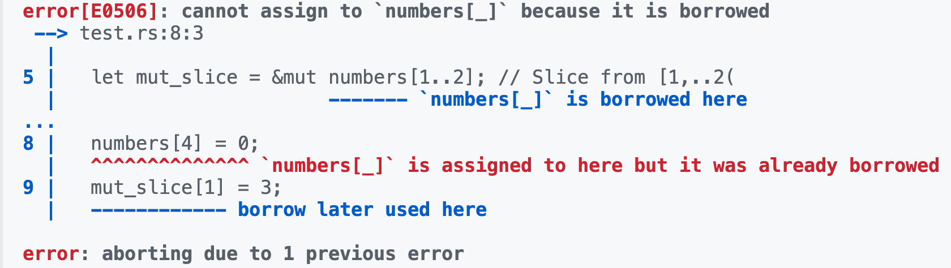
Does this work? - No
fn main() {
let mut numbers = [1, 2, 3, 4, 5];
// Take a slice of the array
let mut_slice = &mut numbers[1..2]; // Slice from [1,..2(
mut_slice[0] = 10;
numbers[4] = 0;
mut_slice[0] = 3;
}

Slide 43
Slices – Summary
Slices are often used in Rust
They are lightweight → data is neither copied nor moved
Slices are safe → bounds checked as well as borrow checker

Slide 44
String
String: is a growable and mutable
Lives in the heap
Is mutable and can alter its size and contents
Variables of type String are fat pointers, 3 x 8 byte
Pointer to actual data on the heap, it points to the first character
Length of the string (# of characters)
Capacity of the string on the heap
// Create a new mutable empty String in the heap
let mut s = String::new();
// Push characters onto the String
s.push('h');
s.push_str("ello");

Slide 45
&str
&str: This denotes a reference to a string slice.
&: Indicates that it's a reference, meaning it doesn't own the data it points to. Instead, it borrows the data from another location.
str: Indicates that the data being referenced is a string slice.
Immutable
Variables of type &str are fat pointers, 2 x 8 byte
Pointer to the start of string data
Length of the string slice (# of bytes)
String literals are stored in read-only memory
&str can also borrow all or part of a String in heap

Slide 46
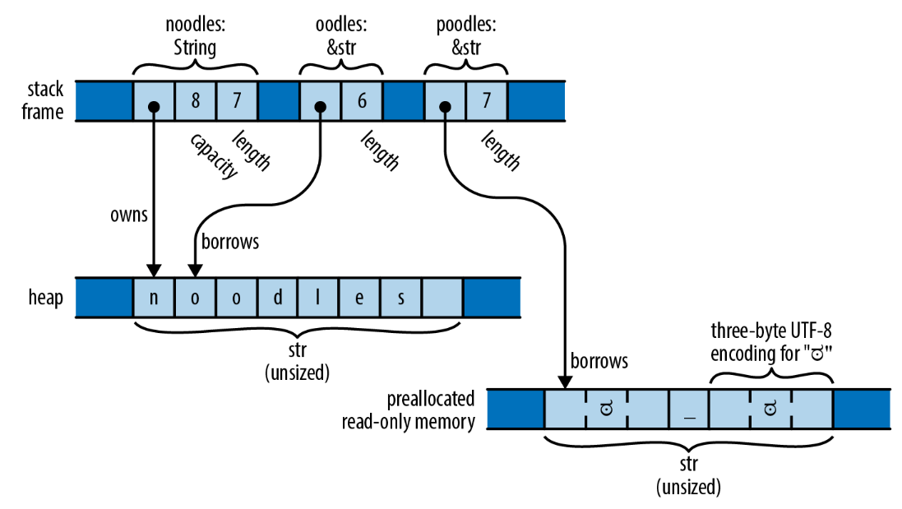
String vs &str
let noodles = "noodles".to_string();
let oodles = &noodles[1..];
let poodles = "ಠ_ಠ"; // this is string literal
Aus: https://stackoverflow.com/questions/24158114/what-are-the-differences-between-rusts-string-and-str

Slide 47
Thin & Fat Pointers
Thin pointer: are used for references to sized types
These are types whose size is known at compile time, such as integers, structs, arrays, etc.
They consist of a simple memory address pointing to the data on the heap or stack
Examples: &T, Box<T>
Fat pointer: are used for references to unsized types
These are types whose size is not known at compile time
They consist of both a memory address and metadata about the referenced data
Example: &[T], &str

Slide 48
References & Lifetimes
A reference is fundamentally just a number → start position of some bytes in memory.
Lifetimes make sure references are always valid:
They prevent dangling references and enforce safe memory access - at compile time.
Every reference in Rust has a lifetime - an area of code where that reference is valid.
Remark: lifetime annotations are only relevant for references (&T, &mut T) - and types that contain references.

Slide 49
Example: references that outlive referents
fn main() {
let r;
{
let x = 1;
r = &x;
}
println!("{}", r)
}
x is dropped here
fn main() {
let r;
let x;
{
x = 1;
r = &x;
}
println!("{}", r)
}
Borrow no longer valid ⚡️

Slide 50
Explicit Lifetimes
Functions sometimes must use lifetime annotations to define which inputs and outputs share the same lifetime.
fn largest(x: &i32, y: &i32) -> &i32 {
if x > y { x } else { y }
}
fn main() {
let a = 1;
let b = 2;
let res = largest(&a, &b);
println!("Largest is {}", res);
}
lifetimes.rs

Slide 51
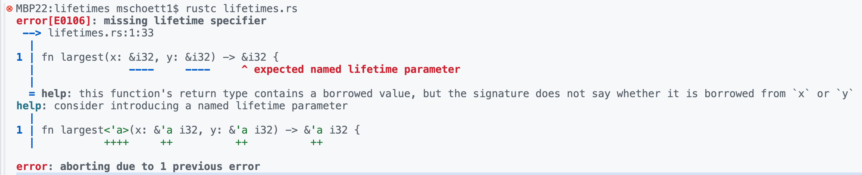
Explicit Lifetimes
Functions sometimes must use lifetime specifiers to define which inputs and outputs share the same lifetime.
fn largest(x: &i32, y: &i32) -> &i32 {
if x > y { x } else { y }
}
fn main() {
let a = 1;
let b = 2;
let res = largest(&a, &b);
println!("Largest is {}", res);
}
lifetimes.rs

Slide 52
Explicit Lifetimes
Lifetime specifiers always start with a ' (e.g. 'a, 'b, 'c, ...)
Corrected example:
The <'a> means: function works for any lifetime 'a (syntax similar to <T>)
The &'a before the parameters mean: both references have the same lifetime
The &'a before the return type means: the returned lives as long as both parameters
fn largest<'a>(x: &'a i32, y: &'a i32) -> &'a i32 {
if x > y { x } else { y }
}

Slide 53
Lifetime Elision¹ Rules
Rust has three simple rules for functions involving references.
Each parameter that is a reference gets its own lifetime parameter.
If there is exactly one input lifetime, it’s assigned to all output references.
If there are multiple input lifetimes and the output is a reference, the compiler needs explicit annotations (no guessing).
This example is OK without explicit lifetime annotations
The Rust compiler automatically adds annotations, if possible:
fn foo(x: &i32) -> &i32 {
x
}
fn foo<'a>(x: &'a i32) -> &'a i32 {
x
}
¹ Elision = Weglassen

Slide 54
Lifetimes in data types
Similarly to functions, data types can be parameterized with lifetime specifiers of its members.
Rust validates that the containing data structure of the references never lasts longer than the owners its references point to.
We can't have structs running around with references pointing to nothing!

Slide 55
Lifetimes in data types
Example:
We need to tell the compiler, that config, which is of type &Config, has the same lifetime as App.
struct Config {
...
}
struct App {
config: &Config
}
struct Config {
...
}
struct App<'a> {
config: &'a Config
}

Slide 56
Multiple lifetimes in data types
Example:
After this update the code works:
struct Point<'a> {
x: &'a i32,
y: &'a i32
}
fn main() {
let x = 3;
let r;
{
let y = 4;
let point = Point { x: &x, y: &y };
r = point.x
}
println!("{}", r);
}
struct Point<'a,'b > {
x: &'a i32,
y: &'b i32
}

Slide 57
Static lifetime
The 'static lifetime is a special lifetime that represents the entire duration of the program.
Any reference with a 'static lifetime can be used anywhere without worrying about its scope.
Should only be used if necessary → 'static resources will never drop.
Example:
// string literals have a 'static lifetime, so 'static is here optional
const MSG: &'static str = "Hello World!";
fn main() {
println!("msg = {}", MSG);
}

Slide 58
Final remarks on lifetime annotations
Lifetime annotations are only relevant for references (&T, &mut T) and types that contain references.
Compiler does lifetime annotations automatically whenever possible otherwise, it will ask for explicit lifetime annotations

Slide 59
4.3 Unsafe stuff
Rust’s compiler enforces memory and thread safety
Some low-level operations in an OS require direct memory access.
These code sections need to be marked as unsafe
Should be used only if functionality can not be expressed in clean Rust
The programmer is taking explicit responsibility
Things you can only do in unsafe
1. Dereference raw pointers: direct memory access, memory mapped IO
2. Call unsafe functions: syscalls, inline assembly
3. Access or modify mutable static variables: kernel globals

Slide 60
unsafe blocks & functions
unsafe means “I promise the safety invariants hold here.”
Example: unsafe block
Example: unsafe function (can only be called inside an unsafe block)
Remarks:
volatile prevents optimization away of I/O.
core::ptr is a raw pointer, see next slides
pub fn write_u8(addr: *mut u8, val: u8) {
unsafe { core::ptr::write_volatile(addr, val); }
}
pub unsafe fn write_u8(addr: *mut u8, val: u8) {
unsafe { core::ptr::write_volatile(addr, val); }
}

Slide 61
Raw Pointers
References can be converted into a more primitive type called a raw pointer
Much like a number, it can be copied and moved around with little restriction.
Rust makes no assurances of the validity of the memory location it points to.
Two kinds of raw pointers exist:
*const T - A raw pointer to data of type T that should never change.
*mut T - A raw pointer to data of type T that can change.

Slide 62
Raw Pointers: Example 1
Accessing a memory-mapped register
The pointer UART0 is constant (const), so no accidental mutation of the address.
Writing to the address is unsafe
volatile prevents optimization away of I/O.
pub fn uart_write(ch: u8) {
const UART0: *mut u8 = 0x1000_0000 as *mut u8;
unsafe { core::ptr::write_volatile(UART0, ch); }
}

Slide 63
Raw Pointers: Example 2
Mutable raw pointer from a Rust reference
As ptr is mutable we can do pointer arithmetic, which is obviously unsafe
fn example() {
let mut x = 10;
let ptr = &mut x as *mut i32;
unsafe { *ptr += 1; }
println!("{}", x);
}

Slide 64
Raw Pointers: Example 3
#[repr(C)] // C-compatible layout
struct DevRegisters {
r1: u32,
r2: u32,
}
const DEV_BASE: *mut DevRegisters = 0x1000 as *mut DevRegisters;
unsafe fn get_dev_regs() -> &'static mut DevRegisters {
&mut *DEV_BASE
}
fn main() {
let dev_regs;
unsafe { dev_regs = get_dev_regs(); }
dev_regs.r1 = 0x41; // write to register r1, safe, using reference
}

Slide 65
References vs Raw Pointers
Rust reference:
Similar to a pointer in C in terms of usage
But with much more compile time restrictions on how it can be stored and moved around to other functions.
Rust raw pointer:
Also similar to a pointer in C
Represents a number that can be copied or passed around, and even turned into numerical types where it can be modified as a number to do pointer math.

Slide 66
4.4 Summary
We covered advanced language concepts of Rust
Note there are no classes with code inheritance
Unsafe code is needed in OS and driver development
Use unsafe only when absolutely necessary
Allows violating Rust safety, so should be used carefully

Slide 67
4.5 Credits & further information
Many slides from Rohan Kumar, Rahul Kumar, and Edward Zeng
Used in the course CS 162: Operating Systems and Systems Programming, Prof. John Kubiatowicz at Berkely University, USA
Interactive Rust book: https://rust-book.cs.brown.edu
Libraries: https://lib.rs
205672 Rust libraries and applications.

