Slide 1
OS Development Coroutines and Threads
Prof. Dr. Michael Schöttner Dr. Fabian Ruhland

Slide 2
Preview
Motivation
Virtual Parallelism
Coroutines
Threads
Summary

Slide 3
Motivation
We want to execute functions in parallel (asynchronous)
Example: Receive network message, or read data from a hard disk

Slide 4
Preview
Motivation
Virtual Parallelism
Coroutines
Threads
Summary

Slide 5
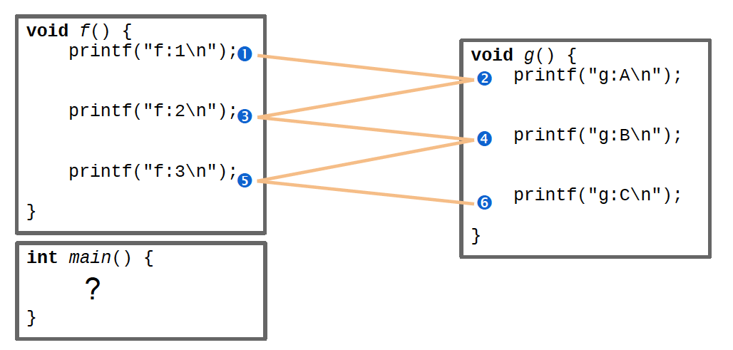
Virtual Parallelism
Given: Functions f and g
Goal: f and g should run interlaced
5.2 Virtual Parallelism

Slide 6
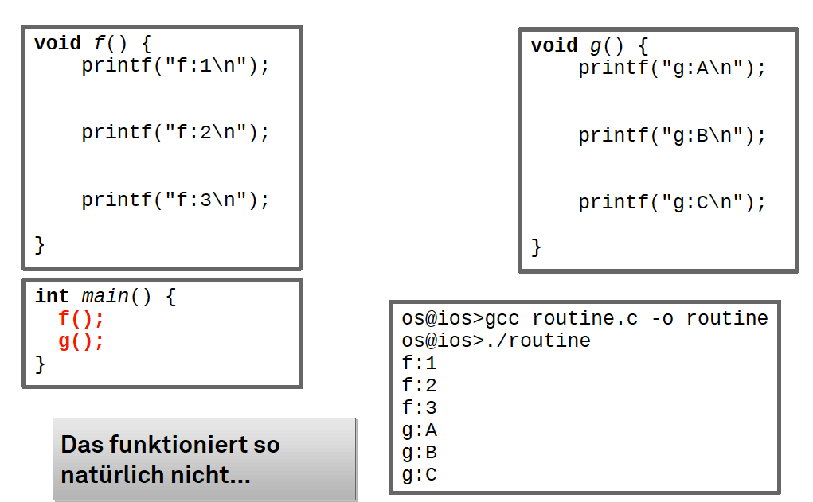
Virtual Parallelism: Experiment 1
Obviously does not work...
5.2 Virtual Parallelism

Slide 7
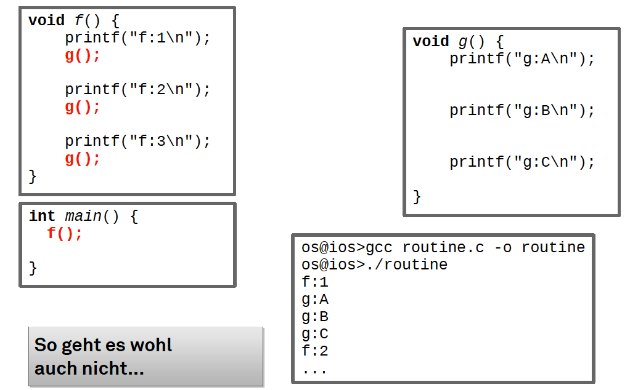
Virtual Parallelism: Experiment 2
Does not work either...
5.2 Virtual Parallelism

Slide 8
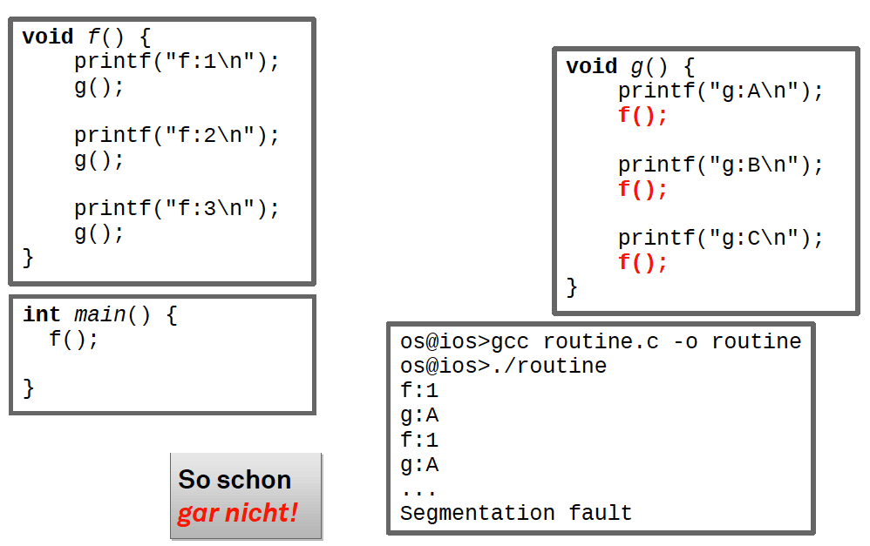
Virtual Parallelism: Experiment 3
Does not work at all!
5.2 Virtual Parallelism

Slide 9
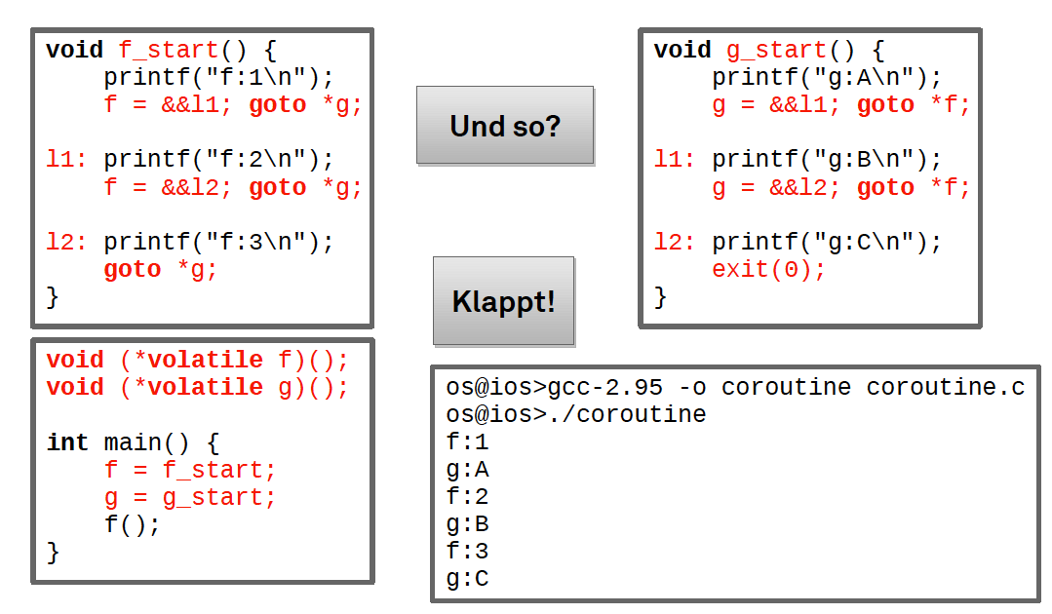
Virtual Parallelism: Experiment 4
This works!
5.2 Virtual Parallelism

Slide 10
First Conclusion
Virtual parallelism cannot be achieved using function calls
Simple function calls (experiment 1 and 2) → Always execute the function fully
Recursive function calls (experiment 3) → Same, leading to endless recursion and stack overflow
Functions must be able to be exited and continued during execution
Somewhat like in experiment 4...
Instruction pointer stored in global variables and resumed using goto
...but without the involved problems
Direct jumps out of and into functions are undefind behaviour in C! (goto with pointers is a GCC feature)
Function state does not only consist of the instruction pointer – What about CPU registers and stack?
5.2 Virtual Parallelism

Slide 11
Preview
Motivation
Virtual Parallelism
Coroutines
Threads
Summary

Slide 12
Definitions
Coroutine: Function that can be interrupted and continued at a later point in time
Each coroutine has its own register set and stack
Similar to a thread, but not known to scheduler
The concept of coroutines comes from programming languages
E.g., Kotlin, Rust, Python, Simula-67, …

Slide 13
Sequential execution of Coroutines
Coroutines are executed in sequence
State of each coroutine is conserved across entry/exit
All coroutines have equal rights
Order of execution is determined by the coroutines themselves
Either static (HeineOS)
Or dynamic (active coroutine decides which one is next)
Order of execution is programmed, contrary to a dynamic schedule (determined by a scheduler)

Slide 14
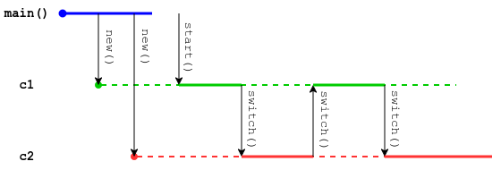
Coroutines in HeineOS
We implement a static schedule → Coroutines are linked in a cycle
Each coroutines simply calls switch() to switch to next coroutine
We implement coroutines as a preliminary stage for cooperative/preemptive threads

Slide 15
Preview
Motivation
Virtual Parallelism
Coroutines
Threads
Summary

Slide 16
Threads
A thread is a coroutine, which is known to the scheduler
Scheduler manages threads and decides, when each thread may run (see next chapter)
Each thread belongs to a process (address space)
HeineOS only has one process (Kernel) → Only one address
Concept origins:
Multithreading is historically (rather) an operating system feature
Coroutines are historically (rather) a programming language feature
5.4 Threads

Slide 17
Lightweight Threads / Fibers
Some programming languages support corotines through the compiler, combined with runtime function to enable asynchronous programming
Primary use: Blocking I/O
When a call blocks, the CPU is implicitly handed off
An executor is responsible for switching to the next coroutine
Coroutines are not statically linked in this case
Rust: async & await
Java: Project Loom

Slide 18
Preview
Motivation
Virtual Parallelism
Coroutines
Threads
Summary

Slide 19
Summary
Coroutines are functions, that can be interrupted in their execution
Similar to a thread, but not known to the operating system
Threads are coroutines, that are managed by the operating system’s scheduler
We implement coroutines as a preliminary stage to our cooperative/preemptive threads

