Slide 1
OS Development 6. Scheduling
Prof. Dr. Michael Schöttner Dr. Fabian Ruhland

Slide 2
Preview
Motivation & Definitions
Thread Switching
Scheduling
Scheduler in HeineOS
Summary
6. Scheduling

Slide 3
Motivation
Goal: Run application as independent threads
We want a dynamic (not static!) schedule
Threads can either yield the CPU voluntarily, or the scheduler withdraws it
Solution: Scheduler in the operating system
Decides which thread runs next
If a thread blocks, the scheduler automatically switches to the next one

Slide 4
Definitions
Cooperative Multithreading: Threads must yield the CPU voluntarily, as the operating system cannot withdraw it
Preemptive Multithreading: Threads can yield the CPU voluntarily, but the operating system is also able to withdraw forcefully

Slide 5
Definitions
Adress Space: Accessible memory at a given point in time
Process: Address space, thread(s) and metadata (program that is currently being executed and its data)
Thread: Independent activity
Always tied to a process → shares data, code and resources with threads of the same process
Separate register set and stack
(Sometimes called lightweight process)

Slide 6
Preview
Motivation & Definitions
Thread Switching
Scheduling
Scheduler in HeineOS
Summary
6. Scheduling

Slide 7
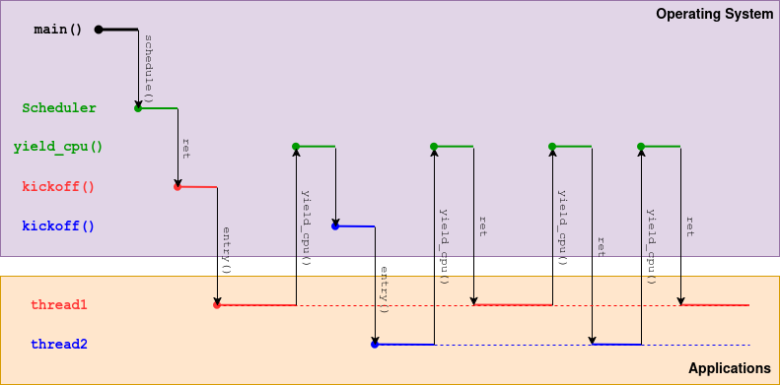
Cooperative Thread Switching
6.2 Thread Switching

Slide 8
Preemptive Thread Switching
Problem: How can the operating system withdraw the CPU from a thread?
Solution: Use the timer interrupt (PIT)
Timer trigger periodic interrupts (e.g., every 1 ms)
Timer interval is programmable
Every timer interrupt is a tick → Switch threads after a certain amount of ticks (e.g. 10)
6.2 Thread Switching

Slide 9
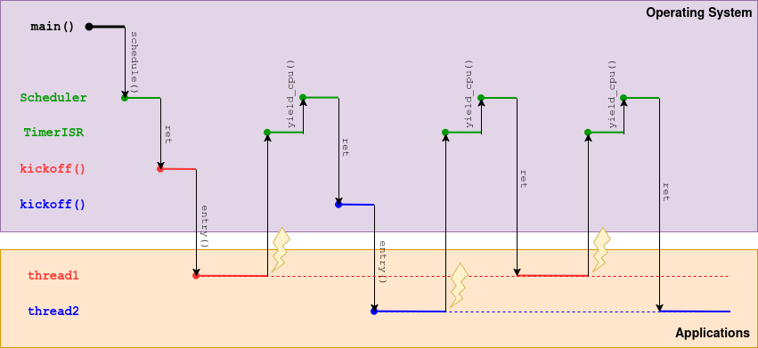
Preemptive Thread Switching
6.2 Thread Switching

Slide 10
Preview
Motivation & Definitions
Thread Switching
Scheduling
Scheduler in HeineOS
Summary
6. Scheduling

Slide 11
Scheduler
Usually, many threads wait for the CPU
Deciding which thread is next must be quick
Scheduler manages all waiting threads in a Ready Queue
In practice, multiple queues (for different priorities) or trees are used
Blocked threads are not stored in the ready, as always skipping them causes overhead
6.3 Scheduling

Slide 12
Scheduling Goals
Fairness: Each thread should get (on average) the same amount of CPU time
Waiting time: Minimal time spent in ready queue
Throughput: Maximum number of threads per time unit
…
6.3 Scheduling

Slide 13
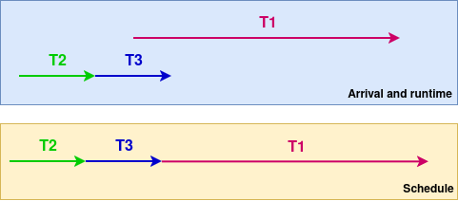
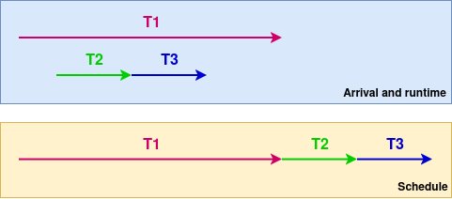
First Come First Served (FCFS)
Threads are processed in the same order they arrive in the ready queue
CPU ownership until end or voluntary yield
Example: Good case
Example: Worst case
Disadvantage:
Convoy effect = Short threads bank up behind a long thread
6.3 Scheduling

Slide 14
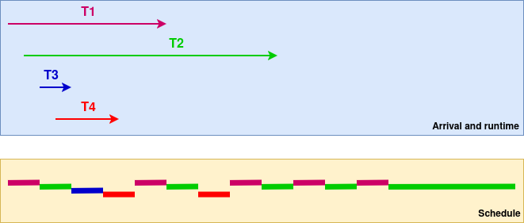
Round Robin (RR)
Goal: Equal division of CPU time
Common strategy:
Threads are processed in order of their arrival
Current thread is preempted after a fixed time slice (e.g., 10-100 ms) and enqueued at the end of the ready queue
Problem: Right choice of time slice
Reasonable proportion between time slice and time needed for context switch
Large time slices reduce context switches, but increas latency
6.3 Scheduling

Slide 15
Scheduling with Priorities
It is desirable to distinguish threads by their importance → Assign a priority number to each thread
Scheduler prefers threads with higher priorites
Implementation:
One ready queue per priority
Allows fast retrieval of right thread
TCB = Thread Control Block
Information about the thread: ID, Stack, etc.
High Priorities
Low Priorities
6.3 Scheduling

Slide 16
Feedback Scheduling
Feedback → Dynamic adaption of scheduling criteria, depending on thread behaviour (e.g., CPU usage, sleep time)
Adaptation is possible via priority, ready queue insertion (beginning or end) and time slice length
Two fundamental strategies:
Bump up priority of waiting threads
Downgrade priority of CPU intensive threads
6.3 Scheduling

Slide 17
Idle
If all threads are waiting, the CPU is free and an idle thread runs:
May not stop, has lowest priority and is interruptible at any time
Busy looping can be avoided using special instructions → Example: „HLT“ (x86): stops CPU; (Timer-) interrupt wakes cpu up again
Idle times can also be used for:
Defragment filesystems
Garbage collection
Software updates
…
6.3 Scheduling

Slide 18
Multicore Aspects
Arbitrary assignment of threads to CPU cores is bad:
If thread t has lastly used core p, there is a chance that parts of its address space are still inside the cache/TLB of p
(If another thread of the same address space was the last active one on this core)
Scheduler wants to achive an even load across all CPU cores
Core affinity allows defining preferences for specific cores
Can weaken priorities
6.3 Scheduling

Slide 19
Preview
Motivation & Definitions
Thread Switching
Scheduling
Scheduler in HeineOS
Summary
6. Scheduling

Slide 20
Cooperative Scheduling in HeineOS
Cooperative FCFS scheduler
Single ready queue without priorities
Current thread is not in ready queue, managed in SchedulerState struct
Next thread to run is always the one at the ready queue’s head
Threads that have just run or freshly arrive are always enqued at the ready queue’s tail
6.4 Scheduler in HeineOS

Slide 21
Preview
Motivation & Definitions
Thread Switching
Scheduling
Scheduler in HeineOS
Summary
6. Scheduling

Slide 22
Summary
Threads allow concurrency in applications
If one thread is blocked, another can run on the
Scheduler decides which thread runs next
In preemptive multithreading, threads are forcefully switched using the timer interrupt

