Slide 1

Spotify Music
Recommendation System
Popularity baseline and content based KNN
Anil Bammidi
Empirical scope
DSC680 Applied Data Science
Bellevue University
October 2026
Only fitted popularity and KNN results are reported

Slide 2
Business problem and research questions
02
A large catalog creates a discovery problem
How does popularity support a listener with no history?
RQ1
The available data can support catalog similarity and cold start. It cannot measure individual listening outcomes.
Can scaled audio features return plausible similar tracks?
RQ2
RQ3
What evidence is needed before collaborative claims?
Current conclusion
Popularity and KNN are usable baselines. Collaborative and hybrid evaluation requires authentic interactions.
DSC680 FINAL PROJECT ANIL BAMMIDI

Slide 3
Data and preparation
03
114,000
89,740
10
source track rows
unique retained tracks
scaled audio features
Preparation steps
Feature vector
01
Remove duplicate track identifiers
Danceability, energy, key, loudness, speechiness, acousticness, instrumentalness, liveness, valence, and tempo
02
Remove records without track names or artists
03
Reset the index to preserve row alignment
Min max scaling to 0 to 1
DSC680 FINAL PROJECT ANIL BAMMIDI

Slide 4
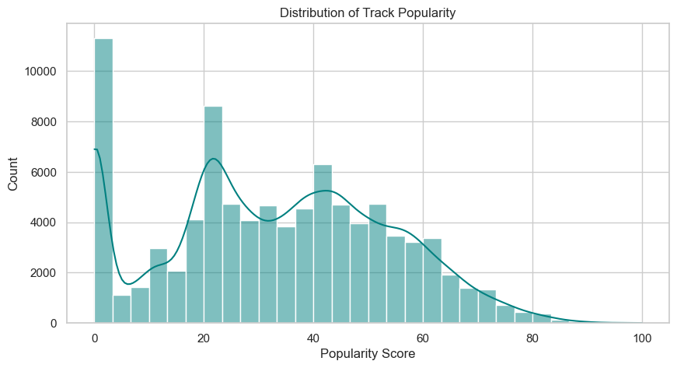
Popularity forms a useful but narrow baseline
04
Why it helps
Immediate cold-start ranking
Transparent benchmark
No user profile required
Main risk
Repeated use concentrates exposure among already popular tracks
Executed notebook output
DSC680 FINAL PROJECT ANIL BAMMIDI

Slide 5
Cold start recommendations
05
Top five tracks ranked by observed popularity
Track | Artist | Popularity
Unholy (feat. Kim Petras) | Sam Smith; Kim Petras | 100
Quevedo: Bzrp Music Sessions, Vol. 52 | Bizarrap; Quevedo | 99
I'm Good (Blue) | David Guetta; Bebe Rexha | 98
La Bachata | Manuel Turizo | 98
Me Porto Bonito | Bad Bunny; Chencho Corleone | 97
Interpretation
The output verifies the ranking logic. It does not measure personal preference or quality.
DSC680 FINAL PROJECT ANIL BAMMIDI

Slide 6
Content based KNN
06
Model input
Strength
Ten audio features for each track
Interpretable similarity without listener history
Scaling
MinMaxScaler places every feature on a common zero-to-one range
Limitation
Audio similarity is a proxy. It does not prove an individual listener will prefer the result.
Retrieval
Five nearest tracks by cosine distance
DSC680 FINAL PROJECT ANIL BAMMIDI

Slide 7
KNN example crosses genre labels
07
Query track: Comedy
Recommended track | Artist | Genre
Sometimes | Ed Solo and collaborators | breakbeat
JAMAICA | Feid; Sech | pop
Skylight | Gramatik | trip-hop
Look For The Good | Jason Mraz | acoustic
En El Coche | Aitana | spanish
What this shows
The fitted model can retrieve acoustic neighbors across genre labels. Listener relevance still requires ground truth.
DSC680 FINAL PROJECT ANIL BAMMIDI

Slide 8
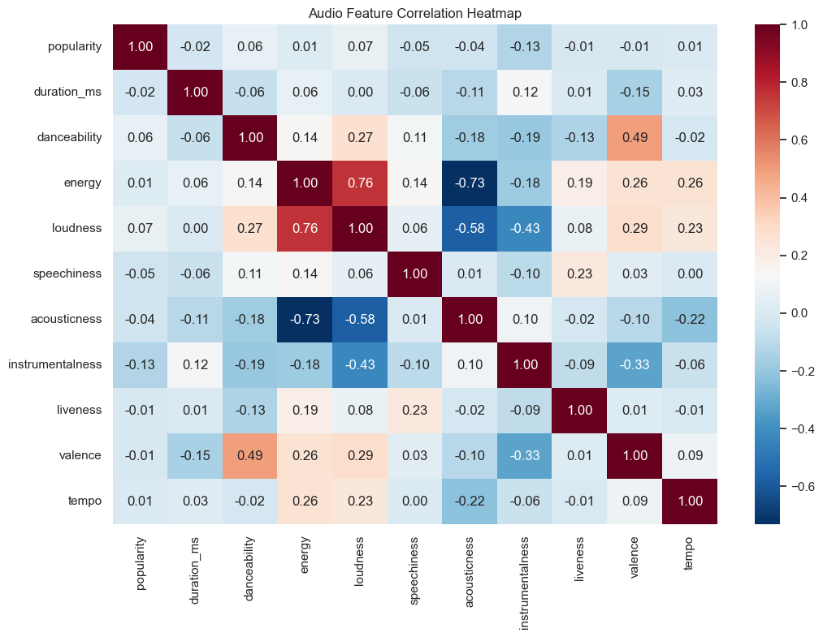
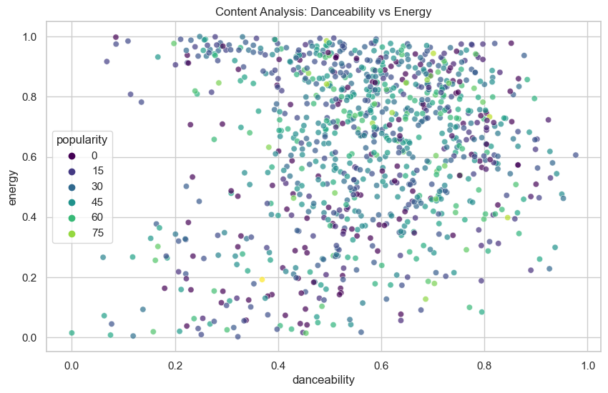
Additional empirical evidence
08
Exploration describes the feature space. It does not measure recommender accuracy.
Energy and loudness correlate at about 0.76
DSC680 FINAL PROJECT ANIL BAMMIDI

Slide 9
Limitations and responsible use
09
Evidence limits
Responsible use
Data
No users, plays, skips, saves, timestamps, or listening duration
Privacy
Consent, minimization, retention limits, access controls
Model
Similarity does not establish personal relevance
Exposure
Monitor popularity tier, artist concentration, novelty, and diversity
Impact
The notebook cannot measure retention or causal business value
Evidence
Report only fitted results and label future work
Simulated SVD and hybrid RMSE figures were removed from the final submission
DSC680 FINAL PROJECT ANIL BAMMIDI

Slide 10
Recommendation and next steps
Use content KNN as the initial model and popularity as the cold-start fallback
1
Collect consented interaction events
2
Create user-aware or time-aware holdouts
3
Evaluate relevance, coverage, novelty, and diversity
4
Run a controlled A B test before business claims
Thank you
Feedback/Questions

