Slide 1
Museum Study
[Phylum : Cnidaria]
Group 01, Dept. of Zoology
University of Dhaka
Dept. of Zoology, University of Dhaka

Slide 2
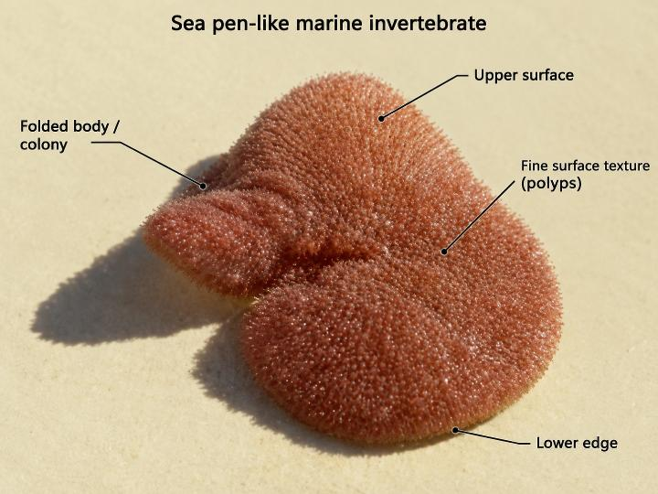
Renilla reniformis
English Name : Sea Pansy Local Name : Not available
Classification:
Phylum : | Cnidaria
Class : | Anthozoa
Order : | Pennatulacea
Family : | Renillidae
Genus : | Renilla
Species : | R. reniformis
Fig: Renilla reniformis
Dept. of Zoology, University of Dhaka
1

Slide 3
Characteristics
1.
It belongs to Cnidaria because it possesses specialized cells called cnidocytes, which are used for capturing food and for defence.
2.
It belongs to Anthozoa because it lives only as polyps and has no medusa stage.
3.
It is placed in Pennatulacea because it is a sea pen colony that grows from a single primary polyp.
4.
It belongs to Renillidae because its colony is flattened and leaf-like and lies on the sediment surface instead of standing erect.
5.
It has a single giant anchoring polyp (oozooid) that forms a muscular peduncle, which matches the genus Renilla.
6.
It shows polyp dimorphism, with feeding polyps (autozooids) and smaller polyps (siphonozooids) that circulate water.
7.
The species name reniformis refers to the kidney-shaped (reniform) outline of its colony.
Dept. of Zoology, University of Dhaka
2

Slide 4



Habit, Habitat & Distribution
Habit
Habitat
Distribution
A colonial octocoral with a flattened, kidney-shaped colony that lies on the sandy sea floor and is anchored by a muscular peduncle buried in the sediment.
It is a marine species found mainly on sandy and muddy seabeds in shallow coastal waters of the western Atlantic.
Western Atlantic, from the coast of the southeastern United States through the Gulf of Mexico and the Caribbean to South America.
Dept. of Zoology, University of Dhaka
3

Slide 5



Food & Feeding, Status & Economic Importance
Economic Value
Food & Feeding
Status
It is a filter feeder. Its polyps capture suspended plankton and other microscopic organic particles from the water.
Not evaluated on the IUCN Red List.
It helps structure soft-bottom habitats, providing shelter and microhabitat for other small organisms. Though having little direct value as a harvested species, it supports a healthy seabed ecosystem that benefits fisheries and biodiversity.
Special Information: It often looks contracted by day and more expanded at night. It is also well known in research for its green fluorescent protein (GFP). It has no photosymbionts, and its life cycle begins as a single primary polyp.
Dept. of Zoology, University of Dhaka
4

Slide 6
Thank You
Dept. of Zoology, University of Dhaka

