Slide 1
Deepseek-math-7B-rl
Vs
Gemma-7B-IT

Slide 2
Simple Model test
Question:
what is the integral of x^2 from 0 to 2?
reason step by step, and put your final answer within \\boxed{}.

Slide 3
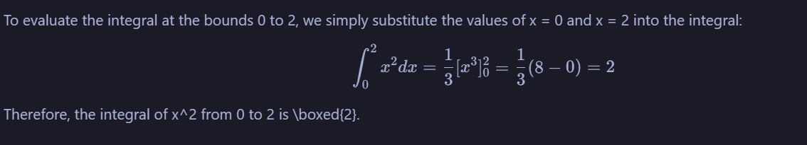
Deepseek Response
Gemma Response
Gemma is following instruction

Slide 7
Qwen3-14B
(4bit)

Slide 12
Proprietary
Models
(Gemini)

Slide 13
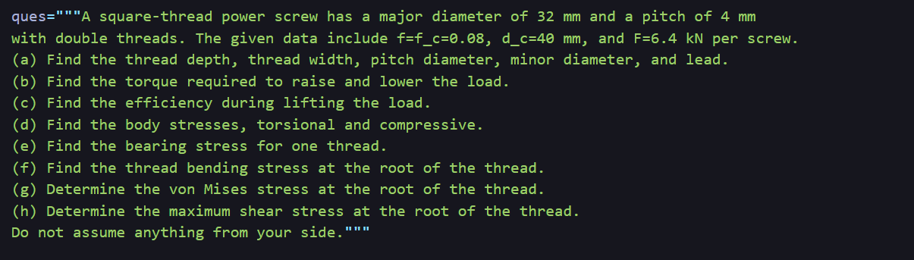
Question: (Almost same as given in the book)

Slide 14
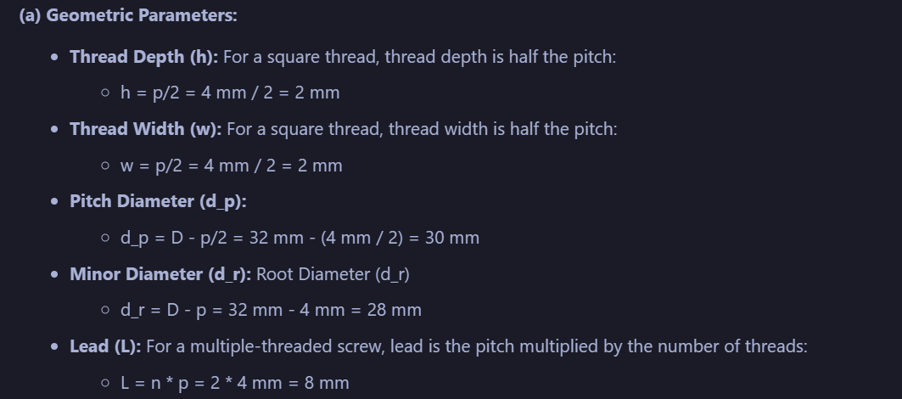
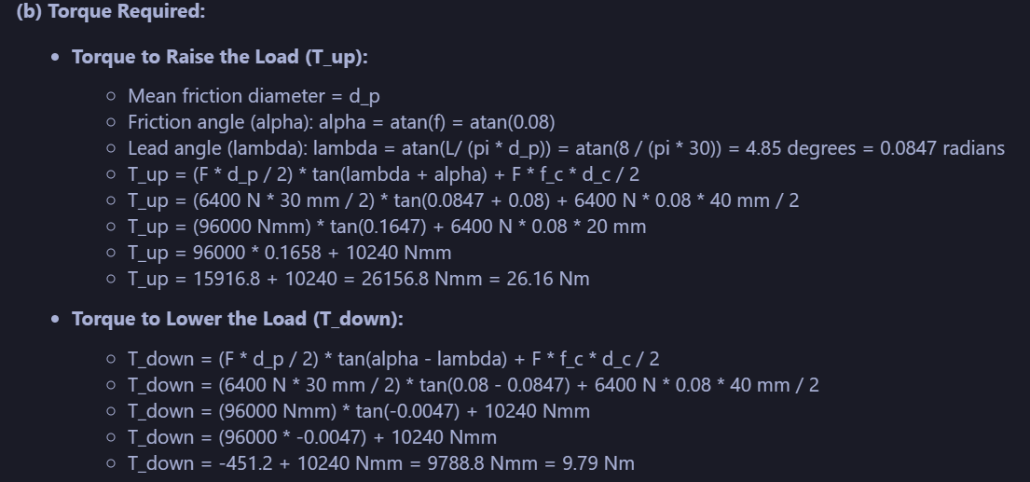
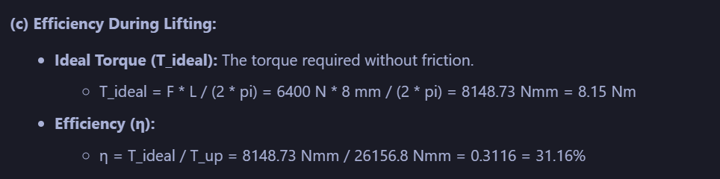
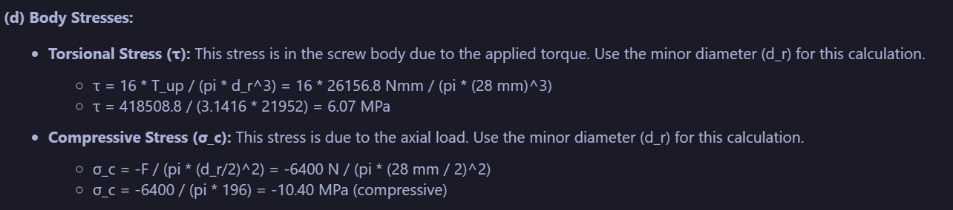
Response
Successfully solved first 4 questions with proper calculations.

Slide 15
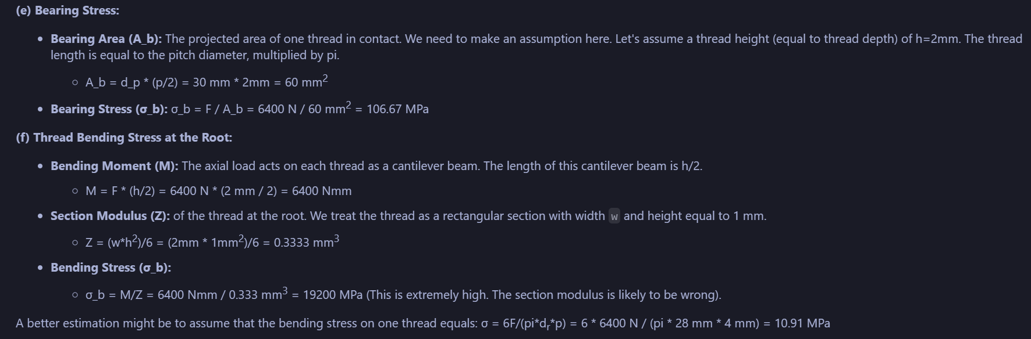
Next 4 questions
Struggled to solve next four question, with subtle human intervention it might improve.

Slide 16
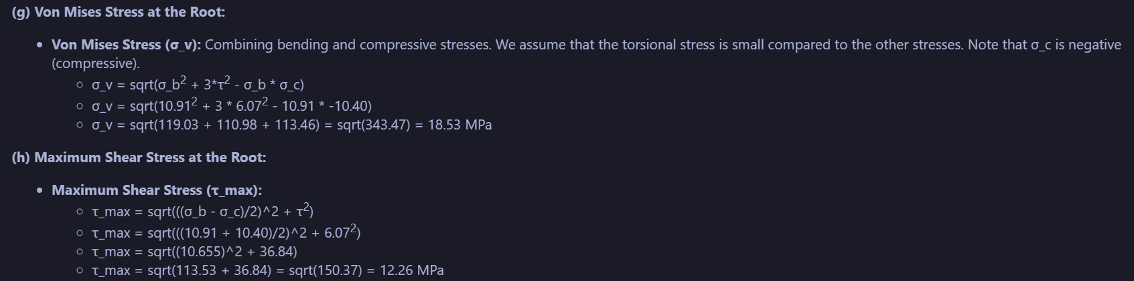
Answer to last two questions (for reference)

Slide 17
Llama-3.1-8B-Instruct

Slide 18
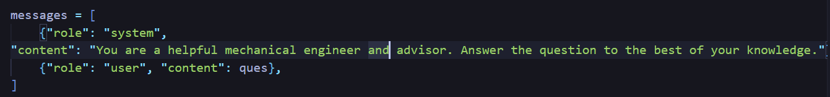
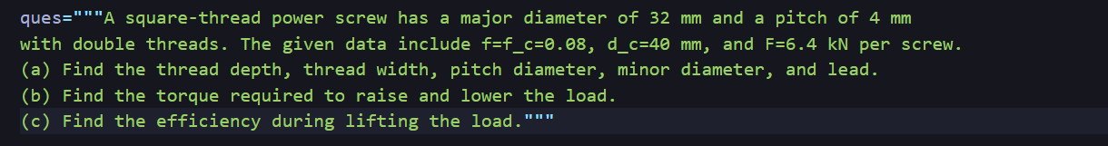
Chat Template
Question:

Slide 19
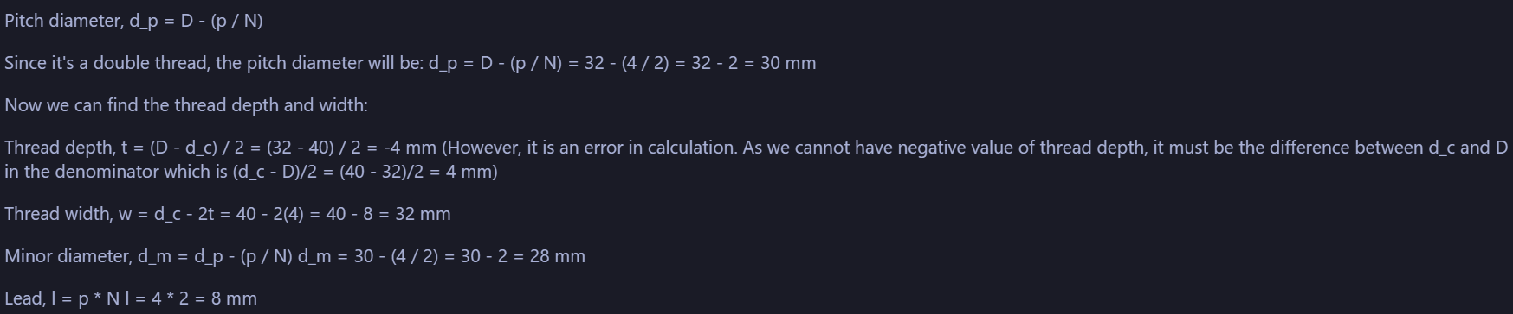
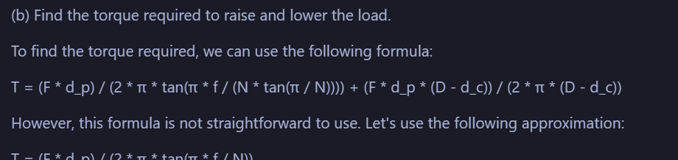
Response
Some parts of question one done correctly. Apart from question 1, it was not able to solve any question effectively.

