Slide 1
Ti Tans Bank – AI Powered KYC System
Project Brief & Summary
TCS AI Hackathon 2025

Slide 2
Problem Statement
Manual KYC is slow, costly, error-prone
Requires branch visits
High fraud risk

Slide 3
Proposed Solution
AI-powered digital KYC portal
Fully online & automated
Real-time validation

Slide 4
Project Objective
Faster onboarding
Fraud prevention
Improved customer experience

Slide 5
System Overview
Web-based Streamlit application
AI-driven validation
Admin monitoring dashboard

Slide 6
User Journey
Register → Login
Upload documents
AI validation
Status notification

Slide 7
Key Features
User registration & authentication
Secure document upload
AI-based verification
Admin review

Slide 8
AI Validation Layers
Face detection
Liveness detection
OCR validation
Face matching

Slide 9
Scoring Mechanism
Weighted scoring model
Approval threshold ≥ 70%
Critical checks enforced

Slide 10
Technology Stack
Frontend: Streamlit
Backend: Python
Database: PostgreSQL
AI: OpenCV, GPT-4 Vision, Tesseract

Slide 11
Database Design
Users
Customers
KYC Applications
Documents
Audit Logs

Slide 12
Security & Compliance
SHA-256 password hashing
Role-based access
Audit trail
Input validation

Slide 13
Admin Capabilities
Review applications
Approve / Reject
Fraud alerts
Reports

Slide 14
Business Impact
90% faster processing
60% cost reduction
Improved fraud detection

Slide 15
Conclusion
Scalable, secure & AI-driven KYC
Ready for real-world banking use

Slide 16
High-Level Architecture
User → Streamlit UI
Application Layer
AI & OCR Services
PostgreSQL Database
External APIs

Slide 17
Detailed Architecture Flow
Frontend → Backend Services
AI Validation Engine
OCR Processing
Database & File Storage

Slide 18
Demo Walkthrough (Suggested)
Landing Page
Registration
KYC Upload
AI Validation
Status Check
Admin Review

Slide 19
Future Enhancements
Cloud deployment
Mobile app
Deep learning face recognition
Govt API integrations

Slide 20
Thank You
AI Powered KYC System
Ti Tans Bank
TCS AI Hackathon 2025

Slide 21
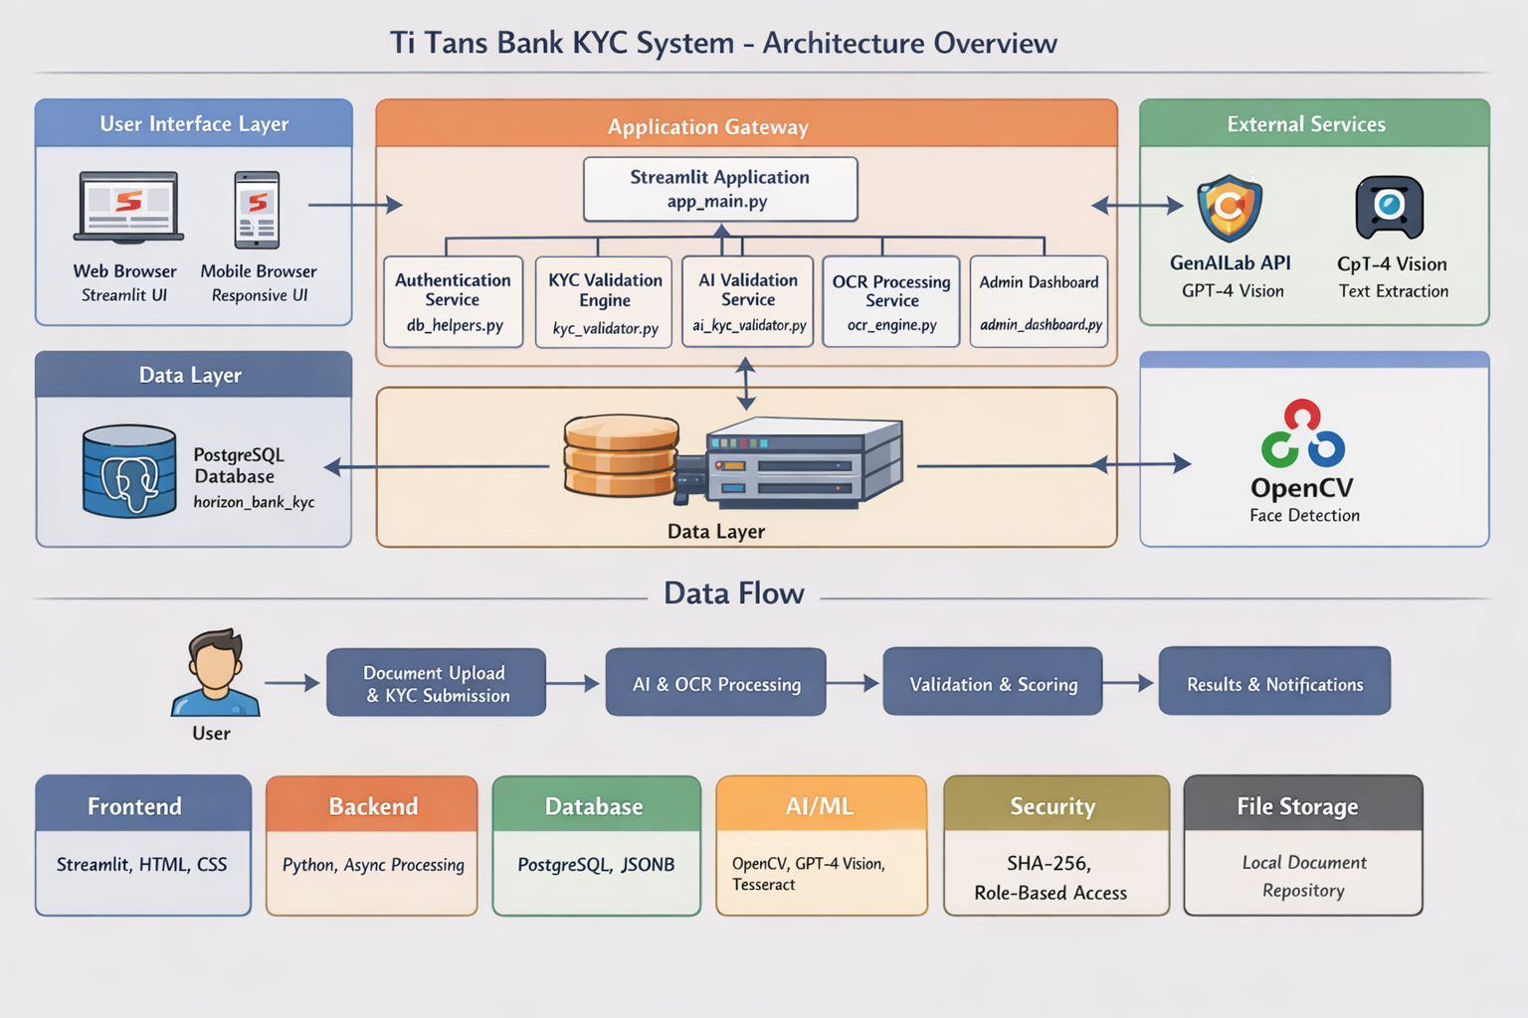
System Architecture Overview

