Slide 1

Forest Fire Risk Classification Using PySpark
Mini Project Presentation
Name: ABAN FALAKKI

Slide 2
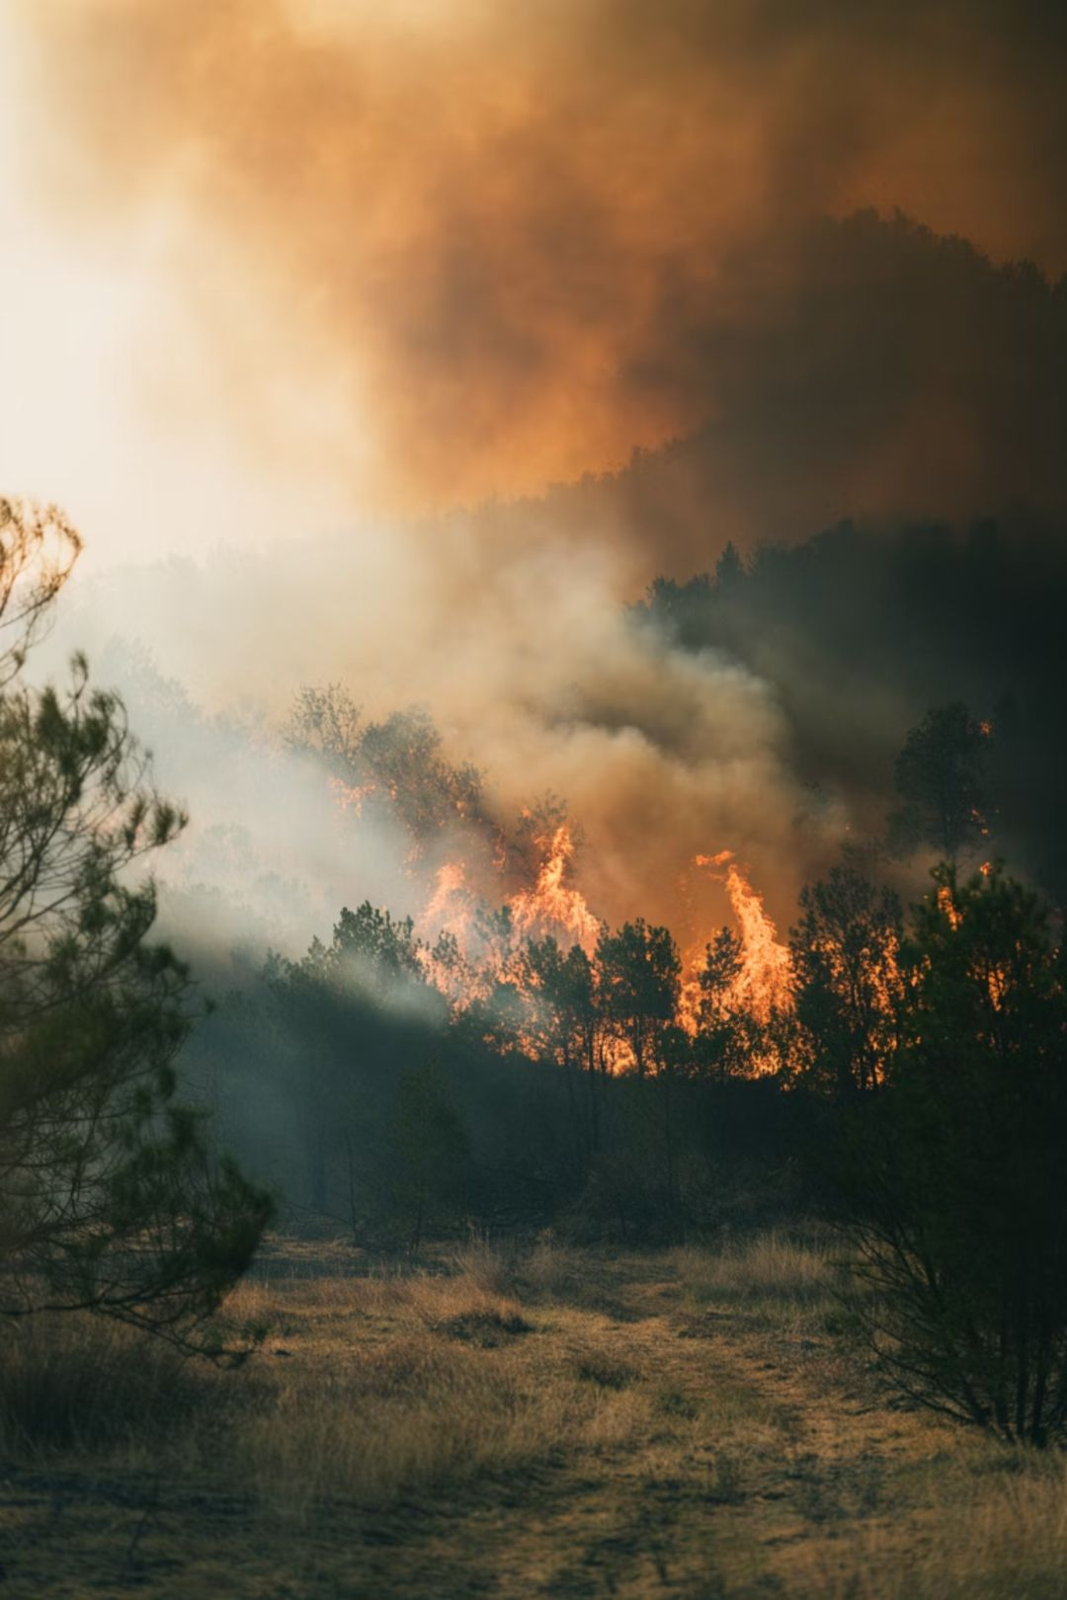
Introduction
What Are Forest Fires?
Uncontrolled fires in forested areas caused by natural factors (lightning, drought) or human activity — among the most destructive environmental disasters globally.
Why Prediction Matters
Early detection enables proactive resource deployment, evacuation planning, and damage mitigation before fires escalate.
Environmental & Social Impact
Destroys ecosystems, displaces wildlife, degrades air quality, and threatens human settlements and livelihoods.

Slide 3
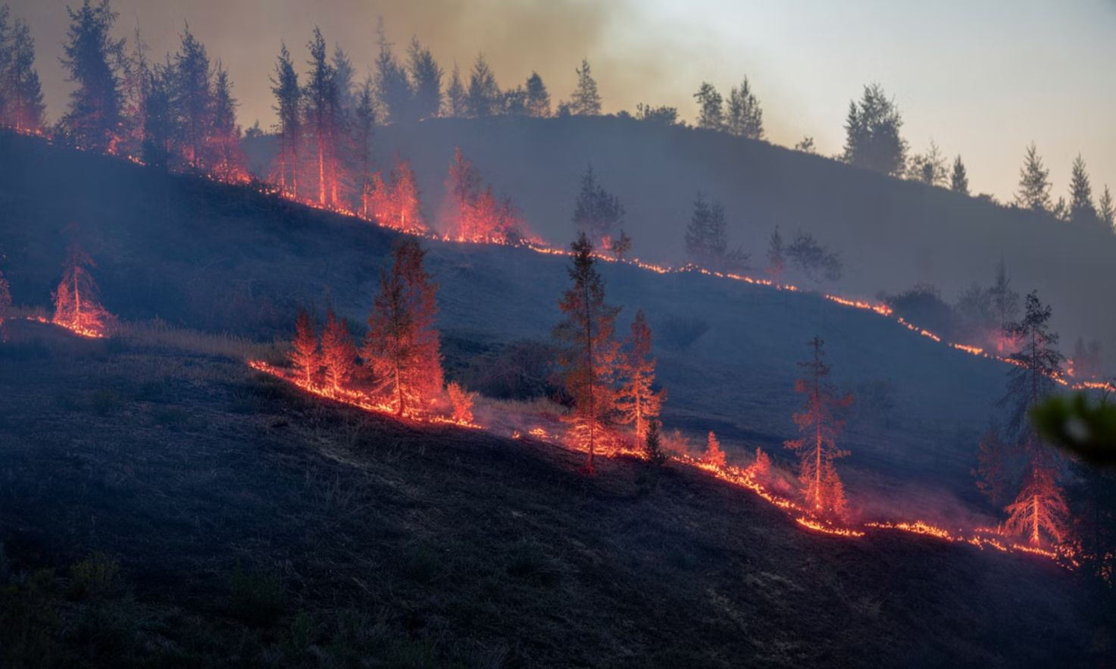
Problem Statement & Objectives
The Problem
Uncontrolled forest fires cause irreversible ecological and economic damage. Traditional detection methods are reactive — fires are identified only after they spread. There is a critical need for data-driven, early prediction systems using machine learning.
Project Objectives
Predict forest fire occurrence using historical data
Leverage PySpark for scalable data processing
Apply Random Forest for binary classification
Evaluate model performance with accuracy and F1 score
Visualize predicted fire risk zones on a coordinate map

Slide 4

Technologies Used
Python
PySpark
Spark MLlib
Core programming language for data processing, model development, and visualization pipelines.
Apache Spark's Python API for distributed, large-scale data processing at speed.
Scalable machine learning library providing Random Forest and feature transformers.
Matplotlib
Random Forest
Visualization library used to plot fire risk zones and model performance metrics.
Ensemble classifier chosen for robustness, interpretability, and resistance to overfitting.

Slide 5
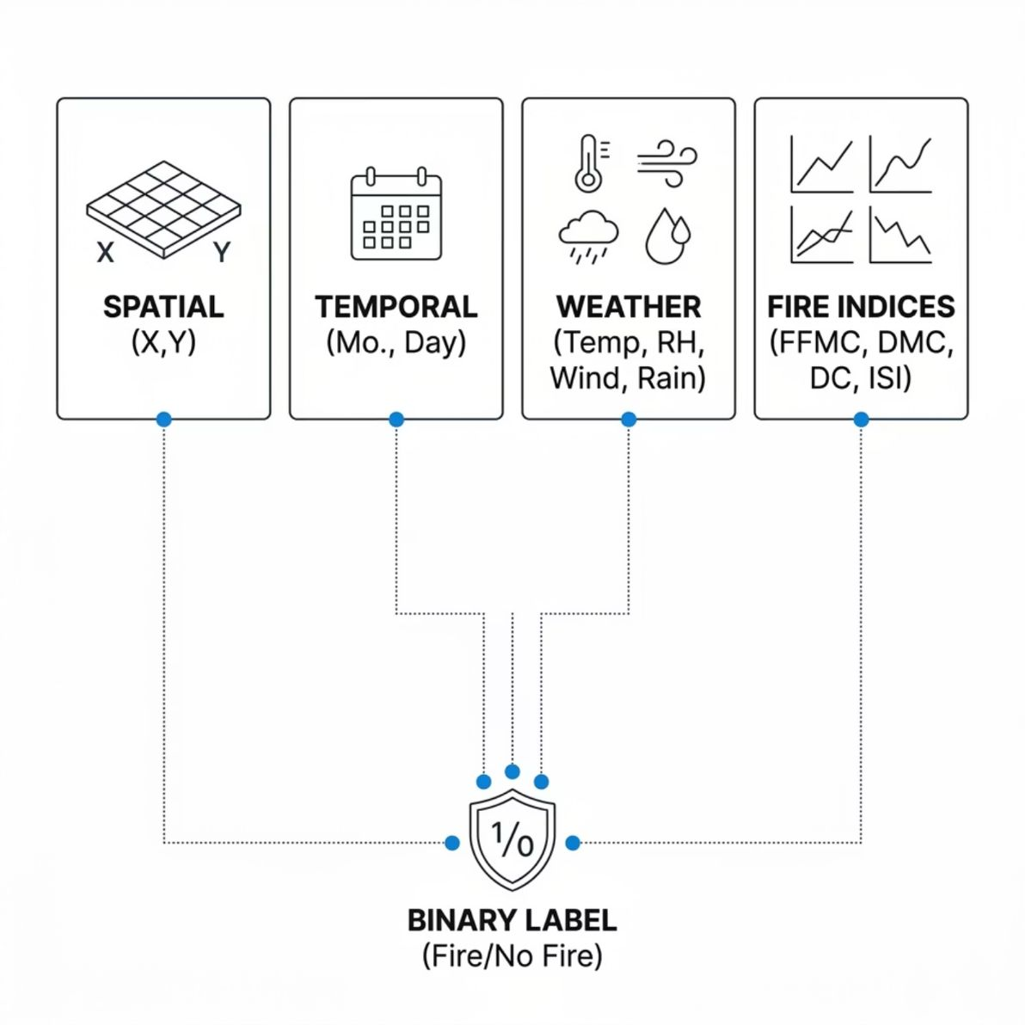

Dataset Description
Forest Fires Dataset
A benchmark UCI dataset from northeast Portugal containing 517 instances with meteorological and spatial features. Each record represents a forest location monitored over time.
Key Features
Spatial: X, Y coordinates
Temporal: month, day
Weather: temp, RH (relative humidity), wind, rain
Fire Indices: FFMC, DMC, DC, ISI
Target: area (burned area in m²)
Label Creation
area > 0 → Fire Occurred (1) | area = 0 → No Fire (0)

Slide 6

Methodology & Workflow
Feature Engineering
Model Training
Assemble feature vector and create binary label.
Train-test split and train Random Forest model.
Data Loading
Evaluation
Load CSV, handle missing values, encode month/day.
Compute accuracy, F1 and plot risk-zone scatter.
The pipeline follows a structured Spark workflow: raw data is ingested and cleaned, features are engineered into a vector format, the Random Forest model is trained on 70% of data, and predictions are evaluated and visualized on the held-out 30% test set.

Slide 7

Machine Learning Model: Random Forest
What Is Random Forest?
An ensemble method that builds multiple decision trees on random subsets of data and features, then aggregates their predictions via majority voting.
Why Random Forest?
Handles both numerical and categorical features naturally
Reduces overfitting through ensemble averaging
Robust to class imbalance in fire/no-fire data
Provides feature importance for interpretability
Natively supported in Spark MLlib for distributed training

Slide 8
Implementation: PySpark Code Flow
01
02
Load CSV
Handle Missing Values
spark.read.csv("forestfires.csv", header=True, inferSchema=True)
Impute or drop nulls using na.fill() and na.drop()
03
04
Encode Categoricals
Create Label
StringIndexer on month and day columns
when(col("area") > 0, 1).otherwise(0)
05
06
Assemble Features
Train & Predict
VectorAssembler combines all numeric features into a single vector column
Fit RandomForestClassifier, transform test data, extract predictions

Slide 9
Results & Visualization
Model Performance
Sample Prediction Output
Results reflect the challenge of class imbalance — most records represent no-fire conditions. F1 Score confirms balanced precision and recall on the minority (fire) class.
X
Y
Label
Prediction
5
8
0
0
7
4
1
1
3
6
0
0
9
2
1
0
6
7
0
1
61.65%
62.04%
Accuracy
F1 Score
Spatial Risk Visualization
A scatter plot of X-Y coordinates color-coded by prediction: green = no fire risk, red = high fire risk — enabling geographic identification of vulnerable zones.

Slide 10
Advantages & Future Scope
Advantages
Limitations
Leverages big data tools (PySpark) for scalable processing
Supports environmental prediction and conservation efforts
Excellent academic learning project for distributed ML
Architecture is extendable to real-world deployment systems
Moderate accuracy due to class imbalance and limited features
Relies on historical data only — no real-time inputs
Future Enhancements
Integrate real-time weather API feeds
Build a live GIS dashboard with map overlays
Deploy a real-time alert system for forest authorities
Experiment with deep learning (LSTM, CNN) for temporal patterns

