Slide 1

nleashing Context: Enhancing Tweet Classification with Contextual Insights
U
238
27
Co
By: Andrija Banić, Dario Pavlović, Marko Jurić

Slide 2
RumuorEval2019
Subtask A
Objective is to label each of the posts in the conversation thread
Support
Deny
Query
Comment
22 competitors
First place F1 score: 0.6187 (GPT model) , last place: 0.1272
Subtask B
Predict the veracity of a given rumour (trinary classification – true, false, unverified)
13 competitors:
First place F1 score: 0.5765, last place: 0.0950

Slide 3
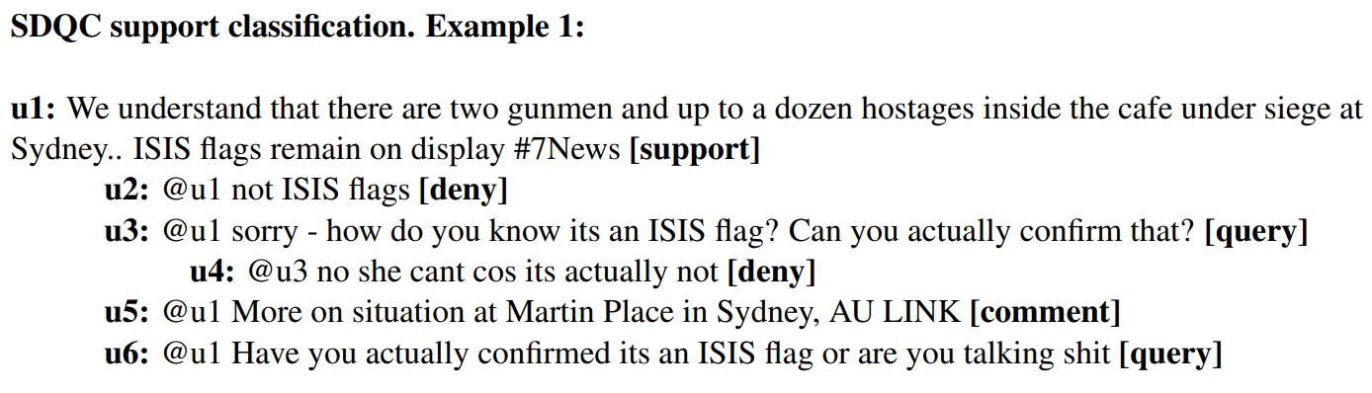
Example

Slide 4
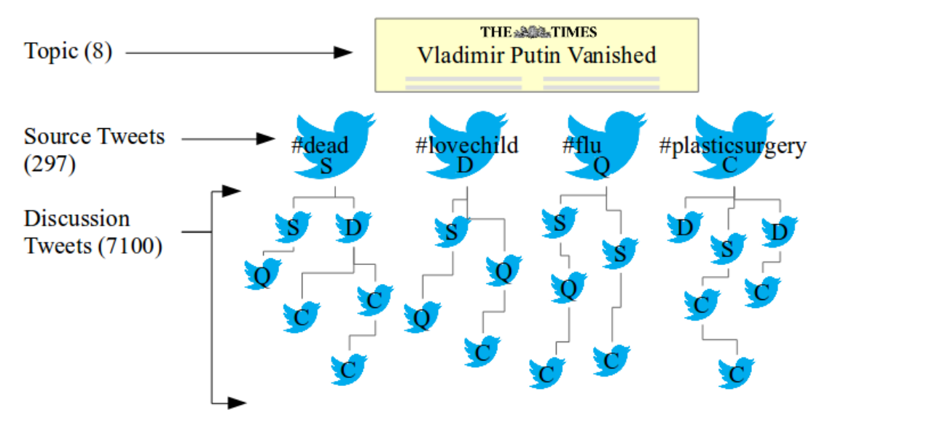
Dataset
Tweets split into train and test set (80:20)
Test set contains less tweets per topic but more topics then train set
Unbalanced labels
 | Support | Deny | Query | Comment
Twitter train | 1004 | 415 | 464 | 3685
Twitter test | 141 | 92 | 62 | 771

Slide 5
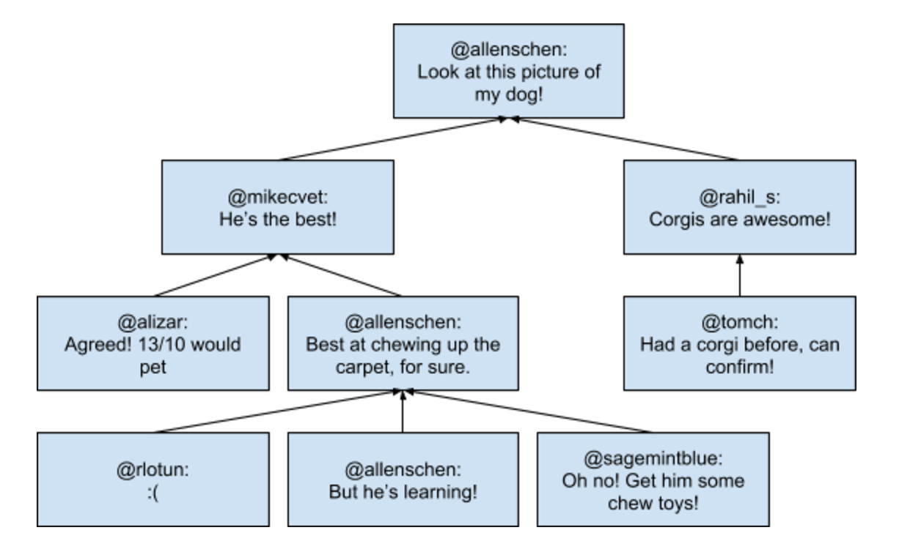
Our approach…
Effects of context on SDQC tweet classification
Three levels of context:
No context (tweet on its own)
Parent tweet context
Parent and children tweet context

Slide 6
Features and models
Features
Glove embeddings, Polarity (Textblob), Capital ratio, Amount of question and exclamation marks, Has a link, Mentions news agency, Tweet length
Reply count and reply labels (only used with parent or parent + children context)
Models
Random Forest Classifier, SGDC, GBC

Slide 7
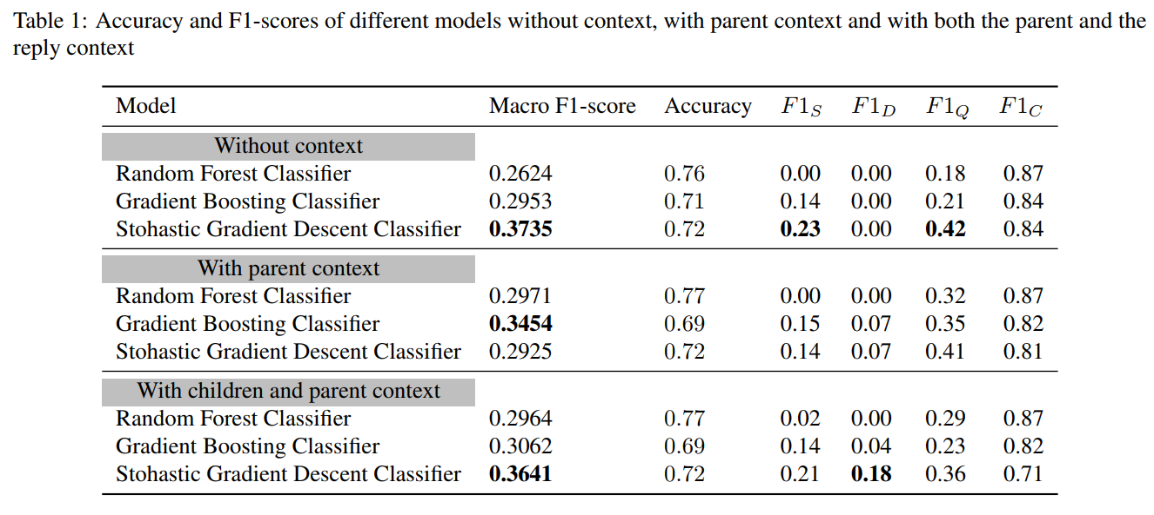
Results

Slide 8
Conclusion
Challenging problem of tackling rumour veracity
Difficult due to various factors such as small datasets and limited availability of labeled datasets
Context helps better detection of deny labels
Using more complex models such as GPT to support this claim

Slide 9
ny
A
Q
uestions

