Slide 1

Predicting Patient Heart Attacks
Arpa Banik and Janhavi Maniar

Slide 2
TABLE OF CONTENTS
DATA OVERVIEW
RESEARCH QUESTIONS
1
2
VISUALIZATIONS & ANALYSIS
3
4
CONCLUSION

Slide 3
DATASET OVERVIEW
This dataset consists of medical records of almost 238,000 patients and offers insights into patient demographics, clinical conditions, and medical history.
Total of 35 different variables, including
Gender, age, ethnicity
Height, weight, BMI
Alcohol and smoking practices
Occurrence of heart attack
History of sickness such as diabetes, kidney disease, asthma, cancer
Indicators of difficulties in walking, concentration, vision
Vaccinations
Contains little missing data
Notes:
The dataset we chose in

Slide 4
RESEARCH QUESTIONS
QUESTION 1
QUESTION 2
QUESTION 3
General Question: Which factors can influence a patient’s likelihood of experiencing a heart attack?
How do gender and geographic location influence the likelihood and distribution of heart attack occurrences across different age groups?
Do patients’ smoking status and alcohol consumption play a role in their likelihood of experiencing a heart attack?
Can a history of other clinical conditions, such as kidney disease or diabetes, contribute to a heart attack?

Slide 5
DEMOGRAPHIC AND GEOSPATIAL FACTORS INFLUENCING HEART ATTACKS

Slide 6
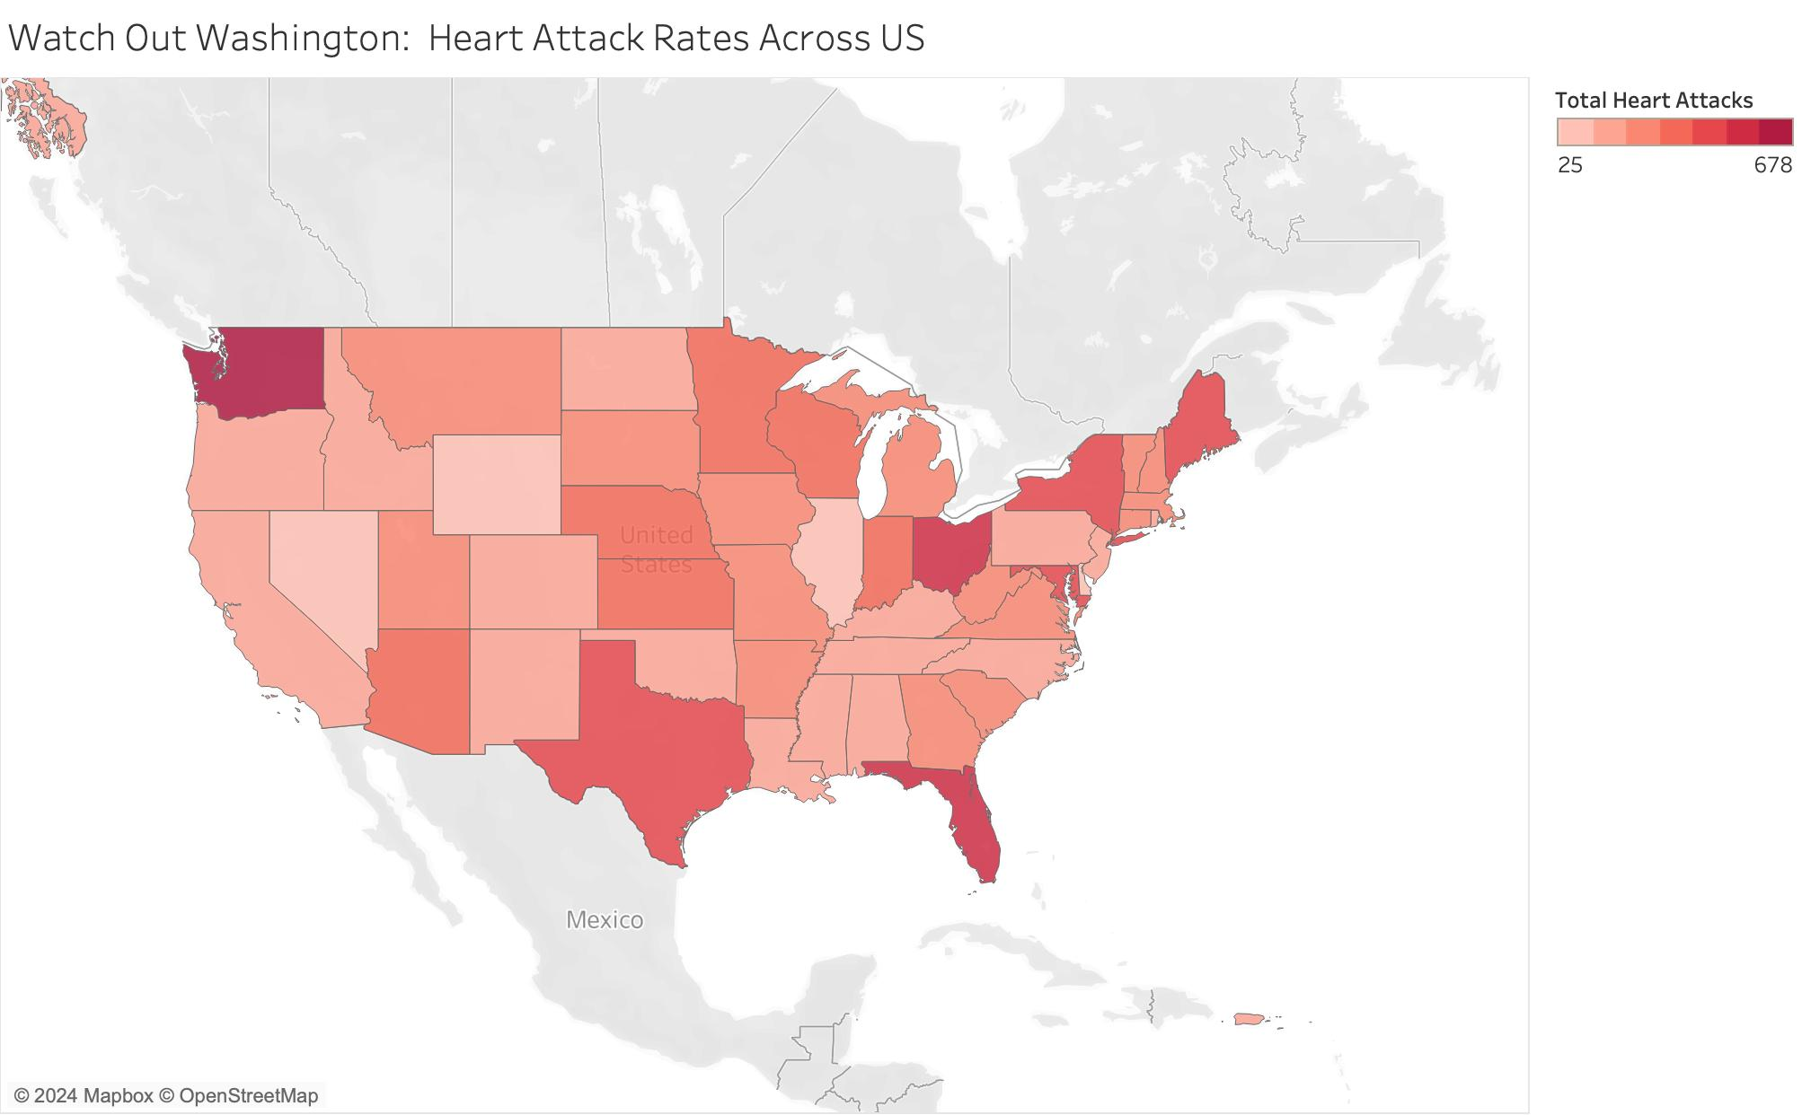
HEART ATTACKS ACROSS THE US
Key Insights
Indicates states with highest rates of heart attack
Washington leads with largest number while Delaware has lowest
Notes:
Arpa
Our first finding centers on geographic and demographic influences. Did you know Washington state has the highest heart attack rates while Delaware has the lowest? This disparity suggests that where you live might determine your access to preventive care or the prevalence of certain risk factors in the community. It’s a reminder of how much geography can shape health outcomes.

Slide 7
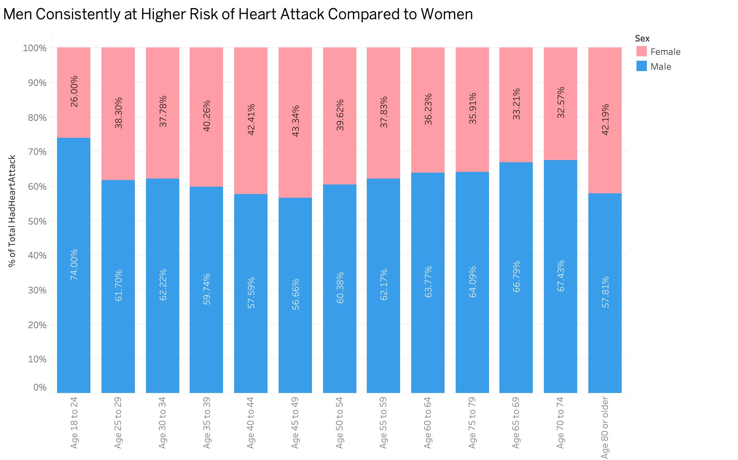
HEART ATTACK TRENDS ACROSS AGE GROUPS AND GENDER
Key Insights
Indicates gender-specific risk factors with age
Mens’ risk of heart attack is highest under the age of 25 and after 65
Womens’ heart attack rates are highest between 40 and 50
Notes:
Arpa
Age and gender brought some fascinating trends to light. For men, the risk of heart attacks peaks under 25 and after 65, while for women, it’s highest between 40 and 50. These findings made us pause—why do these age groups stand out? They suggest life stages where stress, hormonal changes, or underlying health conditions may play a role. It’s personal for me because it aligns with what I’ve seen in my own family history, and it emphasizes the importance of early intervention.

Slide 8
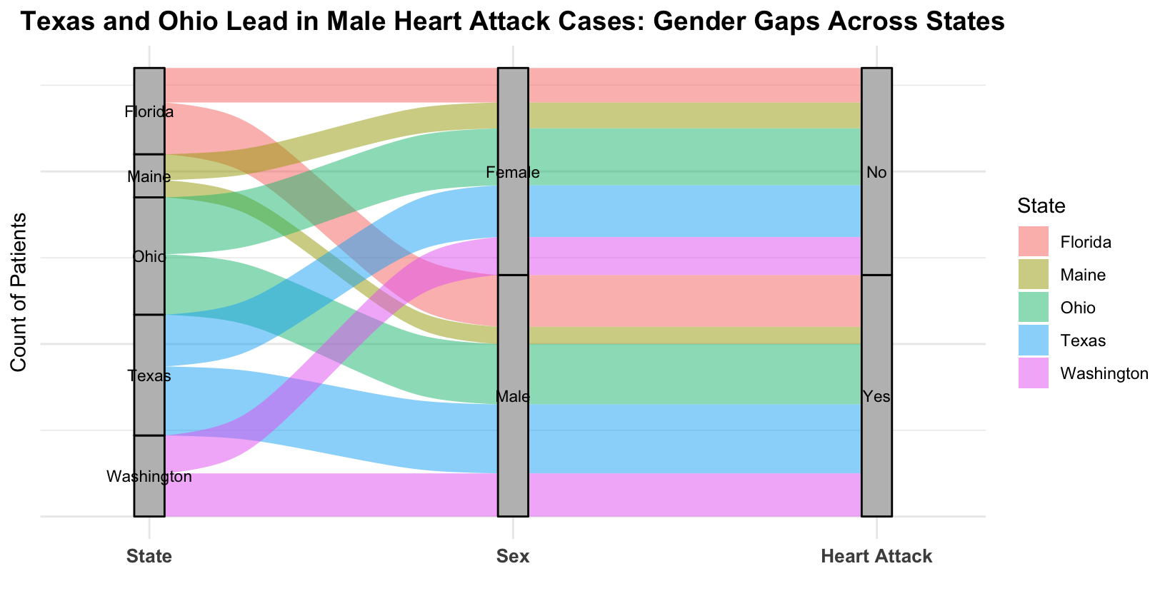
HEART ATTACKS ACCOUNTING FOR GENDER AND LOCATION
Key Insights
Texas has the highest male heart attack rates compared to the other states
Across all states, men are at a higher risk for heart attacks compared to women
Indicates that gender and location can increase likelihood of heart attack
Notes:
Texas and Ohio contribute significantly to the "Yes" category for heart attacks, indicating higher numbers of heart attack occurrences compared to the other states.
Across all states, males show a stronger flow toward the "Yes" (heart attack) category, suggesting a higher prevalence of heart attacks among men compared to women.
Florida and Washington have relatively balanced distributions between "Yes" and "No" for heart attacks, with no apparent strong gender bias.
Arpa
Digging deeper into gender and location, we found that men consistently face higher risks across all states, with Texas having the highest male heart attack rates. This raises critical questions about how societal and environmental factors interplay with gendered health risks.

Slide 9
IMPACT OF ALCOHOL AND SMOKING ON HEART ATTACKS

Slide 10
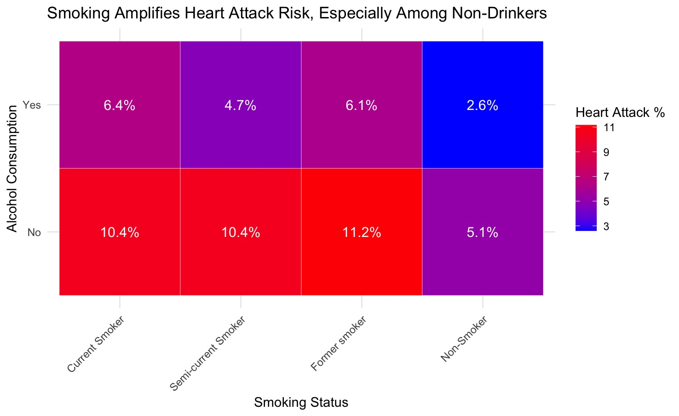
IMPACT OF SMOKING AND ALCOHOL ON HEART ATTACK RISK
Key Insights
Highest heart attack rates are among those who have smoked
Non-smokers reduce likelihood of a heart attack by almost 50%
Interesting to see how alcohol seems to reduce chances of heart attack – need for more research
Notes:
Not smoking can reduce chances of heart attack by about 50%
Research shows that moderate drinkers are a lower risk due to raised levels of good cholesterol which prevent artery damage, but heavy drinkers are at increased risk

Slide 11
CLINICAL CONDITIONS CONTRIBUTING TO HEART ATTACKS

Slide 12
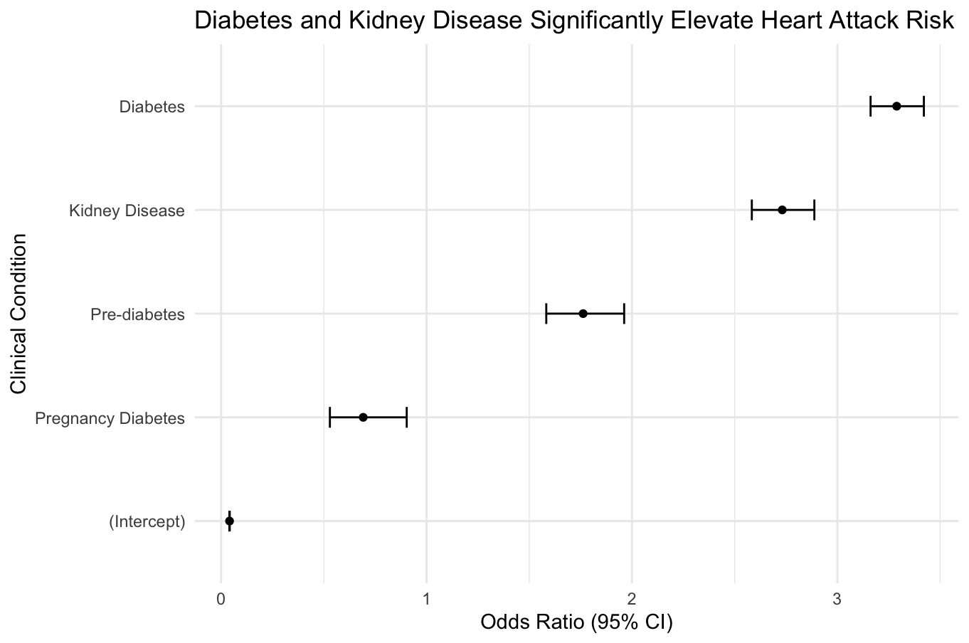
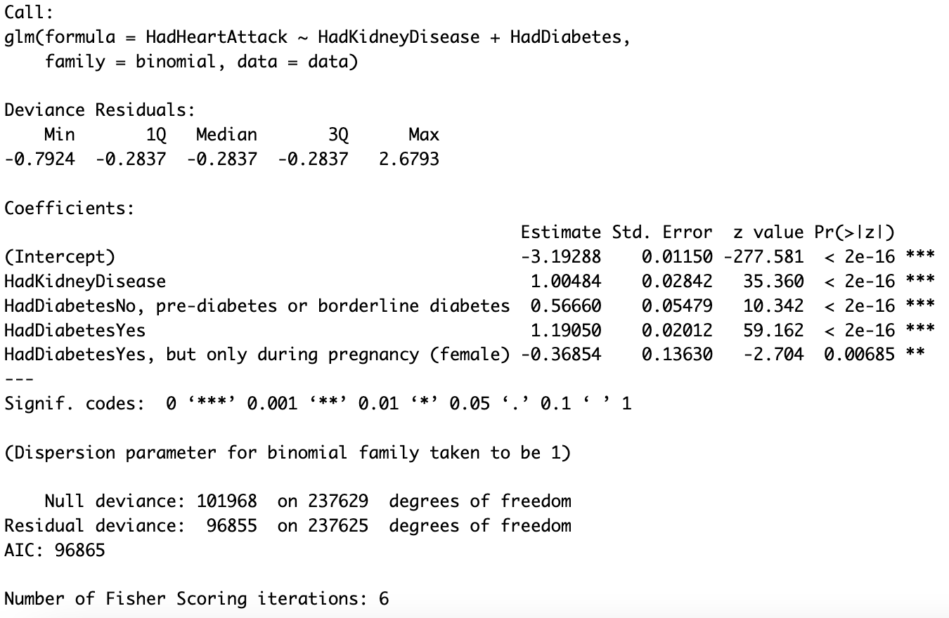
INFLUENCE OF KIDNEY DISEASE AND DIABETES ON HEART ATTACK RISK
Key Insights
Highest odds ratios for diabetes and kidney disease
Pre-diabetes has moderate and gestational diabetes has no statistically significant association with heart attack risk
Notes:
Small intercept indicates that baseline likelihood of having a heart attack is pretty low
Kidney disease and diabetes have a significantly elevated risk of heart attack
Pre diabetes has a moderate risk while gestational diabetes actually seems to be negatively associated, reducing heart attack risk which prompts further research

Slide 13
CONCLUSIONS
Men typically face higher risks of heart attack compared to women, across locations and all ages
Lifestyle choices, such as alcohol and smoking, can increase patients’ chances of heart attack
Understanding patients’ history with diabetes and kidney disease can help predict their likelihood of having heart attack
Analyzing these relationships can aid in establishing measures to prevent heart attack and improve patient outcomes
Notes:
Arpa
To wrap up, here are the key takeaways. Men face consistently higher risks than women, and these risks are influenced by both geography and lifestyle choices. Smoking remains a critical factor, while the role of alcohol requires further study. Finally, understanding a patient’s history of diabetes or kidney disease can provide crucial insights into their heart health. For me, working on this project has been more than an academic exercise—it’s been an opportunity to explore how data can lead to better health outcomes for people like my own family and yours.

Slide 14
Thank you!
Questions?

