Slide 1
IBM CAPSTONE PROJECT – The Battle of Neighborhoods: Cluster Analysis of London Real Estate Market

Slide 2
Business problem section
London Housing Market is in a rut:
Brexit
Hidden price falls
Record-low sales
Homebuilder exodus
Tax hikes addressing overseas buyers of homes in England and Wales.

Slide 3
Business prolem
How could we provide support to homebuyers clientele in to purchase a suitable real estate in London in this uncertain economic and financial scenario?

Slide 4
Solution
Clustering London neighborhoods in order to recommend venues and the current average price of real estate where homebuyers can make a real estate investment.

Slide 5
Data and methodology
Data: merging data on London properties and the relative price paid data from the HM Land Registry and data on amenities and essential facilities surrounding such properties from Four-Square API interface.
Methodology:
Collect Inspection Data;
Explore and Understand Data;
Data preparation and preprocessing;
Modeling

Slide 6
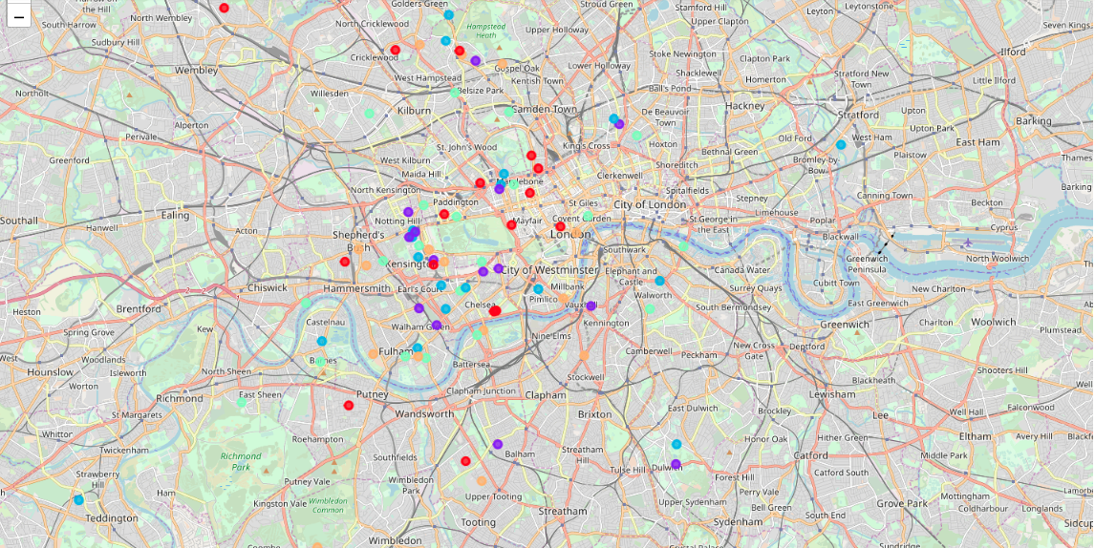
K-Means clustering

Slide 7
Out-come:
Examination of real estates according to neighborhoods/London areas
West London (Notting Hill, Kensington, Chelsea, Marylebone) and North-West London (Hampsted) might be considered highly profitable venues to purchase a real estate;
South-West London (Wandsworth, Balham) and North-West London (Isliington) are arising as next future elite venues with a wide range of amenities and facilities.
Examination of real estates by clusters
Clusters 0, 2 and 4 may target home buyers prone to live in 'green' areas with parks, waterfronts;
Clusters 1 and 3 may target individuals who love pubs, theatres and soccer.

