Slide 1
Application learning for children
In this application
You read information about some things then you solve questions about it and you will obtain your grade.

Slide 2
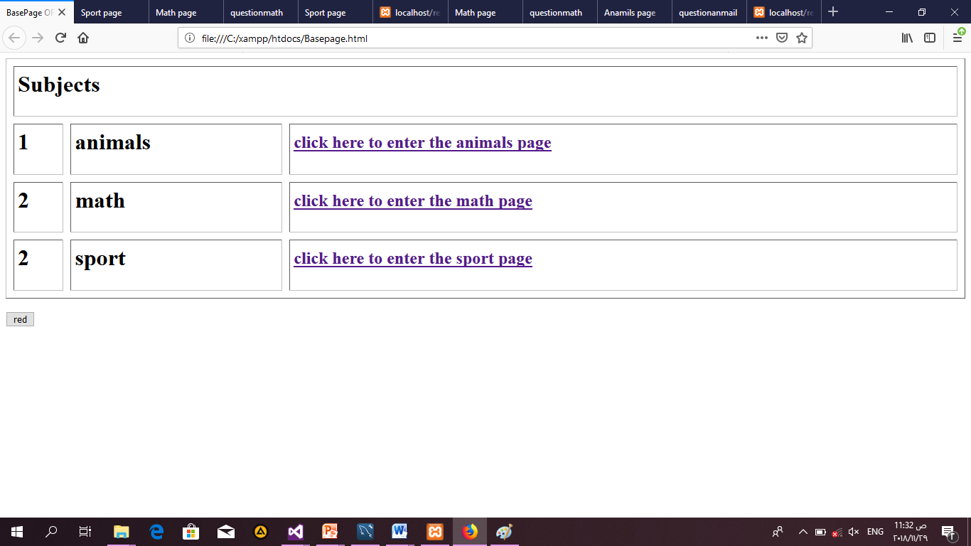
The BasePage
You will find three links can choose one of this links

Slide 3
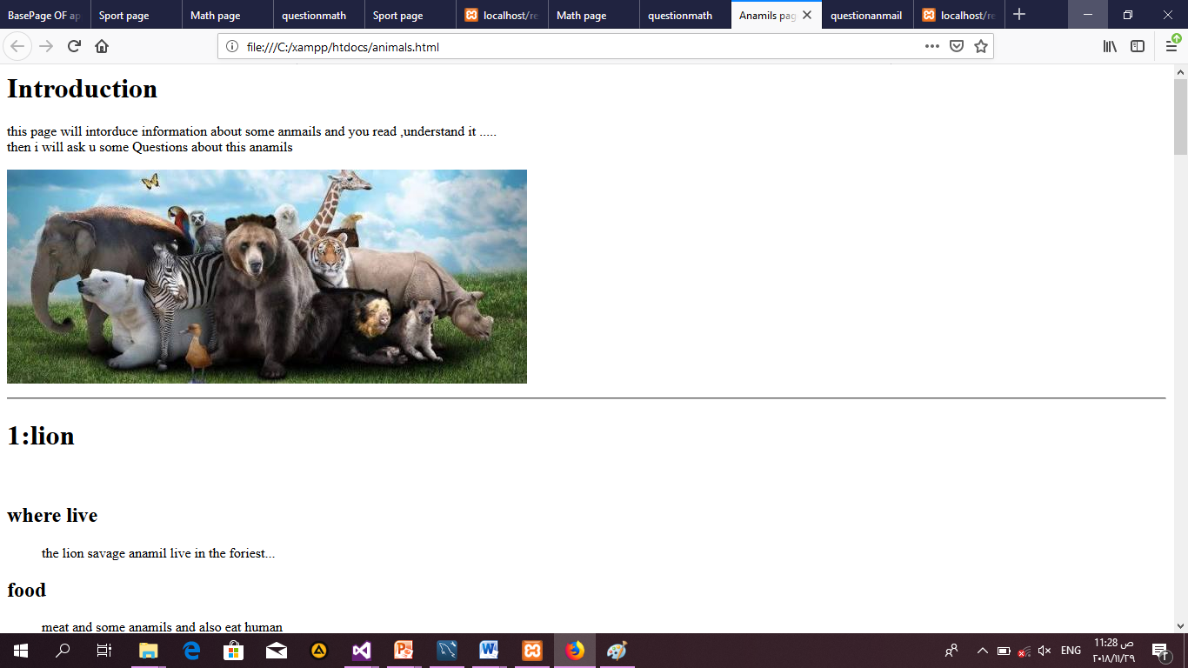
The Animalpage
Contain information about some animals the end of it link of questions
About this information

Slide 4
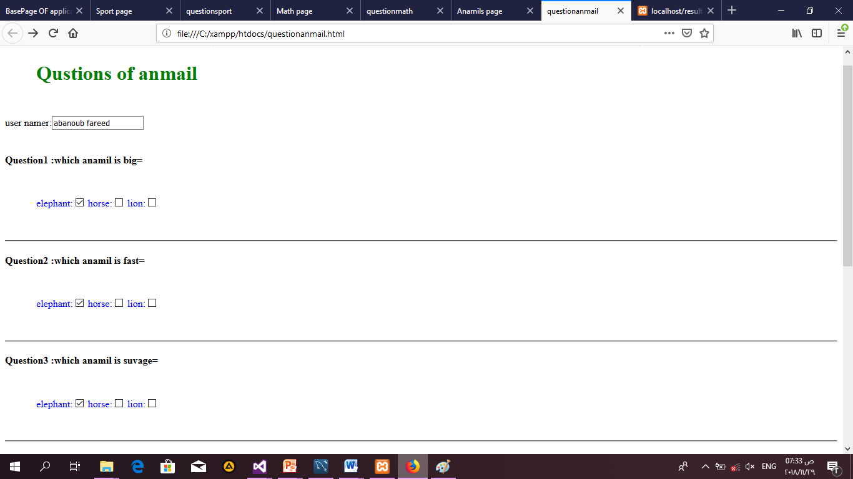
Questionanimalpage
Enter your name and
Choose the correct answer

Slide 5
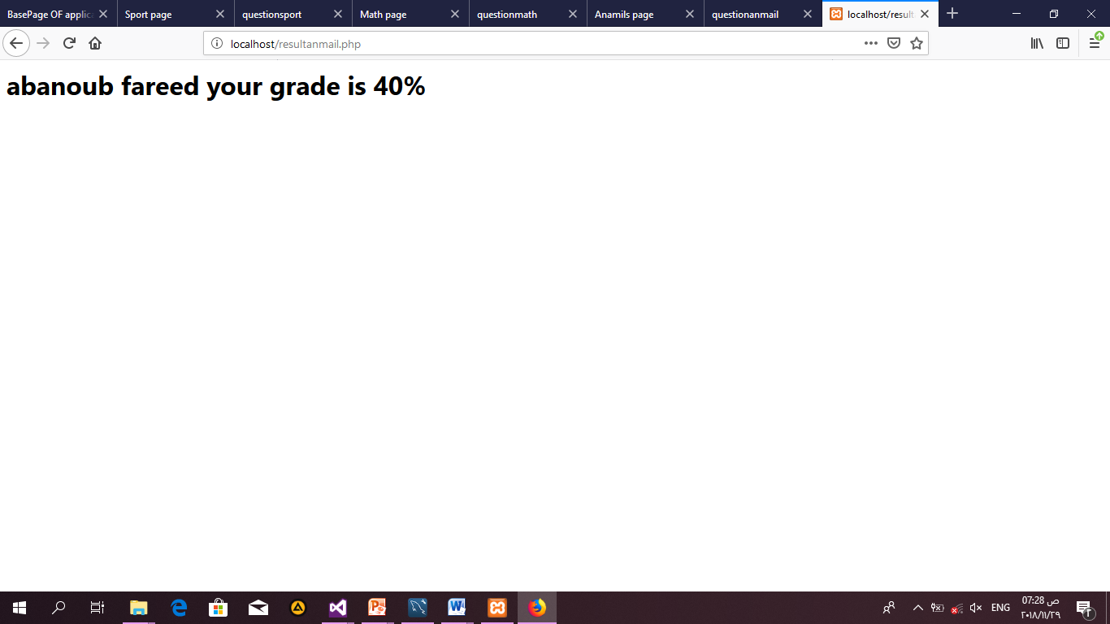
resultanmail.php page
Print Your grade

Slide 6
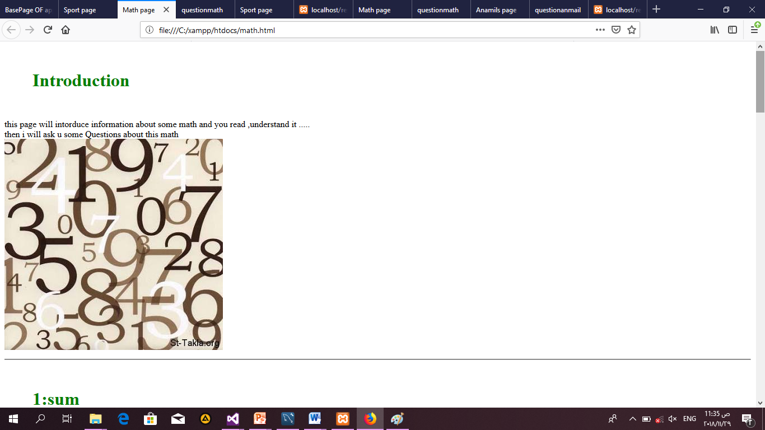
The mathpage
Contain information about some math the end of it link of questions
About this information

Slide 7
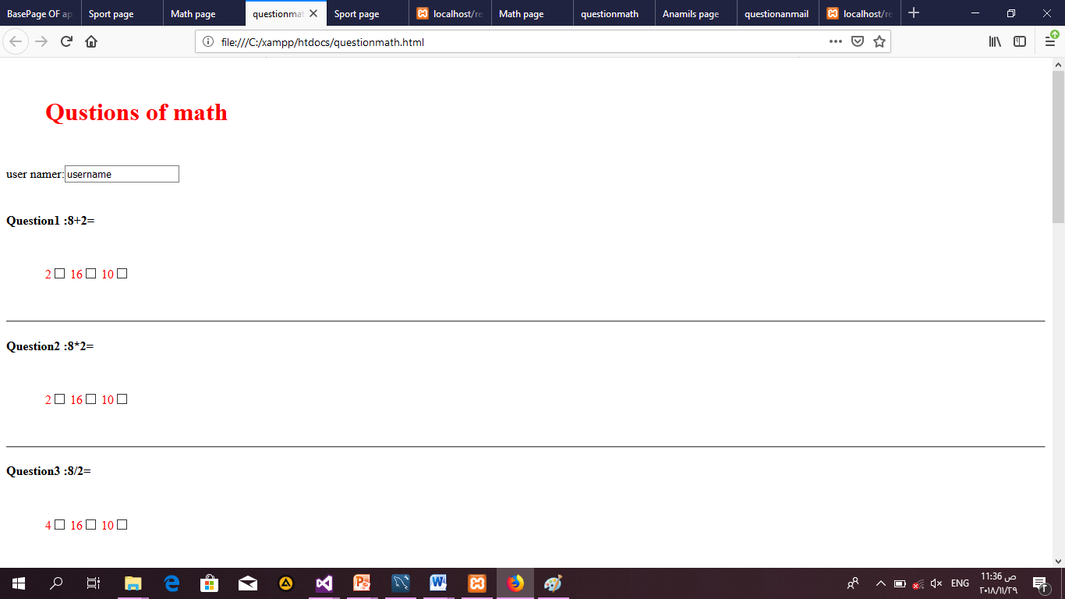
Quesmathpage
Enter your name and
Choose the correct answer

Slide 8
resultmath.php page
Print Your grade

Slide 9
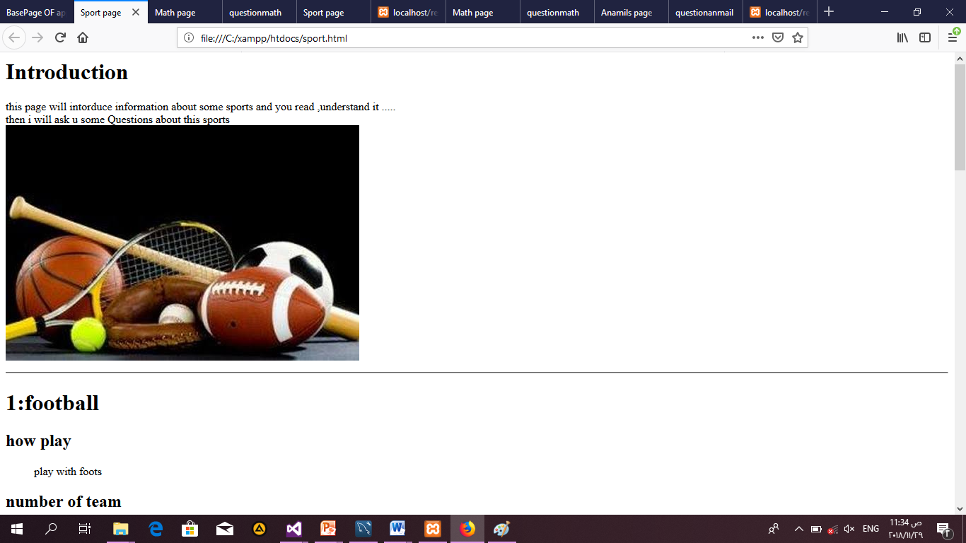
The sport page
Contain information about some sport the end of it link of questions
About this information

Slide 10
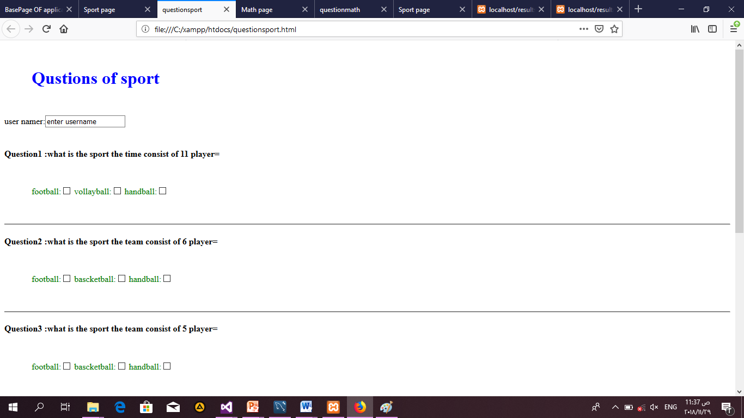
Quessportpage
Enter your name and
Choose the correct answer

Slide 11
resultsport.php page
Print Your grade

