Slide 1

Grokking
Algorithms

Slide 2
Chapter 1
Introduction To Algorithms

Slide 3
In THIS CHAPTER
1- You get a foundation for the rest of the book
2- You write first search algorithm (binary search)
3- You learn how you talk about the running time of an algorithm (big O notation)
4-You are introduced a common technique for designing algorithms (recursion)

Slide 4
Introduction
An algorithm : is a set of instruction for accomplishing a
task
An algorithm is a procedure used for solving a problem or performing a computation. Algorithms act as an exact list of instructions that conduct specified actions step by step in either hardware- or software-based routines.

Slide 5
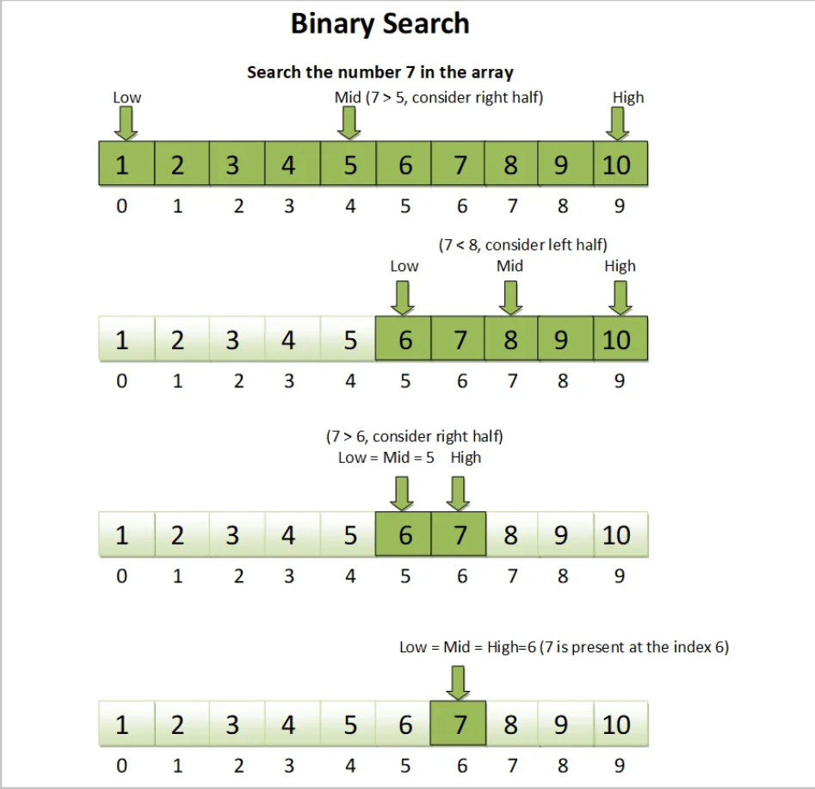
Binary Serarch
Binary search is an algorithm ,
its input is a Sorted List of elements
Binary search returns the position
where it Is located the element
Otherwise :binary search returns null

Slide 6
(stupid search) Simple Search
To search about item in array of elements by simple search you guess 9 elements by compare each element with item i have to guess
If I was search of number 9 its takes 9 steps
1
2
3
4
5
6
7
8
9
no
no
no
no
no
no
no
no
yes

