Slide 1
RUN 2.0
Welcome!
Hi NASA

Slide 2

Build A Junior Astronaut Mission Trainer

Slide 3


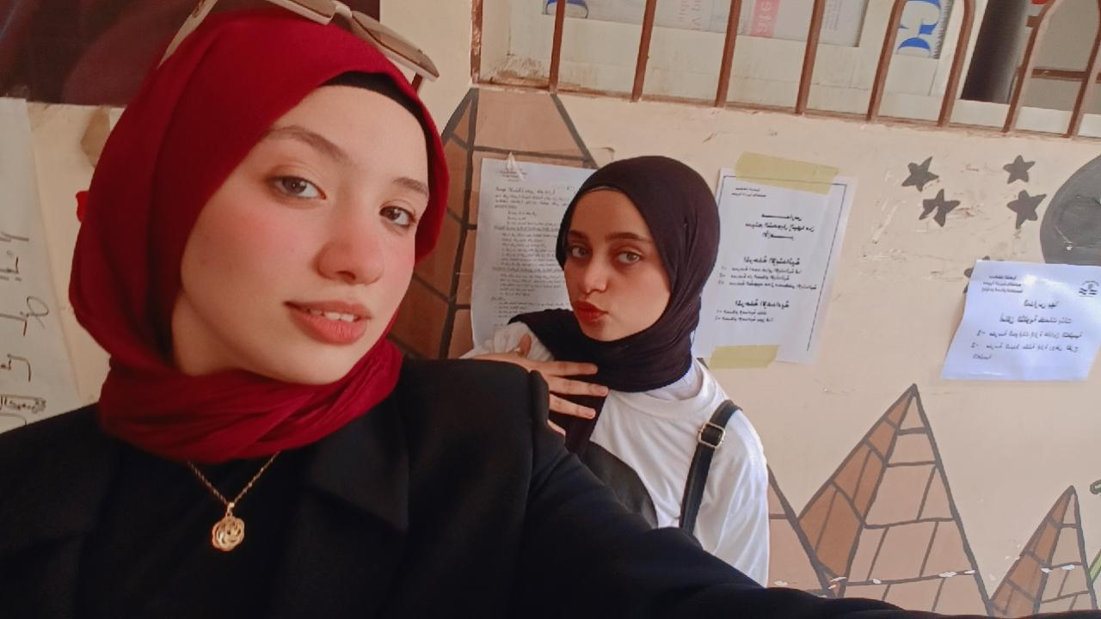



MEET THE TEAM
Reem Mohamed
Abanoub Wagim
Roqia Mahmoud
Kareem Mohamed
Fadwa Mohamed
Nour Amin
abanoubd

Slide 4
Reasons for choose the project
01
02
03
Transform gaming time into active learning, allowing kids to manage a lunar base themselves
Bridge the gap between complex space science and fun by turning NASA facts into an immersive 4-day lunar adventure
Adopt a playful, interactive tone to get them ready for the critical decisions and challenges ahead

Slide 5
WHAT
WE’RE
ABOUT
*More Than a Game. A Mission to Survive.*
MoonBase is an interactive space survival game that challenges young explorers to make critical decisions, solve problems, and experience the challenges of living on the Moon.
Over four mission days, players face unexpected emergencies, manage limited resources, and discover how science and smart decisions can make the difference between success and failure.
Inspired by real space exploration and NASA knowledge, MoonBase turns learning into an exciting mission where every decision matters.
Think Smart. Solve Problems. Survive the Mission.

Slide 6
MoonBase :
4 Days to Survive
Our application is designed for young people and children, ranging from 8 to 12 years old; those who are older are also welcome to use it if they wish.
Run 2.0
Welcome aboard!

Slide 7
SURVIVAL CHALLENGES & THREATS
DAY 1: POWER GRID FAILURE
Energy Collapse: Solar panel system failed, threatening base operations and oxygen generation.
DAY 2: DUST STORM & WATER SHORTAGE
Resource Depletion: A severe lunar dust storm blocked solar input and cut off access to water reserves.
DAY 3: CRITICAL OXYGEN LEAK
Hull Breach: Sudden pressure drop and oxygen leak inside the habitat, risking crew suffocation.
DAY 4: EXTREME FATIGUE & SYSTEM SURVIVAL
Crew Exhaustion: Critical depletion of food/stamina while waiting for emergency extraction.

Slide 8
HOW YOU PLAY & LEARN
Three things every young explorer does during the four-day mission.
Ages 8–12
STEP 01
STEP 02
STEP 03
Decide fast: every emergency, from a power cut to an oxygen leak, needs a smart choice.
Manage limited resources: keep power, water, oxygen and food balanced across the days.
Learn real science: NASA-inspired facts show why each choice works or fails.

Slide 9
PROBLEM & SOLUTION
Space science feels distant to kids,
so MoonBase turns it into play.
Pain points
Solutions
THE PROBLEM
WE ARE
SOLVING
Space science feels complex
Facts are hard to remember
Simple NASA-inspired stories
Facts tied to each emergency
Complex space science is hard for kids to connect with, and gaming time is often passive.
Each pain point is matched by a MoonBase solution.
Screen time is passive
Lectures bore kids
Learning by doing
Playful, interactive tone
Real decisions feel far away
Learning feels like homework
Manage a lunar base yourself
Four short mission days

Slide 10
NEXT
STEPS
1.PLAYTEST
Test the four-day mission with kids aged 8 to 12 and collect their feedback.
2.EXPAND
Add more missions and NASA-based facts beyond the first four days.
Where MoonBase goes after the hackathon.
3.LAUNCH
Share MoonBase publicly so young explorers can play anywhere.

Slide 11
THANK
YOU
Thank you, NASA, for the chance to build MoonBase. Think smart, solve problems, survive the mission!
Bye!

