Slide 1
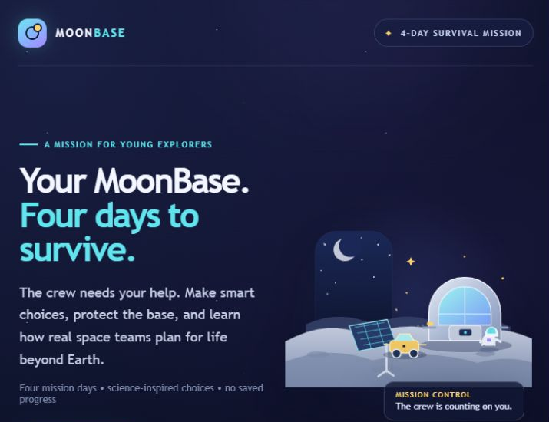
NASA SPACE APPS CHALLENGE 2026
MoonBase
4 Days to Survive
Build a Junior Astronaut
Mission Trainer
An interactive lunar survival game for young explorers ages 8–12.
TEAM RUN 2.0
Independent educational project · not a NASA product
THE CHALLENGE / JUNIOR ASTRONAUT MISSION TRAINER
Notes:
RUN 2.0 presents MoonBase: 4 Days to Survive, an independent educational entry for NASA Space Apps Challenge 2026, Junior Astronaut Mission Trainer. The project is not an official NASA product and is not endorsed or validated by NASA. The screenshot is from the actual local game welcome screen.

Slide 2
01 / THE TEAM
Meet Team RUN 2.0
Six team members · responsibilities are shown only where project records support them
TEAM MEMBERS
VERIFIED PROJECT OUTPUTS
01
04
• Browser game: HTML, CSS, JavaScript
• Rules API: Java and Spring Boot
• Game rules, science references, and judges' technical briefing
• Automated test suites and recorded browser walkthrough
Reem Mohamed
Abanoub Wagim
02
05
Roqia Mahmoud
Kareem Mohamed
03
06
Fadwa Mohamed
Nour Amin
The project files do not assign individual responsibilities. We list the team together rather than inventing role labels.
RUN 2.0 · MOONBASE: 4 DAYS TO SURVIVE
02
Notes:
The original project presentation supplies the six names shown. The repository verifies the shared project artifacts: a static HTML/CSS/JavaScript game frontend, a Java/Spring Boot API and rules engine, game/science documentation, automated tests, and a recorded browser walkthrough. No source record maps individual members to specific responsibilities; the deck does not infer individual roles.

Slide 3
02 / THE DESIGN CHALLENGE
Make connected systems visible
A design question—not a claim that learning outcomes have already been measured
How can an 8–12-year-old see that power, water, food and shelter depend on one another?
POWER
WATER
FOOD
SHELTER
runs habitat
and equipment
↔
crew supply
& recycling
↔
daily use
& grow tray
↔
readiness for
final alert
Every choice changes the same mission ledger; some effects arrive later.
RUN 2.0 · MOONBASE: 4 DAYS TO SURVIVE
03
Notes:
The project addresses a design question: whether a short interactive mission can make linked resource trade-offs concrete for children ages 8–12. The deck presents this as an intended design goal only. No child user study or learning-outcome measurement is documented.

Slide 4
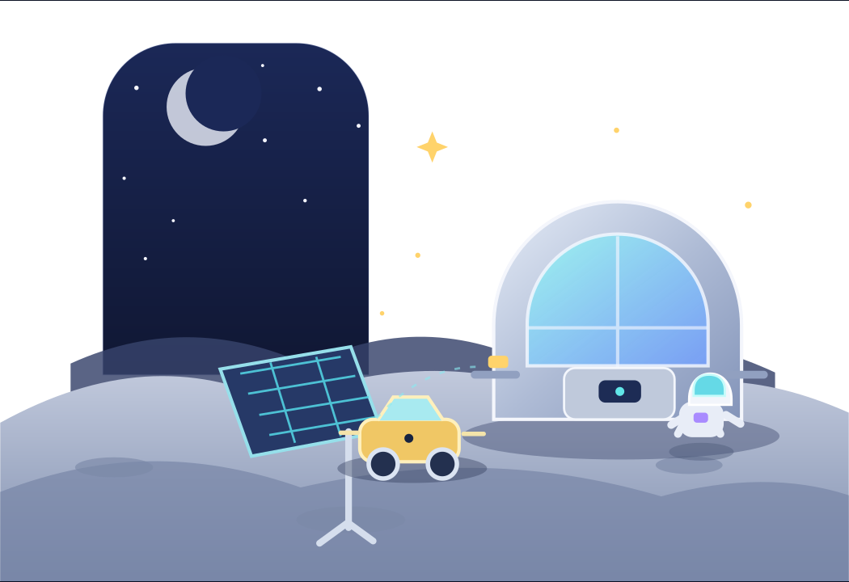
03 / OUR SOLUTION
A four-round mission for ages 8–12
Science-inspired choices with an explicit boundary between NASA evidence and game rules
01
Read the event
Each day introduces a new mission-planning situation.
02
Choose one plan
Compare an immediate cost with a possible later benefit.
03
See the ledger
Mission Control returns a server-calculated change for every resource.
04
Connect to NASA
Short science signals link each theme to a NASA source.
ORIGINAL ART FROM THE PROJECT
RUN 2.0 · MOONBASE: 4 DAYS TO SURVIVE
04
Notes:
MoonBase is a browser-based, four-planning-round educational game. The frontend displays backend-provided event choices and resource outcomes. It is an independent project; NASA source links inform themes and do not imply NASA endorsement or validation.

Slide 5
04 / HOW THE GAME WORKS
One loop, repeated across four days
Each in-game day is a planning round, not a real Earth day or lunar daylight cycle
01
02
03
04
Challenge
→
Decision
→
Recalculate
→
Feedback
Read the event and science signal.
Choose one available crew plan.
Backend replays the full choice history.
Review daily, delayed, event and choice effects.
If any resource reaches 0, the run ends; after Day 4, Shelter readiness must be at least 6.
RUN 2.0 · MOONBASE: 4 DAYS TO SURVIVE
05
Notes:
The backend is the single rules engine. For each submitted ordered history it recomputes from the canonical Day 1 values, validates choices, applies the deterministic rules, clamps each integer resource to 0–12, and returns the event or result plus a breakdown. A zero Power, Water, or Food ends the mission on that day. Success after Day 4 requires Power, Water, and Food above zero and Shelter readiness at least 6. There is no random event, score, rescue, extra day, database, or saved progress.

Slide 6
05 / RESOURCE MANAGEMENT
Four game meters · one shared budget
All quantities are integer game values on a 0–12 scale, not engineering units
STARTING SUPPLIES
WHAT CHANGES EACH ROUND
Power
12 / 12
Daily use: Power −2 · Water −2
Food −2 · Shelter readiness −1
Water
12 / 12
Some choices pay back later
Array plan → Power on Days 2–4
Recycler service → Water on Days 3–4
Grow tray → Food on Day 4
Shelter prep → no readiness wear Days 2–4
Food
10 / 12
Shelter readiness
8 / 12
Before + Daily + Scheduled + Event + Choice → clamp 0–12
RUN 2.0 · MOONBASE: 4 DAYS TO SURVIVE
06
Notes:
Canonical initial values are Power 12, Water 12, Food 10, and Shelter readiness 8. Every resource is an integer from 0 to 12. Daily needs subtract 2 Power, 2 Water, and 2 Food; shelter readiness loses 1 except when Day 1 shelter preparation prevents wear on Days 2–4. Delayed effects: array cleaning adds Power +1 on Days 2–4; recycler service returns Water +1 on Days 3–4; grow tray adds Food +3 on Day 4. For every resource and day: After = clamp(Before + Daily + Scheduled + Event + Choice, 0, 12). These are game-only balance values, not NASA specifications.

Slide 7
06 / MISSION PROGRESSION
Four days · four planning challenges
Event names and choice effects below match the running game
DAY 1
DAY 2
DAY 3
DAY 4
Dust on the solar array
The water loop needs care
Fresh food for the crew
A solar storm warning
Clean array: −1 Power now; +1 on Days 2–4.
Spare battery: +1 Power now.
Prepare shelter: −1 Power, +2 readiness; removes readiness wear Days 2–4.
Service recycler: −1 Power, +1 Water now; +1 Water on Days 3–4.
Backup pack: −3 Power, +5 Water now (capped at 12).
Start LED grow tray: −2 Power, −1 Water; +3 Food on Day 4.
Open meal crate: +3 Food now; no later harvest.
Solar-particle alert: −2 Shelter readiness.
Full setup: −1 Power, +4 readiness.
Low-power plan: no Power cost, +2 readiness; relies on earlier preparation.
RUN 2.0 · MOONBASE: 4 DAYS TO SURVIVE
07
Notes:
The event text and selectable effects are taken from the actual rules service and live game. A Day is a planning round, not one Earth day or lunar daylight cycle. On Day 4 the implemented event is named 'A solar storm warning' and its narrative identifies a solar-particle alert. The app does not model atmospheric weather or an Earth-style lunar dust storm. All costs, bonuses, timing and thresholds are game-only values. NASA science caveats are on Slide 8. Sources: NASA NTRS lunar dust report https://ntrs.nasa.gov/citations/20240003496 ; NASA ISS water recovery https://www.nasa.gov/missions/station/nasa-achieves-water-recovery-milestone-on-international-space-station/ ; NASA Advanced Plant Habitat https://science.nasa.gov/mission/advanced-plant-habitat/ ; NASA Orion shelter article https://science.nasa.gov/science-research/heliophysics/how-nasa-will-protect-astronauts-from-space-radiation-at-the-moon/.

Slide 8
07 / SCIENCE BEHIND THE GAME
NASA evidence inspires themes; game values stay fictional
Qualitative science cues are sourced; the simulation is not an engineering model
[1] DUST & POWER
NASA documents lunar dust adhesion and array risks. The game's 'clean array' benefit is invented; NASA warns manual brushing can worsen damage.
MODEL BOUNDARY
No real engineering units.
No lunar habitat design.
No radiation dose, shielding thickness, crop yield, or recovery efficiency calculation.
[2] WATER RECOVERY
The ISS demonstrated a 98% recovery goal. MoonBase's Water points do not use that percentage and are not a lunar system.
[3] PLANT GROWTH
NASA's Advanced Plant Habitat uses LEDs and controlled water/nutrients. A one-turn game harvest compresses real growth time.
[4–5] LIFE SUPPORT & SHELTER
NASA ECLSS manages pressure, oxygen, air and water; MoonBase has no oxygen or pressure meter. NASA's Orion supplies shelter is a concept; readiness points are not a dose or shielding estimate.
NASA sources support the science themes; they do not endorse or validate MoonBase.
[6] LUNAR ENVIRONMENT
The Moon has a thin exosphere; lunar 'weather' comes from space. Day 4 is a particle alert, not an atmospheric dust storm.
RUN 2.0 · MOONBASE: 4 DAYS TO SURVIVE
08
Notes:
Scientific claims and their sources: [1] NASA/TM-20240003496, Lunar Dust Considerations for Vertical Solar Arrays Vol. 1, published 1 Oct 2024, https://ntrs.nasa.gov/citations/20240003496. The report describes dust adhesion/abrasion and risks to exposed array surfaces; its PDF warns that manual brushing can damage arrays and is not recommended. The game's clean-array action is a fictional choice and should not be treated as a real cleaning recommendation. [2] NASA, NASA Achieves Water Recovery Milestone on International Space Station, 20 Jun 2023, https://www.nasa.gov/missions/station/nasa-achieves-water-recovery-milestone-on-international-space-station/. The 98% goal was demonstrated by ISS ECLSS; no game Water value represents 98% recovery. [3] NASA Science, Advanced Plant Habitat, https://science.nasa.gov/mission/advanced-plant-habitat/. The ISS facility uses LED lights and controlled delivery of water/nutrients; Day 4 harvest is compressed game time. [4] NASA, Environmental Control and Life Support Systems, https://www.nasa.gov/reference/environmental-control-and-life-support-systems-eclss/. ECLSS controls pressure, oxygen, ventilation, waste and water; MoonBase tracks no oxygen or pressure. [5] NASA Science, How NASA Will Protect Astronauts From Space Radiation at the Moon, 7 Aug 2019, https://science.nasa.gov/science-research/heliophysics/how-nasa-will-protect-astronauts-from-space-radiation-at-the-moon/. NASA describes a representative Orion temporary shelter using onboard supplies during an SEP event; this is not a lunar base design. Game Shelter readiness 0–12 is abstract, not dose or shielding. [6] NASA Science, Weather on the Moon, https://science.nasa.gov/moon/weather-on-the-moon/. NASA explains the Moon's exosphere is too thin for Earth-like weather; lunar weather comes from space. The game uses a solar-particle alert and does not model an atmospheric dust storm. No NASA endorsement or validation is claimed.

Slide 9
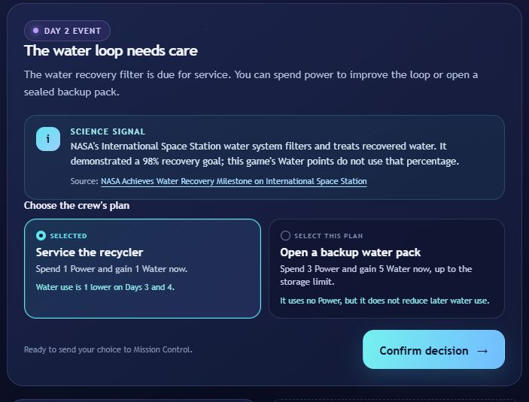
08 / LIVE GAMEPLAY
A real Day 2 choice in the running game
The selected path trades power now for water now and later
MISSION STATE BEFORE THE CHOICE
Power 11 · Water 10
Food 8 · Shelter readiness 7
SERVICE THE RECYCLER
Spend 1 Power, gain 1 Water now, then use 1 less Water on Days 3 and 4.
ALTERNATIVE
Backup pack: spend 3 Power for 5 Water now (capped at 12), with no later reduction in Water use.
RUN 2.0 · MOONBASE: 4 DAYS TO SURVIVE
09
Notes:
Screenshot captured from the actual running game on 27 Oct 2026. The Day 2 state followed Day 1's Connect the spare battery choice: Power 11, Water 10, Food 8, Shelter readiness 7. The service choice spends 1 Power and gains 1 Water immediately, then reduces Water use by one game unit on Days 3 and 4. Alternative backup pack costs 3 Power and adds 5 Water up to the 12 maximum, with no later water-use reduction. The in-game science signal references NASA's ISS water recovery milestone: https://www.nasa.gov/missions/station/nasa-achieves-water-recovery-milestone-on-international-space-station/. Its 98% figure is explicitly not applied to game values.

Slide 10
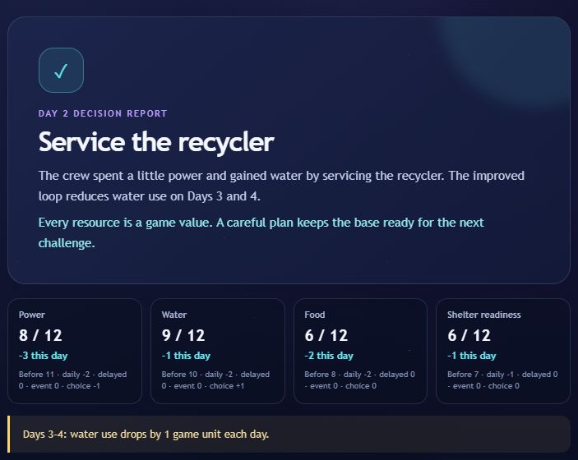
09 / DECISION FEEDBACK
Mission Control shows the cost and payoff
The game returns a breakdown instead of hiding the resource arithmetic
SERVER-CALCULATED RESULT
Power
11 → 8
−2 daily · −1 choice
Water
10 → 9
−2 daily · +1 choice
Food
8 → 6
−2 daily
Shelter readiness
7 → 6
−1 daily
Carry-over: Water use is 1 lower on Days 3–4. All values remain game units.
RUN 2.0 · MOONBASE: 4 DAYS TO SURVIVE
10
Notes:
Authentic Day 2 feedback screenshot captured in the live local browser. The exact returned result was Power 8/12 (Before 11; daily −2; choice −1), Water 9/12 (Before 10; daily −2; choice +1), Food 6/12 (Before 8; daily −2), Shelter readiness 6/12 (Before 7; daily −1). The server also scheduled Water use one game unit lower on Days 3 and 4. This example is from the actual battery → recycler route, not the separate documented worked route that cleans the array.

Slide 11
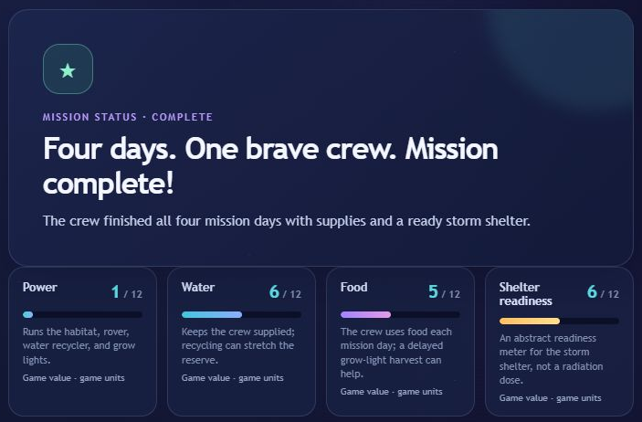
10 / MISSION OUTCOME
A complete four-day run, captured from the game
This is the route demonstrated in the screenshots
DEMONSTRATED CHOICES
Day 1 · Connect spare battery
Day 2 · Service recycler
Day 3 · Start LED grow tray
Day 4 · Full shelter setup
FINAL GAME VALUES
Power 1 · Water 6
Food 5 · Readiness 6
A successful run; not a real survival forecast.
RUN 2.0 · MOONBASE: 4 DAYS TO SURVIVE
11
Notes:
Actual final result captured in local browser after the sequence Connect the spare battery → Service the recycler → Start the LED grow tray → Power the full shelter setup. The live game declared mission complete and returned (Power 1, Water 6, Food 5, Shelter readiness 6), all game-value units. This path differs from the canonical worked path in docs/GAME_RULES.md (which begins with clean_solar_array and ends at (2,6,5,6)); both satisfy the implemented success criteria. No real lunar-survival or engineering performance is implied.

Slide 12
11 / LEARNING DESIGN
What players are invited to practice
Intended learning objectives · no child study or outcome measurement is documented
01
Track connected supplies
02
Compare now with later
Notice that energy, water, food and shelter readiness share one mission budget.
Weigh an immediate cost against a scheduled benefit on a future round.
03
Read the evidence
04
Separate fact from model
Use the feedback breakdown to explain how a choice changed the state.
Recognize NASA science themes while questioning simplified game values.
These are goals for play, not measured learning gains.
RUN 2.0 · MOONBASE: 4 DAYS TO SURVIVE
12
Notes:
Learning objectives are inferred from the implemented choices, resource descriptions, feedback, and end-of-mission learning takeaways. They are intended outcomes, not measured results. No child user study or formal learning assessment is documented.

Slide 13
12 / IMPLEMENTATION & CHECKS
A small, stateless rules service powers the game
Technology and test evidence confirmed in project files
IMPLEMENTATION
EVIDENCE ON RECORD
Backend: 9 tests passed
Frontend: 3 tests passed
Recorded local browser walkthrough
FRONTEND
API
RULES ENGINE
HTML · CSS
Vanilla JavaScript
→
JSON requests
Full choice history
→
Java 17
Spring Boot 4.1.2
Reported in project docs; not rerun for this deck.
Backend owns decisions and totals; no database, account, or saved progress.
VALIDATION BOUNDARIES
This presentation task: local app health check, complete live winning route, and authentic screenshots.
Local demo only; no public deployment URL is documented.
Not documented: child study, NASA validation, public deployment, or performance measurements.
The game is an educational model, not an engineering simulator.
RUN 2.0 · MOONBASE: 4 DAYS TO SURVIVE
13
Notes:
README and source confirm a plain static HTML/CSS/vanilla JavaScript frontend and a Java 17 Spring Boot 4.1.2 backend. The backend replays the complete ordered history and owns resource calculations and outcomes. No database/accounts/saved mission progress are used. docs/JUDGES_BRIEFING.md records backend 9 tests passed, frontend 3 tests passed, and a browser walkthrough/responsive checks. These tests were not rerun for this deck. During this presentation task the local health route returned UP and a full successful route was completed in the local browser; that live verification used a different successful route than the docs' clean-array path. No child study, NASA endorsement/validation, public deployment URL, production-origin CORS test or performance measurement is documented. Local app only, URL http://127.0.0.1:5500/html/ is not public.

Slide 14
13 / SOURCES
NASA references used in this presentation
Select a title in PowerPoint to open the official source
[1] Lunar Dust Considerations for Vertical Solar Arrays · Vol. 1
[4] Environmental Control and Life Support Systems
NASA Technical Reports Server · 2024 · dust, adhesion, array risks
NASA · atmospheric pressure, oxygen, air, water and waste
[2] NASA Achieves Water Recovery Milestone on the ISS
[5] How NASA Will Protect Astronauts From Space Radiation at the Moon
NASA · 20 Jun 2023 · ISS ECLSS water recovery
NASA Science · Orion shelter concept and solar-particle events · 2019
[3] Advanced Plant Habitat
[6] Weather on the Moon
NASA Science · LEDs and controlled plant research
NASA Science · the exosphere and weather from space
Sources checked 27 October 2026 · NASA sources support themes only; game values are invented balancing rules.
RUN 2.0 · MOONBASE: 4 DAYS TO SURVIVE
14
Notes:
1. NASA/TM-20240003496, Lunar Dust Considerations for Vertical Solar Arrays Volume 1: Lunar Environment and Dust Interactions (1 Oct 2024): https://ntrs.nasa.gov/citations/20240003496
2. NASA, NASA Achieves Water Recovery Milestone on International Space Station (20 Jun 2023): https://www.nasa.gov/missions/station/nasa-achieves-water-recovery-milestone-on-international-space-station/
3. NASA Science, Advanced Plant Habitat: https://science.nasa.gov/mission/advanced-plant-habitat/
4. NASA, Environmental Control and Life Support Systems (ECLSS): https://www.nasa.gov/reference/environmental-control-and-life-support-systems-eclss/
5. NASA Science Editorial Team, How NASA Will Protect Astronauts From Space Radiation at the Moon (7 Aug 2019): https://science.nasa.gov/science-research/heliophysics/how-nasa-will-protect-astronauts-from-space-radiation-at-the-moon/
6. NASA Science, Weather on the Moon: https://science.nasa.gov/moon/weather-on-the-moon/
All sources are official NASA websites or NASA NTRS. They are science references for an independent game and do not constitute endorsement or validation.

Slide 15
RUN 2.0 · NASA SPACE APPS CHALLENGE 2026
Survival is a
systems problem.
What would your crew choose?
MoonBase: 4 Days to Survive
Junior Astronaut Mission Trainer
Four decisions. Visible consequences.
Science-inspired, clearly simplified.
LOCAL DEMO ONLY · NO PUBLIC URL DOCUMENTED
INDEPENDENT EDUCATIONAL PROJECT · NOT NASA-ENDORSED
Notes:
Thank you. The game currently runs locally only; repository documentation does not provide a public deployment URL. Do not present http://127.0.0.1:5500/html/ as a public demo link. MoonBase is not an official NASA product and is not endorsed or validated by NASA.

