Slide 1

EXAM SCHEDULE
Presented by
Name: Anupriya Balasubramanian
Class: II-MSc Computer Science
Register no: C21PG143CSC002
Date:
UNDER GUIDANCE OF MRS.M.PUSHPALATHA,MSc.MCA,M.Phil,SET,NET(Ph.D)
ASSISTANT PROFESSOR
PG & RESEARCH DEPARTMENT OF COMPUTER SCIENCE & COMPUTER APPLICATIONS
PADMAVANI ARTS AND SCIENCE COLLEGE FOR WOMEN
SALEM-11

Slide 2
ABSTRACT
In recent years, chatbots have gained popularity, especially in the domains of education, website customer care, business, and customer service from various organizations.
Chatbot is used for exam schedules that allow human users to interact with a computer program of the colleges or other organizations using natural language processing.
It uses natural language processing techniques to understand user inputs and generate appropriate responses.

Slide 3
INTRODUCTION
Chatbot is a virtual robot assistant. It help users to get answers to their queries.
Chatbots have become increasingly popular in recent years, particularly in the fields of education use, business, and customer service.
The results demonstrate the feasibility of using chatbots for college enquiries and suggest that they can play a valuable role in enhancing the user experience.

Slide 4
SYSTEM SPECIFICATION
HARDWARE CONFIGURATION
Processor : 11th Gen Intel(R) Core(TM) i5-1135G
Hard disk : 520GB
RAM : 8 GB
SOFTWARE CONFIGURATION
Operating System : Windows 10/11
Coding Language : Python, Tkinter, PIP packages
Libraries : NLTK
IDE : Anaconda
Database : SQLite3

Slide 5
EXISTING SYSTEM
In the existing system, students and parents usually have to wait in long lines or make multiple calls to get the exam schedule that students need.
This process can result in frustration to find student’s exam schedule.
This system is time-consuming, prone to errors and delays, and overwhelming for students and college staff.

Slide 6
DRAWBACKS
A chatbot is not a human agent.
Drawbacks of the chatbot are the number of stored queries, it can resolve. At a certain point in time, it will have to connect to an actual human to resolve the issues.
When a user asks a question that isn’t in the chatbot’s database. The chatbot is unable to respond.

Slide 7
PROPOSED SYSTEM
In the proposed system, an exam schedule chatbot uses natural language processing and machine learning algorithms to provide instant answers to student and parent inquiries.
The chatbot can handle multiple inquiries at once, reducing the workload on college staff.

Slide 8
ADVANTAGES
Chatbots are available 24 hours daily to help the students and teachers.
They answer all the users’ queries.
They are virtual assistants for students and teachers.

Slide 9
PROJECT DESCRIPTION
The goal of the chatbot project used to build a conversational interface that can handle a wide range of queries. In the education field, chatbots can be used to answer frequently asked questions about the exam schedule, fees, administration, etc.
OBJECTIVES
It provide automated responses to common questions and requests, reducing the need for human interaction.
NLP algorithms allows them to understand and respond to human language in a conversational manner.
This information can be used to improve the chatbot's functionality and overall user experience.

Slide 10
MODULES DESCRIPTION
PROCESS
STUDENT BOT
TEACHER BOT
WORK MODULES

Slide 11
PROCESS
Chatbot has user interaction, automatic response, collects and retrieves of the data.
Examination Scheduler is the scheduling algorithms for the manual and automatic scheduling modes.

Slide 12
STUDENT BOT
Give the output by entering a particular student’s register number, full name, class, and dob.
They retrieve details from the database to display the exam schedule.

Slide 13
TEACHER BOT
Give the output by entering a particular teacher’s full name, department, class, and batch year.
They retrieve details from the database to display the exam schedule of that particular class.

Slide 14
WORK MODULES
Dialogue Management
Intent Recognition
Knowledge Base
User Interaction

Slide 15
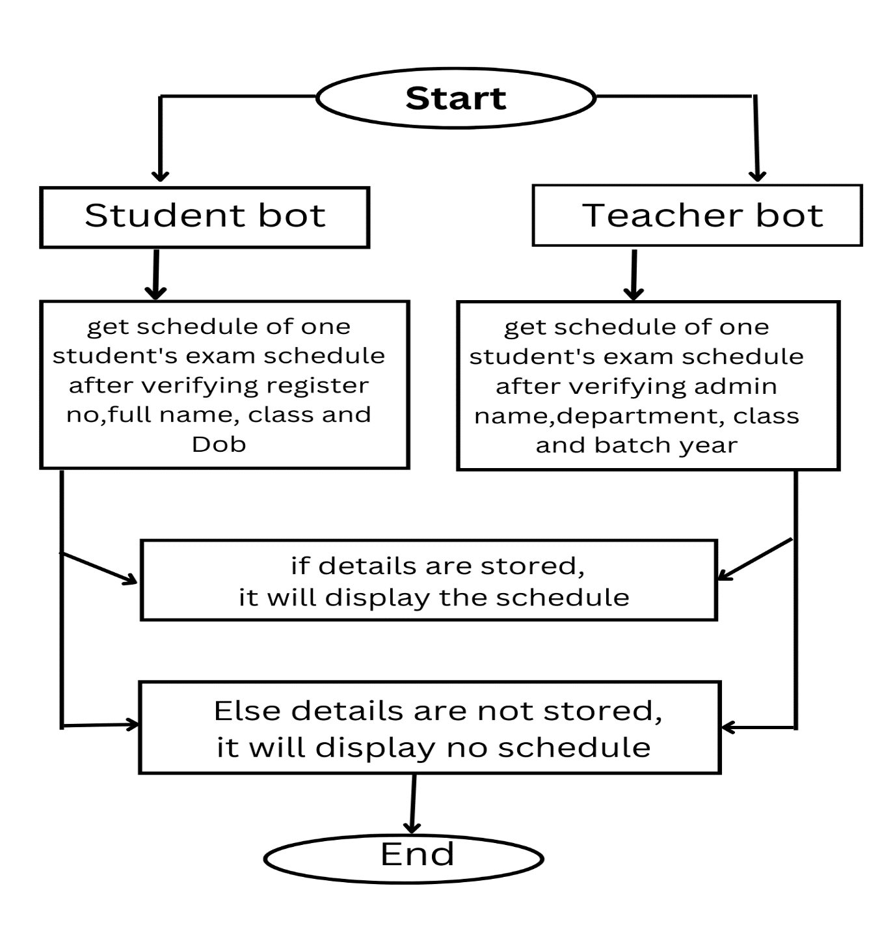
SYSTEM Architecture

Slide 16
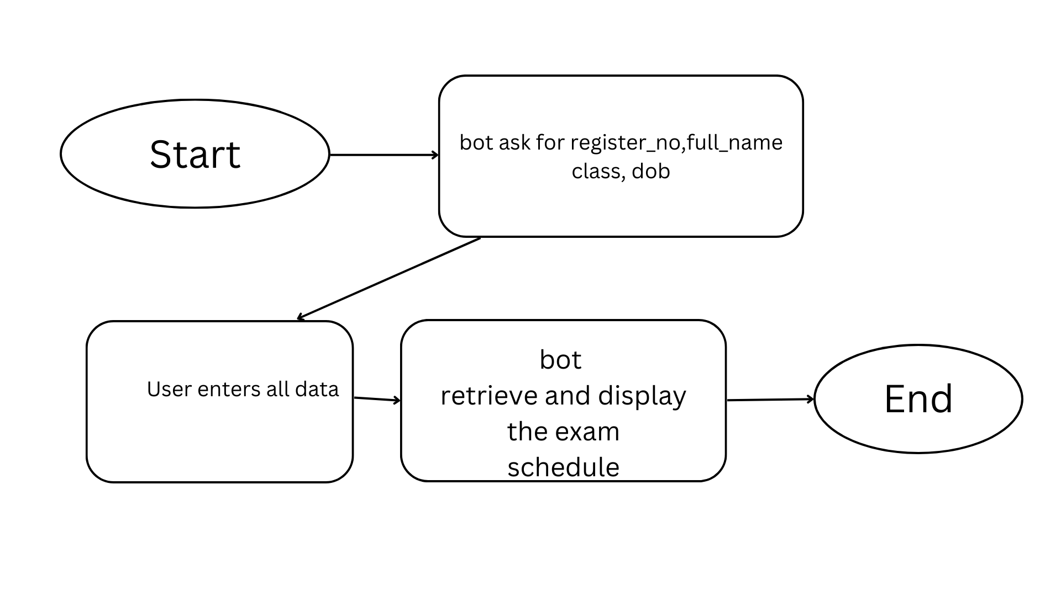
DATAFLOW DIAGRAM

Slide 17
SCREENSHOTS

Slide 18
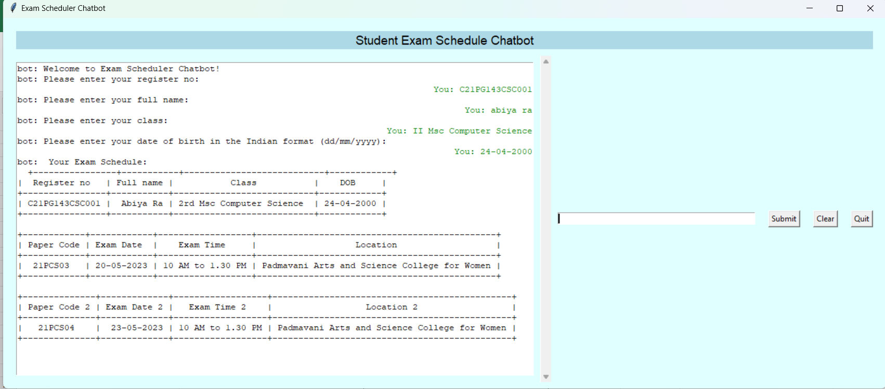
STUDENT VIEW

Slide 19
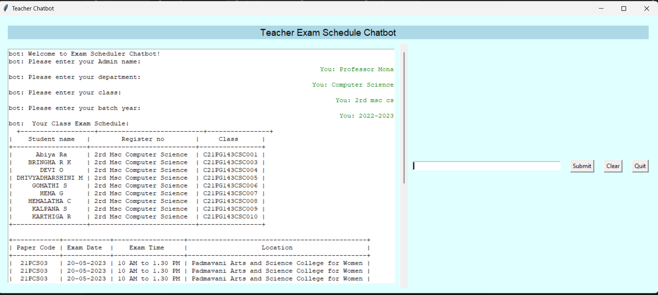
TEACHER VIEW

Slide 20
CONCLUSION
In conclusion, Chatbots are quickly becoming a must-have for businesses, schools, and colleges in the modern age. Not only do they assist customers with basic interactions, but they can also provide an unforgettable experience with their personalized responses.

Slide 21
FUTURE ENHANCEMENT
The future of chatbots is transforming the way businesses, schools, colleges and etc.. interact with their customers. From handling customer inquiries and offering real-time support to providing personalized product recommendations.

Slide 22
THANK YOU

