Slide 1
Lab2
2021
Hsieh-chia-han

Slide 2
Goal
建立一個可以發送檔案的server
建立一個可以接收檔案的client
server要能至少同時服務3個client
使用multicast

Slide 3
Goal Scenario
3 clients on
server on
server sent file
clients receive file
Goal Scenario

Slide 4
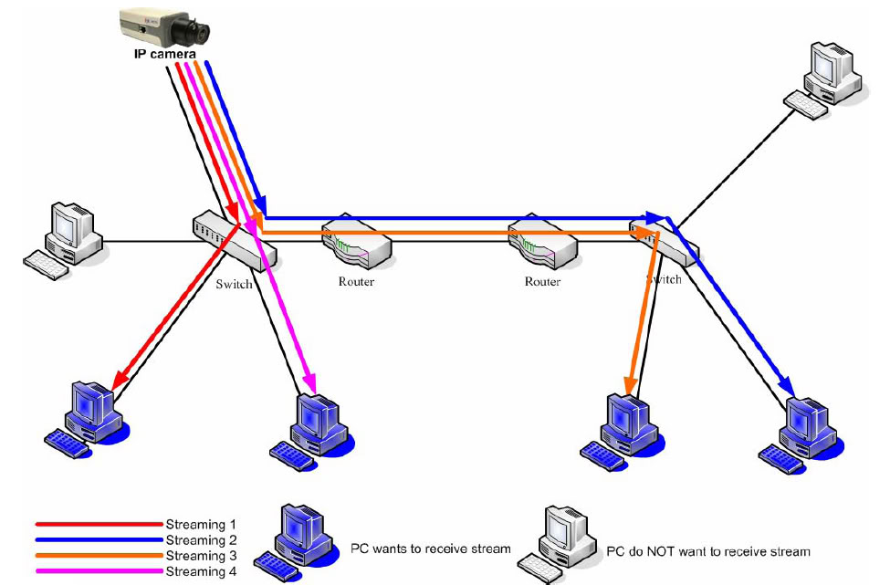
Unicast
Point to Point
Unicast is a network communication between a single sender and a single receiver over a network.
With unicast, the IP camera has to send an individual streaming for each client wish to see the images.
REF: http://softtofree.blogspot.tw/2012/12/multicast.html

Slide 5
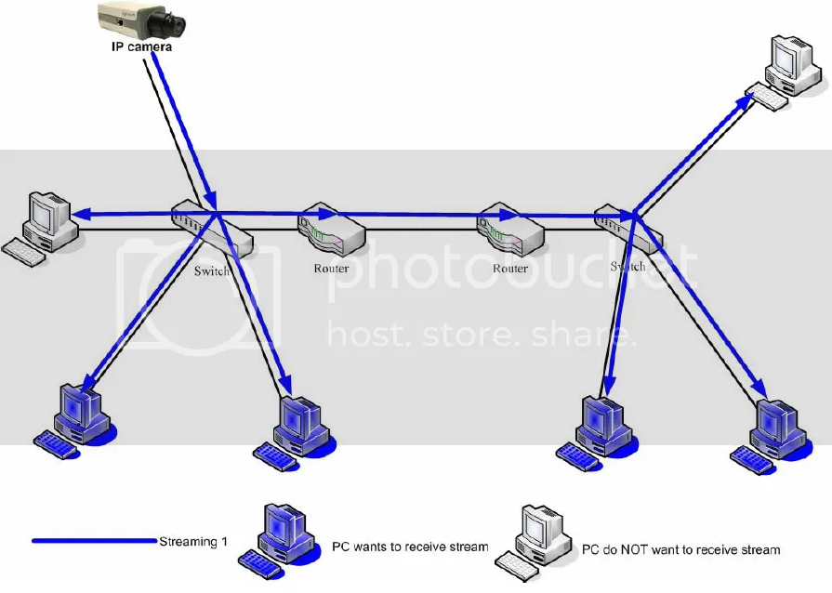
Multicast
降低骨幹網路的loading
NOTE: Multicast is using UDP protocol to transmit the data and the UDP protocol might cause some network package to loss during transmission.

Slide 6
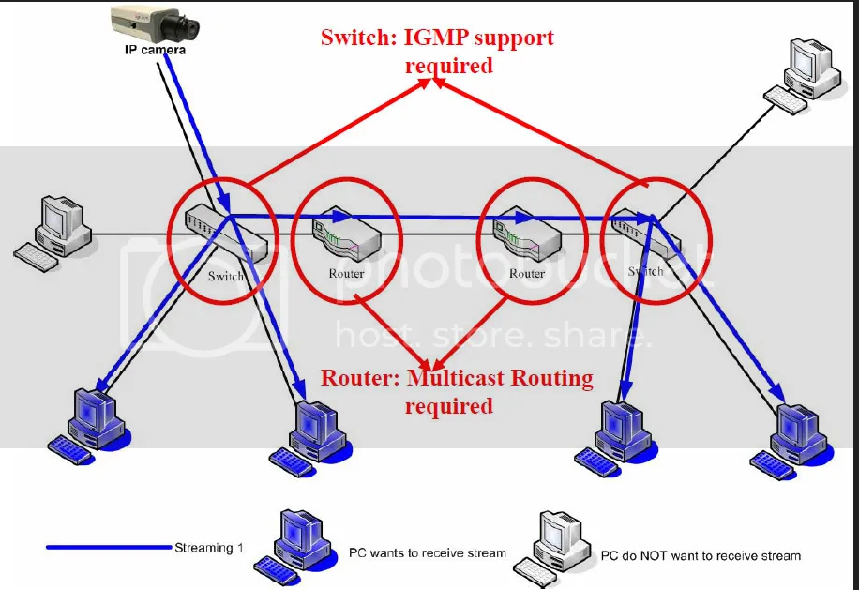
Multicast with IGMP support
NOTE: Multicast is using UDP protocol to transmit the data and the UDP protocol might cause some network package to loss during transmission.

Slide 7
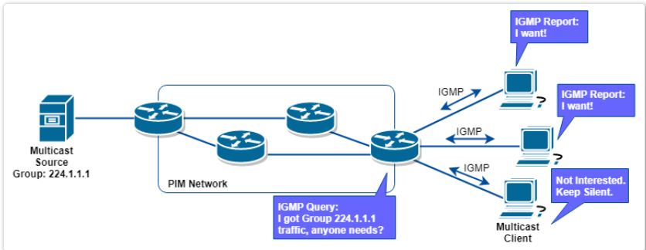
Internet Group Management Protocol
When router receives multicast message, it query the hosts whether need message or not, if nedds, host responds with IGMP Membership Report, then router would send the message to the host.

Slide 8
Classful Network
Class A : 0.0.0.0~127.255.255.255
Class B : 128.0.0.0~191.255.255.255
Class C : 192.0.0.0.0~223.255.255.255
Class D : 224.0.0.0.0~239.255.255.255
For multicast
Notes:
分類網路 A:大型企業、研究機構 128+16,777,214 B:中型氣誒 16,384+65,534 C:小型企業、網路服務商 2,097,152+254
D:群播
E:研究用途

Slide 9
Multicast server side socket programming
建socket
建destination group ip 的structure (ex:226.1.1.1)
設定 socket 為 multicast
設定要不要給local的群組也丟一包datagram
送出

Slide 10
Important function
setsockopt (sd, IPPROTO_IP, IP_MULTICAST_IF, (char *)&localInterface, sizeof(localInterface))
IP_MULTICAST_IF: Sets the interface over which outgoing multicast datagrams are sent.
localInterface :all multicast traffic generated in this socket will be output from the interface chosen.
sendto (sd, databuf, datalen, 0, (struct sockaddr*)&groupSock, sizeof(groupSock))
groupSock: send to group socket

Slide 11
Multicast client side socket programming
建立socket
設定大家都可以從同樣的local port收到東西
Bind with multicast group
設定socket所屬的group和local的interface ip (設定你local的ip)
準備收檔案

Slide 12
Important function
setsockopt(sd, IPPROTO_IP, IP_ADD_MEMBERSHIP, (char *)&group, sizeof(group))
IP_ADD_MEMBERSHIP : Joins the multicast group specified.
group :specify which group you want listen.

Slide 13
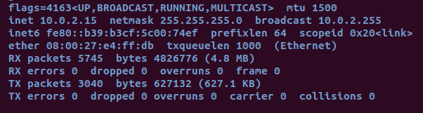
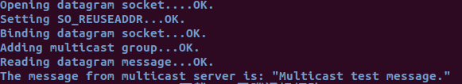
Sample code 1
multicast_client.c/server.c裡面需要把group.imr_interface.s_addr的ip改成自己local的ip address(linux的話在ifconfig裡面可以查)
$gcc multicast_server.c –o server
$gcc multicast_client.c –o client
$./client
$./server
Client會顯示The message from multicast server is: “Multicast test message. ”

Slide 14
Sample – MultiThread Server (參考)
可以服務多個client
聽8888 port
有request時create_pthread

Slide 15
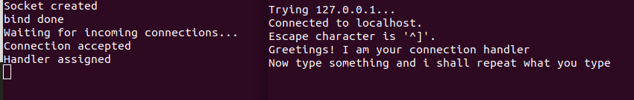
Sample code 2
$gcc multithread_server.c –o server –lpthread
./server
開另外一個視窗
telnet localhost 8888
再開另外一個視窗
telnet localhost 8888
server
client

Slide 16
作業看這邊

Slide 17
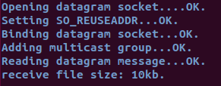

Lab2 報告內容
實驗要求
Server利用 multicast 同時傳送檔案給3個Client (無須利用 MultiThread )
紀錄 client 和 server 連線及傳輸檔案的過程 (請將截圖附在ppt裡)
須包含傳輸的畫面 (4個 cmd)
Client 和 server 須包含接收到的檔案大小
輸入格式如下,請將 client 和 server 分成兩個 file
$gcc multicast_server.c –o server
$gcc multicast_client.c –o client
$./client
$./server filename
client參考格式
Server 參考格式

Slide 18
Lab2作業繳交資訊
請用 Moodle 上傳作業
報告請用PPT檔，code請用.c或.cpp檔， 無須壓縮， ppt檔名用自己的學號加上編號命名, Ex: P76091705_lab2
DUE : 2021. 5. 4. 23:59
遲交一天扣10分, 過一個禮拜後不收補交作業
TA mail :hsiehch@locust.csie.ncku.edu.tw

Slide 19
Reference
https://tldp.org/HOWTO/Multicast-HOWTO-6.html
http://softtofree.blogspot.com/2012/12/multicast.html
https://www.tenouk.com/Module41c.html

Slide 20
