Slide 1
Understanding the WEB

Slide 2
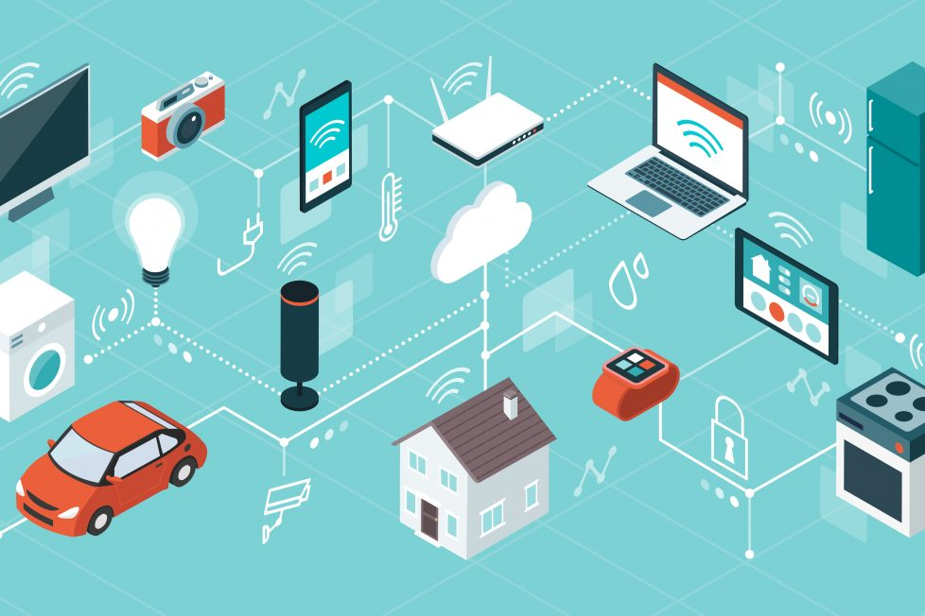
The WEB
The web is an essential part of today’s society, it allows to connect people and systems all around the world
Notes:
From big servers, to small embedded devices, humanity has developed the ability to provide seamless communication and integration across vast amounts of distances and applications.
The internet has allowed us to experience new things, and gather knowledge from all across the world.
But how does it work ?

Slide 3

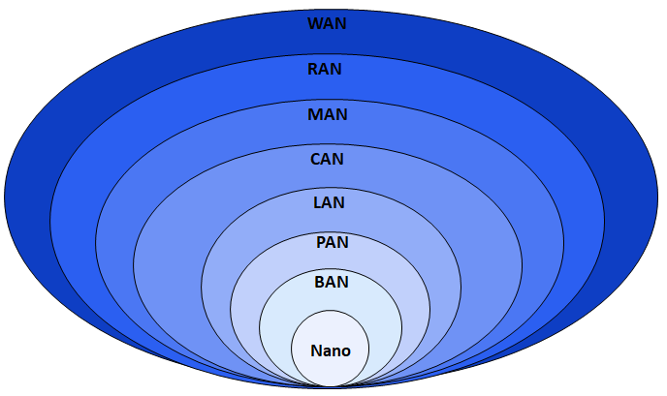
The Internet
The internet is a complex network of interconnected networks.
It is created using a set of protocols of communication, known by the general term of TCP/IP
The internet is a bunch of networks connected between each other
Each part of the network can function independently
There are many levels of a network
The most important ones to understand is LAN and WAN
Notes:
BAN – Body area network
PAN – Personal area network
LAN – Local area network
CAN – Campus area network
MAN – Metropolitan area network
RAN – Radio access network
WAN – Wide area network

Slide 4
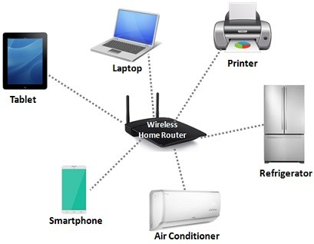
LAN
LAN – Local area networks are networks of devices connected in between each other through a medium
LANs are usually networks we have at our home
LANs have a limited range due to the medium through which they are connected: Ex. Cable, Bluetooth, WiFi
Another example of a Local area network is your computer itself
Components and Programs within your computer communicate with each-other (sometimes)
All the communication within your computer is restricted to that small local network
Notes:
BAN – Body area network
PAN – Personal area network
LAN – Local area network
CAN – Campus area network
MAN – Metropolitan area network
RAN – Radio access network
WAN – Wide area network

Slide 5
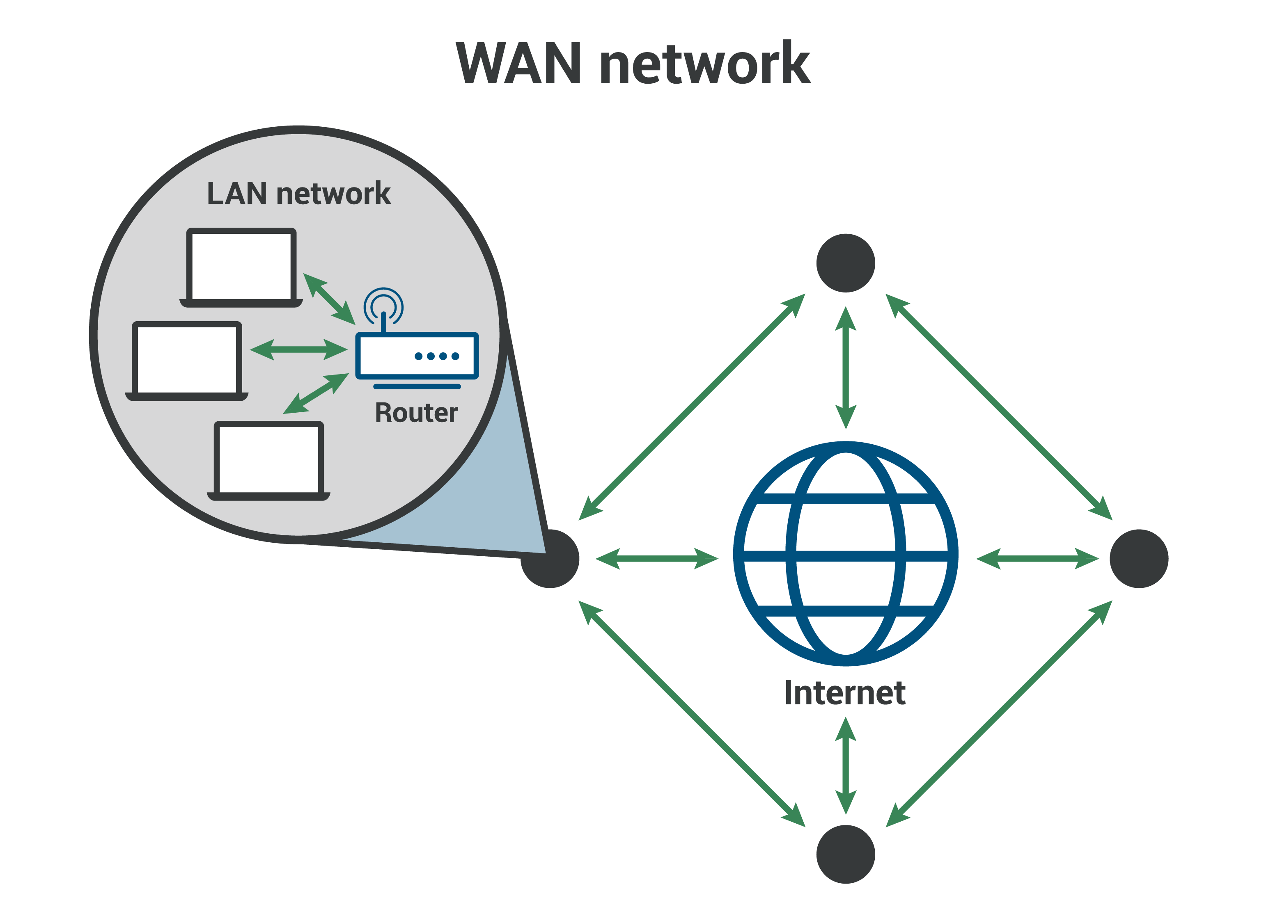
WAN
WAN – Wide area network, is a network of many networks, connected between vast distances.
A WAN is composed of multiple LANs which are able to communicate and distribute information between each other

Slide 6
IP
For elements inside a network to be able to communicate, they need to know where to send the messages
This is where IP comes in:
IP addresses are numerical addresses of entities within a network
IP addresses are used for computers to identify each others within a network
Similar how we can find a place in a city using the address of the street and the street number, IP addresses help us identify a device on a network.
There are two common IP versions: IPv4 and IPv6

Slide 7
IPv4
IPv4 was established a long time ago, and is still used to this day
IPv4 is a standard of IP addresses that uses 4 pairs of numeric values (from 0 to 255) to identify an element in the network
Example: 192.0.0.1
IPv4 can have up to 4,294,967,296 combination of values, that gives us the same amount of connected devices in a network.
Back in 1980 that seemed like a lot, but today, a country may have more than that.

Slide 8
IPv6
IPv6 is a new version of IP addresses, that is ought to address the limit of the number of devices supported.
IPv6 addresses are combinations of 8 groups of 4 characters
Example: 2001:0db8:0000:0000:0000:8a2e:0370:7334
Example shortened: 2001:db8::8a2e:370:7334
They allow us to have 3.4 x 10³⁸ total combinations. Which is (for now) more than enough
IP Addresses are the backbone of the internet, similar how postal codes and addresses are important for postal services, and coordinates are important for GPS

Slide 9
Ports
A port is a “destination” for a package of data within a device.
If the IP is the address of the computer, the port is the apartment number.
Each application in your computer uses one or more ports to communicate in between each other, or with other devices on the same LAN or even WAN.
A combination of both IP and Port is used to access a certain application on a network.
For example, for HTTP (web), port 80 is used.
This way the address for a HTTP server would be: 182.10.34.10:80 (port 80 divided from the address by the colon : )

Slide 10
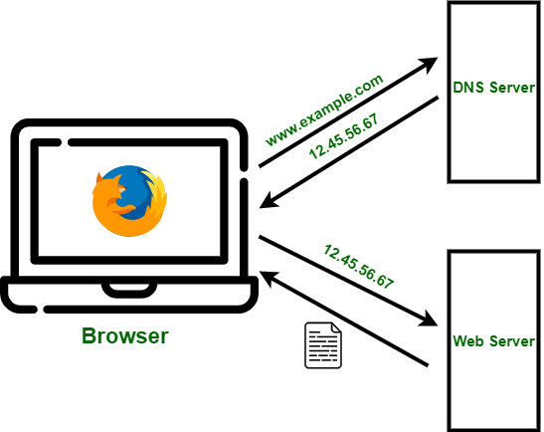
DNS
If everything on a network is identified by IP, why don’t you see them often ?
This is thanks to DNS – Domain Name System
DNS is a system that holds a record for each IP and a name attached to it
For example: google.com = 172.217.168.196
DNS works in the background, when we access a web page, and makes sure that our browser or application sends the requests to the proper destination

Slide 11
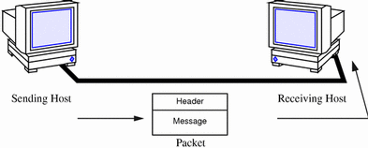
Computer communication
Computers communicate with each other by sending data, alongside other information inside a packet
Each packet contains information about the sender, and about who should receive that package
Each packet also contains data, called payload, which is the message we want to send
It works similar to how postal services work
When the packet is sent, the entire network works together to make sure that the packet gets to the necessary destination

Slide 12
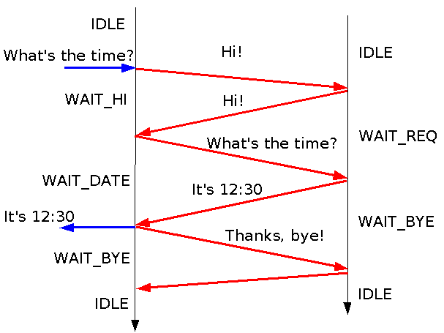
Protocols
Protocols are standardized methods of communication, which define how the information is exchanged or what information is exchanged
Example human communication
Computer protocols follow the same principle, it’s a definition of the means of the conversation between two systems
There are many computer communication protocols
We will discuss two of them: TCP and UDP

Slide 13
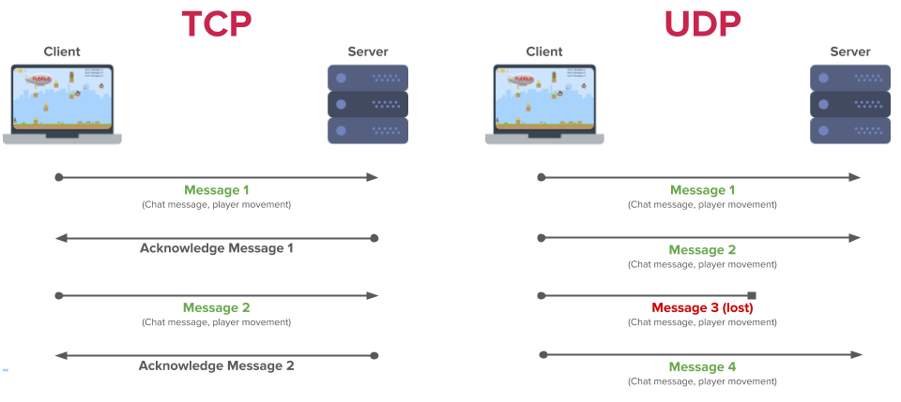
TCP and UDP
TCP and UDP are common data transfer protocols that differ in the way they handle the communication

Slide 14
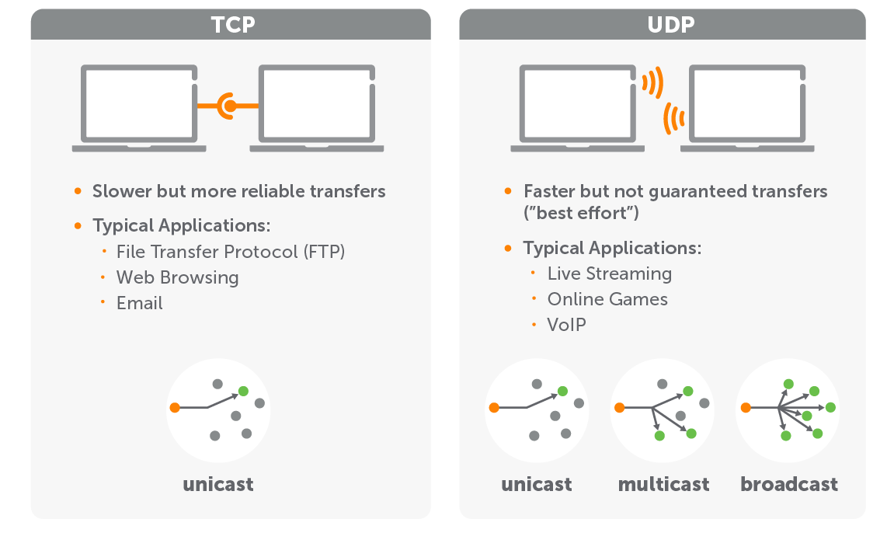
TCP vs UDP

Slide 15
URL
Uniform Resource Locator, it’s an address that allows to find a unique resource on the internet
Scheme: Indicates the protocol we want to use
Authority: Indicates which server web server is being requested, together with the port
Path to resource: Indicates the path of the required file, webpage or general web resource. Paths are similar to the paths of your files on your computer.
Parameters are a way to "customize" what the web resource will display, similar to arguments in a function.
The anchor is a reference to a specific part of a document.

Slide 16
HTTP
Hypertext Transfer Protocol is a protocol for transmitting hypermedia documents
Designed for communication between a web server and a web browser, but can be used for other purposes
HTTP is the easiest way to transmit and received data
It is a Client-Server architecture

Slide 17
The client
The HTTP Client can:
Request Data
Receive Requested data
Example
Creates a request: https://en.wikipedia.org/wiki/Hypertext_Transfer_Protocol
Wikipedia server will respond with a web page for the article
A HTTP Client is any application that can send HTTP Requests

Slide 18
HTTP Server
A HTTP Server – Also called a WEB Server can:
Receive Requests
Return responses
A HTTP Server is permanently waiting for a new request from a client
Once it receives a request, the web server will try to fulfill it
A HTTP Server will not and can not and should not send responses unless requests

Slide 19
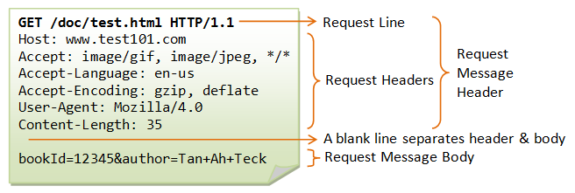
HTTP Requests
HTTP Requests follow a set structure
There are different types of HTTP Requests, also called methods
The most popular methods are GET and POST

Slide 20
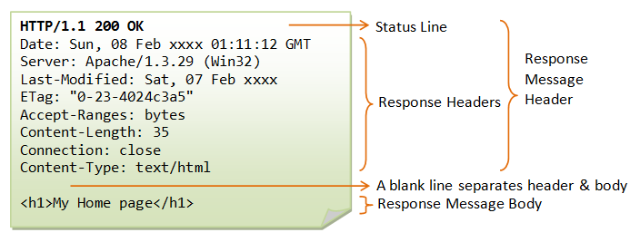
HTTP Responses
Responses are only sent from a web server as a result of a request.
Responses also have both headers and a body
The main part of the header is the status which is a numeric value (example: 200)

Slide 21
Other HTTP Statuses
Status Code | Meaning | When its used
200 | OK | When the response was successful (may contain body)
201 | Created | When the a new resource was created as a result of a request
202 | Accepted | The request was fine, but the action was not triggered yet
204 | No content | The request was received but there is nothing to return
300 | Multiple choice | Multiple options for the response are available, client must choose
301 | Moved permanently | The resource is not available at the location, the response contains the new URL
400 | Bad request | Request information is not valid, and the server doesn't want to process it
401 | Unauthorized | Request requires authentication, and the client doesn't have proper authentication to access the resource
403 | Forbidden | User is authenticated but does not have permissions to access the resource
404 | Not Found | Resource could not be found
405 | Method not allowed | Server doesn't allow that request method for the resource. (Using GET instead of POST for a resource for example

Slide 22
Making requests in Python
We need the following library: requests
pip install requests
import requests response = requests.get('http://google.com/') # Sending a GET Request to google.com print(response.content) # Will print out the HTML code of the requested website print(response.status_code) # Will print out the HTTP Status code of the response for header, value in response.headers.items(): # Will print out the headers for the response print(header, value) for cookie, value in response.cookies.items(): # Will print out the response cookies print(cookie, value)
Content of a request at a usual website will mostly always be a HTML page

Slide 23
Other resources
If the requested information is an image or file, the web server will return the bytes of the given file
Example, downloading an image from the web resource
import requests python_logo = requests.get('https://www.python.org/static/community_logos/python-logo-master-v3-TM.png') with open('python_logo.png', 'wb') as file: # Opening file to write bytes print(python_logo.headers.get('Content-type')) # image/png file.write(python_logo.content)

Slide 24
WEB APIs
WEB APIs are special resources on the web that allow us to get information in a more “code-friendly” way
Similar to external packages, WEB APIs are well documented, and require research into how to work with them and what they can do
Most WEB APIs provide usage examples, and great documentation to get you started
All WEB APIs require authentication, with a “key” or “token”

Slide 25
Weather API
import requests url = "https://community-open-weather-map.p.rapidapi.com/weather"
querystring = {"q": "Chisinau,MD", "lang": "null", "units": "metric", "mode": "json"} headers = { 'x-rapidapi-host': "community-open-weather-map.p.rapidapi.com", 'x-rapidapi-key': "9fc02c456bmsh6626cffb86bc4a3p13dc03jsn476488b50c4e" } response = requests.request("GET", url, headers=headers, params=querystring) data = response.json() print(data['coord']) # {'lon': 28.8575, 'lat': 47.0056} print(data['weather']) # [{'id': 800, 'main': 'Clear', 'description': 'clear sky', 'icon': '01n'}] print(data['main']) # {'temp': 2.42, 'feels_like': -1.03, 'temp_min': 1.63, 'temp_max': 2.74, 'pressure': 1032, 'humidity': 68}

