Slide 1
More WEB

Slide 2
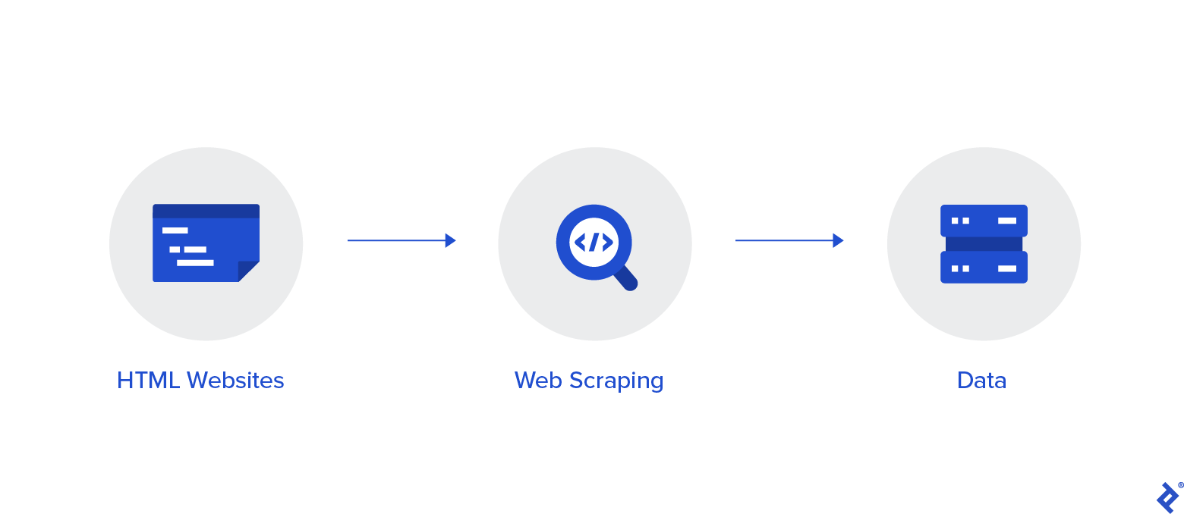
Scraping the web
Web scraping is the process of extracting information from a website
It is achieved by automating a process where a website is accessed by an automatic program, and then elements of the website holding relevant information are identified and their information copied
Web scraping requires a site-by-site approach thus is a hard an unreliable process
Notes:
From big servers, to small embedded devices, humanity has developed the ability to provide seamless communication and integration across vast amounts of distances and applications.
The internet has allowed us to experience new things, and gather knowledge from all across the world.
But how does it work ?

Slide 3
Web scraping
Web scraping requires:
General knowledge about the web
General HTML Knowledge
Patience
A scrapable target

Slide 4
HTML
HTML – HyperText Markup Language
A programming language used to represent the layout and content of an HTML Document
HTML is the only way websites are built ever since the WEB was invented until today
<!DOCTYPE html> <html> <head> <title>Page Title</title> </head> <body> <h1>This is a Heading</h1> <p>This is a paragraph.</p> </body> </html>

Slide 5
HTML Tags
HTML Documents are composed of HTML Elements
Each element is defined by a tag
Each element can have one or more elements inside itself
<!DOCTYPE html> <html> <head> <title>Page Title</title> </head> <body> <h1>This is a Heading</h1> <p>This is a paragraph.</p> </body> </html>
Opening tag
Closing tag
Opening tag
Elements inside body
Closing tag

Slide 6
Common HTML Tags
Tag | Usage | Description
<html> | <html>Body of html</html> | Everything useful inside html page is contained inside a html tag
<body> | <body> body of the page </body> | Used to signify the main content of the webpage
<p> | <p> paragraph </p> | Used for representing textual information
<h1> | <h1> Heading </h1> | Heading (number from 1 to 6 from bigger to smaller)
<a> | <a href=“other_resource.html”> link </a> | Link to another resource (another file/website/anchor)
<img> | <img src=“link/to/image”> | Displays an image from the source
<div> | <div> content inside block </div> | Structural blocks used to group multiple elements

Slide 7
Attributes
HTML Elements are allowed to have various attributes
We already saw some of them
<a href=“other_resource.html”> link </a> - href attribute
<img src=“link/to/image”> - src attribute
Two important attributes:
id and class
<p class=‘main-text’>important text inside</p>
<h1 id=‘main-heading’> Main heading inside </h1>
The ID attribute is unique per element. No two elements inside one HTML document can have the same ID
The class attribute is a “classification” attribute, which is used to describe a common behavior between multiple elements with same class

Slide 8
Example HTML
<html lang="en"> <body> <h1 id="welcome-message">Welcome to my page</h1> <div class="main-info"> <p>Hey everyone, thanks for visiting my page</p> <p>My page is very empty, so you better go to <a href="https://google.com">this page</a></p> <p>By the way, here's an image of a cat</p> <img src="https://i.imgur.com/qZImY9j.jpg" alt="Cat image"> </div> </body> </html>

Slide 9
Parsing HTML Effectively
BeautifulSoup is a library for Python that allows us to parse HTML elements and process the information within them effectively
from bs4 import BeautifulSoup soup = BeautifulSoup(html_code) print(soup.find('img')) # Finds the first image # <img alt="Cat image" src="https://i.imgur.com/qZImY9j.jpg"/> print(soup.find('img').get('src')) # https://i.imgur.com/qZImY9j.jpg # The source of the image, we can download it from this paragraphs = soup.find_all('p') # Finds all paragraphs for paragraph in paragraphs: print(paragraph.text) # Printing just the text inside the paragraphs # Hey everyone, thanks for visiting my page # My page is very empty, so you better go to this page # By the way, here's an image of a cat

