Slide 1
Databases

Slide 2
Lectia de azi
Databases
SQL

Slide 3

Databases
What is a database ?
An organized collection of structured information, or data, stored electronically in a computer system
Data is managed by a software system (DBSM)
Data is usually represented in tables with rows and columns
Mostly use SQL to access/modify the data
Databases are similar to spreadsheets (Excel) in the way they store data
Databases are files containing structured information
that can be accessed using a database software

Slide 4
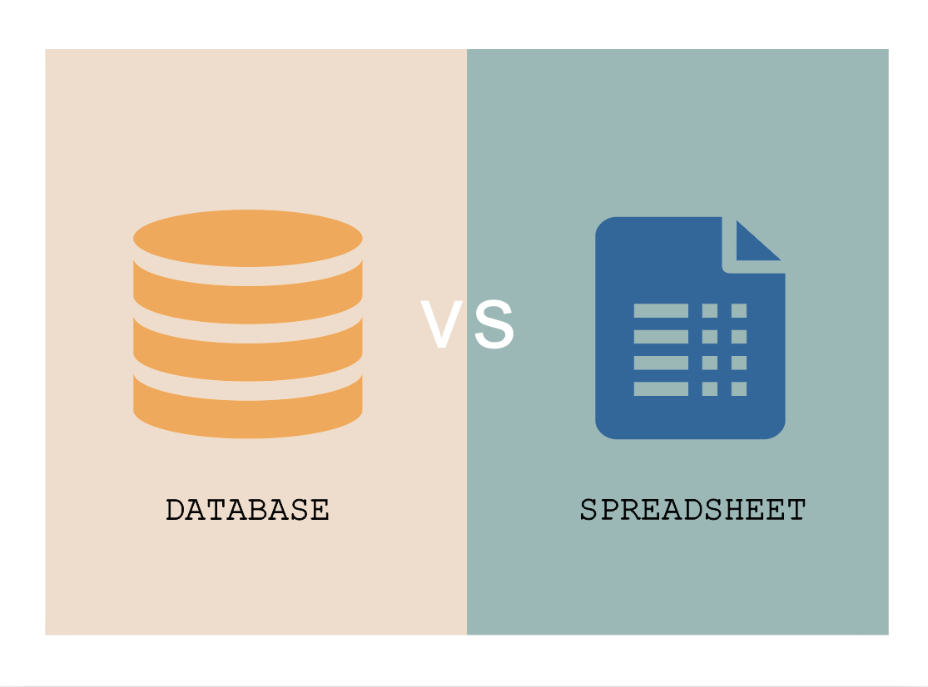
Databases vs Spreadsheets
Spreadsheets:
Single user
Scale bad (large Spreadsheets require large computers)
Great for simple data manipulation and storage
Databases:
Multi-user
Very efficient
Reliable
Can handle complex operations with ease

Slide 5
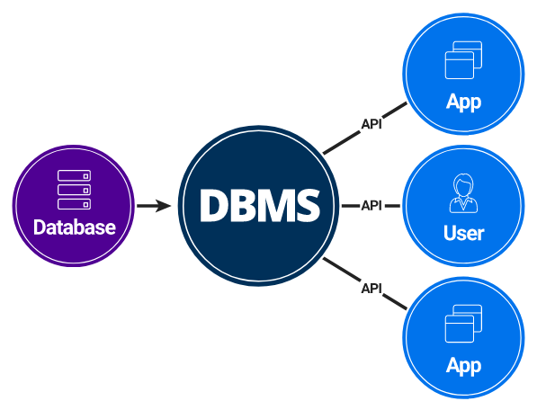
Database Software
Database Software is the software that manages the database files and records
It is responsible for access, storage and retrieval of the data it manages
Commonly known as DBMS, database software is the interface between a database and its users
Besides data access and management most DBMSs also provide the following:
Data retrieval and storage optimization
Access control (users and permissions)
Performance monitoring and tuning options
Backup and recovery options
Overview of database operations
Most DBMS are server applications, that communicates using APIs

Slide 6
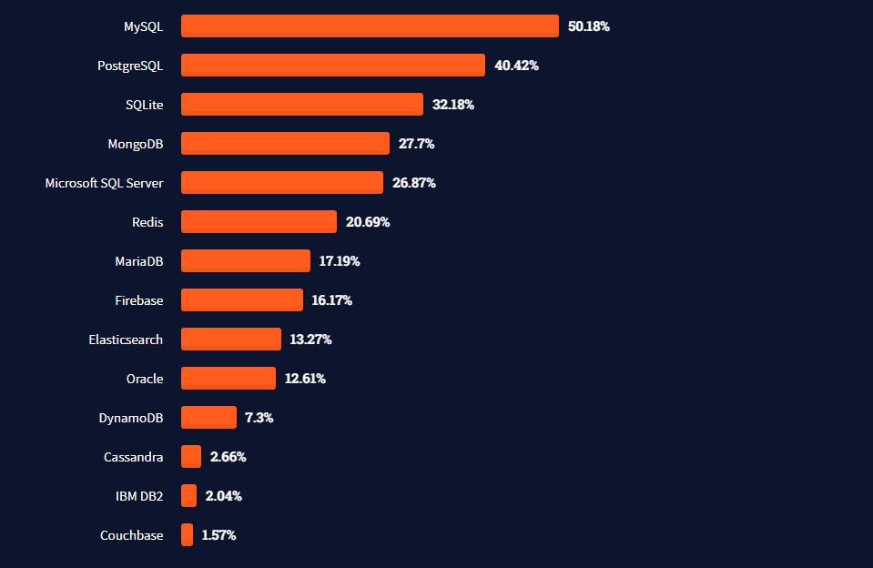
Common DBMS
DBMSs have different characteristics:
Most common are:
Speed
Efficiency
Reliability
Support
Compatibility

Slide 7
SQLite
SQLite is a database engine in form of a software library that provides minimal functionality needed to work with databases
Benefits
Server-less database software
Great SQL Compatibility
Very lightweight and relatively fast
Easy to set-up and no need to configure
Drawbacks
Not well optimized for large databases
Lacks many security and data integrity check features

Slide 8
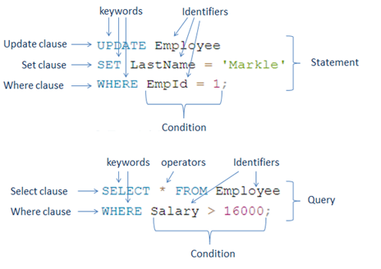
SQL
SQL (Structured query language) is used to query and manipulate the underlying relational databases such as SQL Server, Oracle, MySQL, PostgreSQL, SQLite, etc.
SQL is a standardized language, this means that the syntax and functionality is mostly the same across most SQL Databases
SQL is made up of:
Keywords
Clauses
Identifiers
Conditions
Queries
Statements
Notes:
Keywords - Keywords are reserved or non-reserved words. Reserved keywords in SQL are SELECT, INTO, UPDATE, DELETE, DROP, ASC, DESC, etc.
Identifiers - the names of the database objects like table name, schema name, function name, etc.
Clauses - Clauses forms the components of SQL statements and queries such as WHERE, GROUP BY, HAVING, ORDER BY.
Expression - Expressions in SQL produce either scalar values, or columns and rows of data.
Boolean Conditions - Conditions are the expressions that result in the boolean value TRUE or FALSE. They are used to limit the effect of statements or queries.
Queries - Queries are the SQL statements that retrieve the data based on specific criteria. Statements that start with the SELECT clause are called queries because they retrieve data from the underlying database.
Statements - SQL statements may have a persistent effect on schema and data, or may control transactions, program flow, connections, sessions, or diagnostics. INSERT, UPDATE, DROP, DELETE statements are called SQL statements because they modify the underlying database structure or data.

Slide 9
Data Definition
Data Definition is the process of declaring what data will be stored in the database
It includes such processes as:
Declaring Tables
Modifying Tables
Deleting Tables
Modifying columns and their data types
Before we create a table, we should know the following:
Name of the table
Columns of the table and their names
Data types for each column
Which column will be the primary key (if any)

Slide 10
SQL Data types
SQL database always require a type definition
There are 5 main categories for data types each with their own list of types
Numeric types
Date and time types
String types
Binary data
Misc. (Other)

Slide 11
Numeric Data Types
The variety of numerical data types allows the database and the database managers use appropriate types for their need, thus reducing the memory footprint of the data
Datatype | From | To | Decimal
bit | 0 | 1 | No
tinyint | 0 | 255 | No
smallint | -32,768 | 32,767 | No
int | -2,147,483,648 | 2,147,483,647 | No
bigint | -9,223,372,036,854,775,808 | 9,223,372,036,854,775,807 | No
decimal | -10^38 +1 | 10^38 -1 | Yes
numeric | -10^38 +1 | 10^38 -1 | Yes
float | -1.79E + 308 | 1.79E + 308 | Yes
real | -3.40E + 38 | 3.40E + 38 | Yes

Slide 12
Date and time
Date and time values formats are strict for most databases, values that do not fit the date and time format will not work or result in bad data
Datatype | Description
DATE | Stores date in the format YYYY-MM-DD
TIME | Stores time in the format HH:MI:SS
DATETIME | Stores date and time information in the format YYYY-MM-DD HH:MI:SS
TIMESTAMP | Stores number of seconds passed since the Unix epoch (‘1970-01-01 00:00:00’ UTC)
YEAR | Stores year in 2 digits or 4 digit format. Range 1901 to 2155 in 4-digit format. Range 70 to 69, representing 1970 to 2069.

Slide 13
String data
char – for fixed length textual values
varchar – for unknown length textual values
text – for textual values of big lengths, but unknown limit
Datatype | Description
CHAR | Fixed length with a maximum length of 8,000 characters
VARCHAR | Variable-length storage with a maximum length of 8,000 characters
VARCHAR(max) | Variable-length storage with provided max characters
TEXT | Variable-length storage with maximum size of 2GB data

Slide 14
Binary and other data
Datatype | Description
BINARY | Fixed length with a maximum length of 8,000 bytes
VARBINARY | Variable-length storage with a maximum length of 8,000 bytes
VARBINARY(max) | Variable-length storage with provided max bytes
IMAGE | Variable-length storage with maximum size of 2GB binary data
CLOB | Character large objects that can hold up to 2GB
BLOB | For binary large objects
XML | for storing XML data
JSON | for storing JSON data

Slide 15
Primary keys
Primary keys are optional keys in a table, that defines a unique value to identify a row in that table
Tables should have a primary key only if the data inside the table will be referenced elsewhere, or you want to have a unique value to represent an element in the table, for example an ID
Primary keys can be simple or composite:
Simple keys reference only one column (example: IDNP)
Composite keys reference multiple columns that combined form the key (example: username and email)
Primary keys are UNIQUE so you can't have 2 rows with the same primary key
Primary keys can be referenced as foreign keys to define a table relationship
You are allowed to have only one primary key in a table

Slide 16
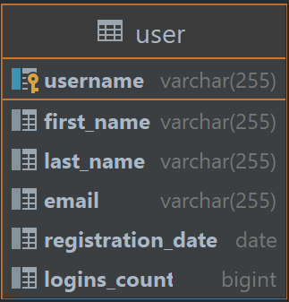
Table Creation and SQL Syntax
Tables in SQL are created using the CREATE TABLE keywords followed by a declaration of each column name, data type and other attributes
CREATE TABLE table_name ( column_name1 data_type [NULL|NOT NULL], column_name2 data_type [NULL|NOT NULL], ... );
Table definition
SQL keywords are case insensitive
Primary key
create table users ( username varchar(255) primary key, first_name varchar(255), last_name varchar(255), email varchar(255), registration_date date, logins_count bigint default 0 );

Slide 17
Modifying tables
Modifying a tables’ definition is done using the ALTER statement
Using the ALTER statement we can rename the table, but also add, rename and remove columns
ALTER TABLE table_name ADD column_name1 data_type, column_name2 data_type, ...
General syntax
Note: Multiple column additions not supported in SQLite
Adding columns
Renaming table
alter table users add date_of_birth date;
alter table users rename to user_table;
Renaming columns
Removing columns
alter table users rename column date_of_birth to birthday;
alter table users drop birthday;

Slide 18
Data manipulation
Data manipulation is the process of working with data in a database
It encapsulates the following abilities:
Adding data
Updating data
Removing data
Accessing data

Slide 19
Inserting Data
To add information to a table we must use the INSERT statement
INSERT INTO table_name(column_name1, column_name2...column_nameN) VALUES (column1_value, column2_value...columnN_value);
Example:
insert into users (username, first_name,
last_name, email, registration_date, logins_count) values ('mtricolici', 'Marius', 'Tricolici', 'mtricolici@email.com', date(), 0);
Inserting will fail if the primary key already exists
date() function returns current date
Inserting multiple records example
Inserting partial data
insert into users (username, email,registration_date) values ('test_user2', 'tu2@email.com', date()), ('test_user3', 'tu3@email.com', date()), ('test_user4', 'tu4@email.com', date()), ('test_user5', 'tu5@email.com', date());
insert into users (username, email, registration_date) values ('test_user1', 'tu@email.com', date());

Slide 20
Updating Values
Updating table values is done using the UPDATE statement
The update statement will change the values across all rows of a table by default, thus it is usually used together with WHERE clause
UPDATE table_name SET column_name1 = new_value, column_name2 = new_value, ... [WHERE Condition];
You can update multiple or single values at a time
Lacking a where condition will update ALL the rows in the table
Example
update users set first_name = 'Test', last_name = 'User' where username = 'test_user';
Note that both item assignment and comparison is done using a single = sign
Where statements should contain a Boolean value

Slide 21
Deleting data
Deleting values form a table is done using DELETE statements
DELETE FROM table_name [WHERE Condition];
Executing a DELETE statement without a where condition will delete ALL the data
Example
delete from users where username = 'test_user';
Deleting tables is done using DROP statements
drop table users
Deleting a table removes all the data forever

Slide 22
More concepts
create table post ( id integer primary key autoincrement, title text, message text, created_at datetime, created_by varchar(255), foreign key (created_by) references users (username) );
Autoincrement fields are set by the database software, every new record gets a new number in sequence
Foreign key is a relationship between tables, declaring that a field in one table references another field in another table
F
Foreign keys should have the same data types as the field they are referencing
Foreign keys should always reference the primary key the referenced table

Slide 23
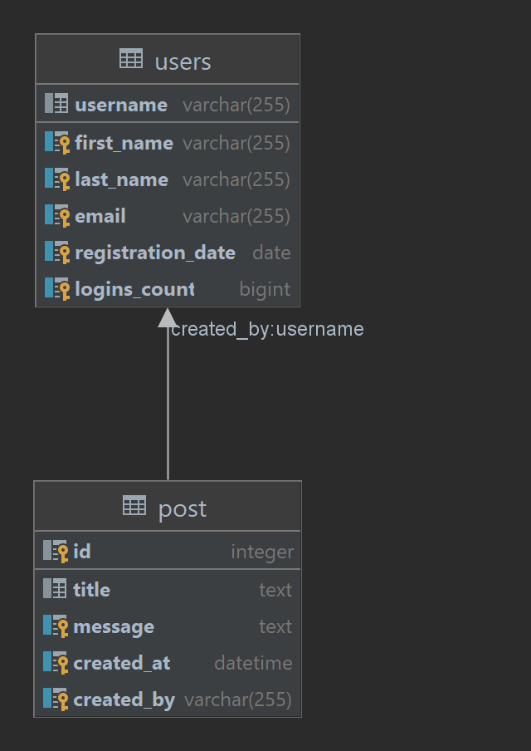
Table relationships
Foreign keys enable relationships between tables
Foreign keys allow us to enforce on database level a "dependency" of one row on another row
insert into post (title, message, created_at, created_by) values ('First post', 'FIrst post message', datetime(), 'test_user1'); delete from users where username = 'test_user1'; -- Should result in error

Slide 24
Accessing data from tables
Accessing data is done using SELECT Queries
SELECT column1, column2, ...columnN FROM table_name
select username, first_name, last_name from users;
username | first_name | last_name
mtricolici | Marius | Tricolici
test_user | Test | User
test_user1 | NULL | NULL
test_user2 | NULL | NULL
test_user3 | NULL | NULL
test_user4 | NULL | NULL
test_user5 | NULL | NULL

Slide 25
Getting all columns
* is used to represent ALL columns in the SELECT Query
select * from users;
username | first_name | last_name | email | registration_date | logins_count
mtricolici | Marius | Tricolici | mtricolici@email.com | 2022-03-20 | 1
test_user1 | NULL | NULL | NULL | 2022-03-20 | 2
test_user2 | NULL | NULL | NULL | 2022-03-20 | 4
test_user3 | NULL | NULL | NULL | 2022-03-20 | 3
test_user4 | NULL | NULL | NULL | 2022-03-20 | 5
test_user5 | NULL | NULL | NULL | 2022-03-20 | 6

Slide 26
Aggregations
We can aggregate column data with aggregator functions
select count(*) from users; select max(logins_count) from users; select min(logins_count) from users; select avg(logins_count) from users; select sum(logins_count) from users;
Aggregate functions produces single values.
You can have multiple aggregations in the same select
7
6
1
select count(*), max(logins_count), min(logins_count) from users;
3.5
21
count(*) | max(logins_count) | min(logins_count)
7 | 6 | 1

Slide 27
Conditional selections
Conditional selecting is done using the WHERE clause
select * from users where logins_count > 3;
The values in a WHERE clause should return Boolean values
There can be only one WHERE clause per query
username | first_name | last_name | email | registration_date | logins_count
test_user2 | NULL | NULL | NULL | 2022-03-20 | 4
test_user4 | NULL | NULL | NULL | 2022-03-20 | 5
test_user5 | NULL | NULL | NULL | 2022-03-20 | 6
Multiple conditions can be used together using Boolean AND and OR operations

Slide 28
LIKE
LIKE operator is used inside a WHERE clause to search for patterns in a columns’ value
There are two wildcards often used in conjunction with the LIKE operator:
The percent sign (%) represents zero, one, or multiple characters
The underscore sign (_) represents one, single character
SELECT column1, column2, ... FROM table_name WHERE columnN LIKE pattern;
Example | Explanation
WHERE username LIKE 'a%' | Finds any values that start with "a"
WHERE username LIKE '%a' | Finds any values that end with "a"
WHERE username LIKE '%or%' | Finds any values that have "or" in any position
WHERE username LIKE '_r%' | Finds any values that have "r" in the second position
WHERE username LIKE 'a_%' | Finds any values that start with "a" and are at least 2 characters in length
WHERE username LIKE 'a__%' | Finds any values that start with "a" and are at least 3 characters in length
WHERE username LIKE 'a%o' | Finds any values that start with "a" and ends with "o"

Slide 29
Ordering data
Ordering (sorting) data is possible using the ORDER BY clause
select username from users order by logins_count desc;
Default ordering is ascending (asc)
We can specify asc | desc after the column name
username
mtricolici
test_user2
test_user3
test_user4
test_user5
select username from users order by logins_count desc, registration_date asc;
We can sort based on multiple columns.
This sorts by the secondary sorting criteria only when the first criteria is the same (values are equal)

Slide 30
Grouping data
The GROUP BY clause is used to get the summary data based on one or more groups
The groups can be formed on one or more columns
For example, the group by clause can be used to group number of users registered on each day
select registration_date, count(*) as number_of_registrations from users group by registration_date;
registration_date | number_of_registrations
2020-06-21 | 1
2021-02-11 | 1
2021-08-12 | 1
2022-01-13 | 1
2022-02-12 | 1
2022-03-23 | 2
Group by statements are generally used together with aggregations
This will apply the count(*) operation for each group of items
Non aggregated values (example registration_date) should be inside the group by clause to avoid bad data

Slide 31
Having clause
The HAVING clause includes one or more conditions that should be TRUE for groups of records
It is like the WHERE clause of the GROUP BY clause
The WHERE clause cannot be used with aggregate functions
The HAVING clause can use aggregate functions to filter data
select registration_date, count(*) as number_of_registrations from users group by registration_date having count(*) > 1;

Slide 32
Order of clauses in a SELECT Query
A SELECT Query should have a specific order in which clauses are provided
Clauses in the wrong order will result in syntax errors
select username, count(p.id) as number_of_posts from users join post p on users.username = p.created_by where username like 'test%' group by username having number_of_posts > 1 order by number_of_posts
The order is the following:
Select
From
Where
Group by
Having
Order by

Slide 33
JOINS
JOINS are the ability of database queries to join data from other tables
This creates a new tables with combined results, where data from the second table is "connected" to the first table
select * from post inner join users u on post.created_by = u.username order by u.registration_date;
Joins the users table by the user foreign key
id | title | message | created_at | created_by | username | first_name | last_name | email | registration_date | logins_count
11 | Post 3 | Post 3 Message | 2021-12-20 12:32:32 | user3 | user3 | User | 3 | user3@email.com | 2020-06-21 | 0
9 | Post 1 | Post 1 Message | 2021-12-20 12:32:32 | user1 | user1 | User | 1 | user1@email.com | 2021-02-11 | 0
12 | Post 4 | Post 4 Message | 2021-12-20 12:32:32 | user4 | user4 | User | 4 | user4@email.com | 2021-08-12 | 0
13 | Post 5 | Post 5 Message | 2021-12-20 12:32:32 | user5 | user5 | User | 5 | user5@email.com | 2022-01-13 | 0
14 | Post 6 | Post 6 Message | 2021-12-20 12:32:32 | user6 | user6 | User | 6 | user6@email.com | 2022-02-12 | 0
10 | Post 2 | Post 2 Message | 2021-12-20 12:32:32 | user2 | user2 | User | 2 | user2@email.com | 2022-03-23 | 0
15 | Post 7 | Post 7 Message | 2021-12-20 12:32:32 | user7 | user7 | User | 7 | user7@email.com | 2022-03-23 | 0

Slide 34
Joins and aggregation
Joins can also be used for aggregation
select username, count(p.id) as number_of_posts from users join post p on users.username = p.created_by group by username
Counts the number of posts grouped by user
Non aggregated data usually is required to be in the group by clause
The AS keyword is used to provide an alias for columns

Slide 35

That’s it folks

