Slide 1
Web Applications

Slide 2
Lectia de azi
Web Servers
Web applications
Flask

Slide 3
Web Services
A web service is any service hosted on the web that uses HTTP to communicate between client and server
Web services can be in the form of:
Websites
Web APIs
Webhook services
A web service is hosted by a web server

Slide 4
Web Servers
A web server is a software that processes HTTP requests
A web server waits for a HTTP request, then does it’s best to fulfill it
When a request is received, it’s the web servers’ responsibility to attempt to fulfill it by:
Locating the resource – if the resource is a file
Sending the request to the web application – if the resource is managed by a web application
A web server can process works with any binary data, so sending and receiving files is easily handled by web servers, not just HTML, XML and JSON.

Slide 5
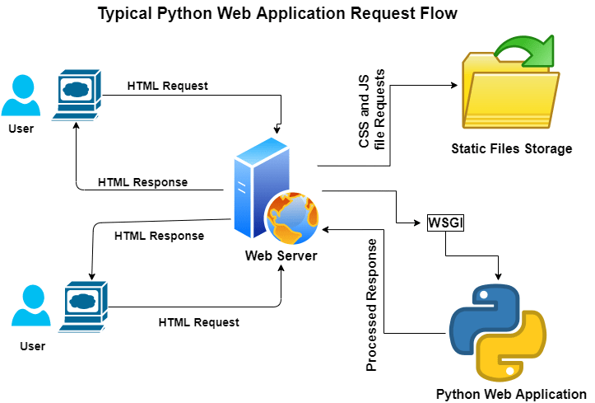
Web Servers
A web server is a program, that listens to all requests on a specific port
For Web, this port can be 80, 8000 or 8080
For a python web application, requests for a web server can result in one of the following
Static file is directly accessed
Python Web Application is called to handle the request
No data is found, an error response is returned

Slide 6


Web Servers
No need to re-invent the wheel
There are many ready-to-go web server implementations
Each has their own benefits and specific applications, but most of them share the same functionality, of processing requests that come from all around the internet.

Slide 7
Web applications
A web application is an application designed to receive HTTP requests from a web server and fulfill them.
It’s similar to how a Web server works
A Web Application can be programmed to call different functions of a program based on the URL that's being accessed
Think of it as calling a function in your program but instead of using a function call, the web application does it for you
For a Python application to work with a web server, it needs to provide an implementation of WSGI

Slide 8
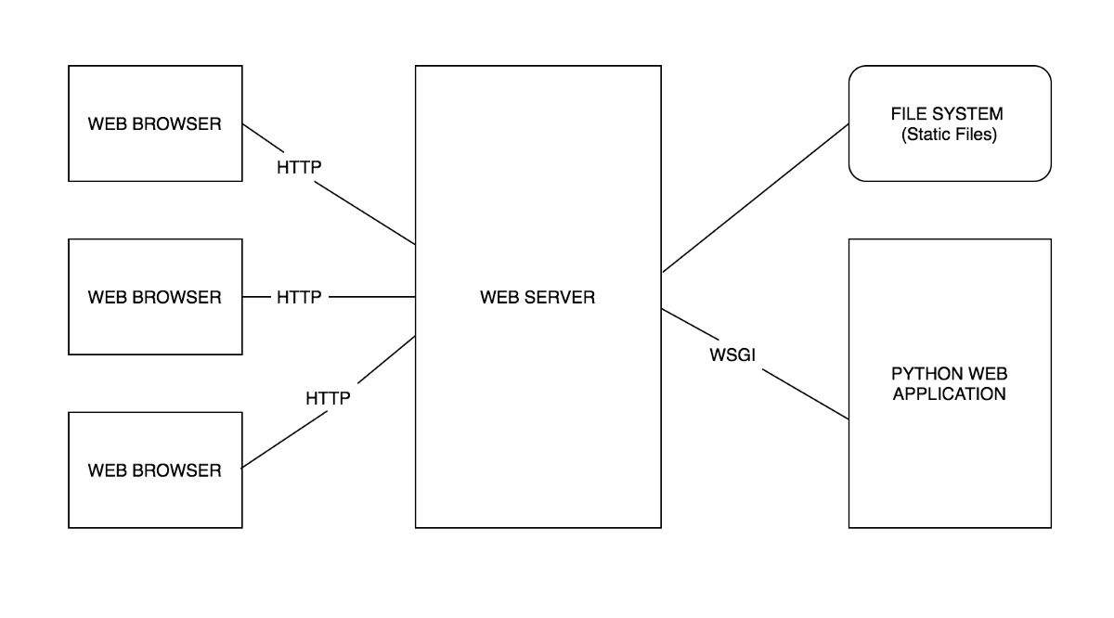
WSGI
WSGI (Web Server Gateway Interface) – is a specification that describes how a web server, and a Python program should communicate
Web servers send the HTTP requests to the Python Application using WSGI

Slide 9
How to implement a web application

Slide 10
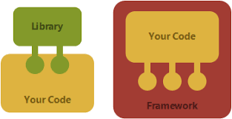
Frameworks
A framework is a pre-packaged collection of tools and libraries that solves common development solutions.
For example, creating web applications
Web frameworks include all the necessary tools we might need to be able to quickly and easily start developing functionality, rather than worry about setting up managing the entire infrastructure
Working with a framework requires reading documentation and understanding the functionality of said framework

Slide 11

Flask
Flask is on of the most popular web development frameworks for Python
Flask allows us to quickly define and develop web resources
Flask applications (as most web applications) can be run locally (on your computer), without needing a Web Server
Flask applications have a starting point: app.py or wsgi.py , similar to how we had main.py files

Slide 12
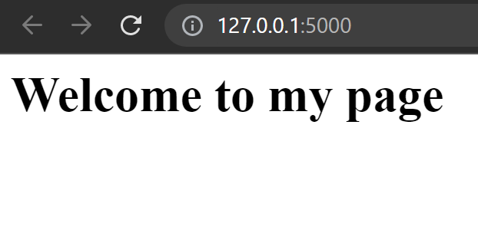
Using flask
Install flask from PIP
Import flask
Define the flask app
You are ready to go
from flask import Flask app = Flask(__name__) @app.router('/') def main_page(): return '<h1>Welcome to my page</h1>'
THE SAME

Slide 13
Other examples
Returning JSON Elements from an endpoint
Function
Response
some_random_list = [ dict(name='Element 1'), dict(name='Element 2'), dict(name='Element 3'), ] @app.route('/element/data') def get_list_data(): return jsonify(some_random_list)
[ { "name": "Element 1" }, { "name": "Element 2" }, { "name": "Element 3" } ]

Slide 14
The route
A route in Python defines an endpoint
An endpoint is the “Destination of the request”
The route decorator transforms a python function into a request handler
The python function should return valid responses for the application to work
Routes naming conventions:
Valid URL name
Best if grouped by usage
Descriptive enough to be easy to recognize
BAD (but works)
GOOD
/list-available-tickets - List all tickets
/buy-ticket - Buy a ticket
/list-bookings - List bookings
/add-booking - Add booking
/delete-booking - Delete booking
/tickets/available/list - List all tickets
/tickets/buy - Buy a ticket
/bookings/list - List bookings
/bookings/add - Add booking
/bookings/delete - Delete booking

Slide 15
The request object
The request object contains all the information from the client for the given request
The request data, url, headers, cookies and even the clients’ IP can be found there
from flask import request @app.route('/example') def get_example(): print(request.data) print(request.args) return jsonify([])
http://127.0.0.1:5000/example?param1=1&param2=2
Empty
ImmutableMultiDict([('param1', '1'), ('param2', '2')])

Slide 16
Responses
Responses are objects that are created by Flask to fulfill the HTTP request
By default, flask returns status code 200 and the data is the returned value (example our JSON data)
We can customize a bit the response by returning different types of tuples
# The data alone, status is automatically 200 return response_body # A tuple of 2 elements, first is data, second is numeric value for status (example 200) return (response_body, response_status) # A tuple of 2 elements, first is data, second is a dict for headers, status is automatically 200 return (response_body, response_headers) # A tuple of data, status and headers return (response_body, response_status, response_headers)

Slide 17
Custom response
We can also create custom response objects, that are far more customizable
There we can explicitly set information that we are going to return to the client
from flask import make_response @app.route('/response-example-2') def response_example(): response = make_response({'data': 'some data'}) response.status = 201 response.set_cookie('Custom-cookie', 'CookieValue') response.headers.set('Custom-header', 'headerValue') return response

Slide 18
Demo and examples

