Slide 1
Object Relational Mappers

Slide 2
Scenario
class User: id: int first_name: str last_name: str user_name: str password: str registration_date: str class Post: id: int title: str message: str created_by: User class Comment: id: int message: str post: Post user: User
We want to make an application where Users can create Posts and Comment on posts
We would need
Classes to work with
Database tables to store the data
A lot of code to make the classes and database work together

Slide 3
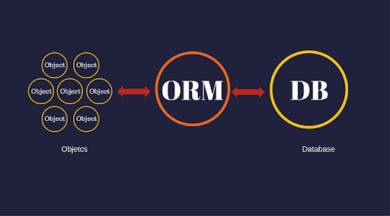
ORMs
Object Relational Mapping is technique in programming that represents data models from a database in Objects inside our programming languages, and the other way around
Allows to interpret our database rows as objects
Allows us to define our database tables using classes
Object Relational Mappers are libraries or frameworks that perform object relational mapping
They are the layer in between your programs objects and the database

Slide 4
Code first approach
Most ORMs work using the Code first principle
This means that we create our classes inside our application
We can program the interaction between these classes as usual Python classes
We allow the ORM Framework to do the rest
This allows us to focus on defining useful programming logic instead of worrying about database interactions
Code first is not always the best idea, but it works like magic when you are creating a new application
Working with existing databases, and/or multiple databases is not a good scenario for this

Slide 5
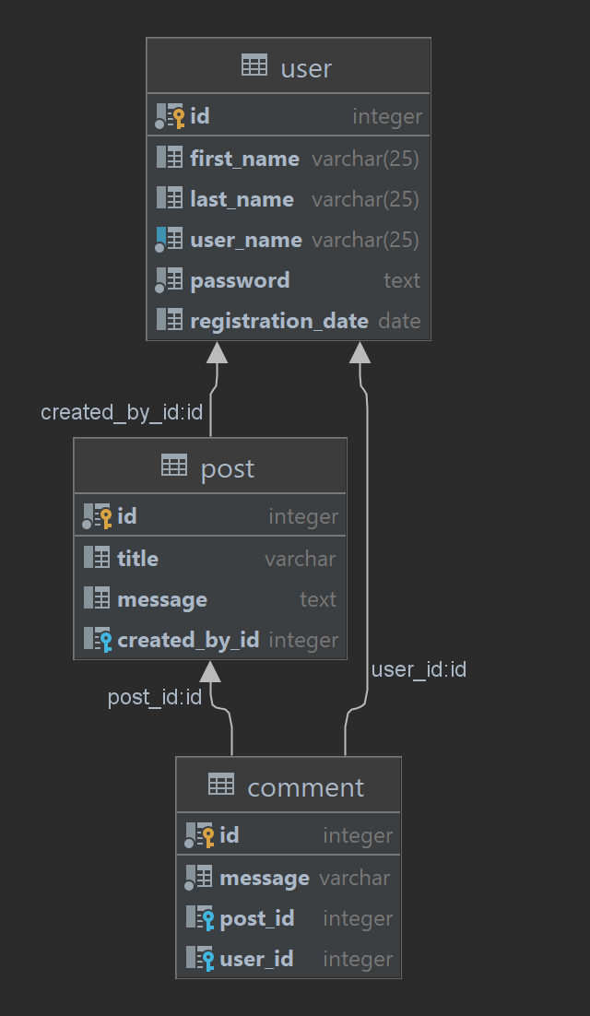
Example table
The database would be very simple.
We would need Foreign keys
Post to User
Comment to Post
Comment to User

Slide 6
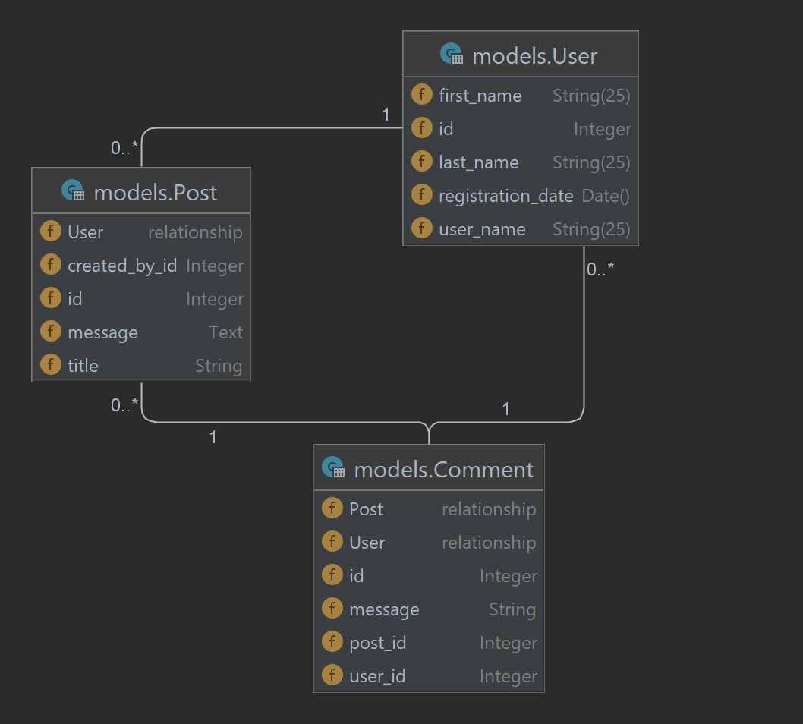
Class interaction
As for the interaction of our classes:
We want to easily access:
Comments of a user
Posts of a user
Comments of a post
All this from inside our objects.
Sound fun, right ?

Slide 7
Declaring classes
from sqlalchemy import create_engine from sqlalchemy.orm import declarative_base engine = create_engine('sqlite:///orm_database.db') Base = declarative_base(engine)
From SQLAlchemy ORM library, we should create a Base
Will act as the base class for our database classes
Binds to the database engine

Slide 8
Declaring our class
from datetime import datetime from sqlalchemy import Column, Integer, String, Date, Text from database import Base class User(Base): # We extend the Base class __tablename__ = 'user' id = Column(Integer, primary_key=True, autoincrement=True) first_name = Column(String(25)) last_name = Column(String(25)) user_name = Column(String(25), unique=True, nullable=False) password = Column(Text, nullable=False) registration_date = Column(Date(), default=datetime.now) Base.metadata.create_all() # Create the tables in our databases, after we declared them

Slide 9
Our class acts as a normal Object
We can work with our data class as with any other class
import hashlib class User(Base): # We extend the Base class __tablename__ = 'user' id = Column(Integer, primary_key=True, autoincrement=True) first_name = Column(String(25)) last_name = Column(String(25)) user_name = Column(String(25), unique=True, nullable=False) password = Column(Text, nullable=False) registration_date = Column(Date(), default=datetime.now) def __repr__(self): return f"User: [{self.user_name}, {self.first_name} {self.last_name}, {self.registration_date}]" def __str__(self): return repr(self) def set_password(self, password: str): self.password = self.hash_password_text(password) @classmethod def hash_password_text(cls, password): return hashlib.sha224(password.encode()).hexdigest()
my_user = User( user_name='mtricolici', first_name='Marius', last_name='Tricolici', password='pass' ) print(my_user.user_name) # mtricolici print(my_user.first_name) # Marius print(my_user.password) # pass

Slide 10
Hashing
my_user = User( user_name='mtricolici', first_name='Marius', last_name='Tricolici' ) my_user.set_password('pass') print(my_user.user_name) # mtricolici print(my_user.first_name) # Marius print(my_user.password) # ccc9c73a37651c6b35de64c3a37858ccae045d285f57fffb409d251d print(my_user.hash_password_text('pass')) # ccc9c73a37651c6b35de64c3a37858ccae045d285f57fffb409d251d print(my_user.hash_password_text('pasS')) # d2bbd5c94105f8b8a6688da15ddaa65667247de50ac8f3eef914fc4c
Hash is a non-reversible string of data, that can be used to obfuscate information
Commonly used with passwords
Every small change in the original strings, produces a very different hash

Slide 11
Session
from sqlalchemy import create_engine from sqlalchemy.orm import declarative_base, sessionmaker engine = create_engine('sqlite:///ord_database.db') Base = declarative_base(engine) Session = sessionmaker(bind=engine)
from database import Session from models import User def create_user(username, firstname, last_name, password): my_user = User( user_name=username, first_name=firstname, last_name=last_name ) my_user.set_password(password) print(my_user) session = Session() # Create new session session.add(my_user) # Add user to the session session.commit() # Save changes to the database return my_user # Testing if __name__ == '__main__': create_user('mtricolici', 'Marius', 'Tricolici', 'pass') # User: [mtricolici, Marius Tricolici, None]
The session object can be used to communicate with our database
This includes: adding, modifying, querying and deleting information
After all changes are finished in the session, we should commit the changes

Slide 12
Query
def user_queries(): session = Session() all_users = session.query(User).all() print(all_users) # [User: [mtricolici, Marius Tricolici, 2022-03-24]] users_count = session.query(User).count() print(users_count) # 1 my_user = session.query(User).filter(User.user_name == 'mtricolici').one() print(my_user) # User: [mtricolici, Marius Tricolici, 2022-03-24]

Slide 13
Relationships
class Post(Base): __tablename__ = 'post' id = Column(Integer, primary_key=True, autoincrement=True) title = Column(String) message = Column(Text) created_by_id = Column(Integer, ForeignKey('user.id')) created_by = relationship("User", backref='posts') class Comment(Base): __tablename__ = 'comment' id = Column(Integer, primary_key=True, autoincrement=True) message = Column(String, nullable=False) post_id = Column(Integer, ForeignKey('post.id')) user_id = Column(Integer, ForeignKey('user.id')) post = relationship("Post", backref="comments") user = relationship("User", backref="comments")
Foreign keys identify database level relations
relationship() defines ORM level relationships
backref argument defines how we access the element from the related Entity (Example: User)
Example: user.posts or user.comments
user = session.query(User).filter(
User.id == user_id
).one() return user.posts

Slide 14
Session
from database import Session from models import User session = Session() user = session.query(User).filter(User.id == 1).one() user.first_name = 'New name' print(session.dirty) # IdentitySet([User: [mtricolici, New name Tricolici, 2022-03-24]]) print(session.new) # IdentitySet([]) new_user = User(user_name='some_new_user') new_user.set_password('pass') session.add(new_user) print(session.new) # IdentitySet([User: [some_new_user, None None, None]]) new_user.first_name = 'Updated name' print(session.new) # IdentitySet([User: [some_new_user, Updated name None, None]])
Session keeps track of:
All the changes
All the additions
And all the deletions
session.rollback() print(session.dirty) # IdentitySet([]) print(user.first_name) # Marius print(session.new) # IdentitySet([])

Slide 15
Final Project

Slide 16
Final Project
Your final project should contain the following:
Provide a service
Examples:
Email subscription service (Allow to register clients to email newsletter, and send an email to all subscribed clients)
Currency converter (Allows to convert from any currency to any currency, save history of convertion rates, etc…)
Weather API (Allows to see current weather, historical data, and forecast)
Provide a WEB API
All actions should be invoked from a Web API
Save all data to a SQL Database (Users, History of access, Data, etc…)
Generate Reports
Examples:
An XLSX Export of all the user activity for the past N days
A graph of user activity for the past N days

Slide 17
Final project presentation
The final project can be presented at our last session
~ 5-10 minutes per person
Should include:
What is the functionality
What were the difficulties and how you overcame them
What would you like to add to the project to make it better
Possible Dates:
08 Apr
13 Apr
20 Apr

Slide 18

That’s it folks

