Slide 1
Getting Started with Strainmeter Data
Strainmeter Short Course
Earthscope Meeting
May 12, 2009

Slide 2
Overview
Download low frequency strain and SOH data
Download 1-sps data
Download Level 2 processed data

Slide 3
Getting Started: Some tools and scripts
http://cws.unavco.org:8080/cws/learn/uscs/2009/2009strainmeter/handouts/
Data Download and Tools
Strainmeter Example Scripts

Slide 4
Getting Started: Some tools and scripts
Untar
  tar -xf examples.tar
Change into the examples directory
  cd examples

Slide 5
Getting Started: Some tools and scripts
Code to convert and merge bottle file
bottle.py
  Converts bottle file to ascii format
bottle_merge.py
  Merges bottle files
Code to read XML files
rdstrain.pl
  Parses XML files

Slide 6
Getting Started: Some tools and scripts
get_lf.csh
  Downloads long-term low frequency strain & SOH data
  Produces raw and linearized strain data
get_1sps.csh
  Downloads 1 sps data,
  Produces raw and linearized data
get_l2.csh
  Downloads most recent processed data set

Slide 7
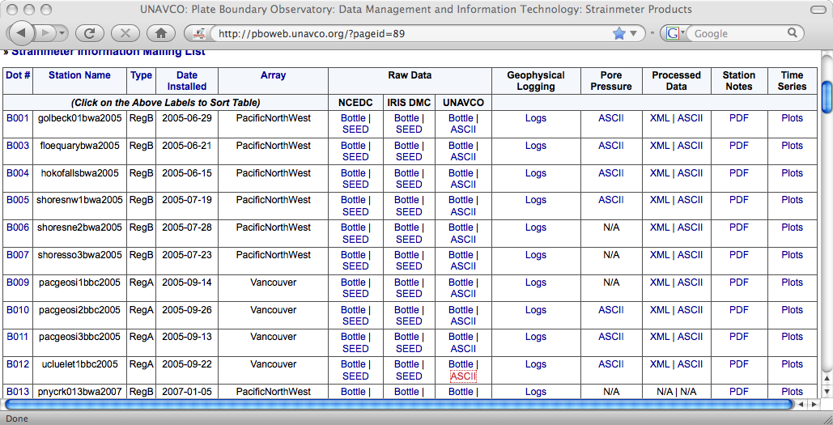
LF strain and SOH data: get_lf.csh
Usage: get_lf.csh Bnum start_date end_date
get_lf.csh B012 2007-02-01 2009-02-01

Slide 8
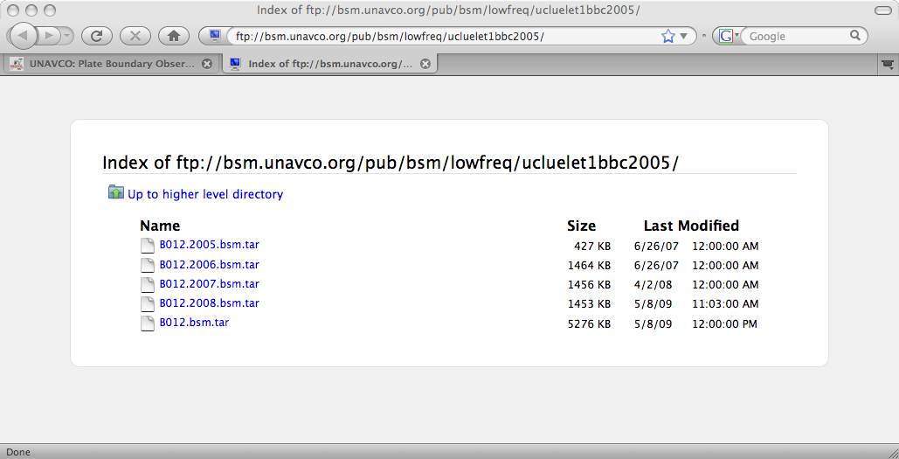
LF strain and SOH data: get_lf.csh
Usage: get_lf.csh Bnum start_date end_date
get_lf.csh B012 2007-02-01 2009-02-01

Slide 9
LF strain and SOH data: get_lf.csh
Usage: get_lf.csh Bnum start_date end_date
get_lf.csh B012 2007-02-01 2009-02-01
B012.ALL_LF.l.txt linearized gauge data
B012.ALL_LF.r.txt raw gauge data
B012.SOH.txt state of health data
B012.bsm.tar original tar file

Slide 10
LF strain and SOH data: get_lf.csh
B012.ALL_LF.r.txt raw gauge data (digital counts)
Date-Time CH0 CH1 CH2 CH3
2007-02-01T00:00:00 51362734 51266227 49898655 47842622
2007-02-01T00:10:00 51362769 51266260 49898739 47842722
2007-02-01T00:20:00 51362798 51266293 49898803 47842797
B012.ALL_LF.l.txt linearized gauge data (ns)
Date-Time CH0 CH1 CH2 CH3
2007-02-01T00:00:00 0.000 0.000 0.000 0.000
2007-02-01T00:10:00 3.401 3.194 7.693 8.450
2007-02-01T00:20:00 6.219 6.388 13.554 14.788
2007-02-01T00:30:00 8.649 8.131 18.408 20.619

Slide 11
LF strain and SOH data: get_lf.csh
B012.SOH.txt 30 minute interval data
Battery Volts
Downhole Temperature °C
Logger Temperature °C
PowerBox Temperature °C
Pressure KPa
Rainfall mm
Solar Amps
System Amps

Slide 12
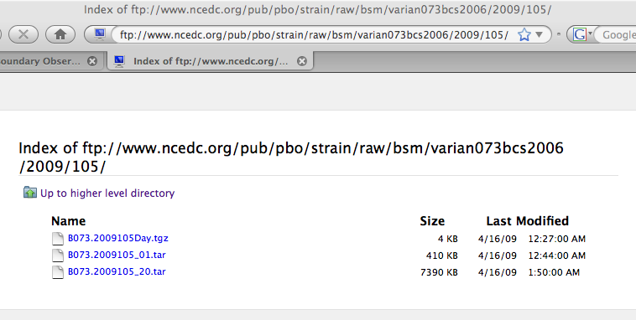
1 sps Bottle Data: get_1sps.csh
Usage: get_1sps.csh Bnum 16-character-code start_year start_day_of_yr start_time end_year end_day_of_year end_time p
get_1sps.csh B073 varian073bcs2006 2009 105 13:00:00 2009 105 16:00:00 p

Slide 13
1 sps Bottle Data: get_1sps.csh
get_1sps.csh B073 varian073bcs2006 2009 105 13:00:00 2009 105 16:00:00 p

Slide 14
1 sps Bottle Data: get_1sps.csh
get_1sps.csh B073 varian073bcs2006 2009 105 13:00:00 2009 105 16:00:00 p
B073.ALL_01.l.txt linearized gauge data
B073.ALL_01.r.txt raw gauge data
B073.ps postscript file
B073.2009105_01.tar original tar

Slide 15
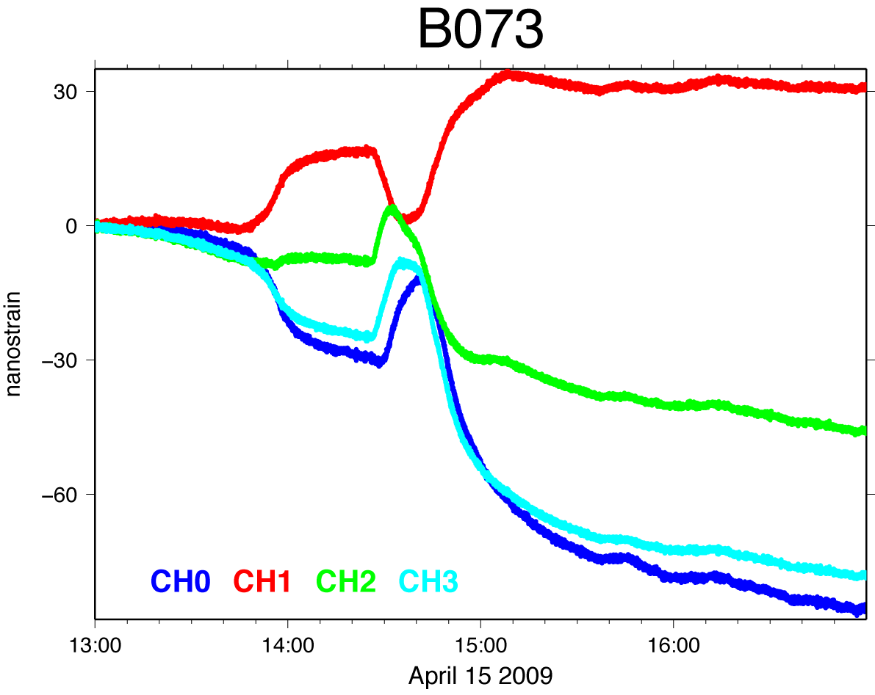
1 sps Bottle Data: get_1sps.csh

Slide 16
Processed Data: get_l2.csh
Usage: get_l2.csh Bnum start end
get_l2.csh B073 2009-04-01 2009-05-01
B073.2Ene.txt
B073.Eee-Enn.txt
B073.gage1.txt
B073.gage3.txt
B073.Eee+Enn.txt
B073.gage0.txt
B073.gage2.txt

Slide 17
Processed Data
strain Type of strain, gauge0
date Date
doy Day of year
MJD Modified Julian Date
gage0(Microstrain) Linear strain
s_offset Running sum of offsets
strain_quality Strain data quality flag
tide_c Tide correction
detrend_c Detrend correction
atmp_c_-0.0110289 Barometric correction
atmp_c_quality Barometric data quality flag
level 2a or 2b
Version Generation date

Slide 18
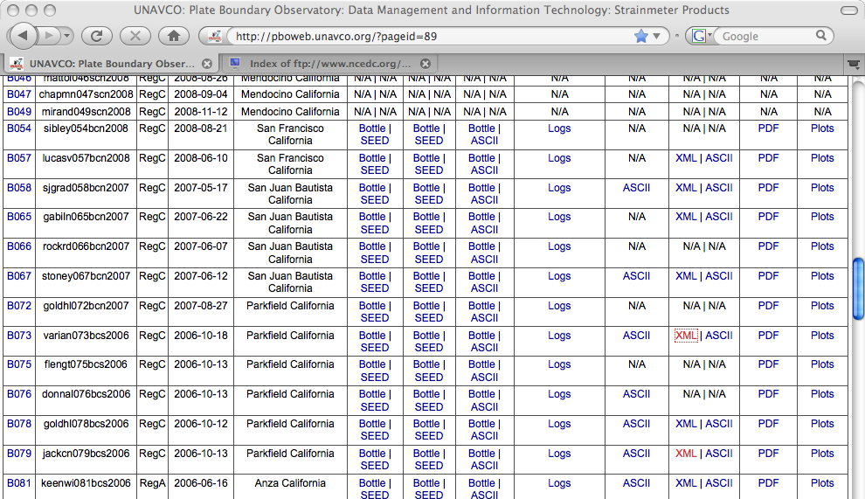
Processed Data: XML files, example
To gain processing information you must read the XML file
Web download,
go to PBO web page, select XML

Slide 19
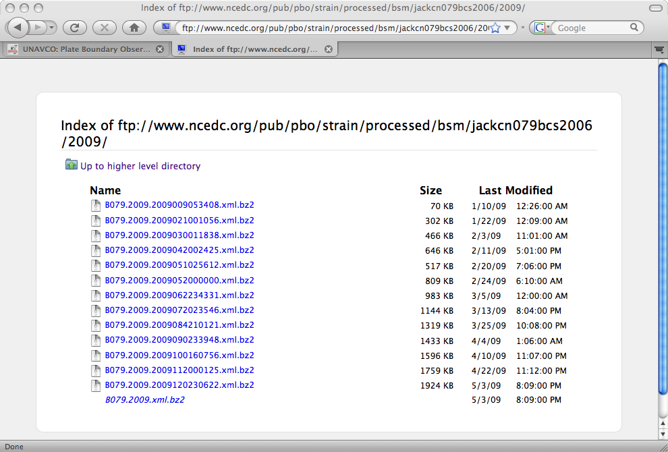
Processed Data: XML files, example
Double click B079.2009.xml.bz2

Slide 20
Processed Data: XML files, example
FTP download
ftp://www.ncedc.org/pub/pbo/strain/processed/bsm/jackcn079bcs2006/2009/B079.2009.xml.bz2

Slide 21
Processed Data: rdstrain.pl
Usage: rdstrain -f xml_file -i -o a|x -j -r flag -q flag -s YYYYMMDDHHMMSS -e YYYYMMDDHHMMSS
-f xml input file
-I extract XML header information only
-l print strainmeter summary only
-o strain data output format (a = ascii x = XML)
-j add offset correction to strain time series
-r if the strain quality flag is anything other than good replace the strain value with flag
-q if the time series correction quality flags are anything other than good replace the strain value with flag
-s start time YYYYMMDDHHMMSS
-e end time YYYYMMDDHHMMSS

Slide 22
Processed Data: rdstrain.pl
rdstrain -f B079.2009. xml -i
<sensor_response>
<sensor_start_date>2006-10-13T00:00:00</sensor_start_date>
<sensor_end_date>3000-01-01T00:00:00</sensor_end_date>
<sensor_type>Gladwin_BSM_component_2_</sensor_type> <sensor_code>E4K2J8S2F6A9+BSM_+Gladwin_BSM_component_2_</sensor_code>
<channel_code>Gladwin_BSM_component_2_+00086400</channel_code>
<depth units="m">181.488</depth>
<orientation direction="east_of_north" units="degrees">279.8</orientation>
<sensor_volts_per_unit>0.0</sensor_volts_per_unit>
…….
<datalogger_manufacturer>GTSM Technologies</datalogger_manufacturer>
<datalogger_serial_number>PBO-05-021</datalogger_serial_number>
<datalogger_model>GTSM21</datalogger_model>
<sensor_serial_number>PBO-05-021</sensor_serial_number>
</sensor_response>

Slide 23
Processed Data: rdstrain.pl
rdstrain -f B079.2009. xml -i
<atm_pressure unit="microstrain_per_millibar">
<apc_g0>-0.00365295</apc_g0>
<apc_g1>-0.00445790</apc_g1>
<apc_g2>-0.00376138</apc_g2>
<apc_g3>-0.00349151</apc_g3>
</atm_pressure>

Slide 24
Processed Data: rdstrain.pl
rdstrain -f B079.2009. xml -i
<decimate_by_two_filter kind="causal" number="30">
0.0983262 0.2977611 0.4086973 0.3138961
0.0494246 -0.1507778 -0.1123764 0.0376576 0.0996838 0.0154992 - 0.0666489 -0.0346632 0.0322767 0.0399294 -0.0097461 -0.0341585 -0.0039241 0.0246776 0.0099725 -0.0157879 -0.0099098 0.0078510 0.0081126 -0.0026986 -0.0061424 0.0007108 0.0039659 -0.0006209 -0.0017117 0.0007240
</decimate_by_two_filter>
<decimate_by_three_filter kind="causal" number="23">
0.0373766 0.1165151 0.238572 0.3083302 0.2887327 0.1597948 0.0058244 -0.0973639 -0.1051034 -0.0358455 0.0359044 0.0632477 0.0302351 -0.0168856 -0.0356758 -0.0190635 0.0126188 0.0159705 0.0082144 -0.0087978 -0.0037289 -0.0017068 0.0028335 </decimate_by_three_filter>
<decimate_by_five_filter kind="causal" number="34">
0.0218528 0.0458359 0.0908603 0.1359777 0.1830881 0.1993418 0.1957624 0.1561194 0.0994146 0.0346412 -0.0236544 -0.0580081 -0.0703257 -0.0555546 -0.0287709 0.0032613 0.0267938 0.0358952 0.0311186
0.0134283 -0.0028524 -0.0170042 -0.0176765 -0.0123123 -0.0036798 0.0057730 0.0059810 0.0083501 0.0000581 0.0005724 -0.0033127 0.0004411 -0.0030766 0.0016604
</decimate_by_five_filter>

Slide 25
Processed Data: rdstrain.pl
rdstrain -f B079.2009. xml -i
<tidal_parameters>
<units phase="degrees" potential="local" lag="negative" amp="nanostrain"/>
<tide name="M2" period_hours="12.42" doodson="2 0 0 0 0 0 ">
<phz kind="gage0">11.058</phz>
<amp kind="gage0">6.270</amp>
</tide>
<tide name="O1" period_hours="25.82" doodson="1 -1 0 0 0 0 ">
<phz kind="gage0">8.330</phz>
<amp kind="gage0">0.872</amp>
</tide>
<tide name="K1" period_hours="23.93" doodson="1 1 0 0 0 0 ">
<phz kind="gage0">-35.781</phz>
<amp kind="gage0">1.798</amp>
</tide>

Slide 26
Processed Data: rdstrain.pl
rdstrain -f B079.xml -o a
B079.2Ene.txt
B079.Eee-Enn.txt
B079.gage1.txt
B079.gage3.txt
B079.Eee+Enn.txt
B079.gage0.txt
B079.gage2.txt

Slide 27
Documentation
http://pboweb.unavco.org/strain_data
Documentation link
http://pboweb.unavco.org/?pageid=101
Network link
http://pboweb.unavco.org/

