Slide 1
Project (30 points)

Slide 2
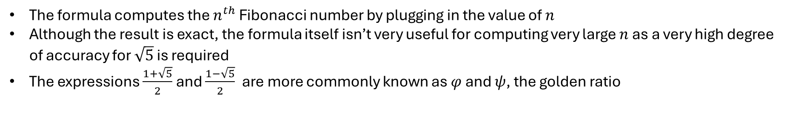

Question 1 – Research
Binet’s formula:
$$F_{n}=\frac{\left({\left(\frac{1+\sqrt{5}}{2}\right)}^{n}−{\left(\frac{1−\sqrt{5}}{2}\right)}^{n}\right)}{\sqrt{5}}$$
The formula computes the $n^{th}$ Fibonacci number by plugging in the value of $n$
Although the result is exact, the formula itself isn’t very useful for computing very large $n$ as a very high degree of accuracy for $\sqrt{5}$ is required
The expressions $\frac{1+\sqrt{5}}{2}$and $\frac{1−\sqrt{5}}{2}$are more commonly known as $φ$ and $ψ$, the golden ratio

Slide 3
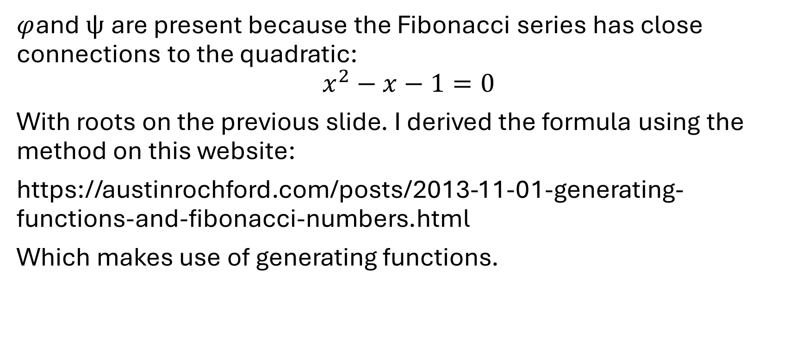
Binet’s formula derivation
$φ$and $ψ$are present because the Fibonacci series has close connections to the quadratic:
$$x^{2}−x−1=0$$
With roots on the previous slide. I derived the formula using the method on this website:
https://austinrochford.com/posts/2013-11-01-generating-functions-and-fibonacci-numbers.html
Which makes use of generating functions.

Slide 4
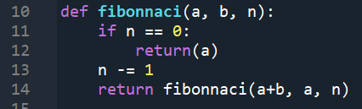
Part A: Question 2 - Recursion
Repeatedly calls the function
New values of a and b are used each time the function is run, until n reaches 0, where the function stops
Limitations: there is a maximum recursion depth so it cannot calculate F(n) with too large n.

Slide 5
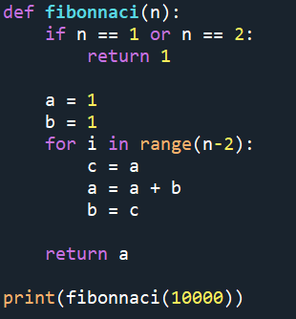
For loop
Similar to the previous method, only with a for loop
It works by reassigning the previous value of a to b, and the new value of a being the sum of the previous values of a and b.

Slide 6
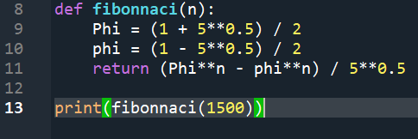
Binet’s formula
Implements Binet’s formula
I have shown how to derive this in my answer to question 1.
Limitations: It cannot calculate large n because the exponent of phi is too large

Slide 7

Question 3: Graph n vs digits in F(n)
They are directly proportional
The graph has a slope of about 0.209, meaning that the digits in $F(n)$ is rough a 5th of $n$ itself

Slide 8

Question 4 - Runtime
Time grows linearly for the function and the for loop, as it takes n steps, whereas time should be constant for Binet’s formula as it is just one calculation

Slide 9

For loop runtime
The run time is clearly not linear, but proportional to about $n^{1.9}$
I was surprised by this because the algorithm only takes $3n$ steps for each time the function is run

Slide 10
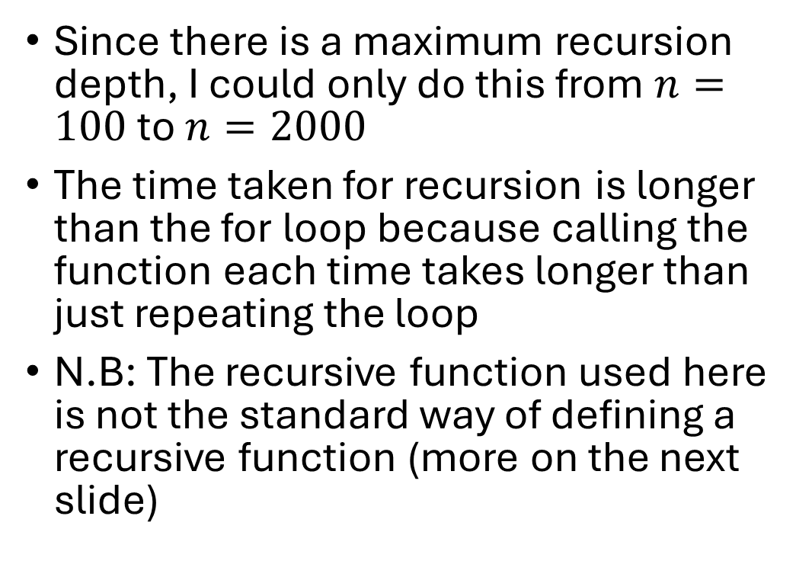
Recursion runtime
Since there is a maximum recursion depth, I could only do this from $n=100$ to $n=2000$
The time taken for recursion is longer than the for loop because calling the function each time takes longer than just repeating the loop
N.B: The recursive function used here is not the standard way of defining a recursive function (more on the next slide)

Slide 11



2 ways of finding $F\left(n\right)$ recursively:
The first way is less efficient, because it calls itself twice each time it is called, but more intuitive because it is the exact definition of the Fibonacci numbers
The second way only calls itself twice every time it is run, but is less user friendly because there are variables $a$ and $b$

Slide 12

Binet’s formula runtime
I ran into the problem that with $n>1500,$the exponent of $φ$ and$ψ$is too large
Ways to get around this were not accurate so I didn’t include this, and concluded that Binet’s formula just isn’t that practical for large $n$ due to floating point errors

Slide 13
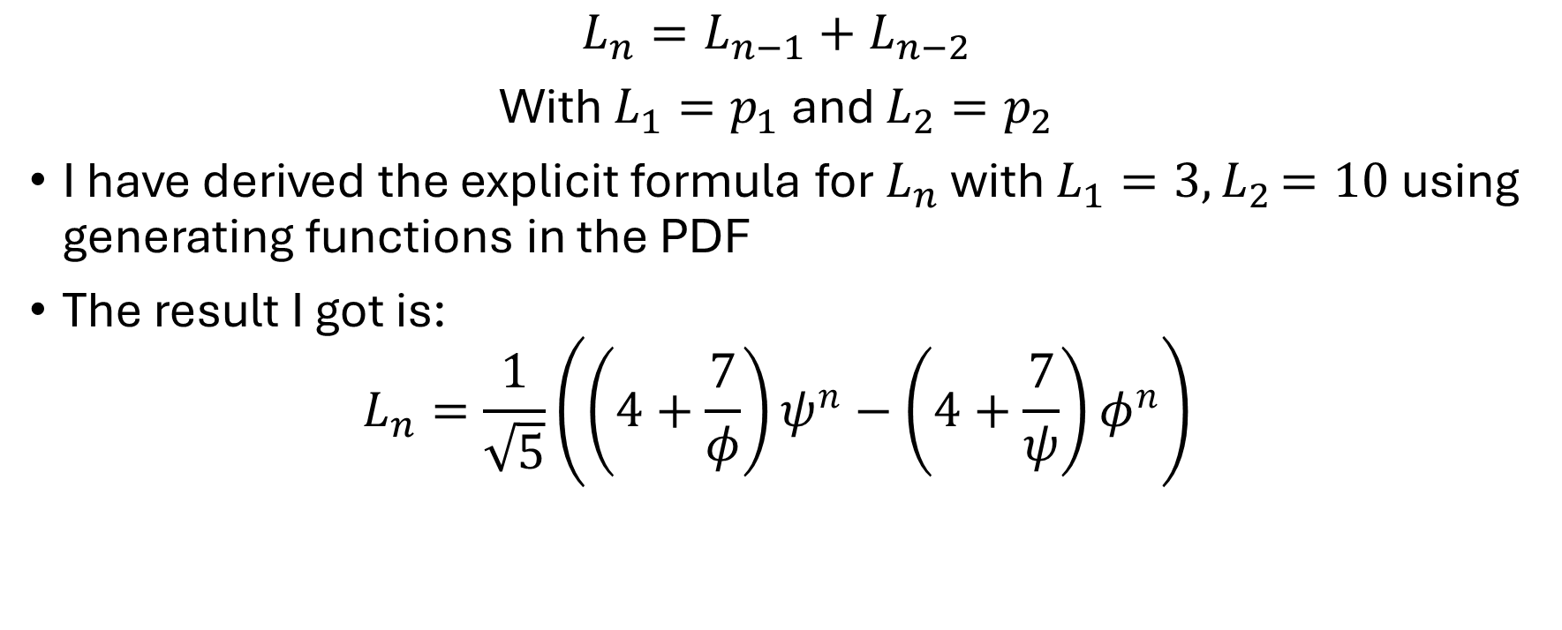
Part B: Question 5a – Lucas sequences
$$L_{n}=L_{n−1}+L_{n−2}$$
With $L_{1}=p_{1}$ and $L_{2}=p_{2}$
I have derived the explicit formula for $L_{n}$ with $L_{1}=3{, L}_{2}=10$ using generating functions in the PDF
The result I got is:
$$L_{n}=\frac{1}{\sqrt{5}}\left({\left(4+\frac{7}{φ}\right)ψ}^{n}−{\left(4+\frac{7}{ψ}\right)φ}^{n}\right)$$

Slide 14
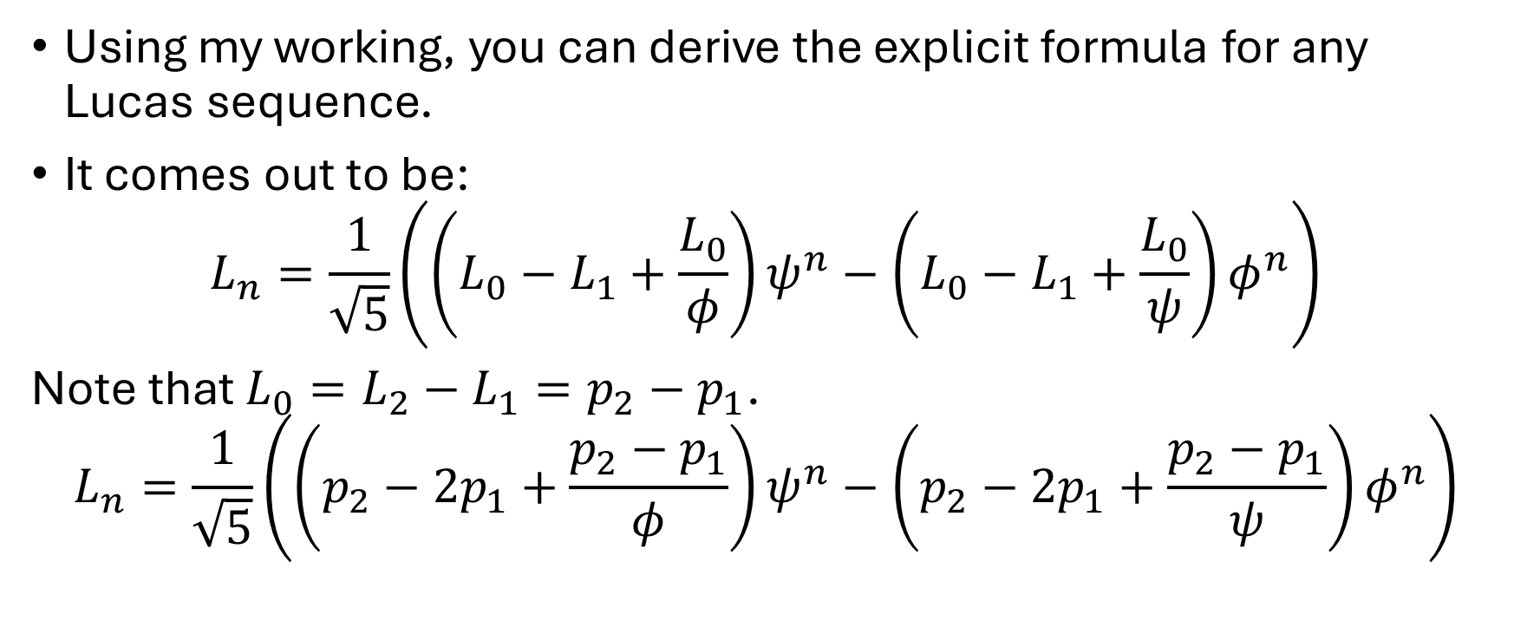
Lucas sequences
Using my working, you can derive the explicit formula for any Lucas sequence.
It comes out to be:
$$L_{n}=\frac{1}{\sqrt{5}}\left({\left(L_{0}−L_{1}+\frac{L_{0}}{φ}\right)ψ}^{n}−{\left(L_{0}−L_{1}+\frac{L_{0}}{ψ}\right)φ}^{n}\right)$$
Note that $L_{0}=L_{2}−L_{1}=p_{2}−p_{1}$.
$$L_{n}=\frac{1}{\sqrt{5}}\left({\left(p_{2}−{2p}_{1}+\frac{p_{2}−p_{1}}{φ}\right)ψ}^{n}−{\left(p_{2}−{2p}_{1}+\frac{p_{2}−p_{1}}{ψ}\right)φ}^{n}\right)$$

Slide 15
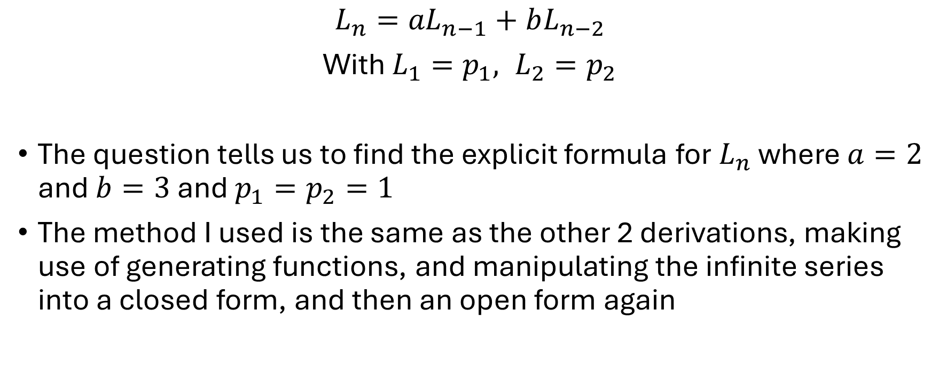
Question 5b: Lucas sequences with coefficients
$$L_{n}={aL}_{n−1}+bL_{n−2}$$
With $L_{1}=p_{1}, L_{2}=p_{2}$
The question tells us to find the explicit formula for $L_{n}$ where $a=2$ and $b=3$ and $p_{1}=p_{2}=1$
The method I used is the same as the other 2 derivations, making use of generating functions, and manipulating the infinite series into a closed form, and then an open form again

Slide 16
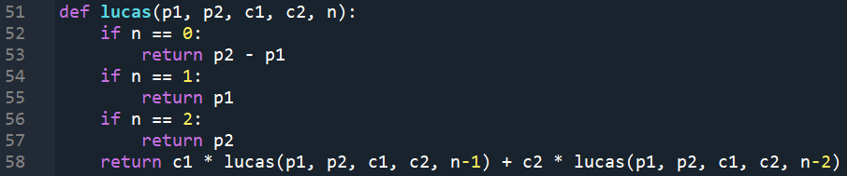

Iterative algorithm for Lucas sequences
This algorithm is just the simplest, recursive definition of the Lucas sequence.
$c_{1}$and$c_{2}$ are just the coefficients of $L_{n−1}$ and $L_{n−2}$, in a) they are 1 and 1, In b) they are 2 and 3
$L_{1}$ and $L_{2}$ are the first 2 terms of the sequence, in a) they are 3 and 10, in b) they are 1 and 1

Slide 17
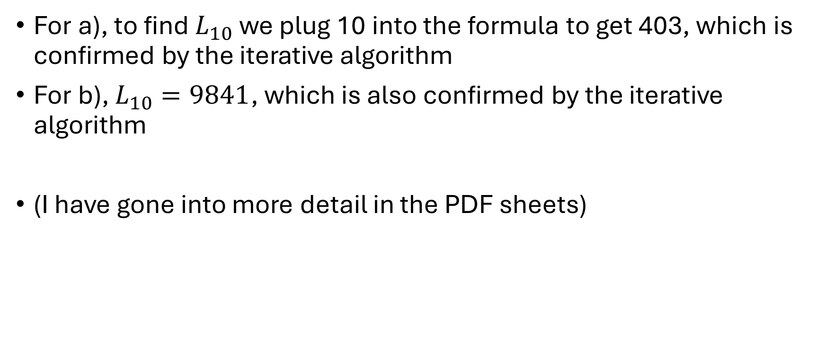
Lucas sequences test
For a), to find $L_{10}$ we plug 10 into the formula to get 403, which is confirmed by the iterative algorithm
For b), $L_{10}=9841$, which is also confirmed by the iterative algorithm
(I have gone into more detail in the PDF sheets)

Slide 18
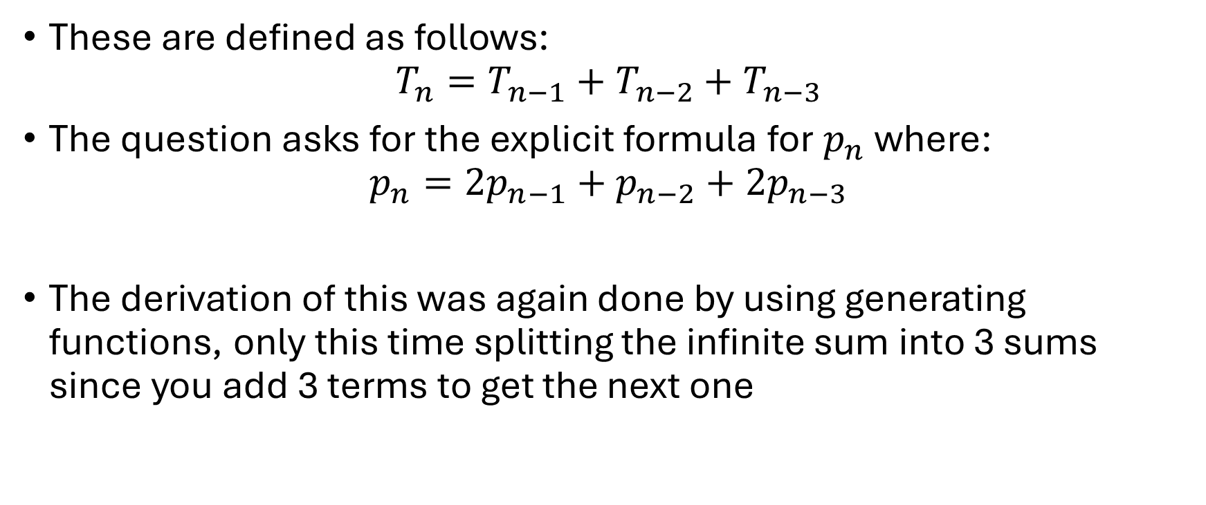
Question 6: Tribonacci numbers
These are defined as follows:
$$T_{n}=T_{n−1}+T_{n−2}+T_{n−3}$$
The question asks for the explicit formula for $p_{n}$where:
$$p_{n}={2p}_{n−1}+p_{n−2}+{2p}_{n−3}$$
The derivation of this was again done by using generating functions, only this time splitting the infinite sum into 3 sums since you add 3 terms to get the next one

Slide 19
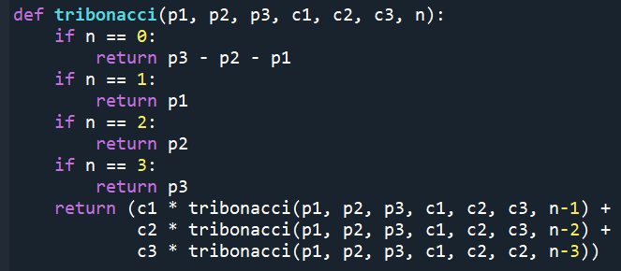
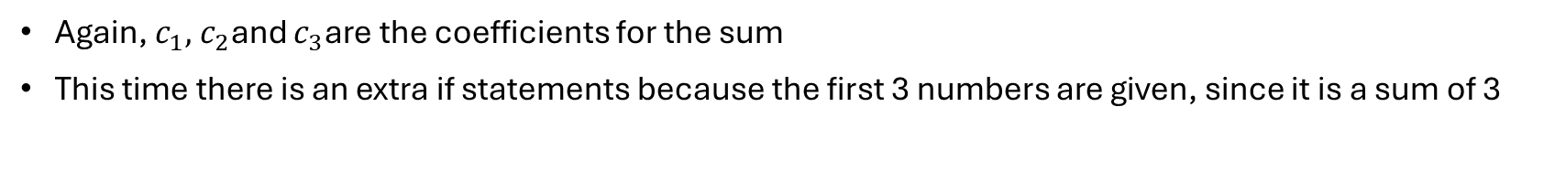
Iterative algorithm for the Tribonacci numbers
Again, $c_{1},$ $c_{2}$and $c_{3}$are the coefficients for the sum
This time there is an extra if statements because the first 3 numbers are given, since it is a sum of 3

Slide 20
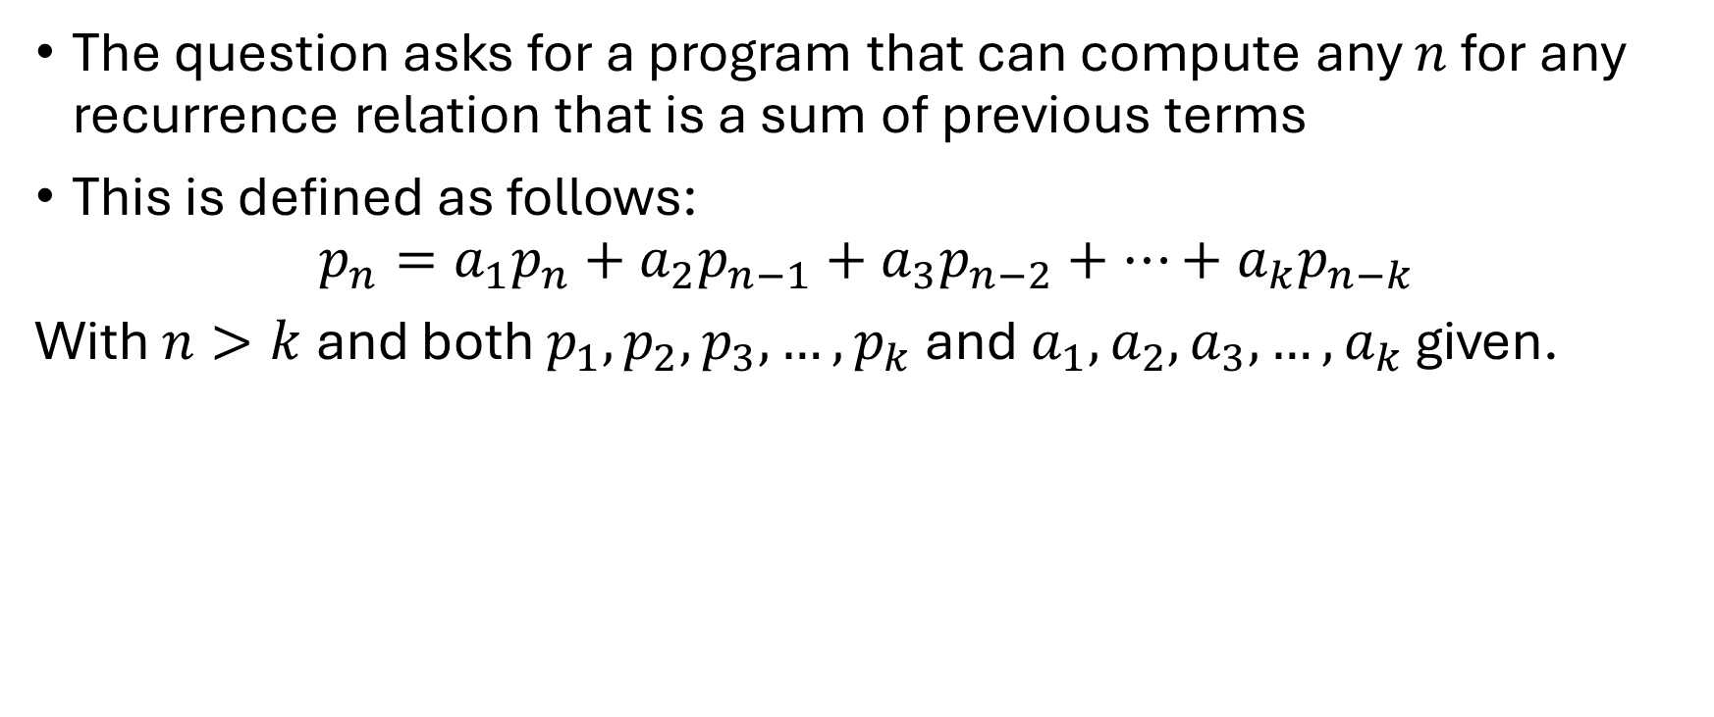
Question 7 – General recurrence
The question asks for a program that can compute any $n$ for any recurrence relation that is a sum of previous terms
This is defined as follows:
$$p_{n}=a_{1}p_{n}+a_{2}p_{n−1}+a_{3}p_{n−2}+…+a_{k}p_{n−k}$$
With $n>k$ and both $p_{1},p_{2},p_{3},…,p_{k}$ and $a_{1},a_{2},a_{3}{,…,a}_{k}$ given.

Slide 21
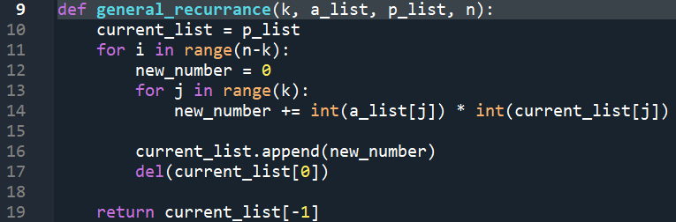
General recurrence
The function takes parameters, a_list, p_list, k and n
a_list and p_list are the lists of the a and p numbers explained before
The function makes use of a simple for loop, with a list of k numbers
This list is added together to make the next number, and this becomes the first element of the new list
The last element is removed to keep this list at a length of k

