Slide 1












Who loves tech?

Slide 2
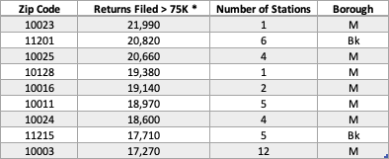
Who loves galas!
Considered income brackets of residents near MTA station stops
Extra income for a night out and to make a voluntary monetary contribution
*Data Source: https://www.irs.gov/statistics/soi-tax-stats-individual-income-tax-statistics-2018-zip-code-data-soi

Slide 3
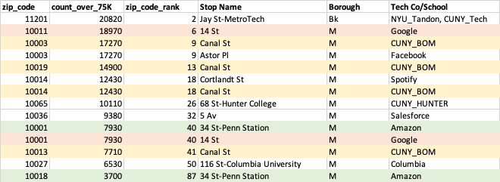
rough table of the biz/edu and income perspectives combined - AB
Note – stations listed more than once have multiple entry/exit points that those addresses are in different zip codes

