Slide 1
Digital Literacy
Kálmán Abari
Psychology BA

Slide 2
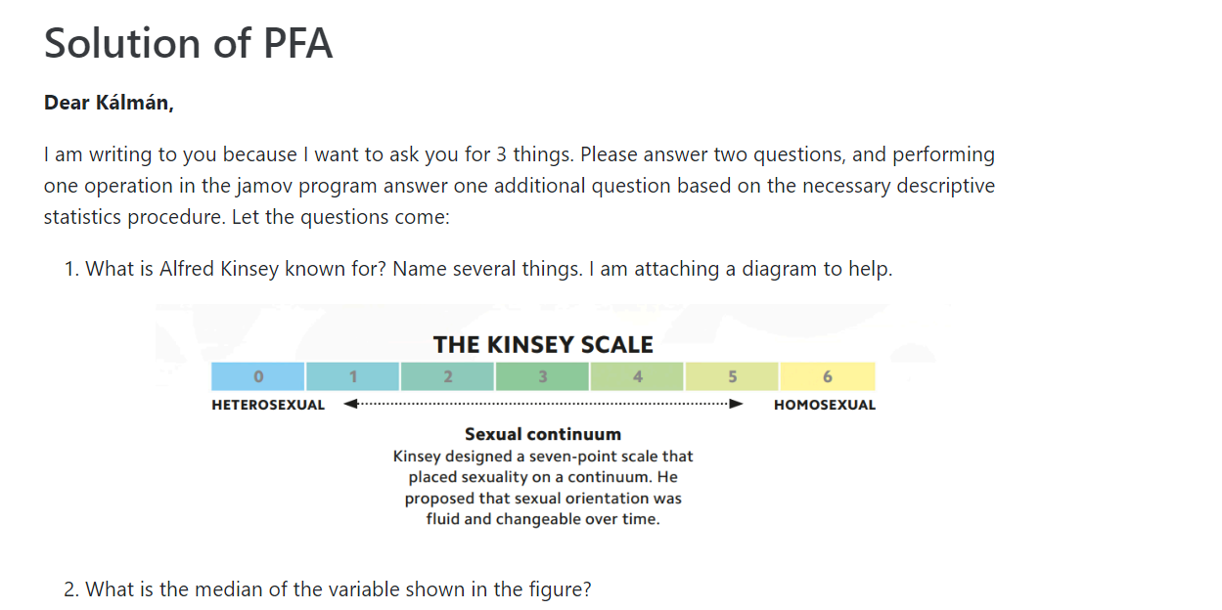
An email from Kálmán

Slide 3
Question 1
What is Alfred Kinsey known for? Name several things.
In 1948, Alfred Kinsey produced one of the first psychological studies of sexual orientation.
The Kinsey Reports are two scholarly books on human sexual behavior, Sexual Behavior in the Human Male[1] (1948) and Sexual Behavior in the Human Female[2] (1953), written by Alfred Kinsey, Wardell Pomeroy, Clyde Martin, and (for Sexual Behavior in the Human Female) Paul Gebhard and published by W.B. Saunders.
The Kinsey Institute for Research in Sex, Gender, and Reproduction (often shortened to The Kinsey Institute) is a research institute at Indiana University.

Slide 4
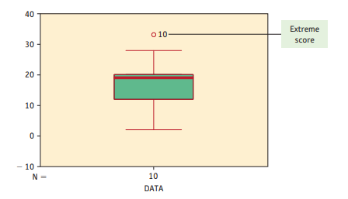
Question 2
What is the median of the variable shown in the figure?
About 20.

Slide 5
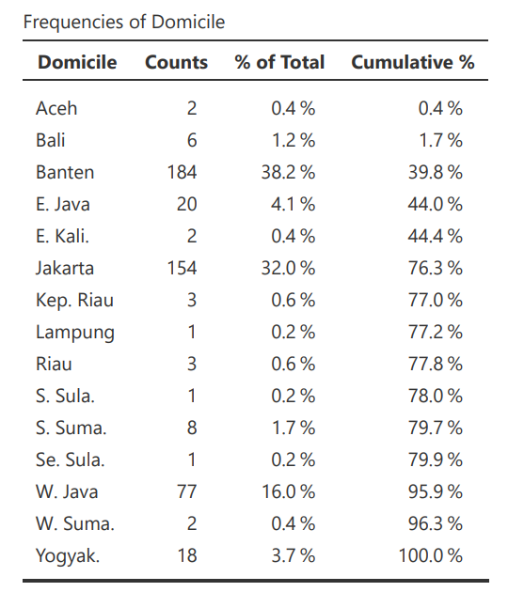
Question 3
What is the distribution of variable Domicile?
Look at the table on the right.

Slide 6
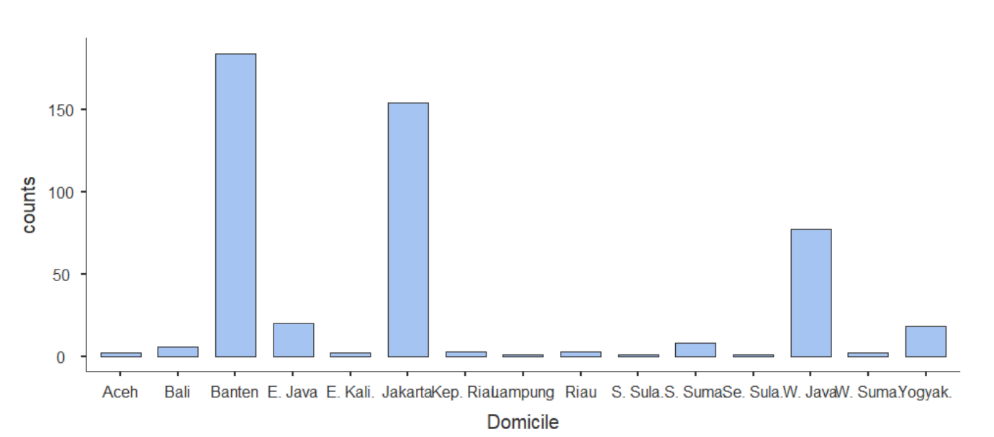
Question 3
What is the distribution of variable Domicile?
Look at the figure on the right.

