Slide 1

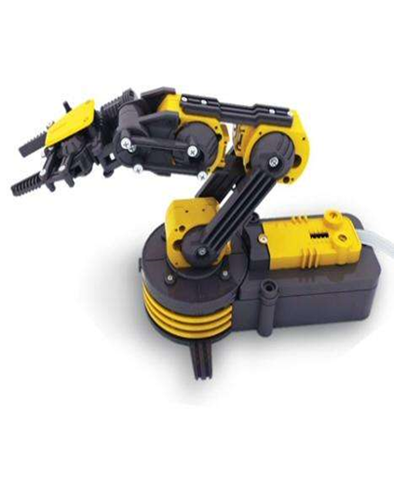
Voice Controlled Robotic Arm (VCRA)
Name: Abhishek Barla
ID: 900559822
Class: ECE 4242 - Senior Design
Faculty Advisor: Dr. Veton Kepuska (Dept. of ECE)
Semester: Spring 2015

Slide 2
Table of Contents
Introduction
Design of the Arm
Main Components
USB Control Explanation
USB Control Sample Code
Speech Recognition Explanation
Speech Recognition Sample Code
Timeline
Cost Table
Other Possibilities
Further Research
Special Thanks
Main Parts
USB Controls

Slide 3
Introduction
Robotic Arm controlled via USB
Linux OS and Python coded
Accepts Speech Input
Uses Google Speech Recognition API
Directs signals to the microcontroller
Sends data in the form of 3 bytes
4 degrees of Freedom
Shuts Motors after 1 or 2 seconds after action

Slide 4
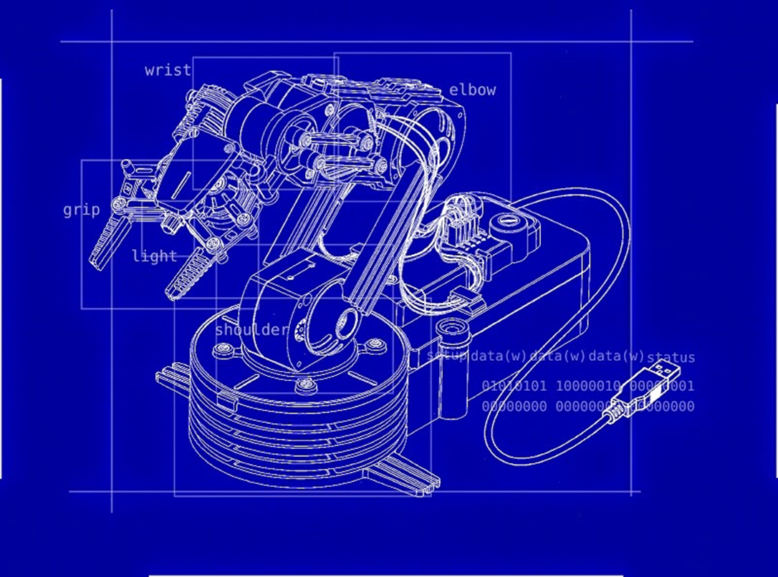
Design of the Arm

Slide 5
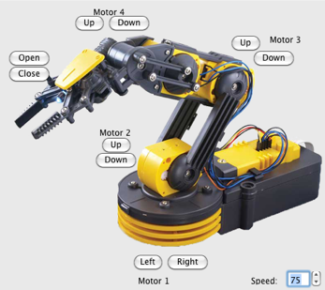
Design of the Arm

Slide 6
Basic Functions
Basic Functions | Speech Words
Grip Open | Open
Grip Close | Shut
Shoulder Up | Shoulder Up
Shoulder Down | Shoulder Down
Elbow Up | Elbow Up
Elbow Down | Elbow Down
Light On | Light On
Light Off | Light Off
Base Clockwise Rotation | Right
Base Anticlockwise Rotation | Left

Slide 7
Main Parts
Speech Recognition
Software
Movement Functions
VCRA
USB Control
Hardware
Controller Setup

Slide 8
Main Components
Hardware
Software
Google Speech Recognition API – Free
pyAudio (Cross platform I/O Python library)
Linux OS (Ubuntu)
pyUSB (USB Module)
libusb (C Library)
OWI Robotic Arm Edge
OWI USB Interface Kit for Windows
USB Wire

Slide 9
USB Control Explanation
To control the Robotic Arm with the USB, the OWI USB Interface Kit was used
The controls of the Arm were found out by reverse engineering the kit
The controls are sent in 3 bytes to the Arm
To make the USB connection and operate the arm using Linux OS, the USB module libraries such as pyUSB and libusb were used
The code was implemented using Python
The combination of the 3 bytes were stored in a datapacked and sent to the Arm to perform specified actions
To prevent the motors in the Arm from wearing out, each action is performed for either 1 second or 2 seconds and then an empty datapacket is sent to stop the motors
Byte 1 | Byte 2 | Byte 3
Main Functions | Rotation | Light
0x80 (Shoulder Down) | 01 (Clockwise Rotation) | 01 (Light on)

Slide 10
USB Controls
Bit Combination | Function
Byte 1 (02) | Grip Open
Byte 1 (01) | Grip Close
Byte 1 (40) | Shoulder Up
Byte 1 (80) | Shoulder Down
Byte 1 (10) | Elbow Up
Byte 1 (20) | Elbow Down
Byte 2 (01) | Base Clockwise Rotation
Byte 2 (02) | Base Anticlockwise Rotation
Byte 3 (01) | Light On
Byte 3 (00) | Light Off

Slide 11
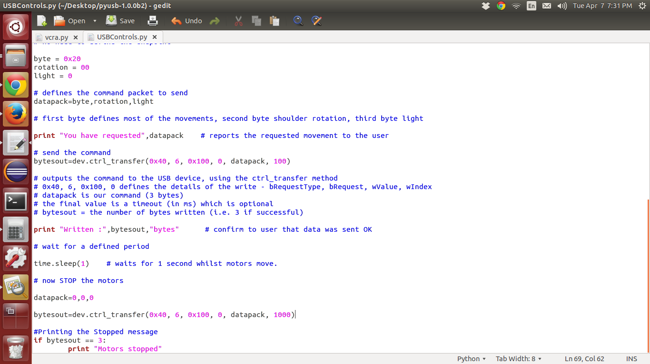
USB Control Sample Code

Slide 12
Speech Recognition API Functioning
Records the input from Microphone
Samples the sound input
Converts to FLAC format
Sends to Google Search API
Receives recognized word from Google Search API
If word is not recognized at all, then it throws error
If command is recognized - Function sends respective bytes to the Arm
The received word is checked with the set of acceptable commands of the Robotic Arm
If command is not recognized - It throws an error

Slide 13
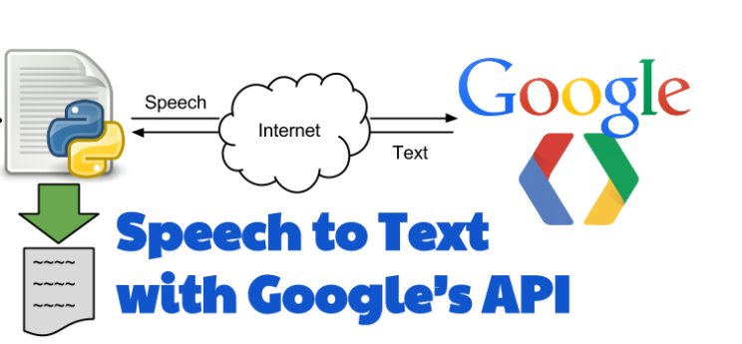
Speech Recognition API Flow Chart
Python Script
Sending Commands to Arm

Slide 14
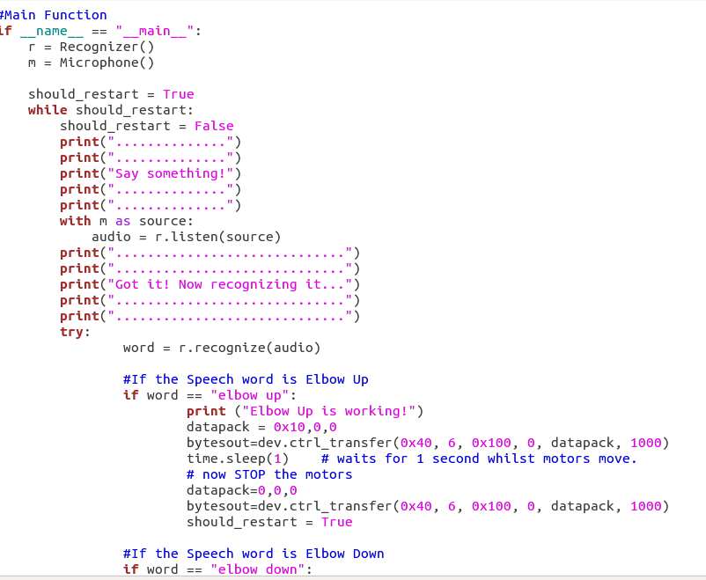
Speech Recognition Sample Code 1

Slide 15
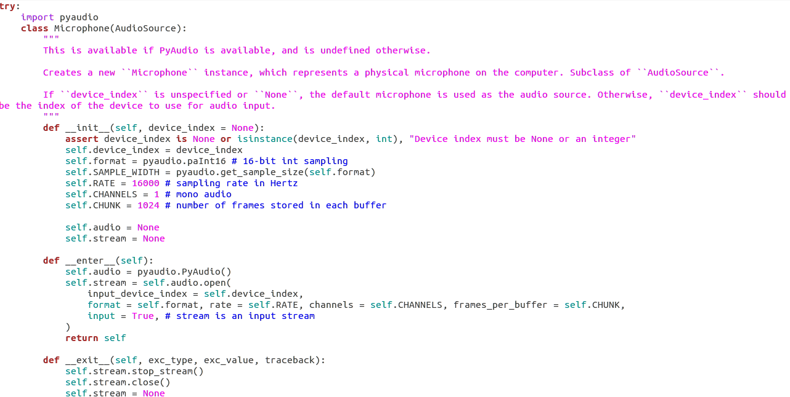
Speech Recognition Sample Code 2

Slide 16
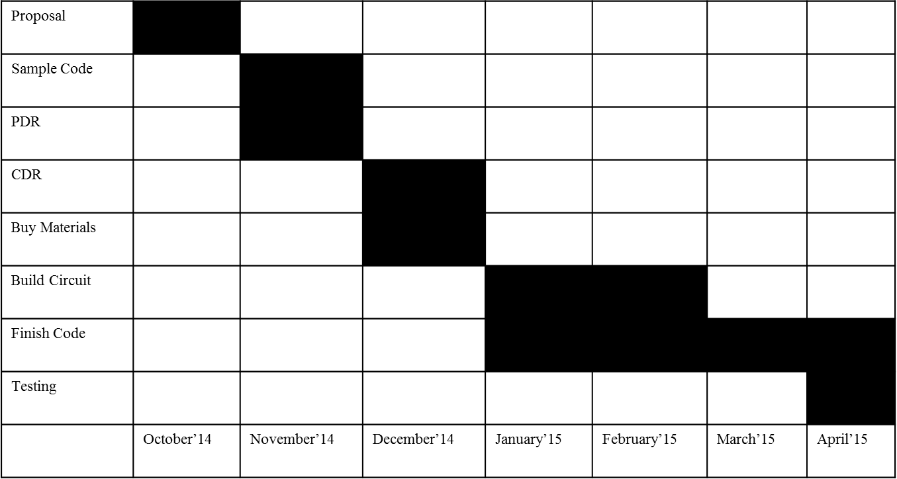
Timeline

Slide 17
Cost Table
Component | Cost
OWI Robotic Arm Edge | $35
OWI USB Interface Kit for Windows | $20
USB Wire | $3
Google Speech Recognition - API | Free
pyAudio (Cross platform I/O Python library) | Free
Linux OS (Ubuntu) | Free
pyUSB (USB Module) | Free
libusb (C Library) | Free
Total Cost | $58

Slide 18
Other Possibilities - Software
The project was tried using various speech recognition engines but none of them worked perfectly as they failed to recognize the control commands. Some of the Speech Recognition Engines and APIs used in the process are:
Windows Speech SDKs
Julius Speech Recognition Engine
Google2Ubuntu Voice API from Google
TalkTyper, an online application for Speech Recognition
Tazti, a PC application to recognize predefined commands
Bing Speech Recognition Control

Slide 19
Other Possibilities - Hardware
The project was also done using:
Raspberry Pi Micro controller to be able to use a USB microphone to recognize speech commands and passing them through the Google Voice APIs
But due to non-functioning of the API and as the project was an individual project, this option was eliminated
However, issues faced in the above possibilities could be solved if the project could be done in a team in a larger time frame

Slide 20
Further Research
The Robotic Arm can be developed in extensively in the future in the following ways:
Using micro controllers such as Raspberry Pi or Arduino
Building a Speech Recognition Engine or a custom API to connect to other freely available Engines
Modifying the Arm to perform more actions such as Moving the Shoulder and Rotating to Left at the same time
Adding more motors to the arm, so that the arm moves from the standard base position
Connecting two such robotic arms to perform various day-to-day tasks that can be controlled using Speech commands
Controlling the Arm using an iPhone App that accepts Speech commands

Slide 21

Special Thanks
For advising me in this project, I offer my special thanks to:
Dr. Veton Kepuska
Associate Professor,
Dept. of Electrical and Computer Engineering,
Florida Institute of Technology, FL
Dr. Barry Grossman
Professor,
Dept. of Electrical and Computer Engineering,
Florida Institute of Technology, FL
Mr. Julius Chatterjee
Doctoral Candidate in Photonics,
Dept. of Electrical and Computer Engineering,
Florida Institute of Technology, FL

