Slide 1

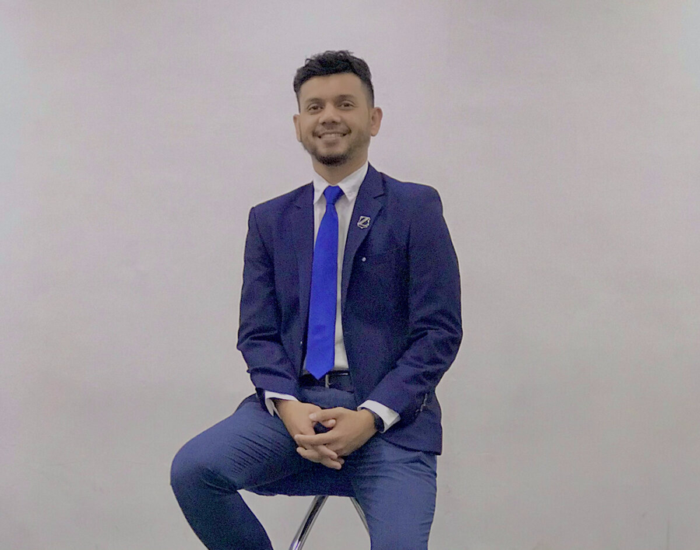
● 100% Shariah-compliant · backed by Zurich
Smart, halal protection for your family's future.
Hj. Asyraf Fauzi — authorised Zurich Takaful specialist with 10+ years helping families and business owners across Kuala Lumpur and the East Coast.
Book a consultation
+60 89 003 244

Slide 2

ABOUT YOUR ADVISOR
A decade of trusted advice
As an authorised Zurich Takaful specialist and Agency Director of Gemilang Empire ZFN, I serve families and business owners across Kuala Lumpur and the East Coast. My approach is simple: listen first, explain clearly, and recommend only what genuinely fits your needs and budget.
10+
2×
RM1M+
Years experience
Champion '22 & '23
Agency volume 2021
Agency Director · Gemilang Empire ZFN
Authorised Zurich Takaful agent
KL & East Coast
BM · EN · Arabic
02

Slide 3



WHY PROTECTION MATTERS
One unexpected event can undo years of saving
Rising medical bills
The protection gap
Your family's future
Private hospital costs in Malaysia keep climbing — one admission can run into tens of thousands of ringgit.
Many rely only on EPF or employer cover, which often stops the moment a job — or a life — changes.
Without a plan, loved ones may inherit debt and uncertainty instead of security and a clear, halal legacy.
03

Slide 4

THE ISLAMIC CONCEPT
Takaful: protection built on cooperation
Takaful replaces the interest, uncertainty and speculation of conventional insurance with mutual donation (tabarru') and shared responsibility. Participants help one another from a cooperative fund — protection practised as an act of brotherhood.
No Riba
No interest in how the fund is managed or invested.
No Gharar
No hidden terms or excessive uncertainty.
No Maysir
No gambling or speculation with your protection.
Backed by Zurich Takaful Malaysia · Regulated by Bank Negara Malaysia · PIDM protected · Dedicated Shariah Committee
04

Slide 5




WHAT I HELP YOU WITH
Five pillars of protection
Medical
Hibah & Family
Savings & Investment
Personal Accident
Motor
1
2
3
4
5
Every plan is Shariah-compliant and underwritten by Zurich Takaful Malaysia.
05

Slide 6
PILLAR 1 — MEDICAL TAKAFUL
Never choose between your health and your savings
● Annual limits up to RM2,000,000 — no lifetime cap
● Cashless admission at panel hospitals
● Pre- & post-hospitalisation, day-care & dialysis
● Guaranteed renewable up to age 80
RM2,000,000
annual medical limit · no lifetime cap
PLANS
MediPro
MediAfya
Z-MedProtect
Takaful MediCash
06

Slide 7
PILLAR 2 — HIBAH & FAMILY TAKAFUL
A gift of certainty for the people you love
● Death, Total & Permanent Disability and Golden Age Disability cover
● Shariah-compliant hibah — pass on your benefit clearly, no disputes
● Plan for Hajj, Umrah, children's education and retirement
● Critical illness & income-protection add-ons
Takaful ProSecure
Takaful Al-Shams
Takaful Term 80
Takaful SureCover
07

Slide 8
PILLARS 3–5
Savings, accident & motor
Savings & Investment
Personal Accident
Motor Takaful
Investment-linked growth + protection. Education & retirement. Shariah funds.
ProInvest · Mumtaz · Executive20
Cover for injury, disablement or accidental death. Yearly renewable.
Personal Sentinel V3 Plus
PA up to RM175k/car from ~RM15/yr. Flood add-on, unlimited courtesy car.
Z-Driver · Z-Drive Assist
08

Slide 9




HOW IT WORKS
Getting protected is simple
1
2
3
4
Discovery
Tailored plan
Apply with ease
Lifetime support
We talk through your needs, family and budget — no pressure.
One or two Shariah-compliant options that fit you.
Simple paperwork, fully guided from start to finish.
Reviews, claims help and updates whenever you need.
09

Slide 10

TRACK RECORD
A decade of trusted advice
10+
RM1M+
2×
100%
Years in takaful
Agency volume, 2021
Champion Producer
Shariah-compliant
Champion Personal Producer 2022 & 2023 · RM1 Million Agency milestone 2021
10

Slide 11



Let's build your protection plan
Book a free, no-obligation consultation — in person across KL & the East Coast, or online.
Call / WhatsApp +60 89 003 244
Book a
consultation
Email maf.zurichtakaful@gmail.com
Service area Kuala Lumpur & East Coast, Malaysia
11

Slide 12

Terima Kasih · Thank You
Hj. Asyraf Fauzi · Authorised Zurich Takaful Specialist · +60 89 003 244
Hj. Asyraf Fauzi is an authorised takaful agent representing Zurich Takaful Malaysia Berhad. This presentation is for general information only and does not constitute a contract of takaful. All plans are subject to Zurich Takaful's terms, conditions and Shariah approval. Regulated by Bank Negara Malaysia.

