Slide 1
Edu game
Created by Team4

Slide 2
Application purpose
Users can create defined lists of terms and corresponding definitions and then use these lists for memorization
Digital alternative to flashcards

Slide 3
Project planning
Planner 0.14.6 project management tool
Original plan – incremental development with increments defined by different menus of the application
Scrum approach for workload management
Separated project into 2 one week long sprints
Useful team effort toward emerging problems

Slide 4
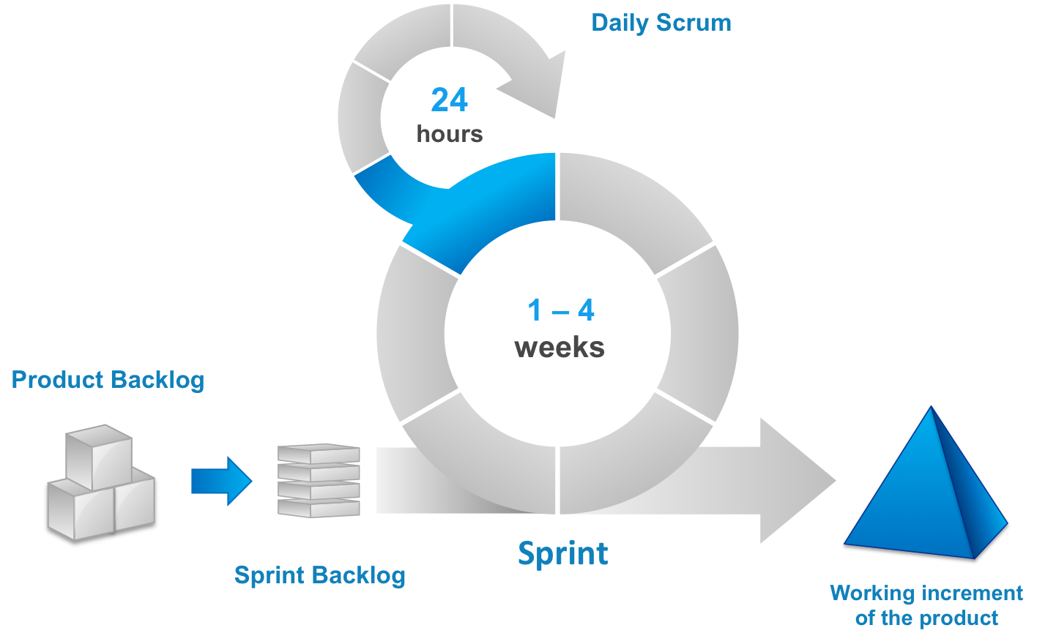

Slide 5


Overall system design
Used Spring Boot and Thymeleaf frameworks for efficient integration of HTML and MySQL
In addition to JCL, used libraries: Maven, Hibernate, JUnit, and Mockito

Slide 6
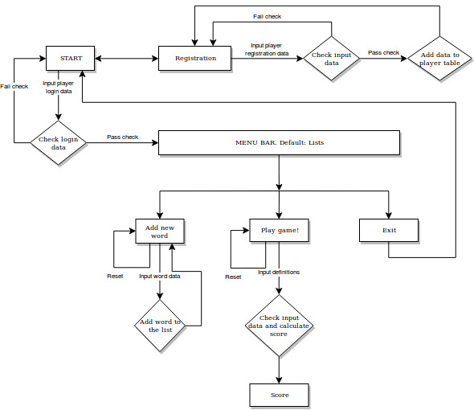
Application flowchart

Slide 7


Unit testing
For testing used JUnit and Mockito

Slide 8
User guide, functional specification, and other documentation is available at:
https://github.com/abarmins/Edu_game

Slide 9
Team members and their main contributions to the project
Alena Kritskaja: front end, creation of classes for database
Martins Murans: registration and login handling, Junit tests, front end, back end, debugging
Maxim Lysov: Scrum master, front end, back end
Arina Tsoy: front end, debugging, documentation preparation
Artjoms Barmins: initial plan organization, MySQL table setup, presentation and documentation preparation

Slide 10
Biggest challenges of the project
Implementation of technologies for integration of web applications with MySQL databases
User registration security

Slide 11
Lessons learned
Teamwork and task management for application development
Usage of new programming frameworks
Comprehension of personal limitations in application development environment

Slide 12
Future work
Implementation of different testing modes
Personalization
Image quiz implementation
Lootboxes

Slide 13
Thank you for your attention!

