Slide 1
Self-Supervised Domain Adaptation with DINOv2-HRNet
for Multi-Task Ultrasound Landmark Detection
A. Panagiotakopoulou · A. Barmperis · V. E. Katsigiannis · G. K. Matsopoulos
Biomedical Engineering Laboratory, School of Electrical and Computer Engineering,
National Technical University of Athens · Archimedes Research Unit, Athena Research Center
FU_Biometry Challenge · MICCAI 2026
Notes:
One unified model for all nine biometry tasks. Two phases: self-supervised domain adaptation of DINOv2 on unlabeled ultrasound, then a supervised HRNet-style decoder with nine task-specific heads.

Slide 2
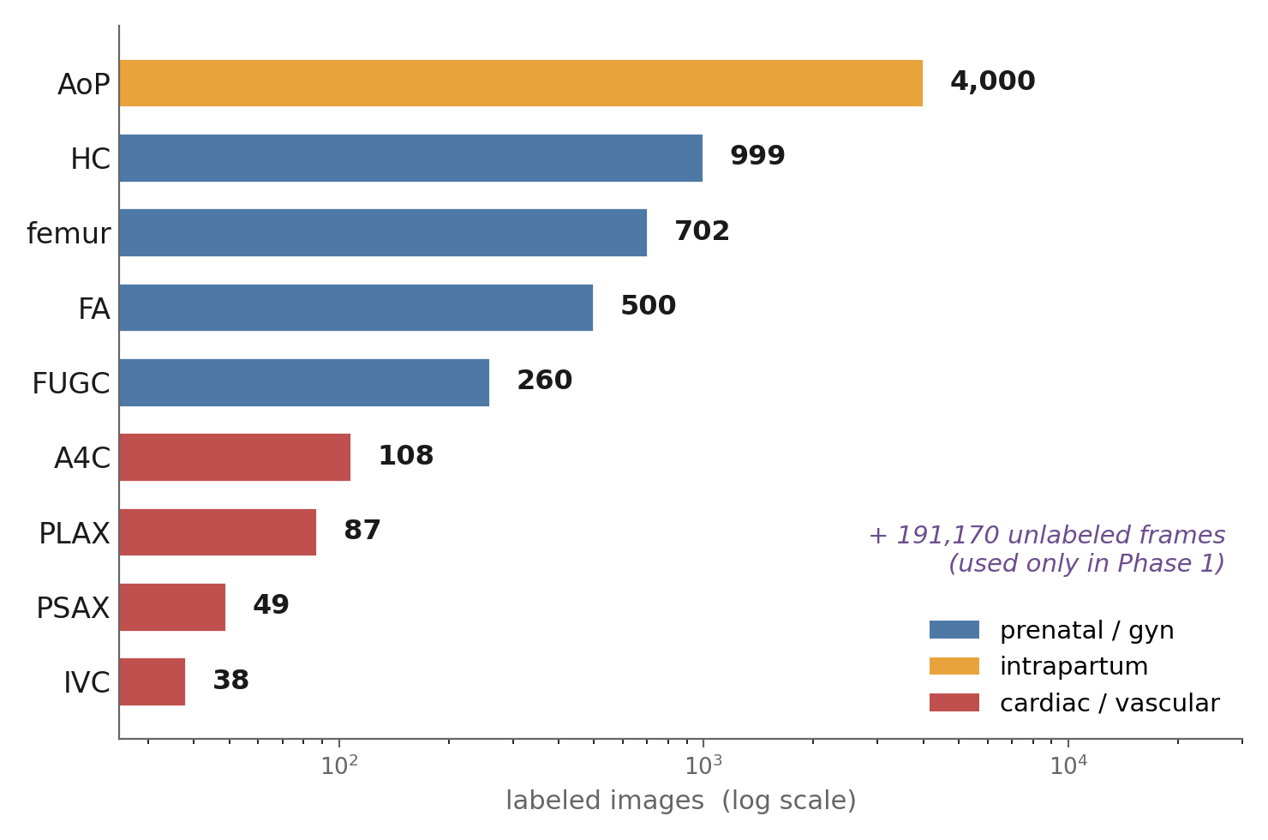
Nine tasks, one model — why that is hard
• A few anatomical landmarks become clinical measurements — fetal growth, labour progression, cardiac structure. Manual measurement is slow and operator-dependent.
• 9 tasks, 3 clinical domains, 20+ parameters in one benchmark — and task-specific models transfer poorly across scanners and sites.
• Labels are scarce: only 3.4% labeled — 6,768 labeled vs 191,170 unlabeled images.
• Three orders of magnitude between the largest and smallest task: naive pooled training gives an AoP model that ignores the heart.
Notes:
The chart is the headline: three orders of magnitude between the largest and smallest task (AoP 4,000 labeled images vs IVC 38), colored by clinical domain — blue prenatal/gyn, orange intrapartum, red cardiac/vascular. Anything that trains naively on the pooled data will be an AoP model that ignores the cardiac tasks. Also note 191,170 unlabeled frames exist — they are used only in Phase 1.

Slide 3
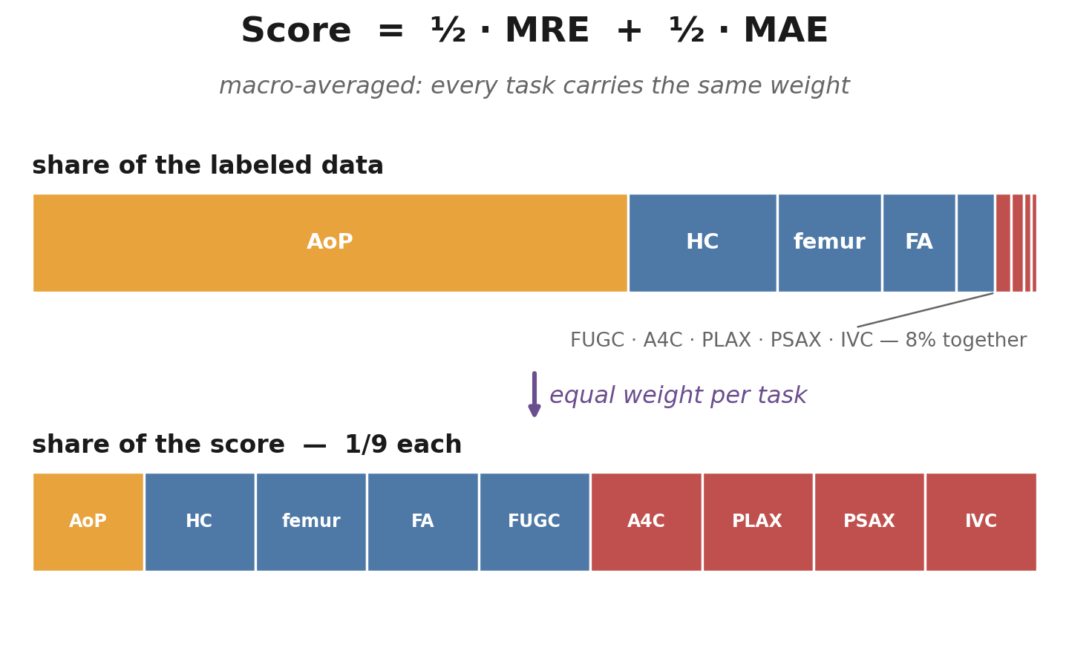
The metric dictates the design
• Score = 50% landmark error (MRE) + 50% clinical-measurement error (MAE), macro-averaged with equal weight per task.
• So a 38-image task counts exactly as much as a 4,000-image one — the tiny cardiac tasks decide the ranking.
• Three consequences that run through the whole system:
  – √-balanced task sampling — AoP is seen ~9× as often as PSAX, not 82×
  – loss in original-image pixels, not on the 518 training canvas
  – checkpoint selection on a metric-aligned blend — never on canvas loss
Notes:
Worth dwelling on: we treat the metric as a design constraint rather than something measured at the end. The two strips say it visually: AoP is 59% of the labeled data but 1/9 of the score. The per-task macro average is what makes the tiny cardiac tasks decisive.

Slide 4
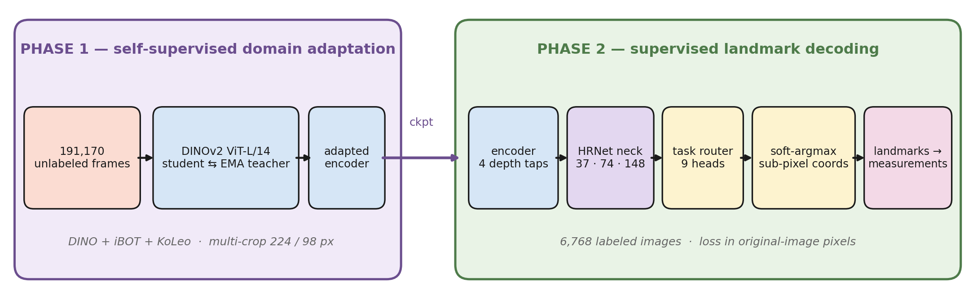
The method in one picture
Phase 1 adapts DINOv2 to ultrasound on the 191k unlabeled frames — Phase 2 trains an HRNet-style neck and 9 task heads on the 6.7k labeled images. The next slides walk left to right.
Notes:
Left, Phase 1: continued DINOv2 self-supervision (DINO + iBOT + KoLeo, student/EMA-teacher) on all 191,170 unlabeled frames — no labels anywhere. The adapted encoder checkpoint seeds Phase 2. Right, Phase 2: four encoder depths feed an HRNet-style multi-resolution neck, a task router picks one of nine heads, and soft-argmax reads out sub-pixel landmark coordinates that become the clinical measurements. Every batch is task-homogeneous, because each forward pass runs exactly one head.

Slide 5
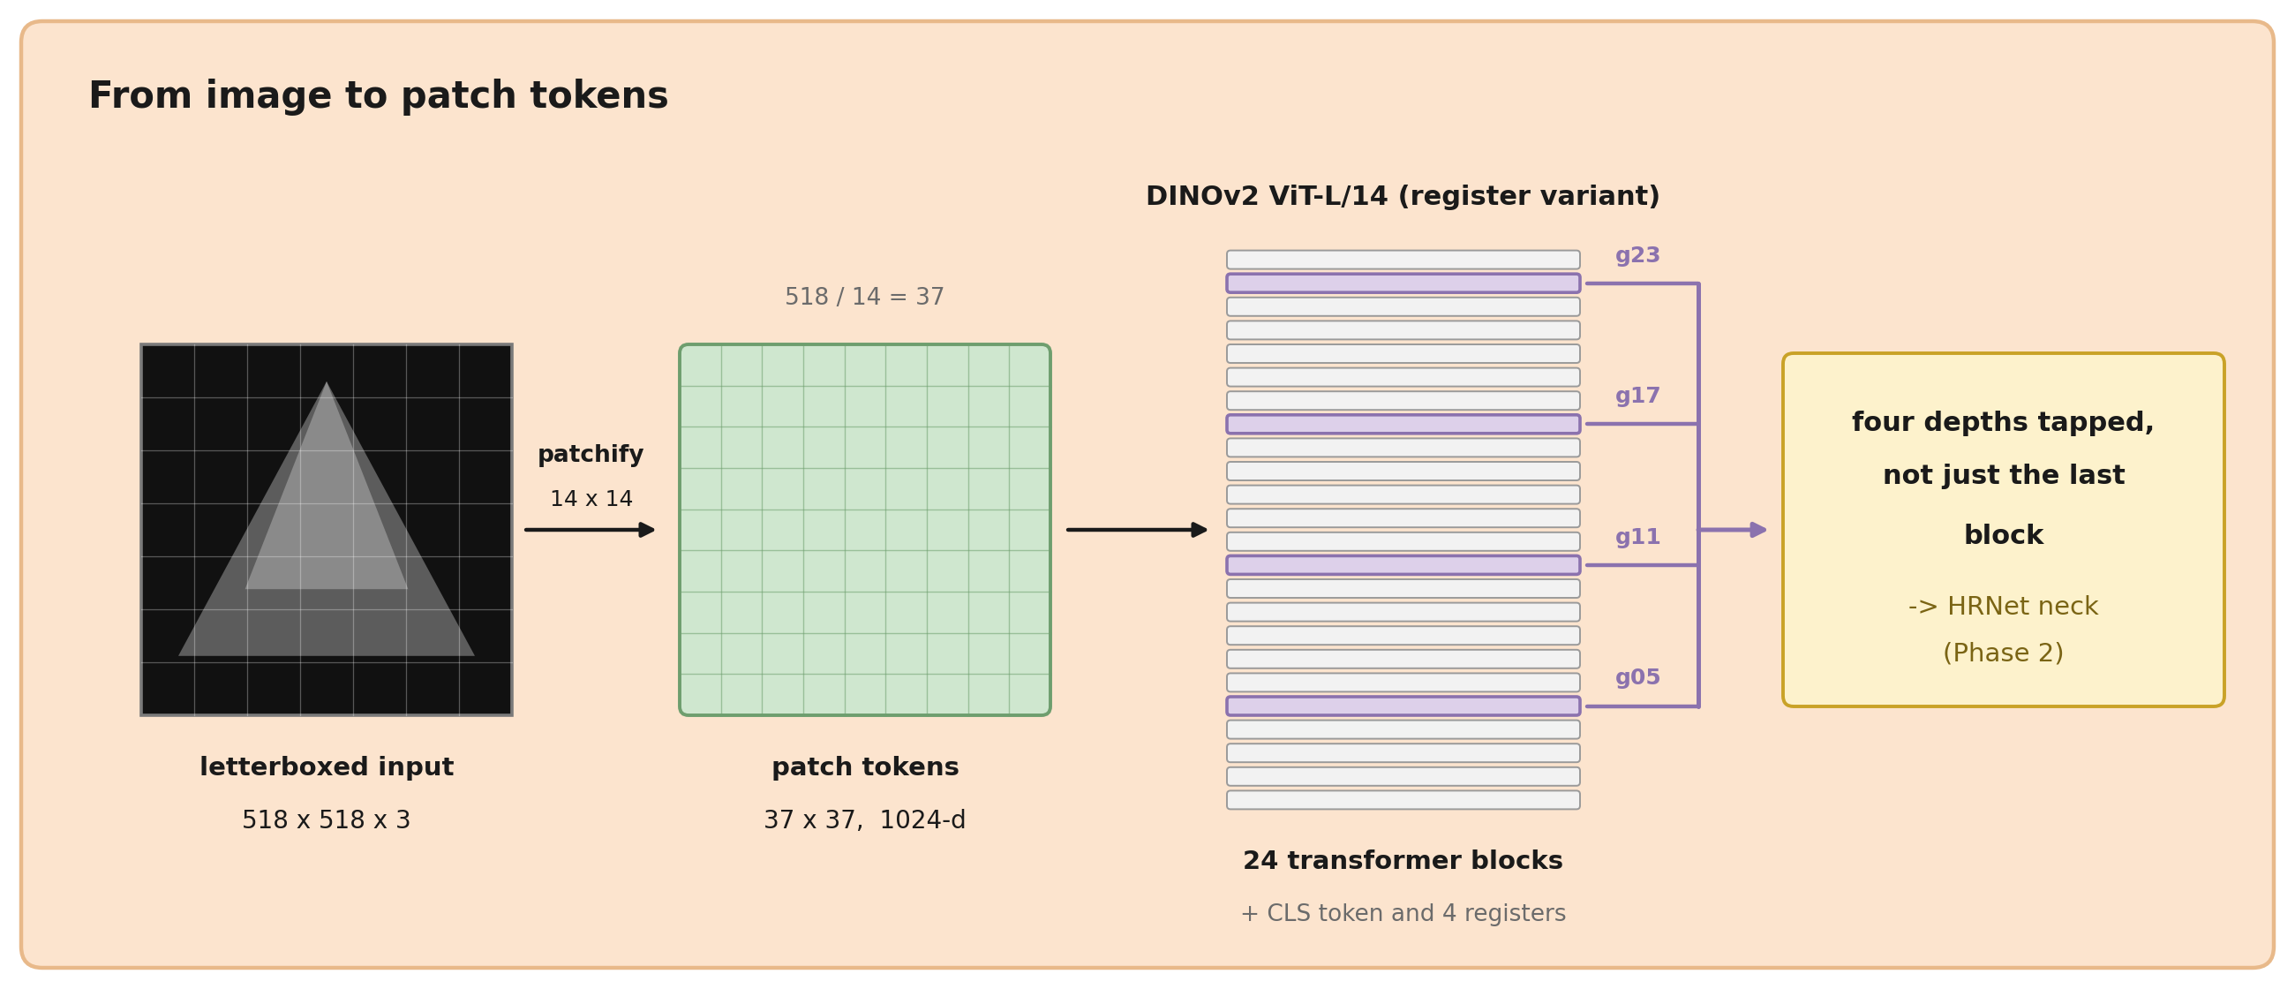
From image to patch tokens
• 518 × 518 letterboxed input, aspect ratio preserved (native sizes range from ~336 × 544 to 768 × 1024).
• DINOv2 ViT-L/14 with registers → 37 × 37 grid of 1024-d patch tokens.
• We tap four depths (blocks 5, 11, 17, 23), not only the last — coarse semantics and finer detail both reach the decoder.
Notes:
This is the piece the paper assumes you know. The g05/g11/g17/g23 notation on the next architecture figure refers to these taps.

Slide 6
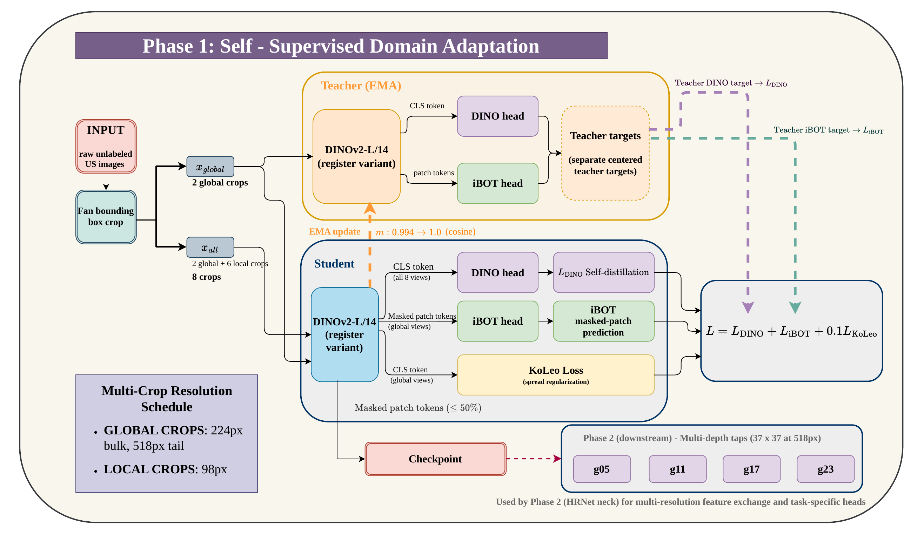
Phase 1 — self-supervised domain adaptation
Continued DINOv2 pretraining on 191,170 unlabeled ultrasound frames — no labels are used anywhere in this phase.
Notes:
Off-the-shelf DINOv2 is trained on natural images; sonography has very different texture statistics, acquisition physics and artifacts. We adapt the encoder to the domain before asking it to localize anything.

Slide 7
Phase 1 — the recipe in brief
• Multi-crop self-distillation: 2 global crops + 6 local crops (98 px); the student sees all 8 views, the EMA teacher only the 2 globals.
• L = L_DINO + L_iBOT + 0.1 · L_KoLeo — CLS self-distillation, masked patch-token prediction, and an anti-collapse spread term.
• Two-resolution curriculum: 100 epochs at 224 px, then a 4-epoch tail at 518 px — the deployment resolution, ~5× cheaper than full-res throughout. ~96 GPU-hours on one A100.
• Ultrasound-specific: fan bounding-box crop, gentler ±10° rotation (view orientation is semantically meaningful), background-heavy crops resampled.
Notes:
Details kept for questions: DINO loss over K=65,536 prototypes; iBOT masks restricted to foreground; teacher temperature annealed 0.04 to 0.07; EMA momentum 0.994 to 1.0; effective batch 256 via gradient accumulation. The 224-then-518 curriculum is the cost trick: 518 px throughout is roughly 5x more expensive per epoch, and as the ablation shows, it is not better.

Slide 8
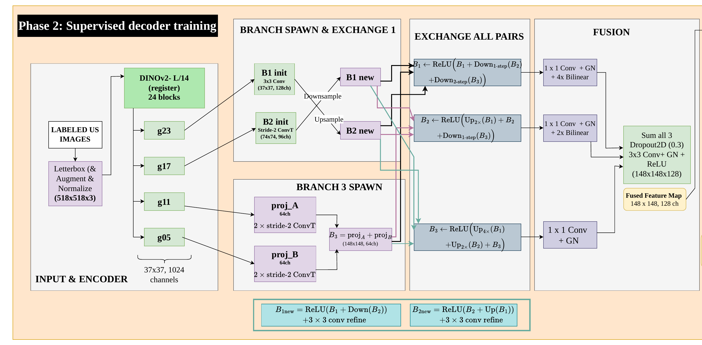
Phase 2 — HRNet-style multi-resolution neck
Three parallel branches at 37 / 74 / 148 with widths 128 / 96 / 64, two rounds of bidirectional exchange, fused to 148 × 148 × 128. GroupNorm throughout — never BatchNorm.
Notes:
ViT tokenization is coarse — 37×37 for a 518 image. Rather than a U-Net decoder that downsamples then climbs back, HRNet keeps a high-resolution branch alive throughout and exchanges between scales. GroupNorm everywhere, never BatchNorm: batches are task-homogeneous, so BatchNorm's eval-time running statistics would blend nine incompatible domains — training error fell while validation error stayed flat until we changed it.

Slide 9
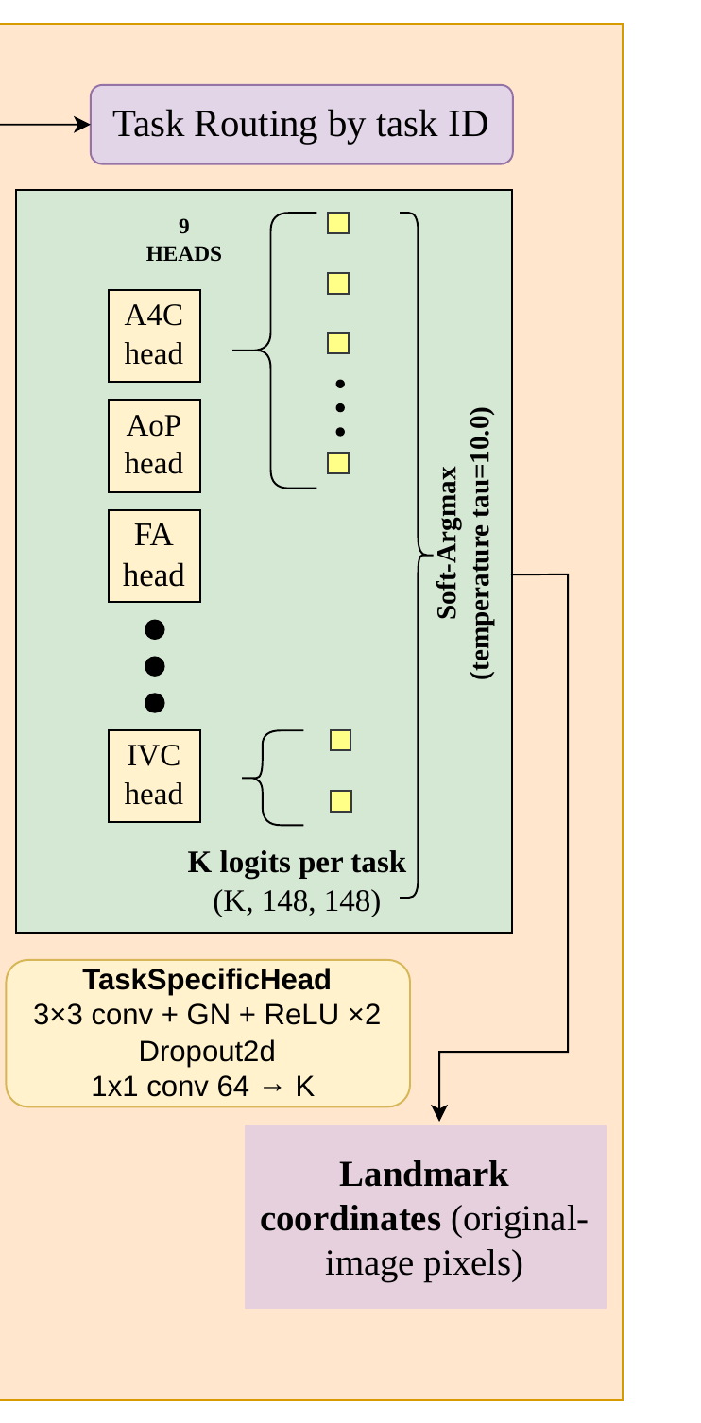
Phase 2 — task routing and sub-pixel decoding
• Nine independent heads; the batch's task id selects exactly one. Landmarks per task: 2 (FUGC, IVC, femur) up to 22 (PLAX).
• Soft-argmax (τ = 10): temperature-scaled softmax over the logits, then the spatial expectation — differentiable and sub-pixel, so the network is a direct coordinate regressor. Heatmaps are never MSE-supervised.
• Masked L1 over annotated landmarks; missing ones are (−1, −1) and contribute no gradient.
• Predictions inverse-letterboxed to original-image pixels — training in the metric's own units.
• Training: single A100, AdamW + layer-wise LR decay; the EMA teacher is what gets validated and deployed.
Notes:
Soft-argmax is the method, not a detail. It is what lets us train in the metric's own coordinate space. Training facts behind the last bullet: batch 64, bf16, AdamW base LR 2e-4 with 15-epoch warmup and 150-epoch cosine decay, last 4 backbone blocks unfrozen at 0.1x base LR with LLRD 0.75, EMA alpha 0.999, early-stopping patience 40, sampler temperature 0.5 (allocation proportional to sqrt of task size), affine + intensity augmentation. 312.2M parameters, 58.2M trainable; 84.4 img/s training, up to 127.3 img/s inference. Phase 2 is comparatively cheap — the expensive part was Phase 1's 96 GPU-hours.

Slide 10
Official challenge evaluation
Validation phase · 619 images · official scorer (red = worst per column, green = best)
Task | Landmarks | MRE (px) ↓ | MAE ↓
HC (head circumference) (N=215) | 4 | 49.07 | 76.70
FA (fetal abdomen) (N=188) | 4 | 21.61 | 92.16
fetal_femur (N=62) | 2 | 25.33 | 18.10
FUGC (cervical) (N=20) | 2 | 9.88 | 11.55
AoP (angle of progression) (N=60) | 4 | 16.02 | 9.07
PLAX (N=26) | 22 | 18.94 | 9.48
A4C (N=20) | 16 | 23.54 | 20.37
PSAX (N=18) | 4 | 39.02 | 20.00
IVC (N=10) | 2 | 33.65 | 9.87
Overall (unweighted mean, N=619) | — | 26.34 | 29.70
For context, the best leaderboard entry at the time of writing reported MRE 22.56 px / MAE 29.02 on the same scorer.
Notes:
HC, PSAX and IVC are the weak points. PSAX and IVC have both the least training data and the smallest evaluation sets (N=18, N=10), so those numbers carry real uncertainty. HC is the interesting one: 999 labeled images, an order of magnitude more than the cardiac tasks, and still the worst task — difficulty here is not explained by dataset size.

Slide 11
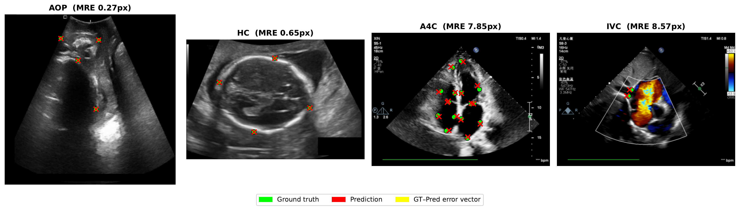
Qualitative results
Representative examples across four tasks spanning different clinical domains. Ground truth in green, predictions in red.
Notes:
Four tasks from different domains, showing the same network handling very different anatomy and image appearance.

Slide 12
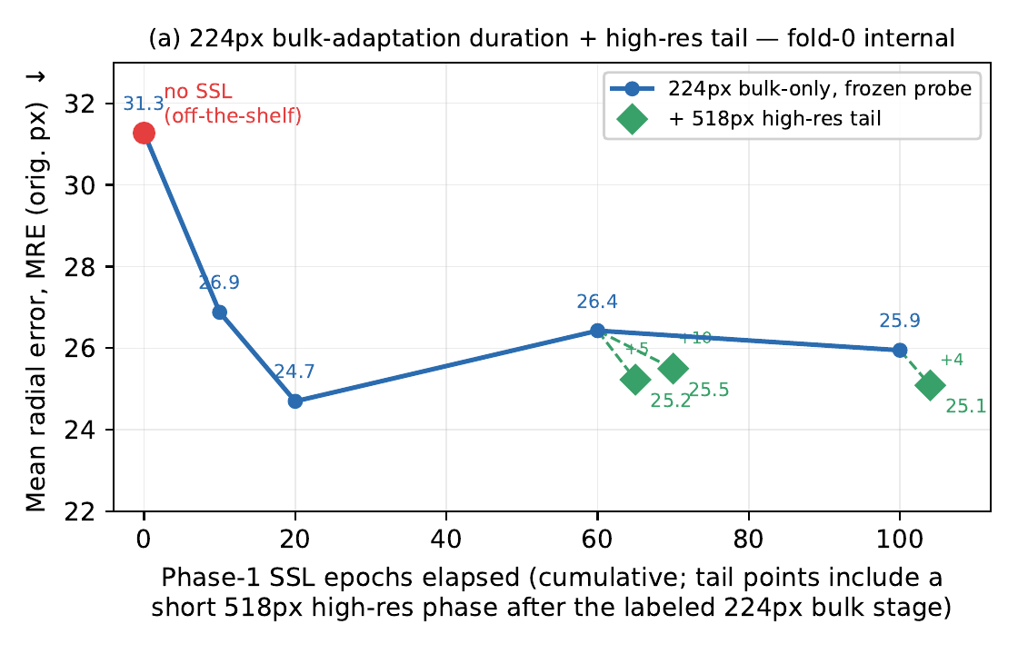
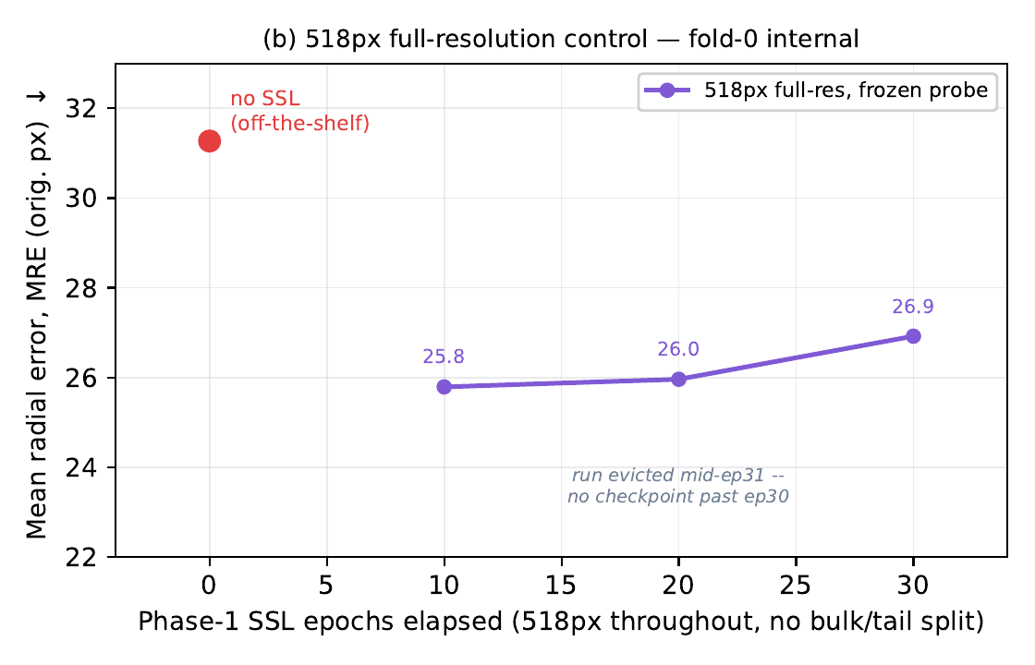
How long should self-supervised adaptation run?
(a) 224 px bulk + high-resolution tail
(b) 518 px full-resolution control
• Frozen-encoder probe (25 epochs, fold 0) isolates representation quality from fine-tuning.
• Adaptation is not monotonic: bulk-only MRE bottoms out at epoch 20 (24.70 px); by epoch 100 the blend is worse than the non-adapted encoder (0.0974 vs 0.0890).
• A 4-epoch 518 px tail rescues the later checkpoints — best blend of any checkpoint tested (0.0747). We select ep104.
• At matched 20 epochs, full-resolution adaptation is worse than 224 px (25.96 vs 24.70 px) — the cheap curriculum is also the better one.
Notes:
The honest finding of the paper: more self-supervision is not better, and the failure is invisible unless you probe the frozen encoder. Decoder ablation over 5 folds was inconclusive — HRNet 0.0707±0.0089 vs simple decoder 0.0740±0.0068, with MRE favouring the simple one; differences are small against fold variance.

Slide 13
Conclusions
• One model, nine tasks: a two-stage DINOv2-HRNet pipeline for heterogeneous ultrasound biometry.
• 191k unlabeled frames support 6.7k labeled ones by separating domain-level representation learning from task-specific localization.
• SSL duration is non-monotonic — a short high-resolution tail matters more than more low-resolution epochs.
• Design follows the metric: balanced sampling, original-pixel loss, metric-aligned checkpoint selection.
• Future work: 5-fold ensembling with multi-scale and intensity TTA; ablating the neck's multi-level fusion and fine-tuning depth.
• Code: github.com/abarmper/US-Foundation · A100 80GB instances provided by the NVIDIA Academic Hardware Grant Program (MedViLA).
Notes:
Thank you — happy to take questions.

