Slide 1
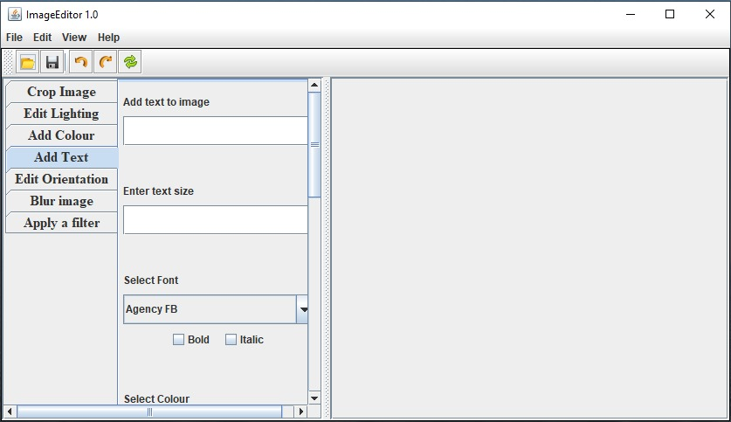
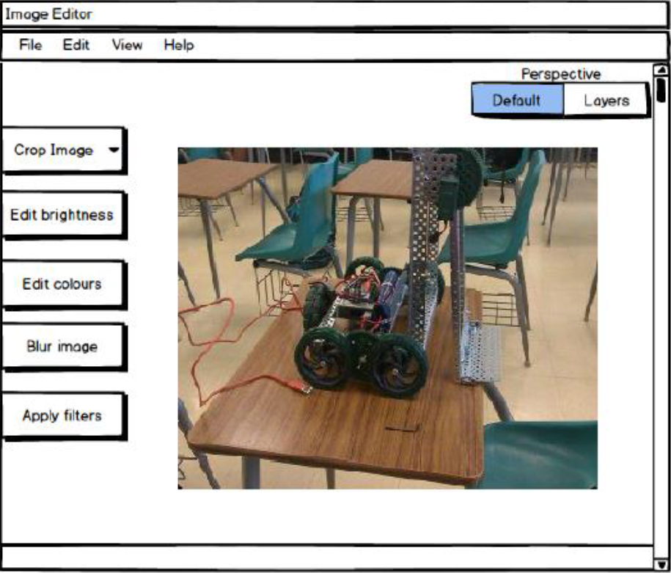
Image Editor version Mercury
Implementation
Initial Design
By: Abarna Kucheri Subburaman
and Elijah Nnorom

