Slide 1
Quiz management system
EBEON1121476808-M.ABARNA

Slide 2
ABSTRACTION
Quiz Management System is an online application, from which user can easily manage Academic details, Performance details, Quiz details.
Admin can track all the information of Academic, Score, Performance ect. Admin can edit, add, delete and update the records of Quiz, Participate, Winner.

Slide 3
SOFTWARE REQUIREMENTS
JAVA 8
MYSQL
JDBC

Slide 4
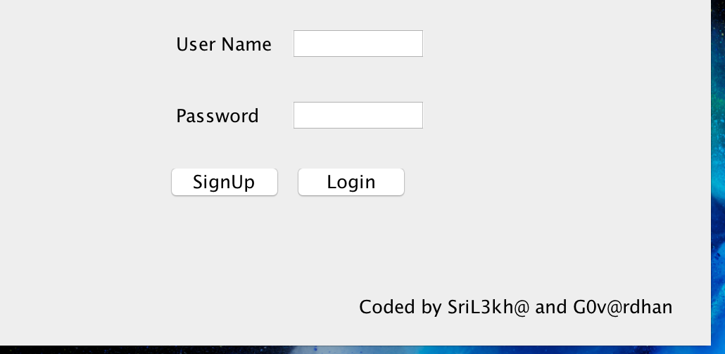
SNAPSHOTS

Slide 5
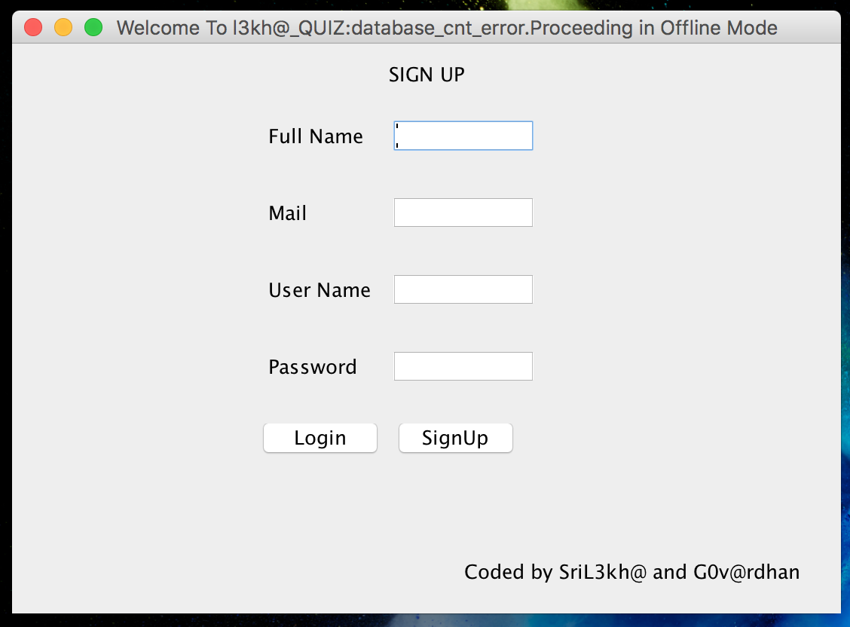

Slide 6
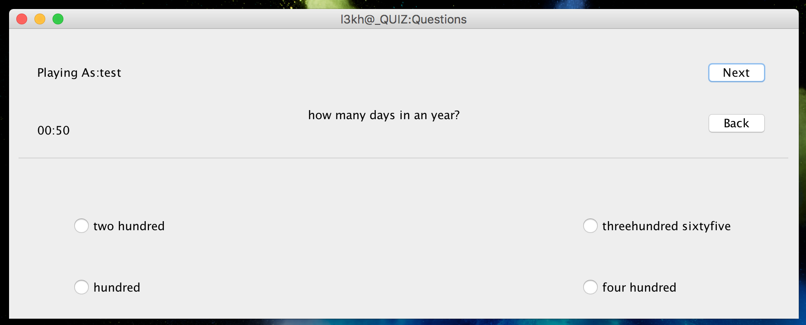

Slide 7
OUTCOME
Engage your audience. Engage your audience in a unique and fun way and connect them to your brand or learning material. ...
Large number. ...
Randomizing questions. ...
Quiz results/ gain insight in audience. ...
No instructor needed. ...
Set timer. ...
Better overview. ...
Improve your brand.

Slide 8
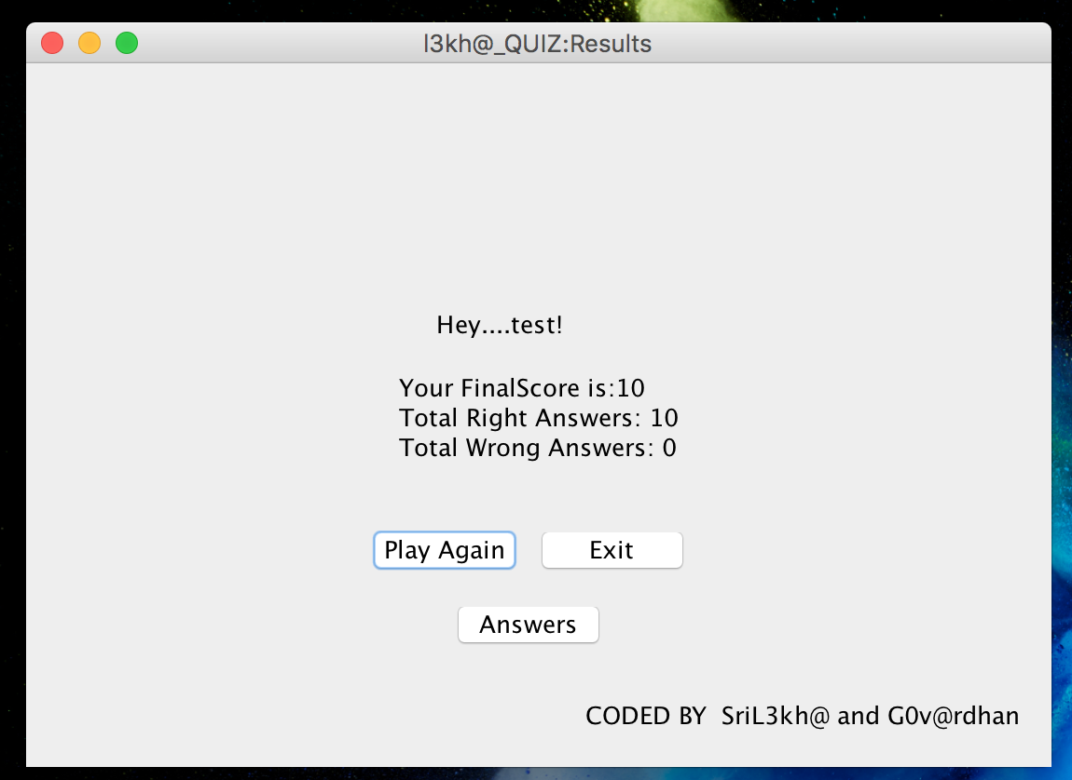
SNAP

Slide 9
THANK YOU

