Slide 1
Employee Record
Management System
(ERMS)
Mini Project
Presented by: Abarna Ragsitha
Reg no: 811324243003
Department: B.tech Artificial Intelligence and Data Science

Slide 2
IN
INTRODUCTION
• Python-based employee management application
• Maintains employee records
• Performs payroll calculations
• Demonstrates Object-Oriented Programming concepts

Slide 3
OB
OBJECTIVES
• Manage employee records efficiently
• Implement OOP concepts
• Validate employee information
• Generate payroll and Displays high paid employee.

Slide 4
TS
TECH STACK
• Programming Language: Python
• IDE: Visual Studio Code
• Concepts used: Object-Oriented Programming concepts
• (Abstraction, Encapsulation, Polymorphism, Inheritance)

Slide 5
OO
OOP CONCEPTS
AB
Abstraction: Abstract Employee class
EN
Encapsulation: Private salary, employee ID and mailId.
IN
Inheritance: Employee Record inherits Employee
PO
Polymorphism: Overridden display() and salary calculation

Slide 6
MO
MODULES
1
2
3
4
Employee Management
Payroll Management
Validation Module
Highest Paid Employee

Slide 7
PS
PROJECT STRUCTURE
01
employee.py
02
employee_record.py
03
erm.py
04
payroll.py
05
validation.py
06
main.py

Slide 8
FE
FEATURES
• Add, View, Update, Delete Employee
• Search Employee
• Payroll Calculation
• Phone No Validation
• Highest Paid Employee

Slide 9
WF
WORKFLOW
1
2
3
4
5
Menu
Employee Operations
Validation
Payroll Management
Exit
User is presented with the main menu.
User selects and performs employee operations.
Input details are validated for accuracy.
Payroll is calculated and managed accordingly.
User exits the system.
01
02
03
04
05

Slide 10
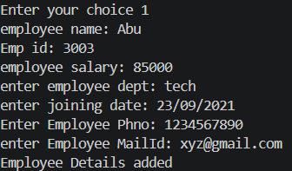
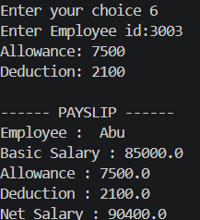


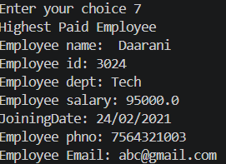
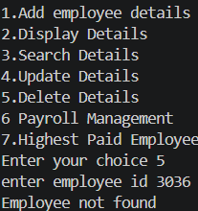

Slide 11
✓ CONCLUSION
The project successfully
demonstrates Python OOP
concepts while providing
an efficient employee
management solution.
👩‍💼
Employee
Dashboard

Slide 12
THANK YOU
THANK YOU

