Slide 1

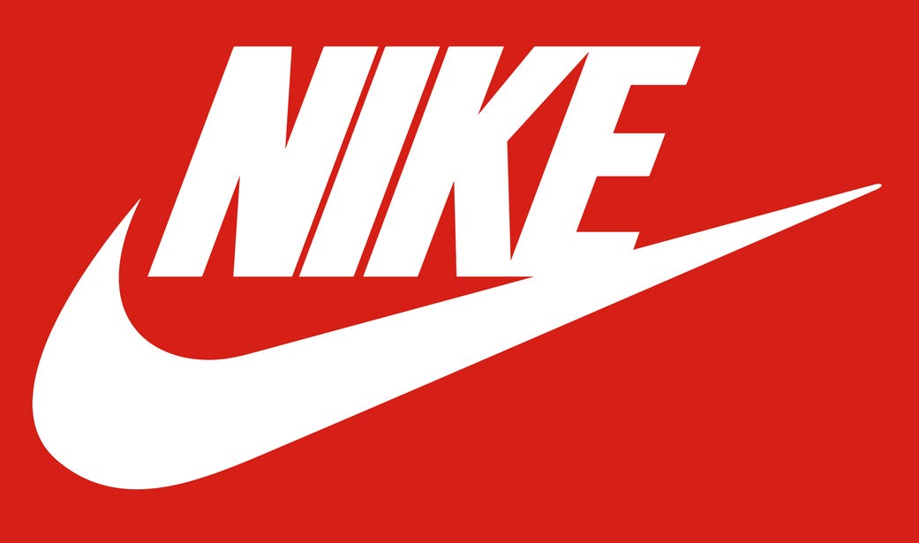

Nike vs. adidas
Alejandro, Aaron, Brett, Sung, Adam
Notes:
Goal was to compare Nike vs. Adidas
Customer reviews
Discounting strategy

Slide 2


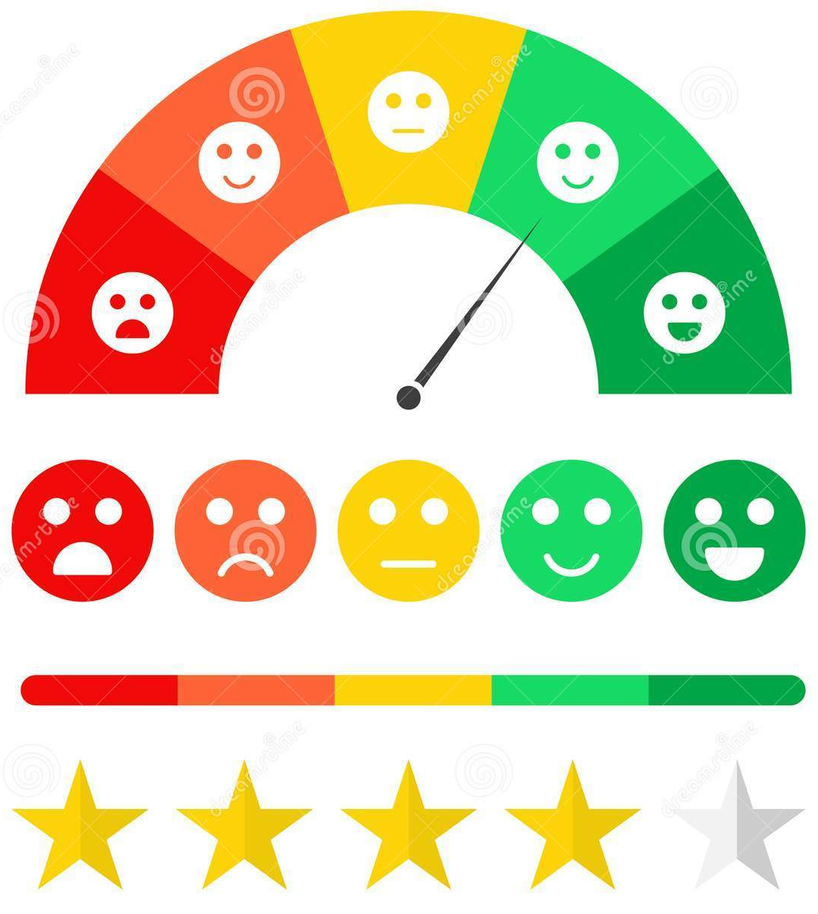
BUSINESS QUESTIONS: Nike vs. Adidas
Discounting strategy
Customer reviews
Customer ratings
Notes:
Brett
Assess differences in discounting strategy between Adidas & Nike.
Evaluate differences in customer ratings between Adidas & Nike.
Evaluate differences in customer reviews between Adidas & Nike.

Slide 3



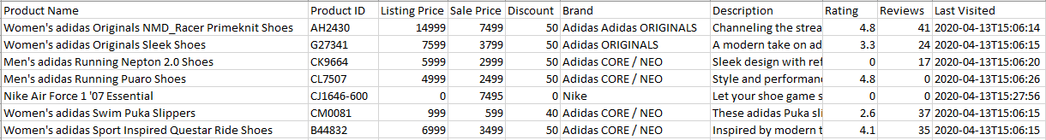
Data Clean-Up
Original data source
Remove bad data
Clean up columns
Notes:
Aaron
30 seconds, hi-level
Original Data Source: Kaggle.com > intended for a blog to compare discounting trends in early COVID
Remove Bad Data: missing price, no ratings, no reviews. Dropped 600 of 3,200 rows.
Clean up Columns: added brand consolidation column (Nike vs. Adidas), Gender column, and columns for list & sale price (divide by 100)

Slide 4
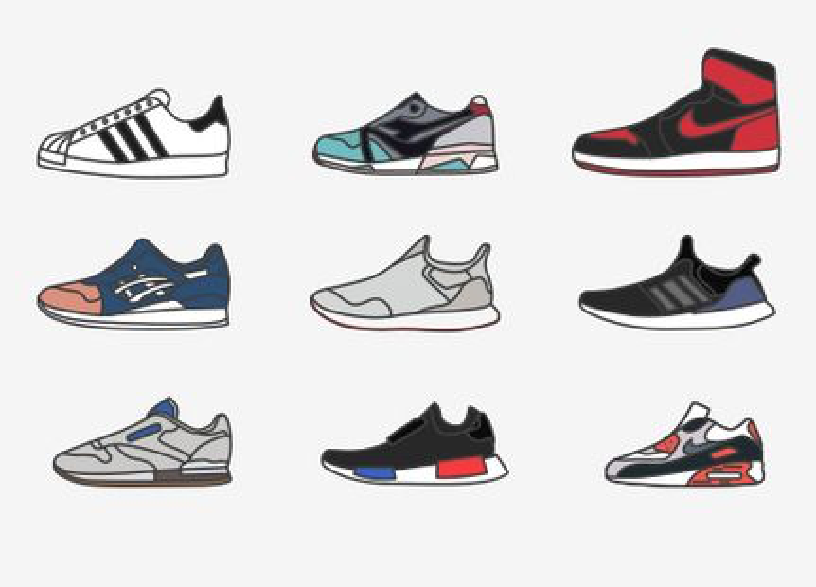


Limitations
Product category
NO Sales Data
Data size & scope
Notes:
Adam
Product Category: data not standardized enough to create category bins (ie: running, basketball, etc.)
Sales Data: no units or dollars sold. Potentially could provide more relevant guidance to company if we had sales units or dollars.
Data size & scope:
Single-day snapshot in time for prices (April 2020),
Timing of ratings & reviews unknown, but likely different from pricing data
more adidas rows than Nike (>2k for Adidas, only 155 for Nike)

Slide 5
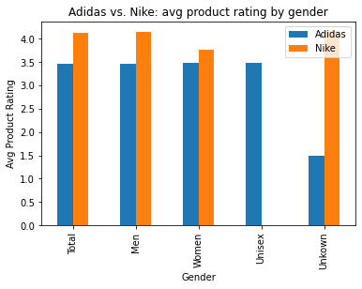
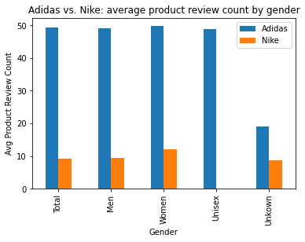
Customer Ratings / Reviews
Notes:
Alejandro
Nike generally had higher-rated products, potentially indicating higher customer satisfaction
Adidas generally had more ratings, potentially indicating higher customer engagement

Slide 6
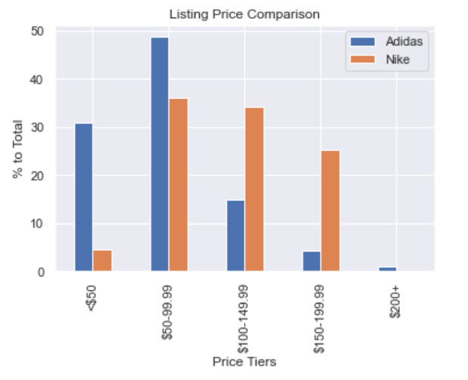
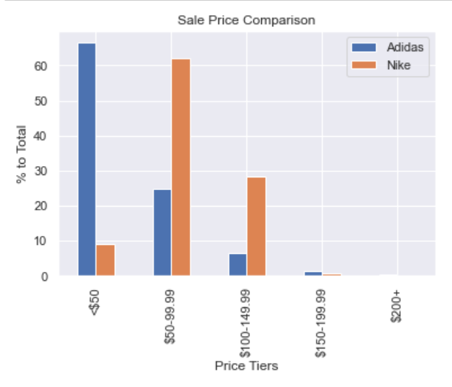
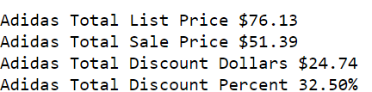
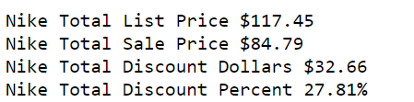
Discounting
Average Discount
Notes:
Sung

Slide 7
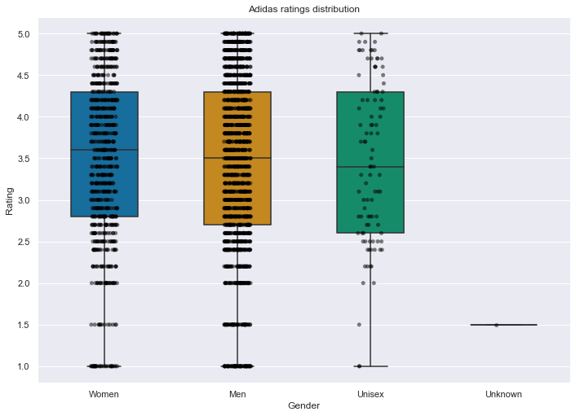
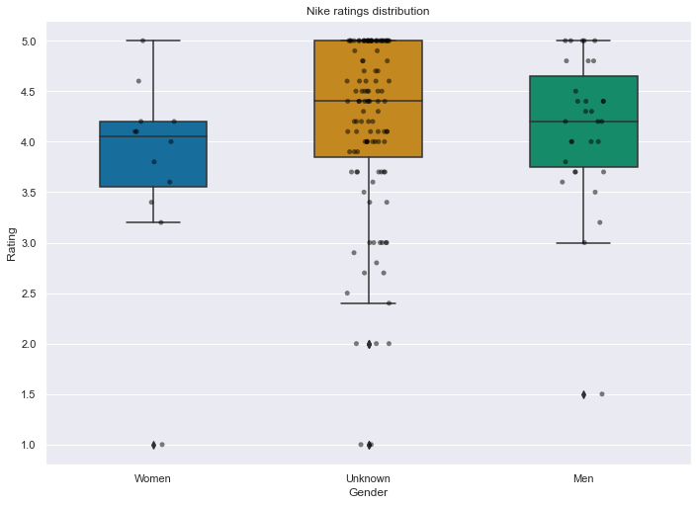
Appendix
Notes:
Aaron
Ttest_indResult(statistic=-9.181162235290103, pvalue=9.538449921033955e-17)

Slide 8
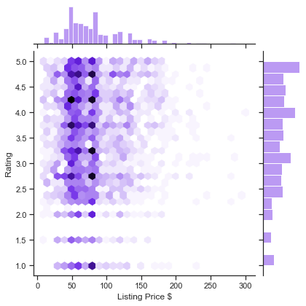
Appendix
Notes:
Aaron

Slide 9
Q & A
Alejandro, Aaron, Brett, Sung, Adam
Notes:
Goal was to compare Nike vs. Adidas
Customer reviews
Discounting strategy

