Slide 1

Nike vs. adidas
Alejandro, Aaron, Brett, Sung, Adam
Notes:
Goal was to compare Nike vs. Adidas
Customer reviews
Discounting strategy

Slide 2
BUSINESS QUESTIONS: Nike vs. Adidas
Discounting strategy
Customer reviews
Customer ratings
Notes:
Brett
Assess differences in discounting strategy between Adidas & Nike.
Evaluate differences in customer ratings between Adidas & Nike.
Evaluate differences in customer reviews between Adidas & Nike.

Slide 3
Data Clean-Up
Original data source
kaggle
Remove bad data
- Missing price
- No ratings/reviews
- Dropped 600 of 3,200 rows
Clean up columns
- nike/adidas column
- Gender column
- Price columns
Notes:
Aaron
30 seconds, hi-level

Slide 4
Limitations
Product category
Sales volume
Nike < adidas data size
155 nike rows
Notes:
Adam
Category: data not standardized enough to create category bins (ie: running, basketball, etc.)
Single-day snapshot in time

Slide 5
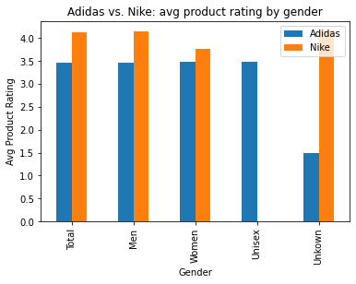
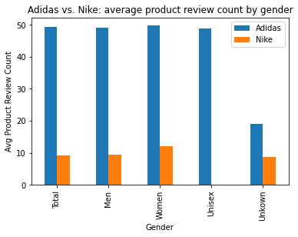
Customer Ratings / Reviews
Notes:
Alejandro
Nike generally had higher-rated products, potentially indicating higher customer satisfaction
Adidas generally had more ratings, potentially indicating higher customer engagement

Slide 6
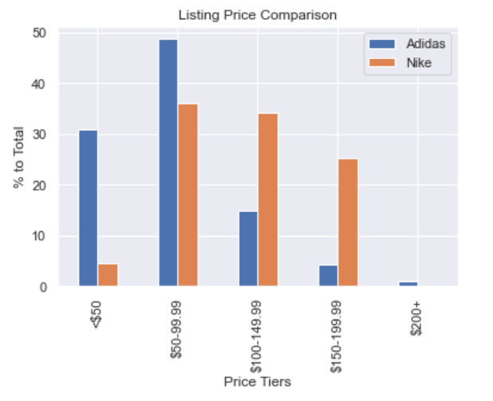
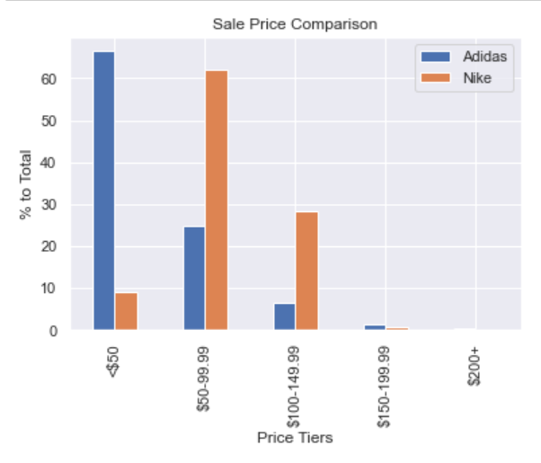
Discounting
Notes:
Sung
Discounting: Adidas is more aggressive with discounting, offering higher discount across all price bins.
Pricing:
Recommendation: assess price offering to identify potential gaps to competition. Ie:

Slide 7
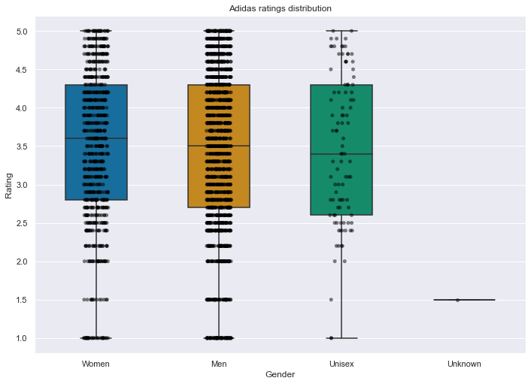
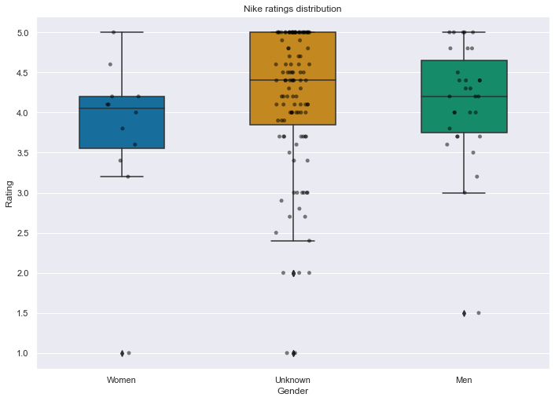
Appendix
Notes:
Aaron
Ttest_indResult(statistic=-9.181162235290103, pvalue=9.538449921033955e-17)

Slide 8
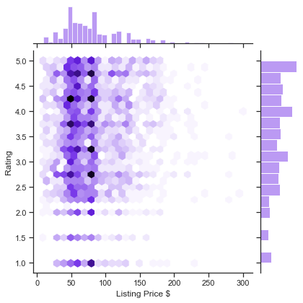
Appendix
Notes:
Aaron

Slide 9
Q & A
Alejandro, Aaron, Brett, Sung, Adam
Notes:
Goal was to compare Nike vs. Adidas
Customer reviews
Discounting strategy

