Slide 1
title
Amani Johnson-Singh-Barnett
Jeff Petrella
Sakura Anning Yoshihara

Slide 2
Objectives
Introduction
Define the Problem
Purpose & Objective
Gather Data
Validate & Explore Data
Data Preparation
Model Selection & Analysis
Evaluation of Results
Conclusion
Citations
Notes:
The organization of this presentation follows the CRISP-DM steps outlined here – that we’re all familiar with.

Slide 3
Introduction
Background & Situation
Chest X-rays produce images of our heart, lungs, blood vessels, airways, and the bones of our chest and spine. These images help doctors determine whether a patient has heart problems, a collapsed lung, pneumonia, broken ribs, emphysema, cancer or any of several other conditions. A chest X-ray is often among the first procedures that a patient undergoes when a doctor suspects any disease. Related to heart or lung.
A chest X-ray can reveal many things inside your body, including:
The condition of your lungs.
Heart-related lung problems.
The size and outline of your heart.
Blood vessels.
Calcium deposits.
Fractures.

Slide 4
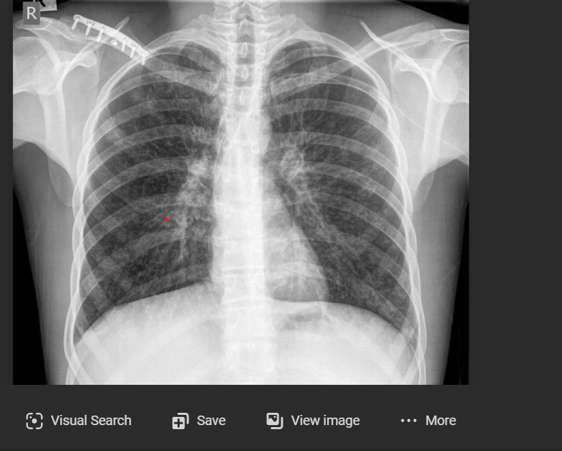
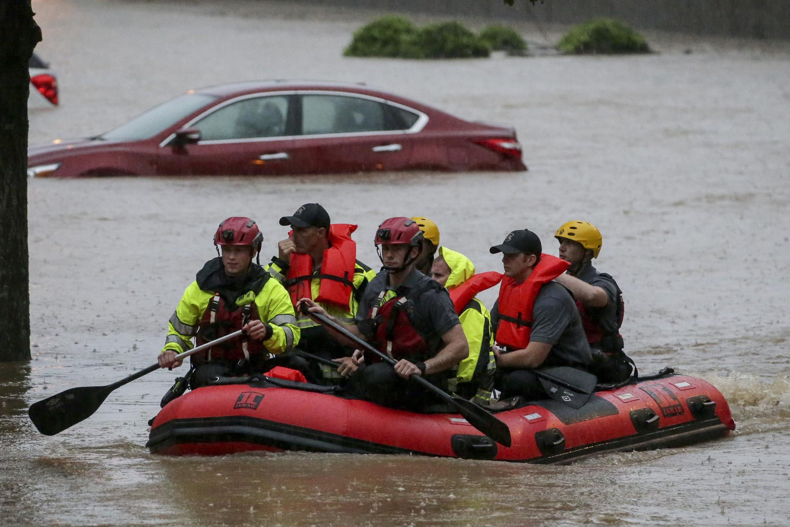
Define the Problem
Examining x-ray images for a large number of patients manually can be very time-consuming and cause delay.
Need a method to differentiate between the reports model finds some serious health issues, then we can involve the experts and thus minimize the stress on the healthcare sector.
Triage whether or not to be seen by radiologist or ER doc.

Slide 5
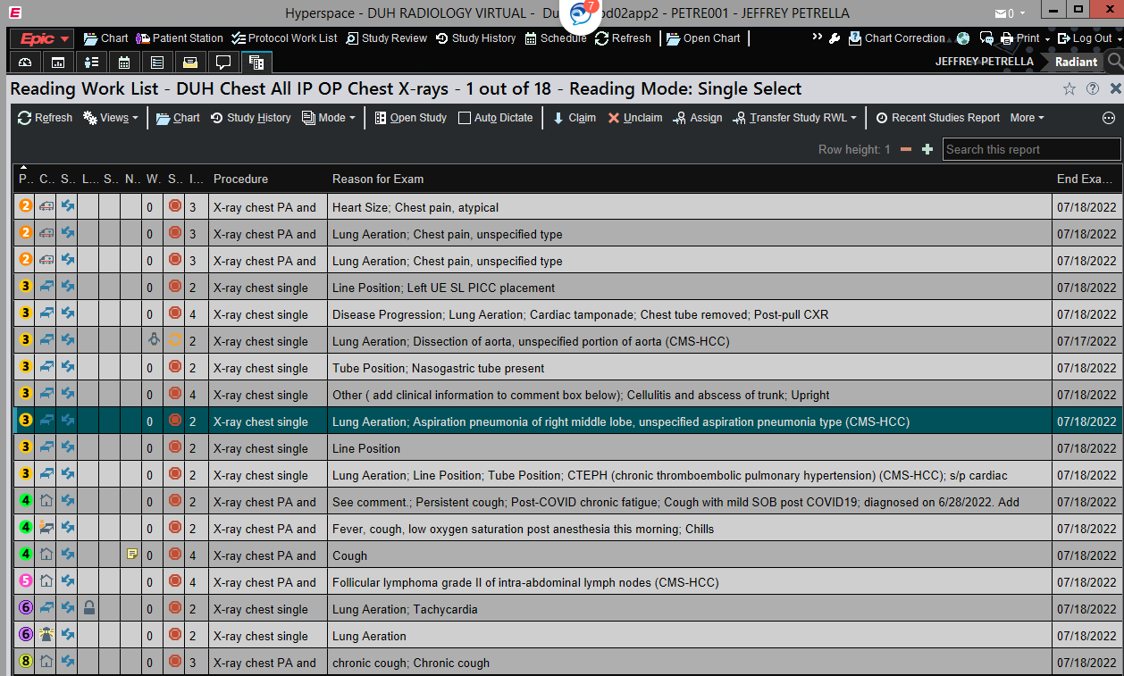

Slide 6
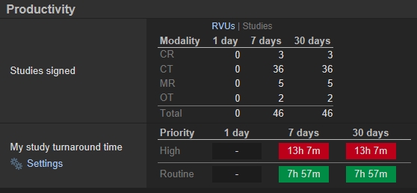

Slide 7
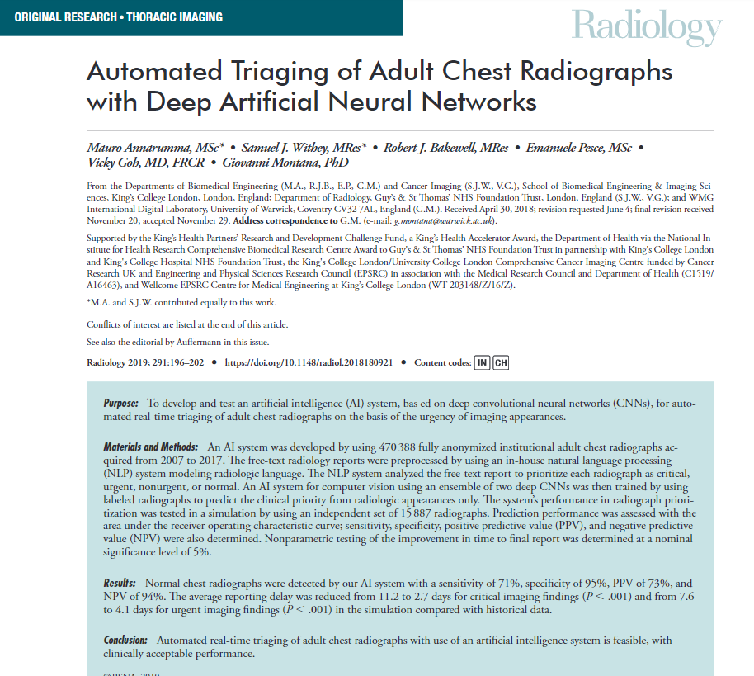
Normal chest radiographs were detected with a
  sensitivity of 71%
  specificity of 95%
  PPV of 73%
  NPV of 94%
  Average reporting delay reduced from 11.2 to 2.7 days for critical imaging findings (P < .001)
  7.6 to 4.1 days for urgent imaging findings (P < .001) in the simulation compared with historical data.

Slide 9
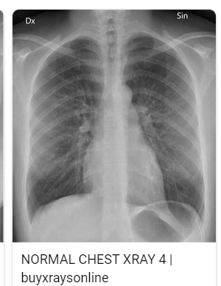
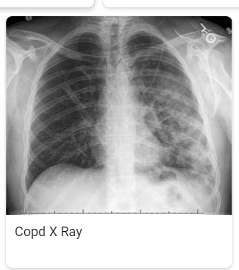
Purpose & Objective
Normal
normal
Purpose: Report generates accurately based on the x-ray images and takes the labeled reports, normal, abnormal, or XXXXX. The reports are triaged provided with minimal delay and remove any chances of any human error.
Objective: Create an NLP model to identify radiology reports as normal or abnormal, XXX.
Abnormal
abnormal

Slide 10
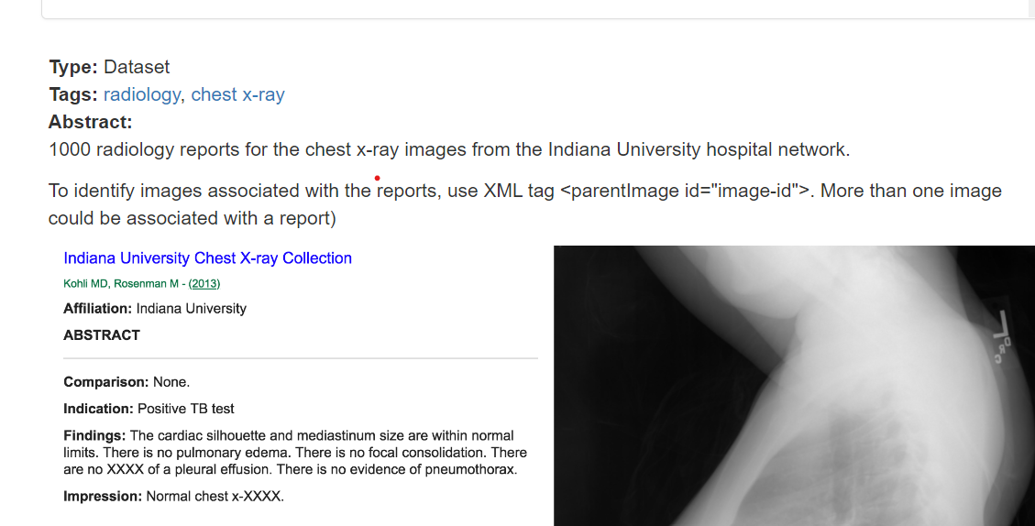
Gather Data:
Indiana University - Chest X-Rays (XML Reports)

Slide 11
Gather Data
Downloaded 400 chest x-ray impressions from the radiology reports
Extracted the impressions from the reports; blanks removed
Manually binary classification 400 impressions: normal (0) or abnormal (1)
Separate data train/test (80:20)set
Preprocessing data: tokenization, removing stop words, lemmatization
Featurizing Text: create N-grams>Bag of Words>TF-IDF
Input featurize text and labels into models> normal(0) or abnormal(1)

Slide 12
Validate & Explore Data

Slide 13
Data Gathering Approach
Dataset Used
for Model Training

Slide 15
Citations
Indiana University — Chest X-Rays Automated Report Generation | by Rohan kumar soni | Medium

