Slide 1
Chest X-ray: abnormal or normal
An innovative approach using NLP
Amani Johnson-Singh-Barnett
Jeff Petrella
Sakura Anning Yoshihara

Slide 2
Objectives
Introduction
Define the Problem
Purpose & Objective
Gather Data
Validate & Explore Data
Data Preparation
Model Selection & Analysis
Evaluation of Results
Conclusion
Citations
Notes:
The organization of this presentation follows the CRISP-DM steps outlined here – that we’re all familiar with.

Slide 3
Introduction
Background & Situation
Chest X-rays: most common imaging procedures in medicine
Images of our heart, lungs, blood vessels, airways, and the bones of our chest and spine. These images help doctors determine whether a patient has heart problems, a collapsed lung, pneumonia, broken ribs, emphysema, cancer or any of several other conditions.
Chest X-ray is obtained by a certified technologist
Images are sent for interpretation by a radiologist.
Radiologists read from large queues which are prioritized by indication – some examples; however, often unexpected findings come up in low priority cases.

Slide 4
NLP Presentation Script
Background
The mix of normal to abnormal cases obviously varies; however, some studies have estimated that over 60% of CXR’s are interpreted as normal. If the abnormal studies could be prioritized over the normal studies, this could reduce the time for communication of potentially urgent or emergent findings in half.

Slide 5
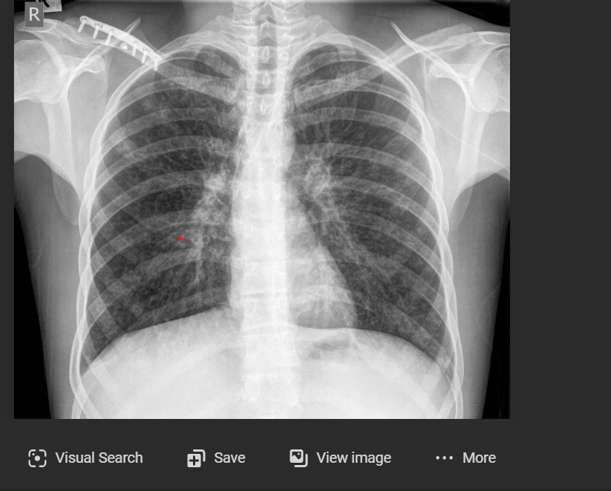
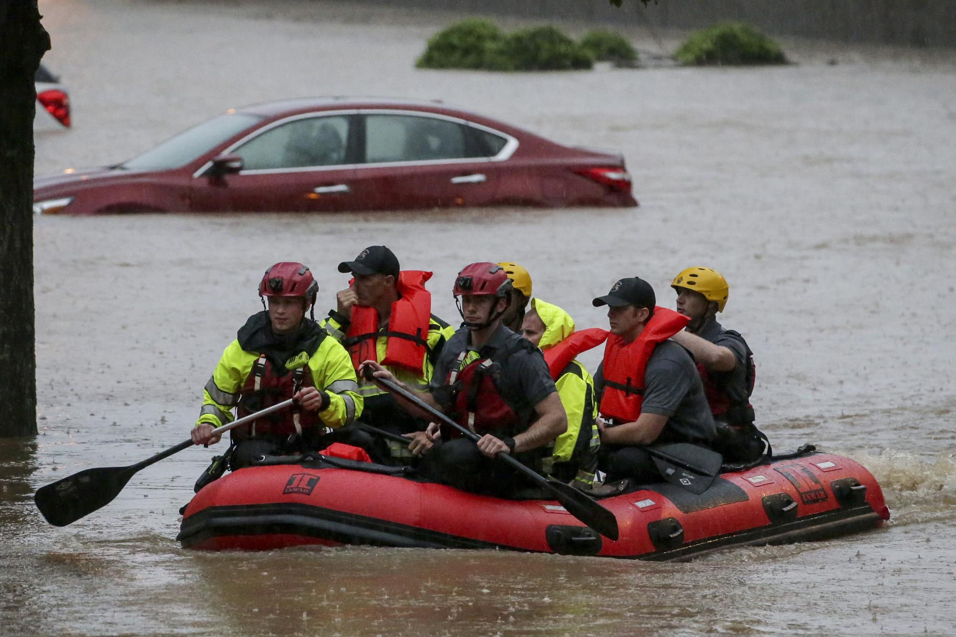
Define the Problem
Examining x-ray images for a large number of patients manually can be very time-consuming and cause delay.
Multiple efforts to use AI and computer vision to help triage CXR’s are underway; however, these efforts are limited by the availability of large sets of labelled data (on the order of 10’s of thousands). There are however an abundance of CXR images with accompanying radiology reports.
Need a method to differentiate between the reports model finds some serious health issues, then we can involve the experts and thus minimize the stress on the healthcare sector.
To minimize the time it takes for emergent findings to be communicated, it would be great to have a tool that could triage the abnormal cases to the head of the queue to be read first by a radiologist.

Slide 6
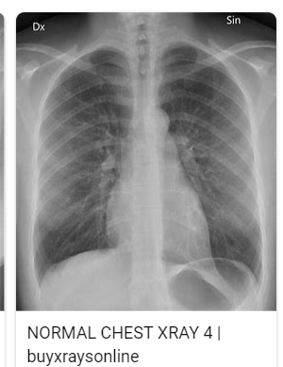
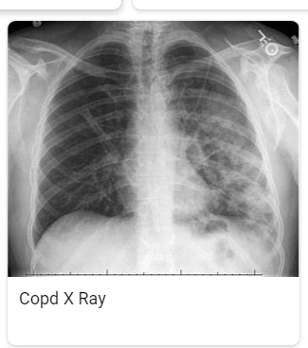
Purpose & Objective
Normal
normal
Purpose: Report generates accurately based on the x-ray images and takes the labeled reports, normal, abnormal, or XXXXX. The reports are triaged provided with minimal delay and remove any chances of any human error.
Objective: Create an NLP model to identify radiology reports as normal or abnormal, XXX.
If there were a way to generate weak labels in an automated fashion from CXR reports; this would have a large impact on efforts to develop computer vision systems to triage CXR for radiologic interpretation. Such systems could be trained by large datasets as well as tailored to a particular hospital’s case spectrum and equipment; thereby increasing their value in a local setting.
Abnormal
abnormal

Slide 7
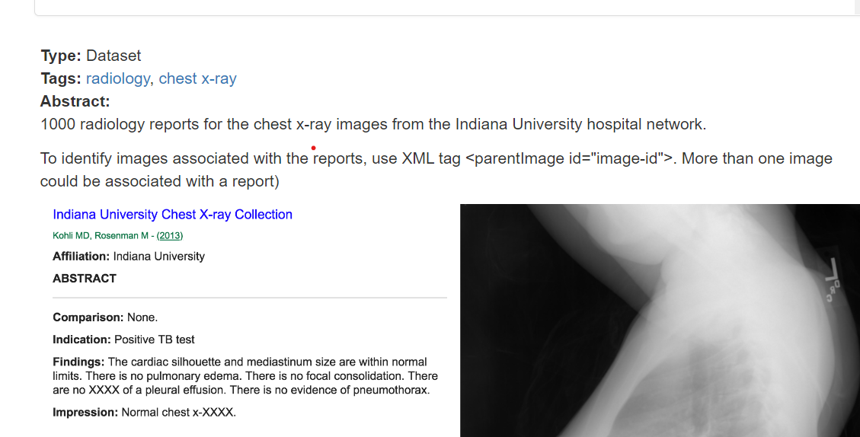
Gather Data:
Indiana University - Chest X-Rays (XML Reports)

Slide 8
Gather Data
Downloaded 400 chest x-ray impressions from the radiology reports
Extracted the impressions from the reports; blanks removed
Manually binary classification 400 impressions: normal (0) or abnormal (1)
Separate data train/test (80:20)set
Preprocessing data: tokenization, removing stop words, lemmatization
Featurizing Text: create N-grams>Bag of Words>TF-IDF
Input featurize text and labels into models> normal(0) or abnormal(1)

Slide 9
Validate & Explore Data

Slide 10
Data Gathering Approach
Dataset Used
for Model Training

Slide 11
Demo

Slide 12
References
Indiana University — Chest X-Rays Automated Report Generation | by Rohan kumar soni | Medium
https://www.rsna.org/news/2019/january/ai-for-chest-x-rays (Annarumma M, Automated Triaging of Adult Chest Radiographs with Deep Artificial Neural Networks, Radiology 2019)
Building Web Applications with Streamlit for NLP Projects | by Ram Vegiraju | Towards Data Science (medium.com)

