Slide 1


Diabetes Predictions
Amani Johnson-Singh-Barnett
July 2023
Notes:
https://scitechdaily.com/images/Diabetes-Treatments.jpg
Other diabetes pic in github https://th.bing.com/th/id/OIP.zebRpAIqbDv0MS43zo7ZbQHaE8?pid=ImgDet&rs=1

Slide 2





OBJECTIVE
Predictive Diabetes

Slide 3
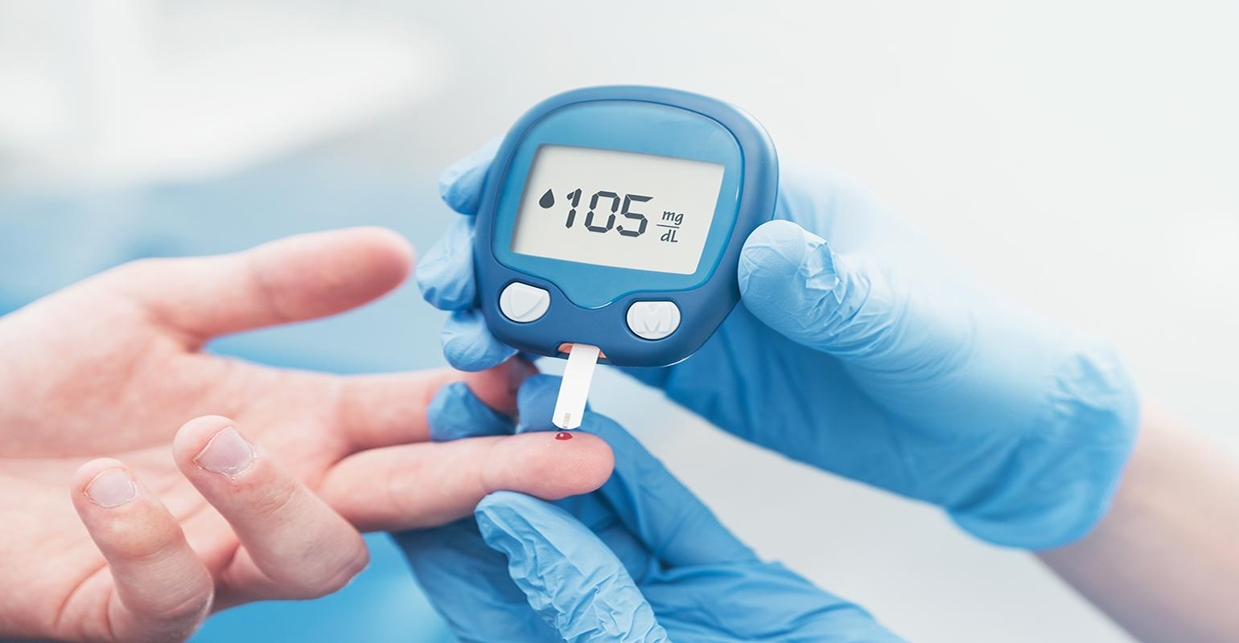

What is diabetes?
“A metabolic disease in which the body’s inability to produce enough insulin causes elevated levels of glucose in the blood.”
Notes:
https://insights.omnia-health.com/sites/omnia-health.com/files/styles/article_featured_retina/public/diabetes_3.jpg?itok=v8xBPZYG

Slide 4
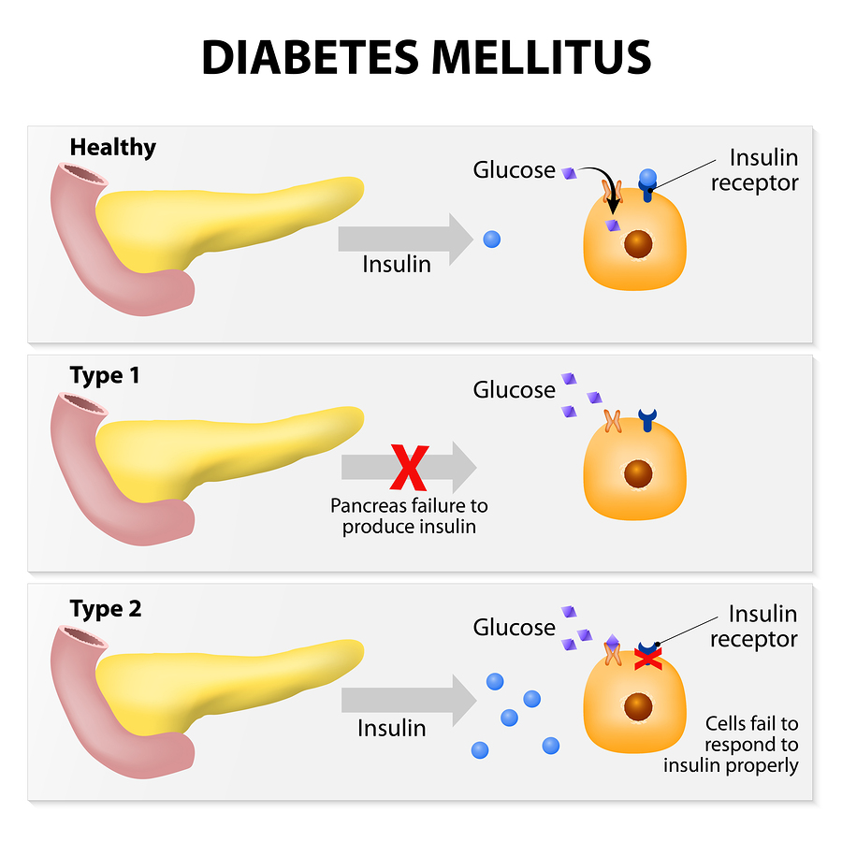
TYPES OF
DIABETES
Most common form of diabetes – about 90% of cases
Used to be called adult onset, non insulin dependent diabetes
Body produces insulin, but does not use it properly
glucose doesn’t move into cells, they pile up in the bloodstream
Signs/symptoms when they do occur are often ignored because they may not seem serious
most common
Notes:
https://www.healthstyle.net.au/wp-content/uploads/2015/07/bigstock-Diabetes-Mellitus-89255183.jpg

Slide 5
RISK FACTORS
Genetics
Family pmHx
Polycystic ovary syndrome
Irregular menses
Race
African Americans, Hispanics and Asians > whites
Age
After age 45, but increases in younger adults and children
Environmental factors
Inactivity
Weight gain

Slide 6






FEATURES
The target variable being predicted is the presence or absence of diabetes, with a value of 1 representing the presence and 0 representing the absence.
Gender pertains to an individual's biological sex, which may influence their susceptibility to diabetes. Male, female, and other are the three categories within this scope.
A person’s age is a crucial factor as diabetes is more frequently detected in older individuals. Our dataset includes age ranges from 0 to 80 years old.
Hypertension is a persistent medical condition characterized by elevated arterial blood pressure. It is measured on a scale of 0 or 1, with 0 indicating the absence and 1 indicating the presence of hypertension.
The level of glucose in the blood at a specific moment is known as blood glucose level. If the blood glucose level is high, it is a significant sign of diabetes.
There is a correlation between heart disease and an elevated risk of developing diabetes. The medical condition is measured by a binary system, with 0 indicating the absence of heart disease and 1 indicating its presence.

Slide 7



FEATURES
A person’s smoking history is deemed a risk factor for diabetes and can worsen the complications linked with the condition. Our dataset comprises five categories: not current, former, no information, current, never, and ever.
Increased BMI readings are associated with increased diabetes risk. The BMI range in the dataset spans from 10.16 to 71.55. BMI less than 18.5 is considered underweight, 18.5-24.9 is considered normal, 25-29.9 is considered overweight, and 30 or above is considered obese
The HbA1c (Hemoglobin A1c) level is a way to determine a person's average blood sugar level over the last 2-3 months. If the level is higher, it suggests a higher risk of developing diabetes. Typically, a HbA1c level of over 6.5% indicates diabetes.

Slide 8


Slide 9
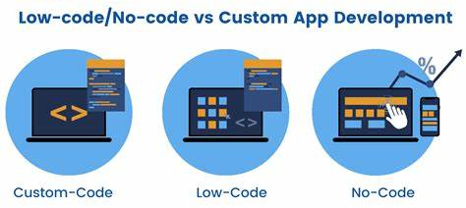
Notes:
https://hashstudioz.com/blog/wp-content/uploads/2022/07/low-code-No-code-vs-Custom-App-Development.png

Slide 10

AWS SageMaker Autopilot is a powerful machine learning (ML) tool that offers several benefits and use cases.
Here are some reasons why you might consider using AWS SageMaker Autopilot for your ML projects:
Transparency and Explainability: Detailed reports are generated to showcase the steps taken during model creation, which includes data preprocessing, feature engineering, and hyperparameter tuning.
Continuous Learning and Iteration: After deploying a model, Autopilot facilitates effortless retraining and updating of the model using new data. It offers incremental learning, enabling continuous enhancement of models over time, without the need to begin from scratch.

