Slide 1


2015
Topic 13:
Task management web application
By
Alexis Barny
Pierre Eveno
Hadrien Tran

Slide 2

Customer demand
create a task management application with:
Drag and drop system
Calendar
tasks displayed like post-it

Slide 3






Tools
This application was developed in:

Slide 4
Plan
Application features
Improvements
Difficulties
Results

Slide 5
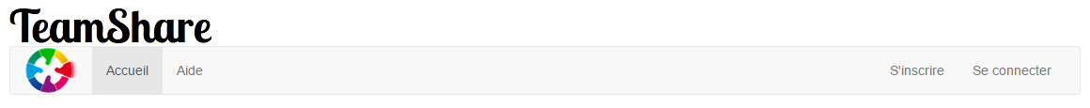
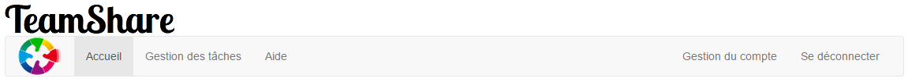

operating of the application
3 levels:
Visitor
Member
Administrator

Slide 6
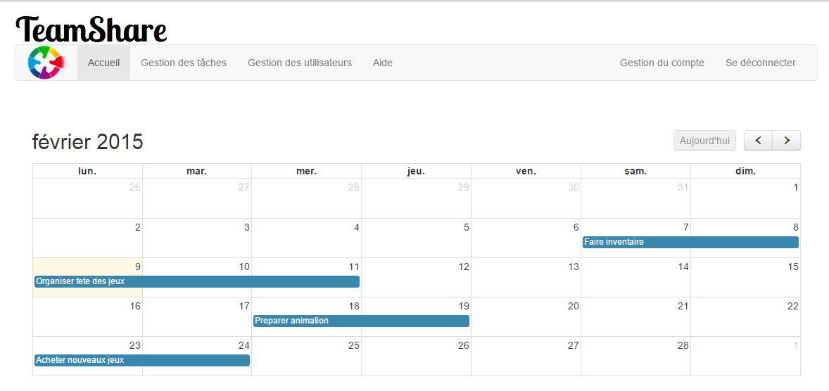
Home page
The home page is in the form of a calendar showing all tasks for the selected month.

Slide 7
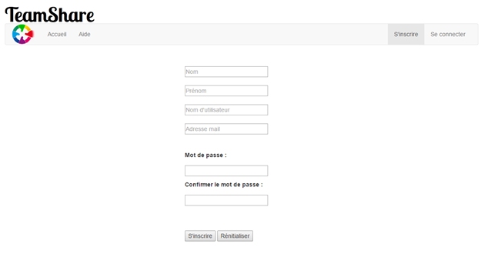
Registration
The registration page allows a new user to register to access functionalities of the application.

Slide 8
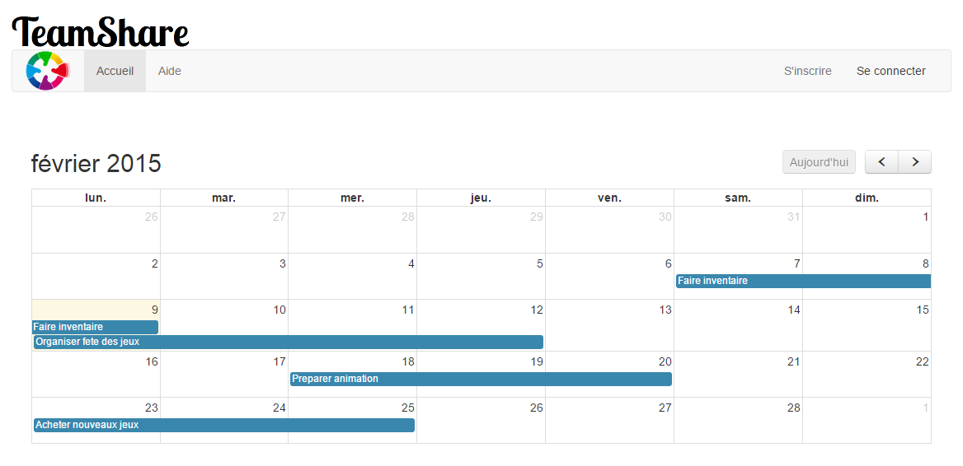
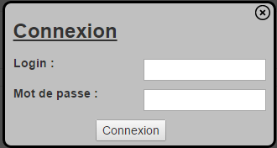
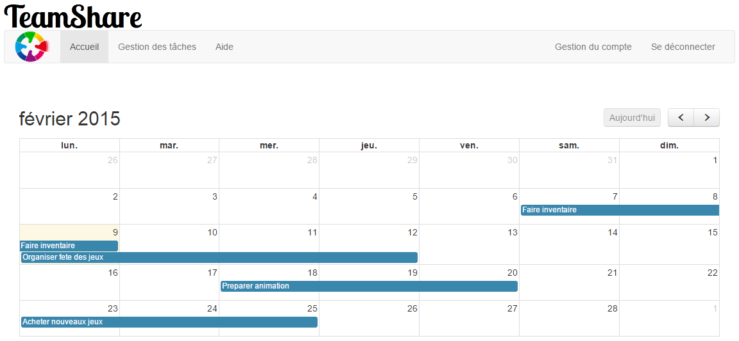

Connection
The connection allows a user session with the appearance of new tabs
session member with management tasks tab and the Account Management tab
Administrator session with the user management tab

Slide 9
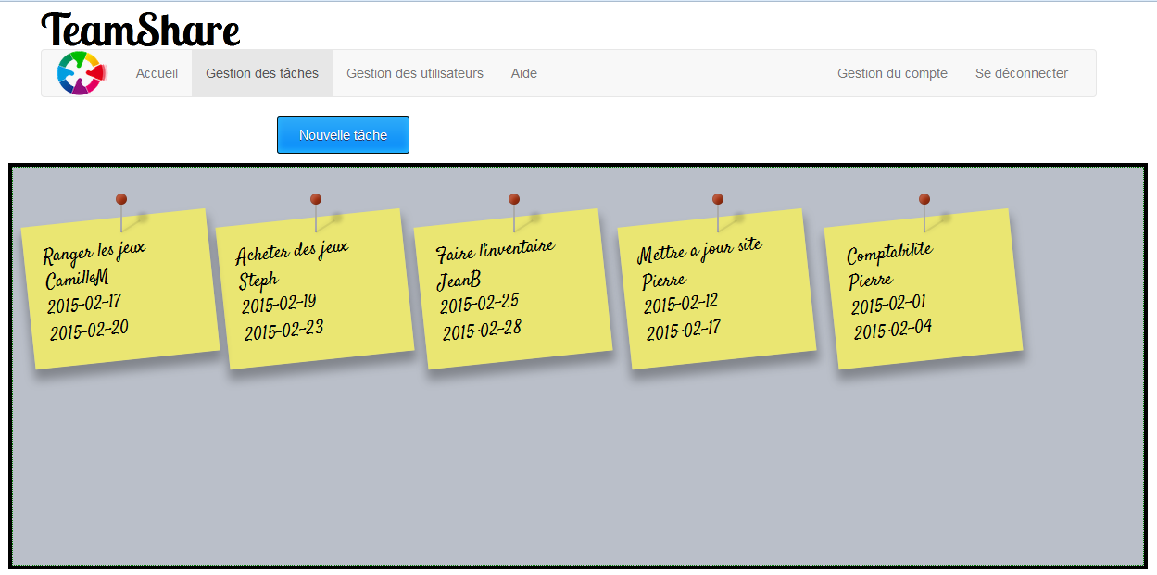
task management
Task management allows a connected user to visualize the tasks for which he is registered, and also create new tasks.

Slide 10
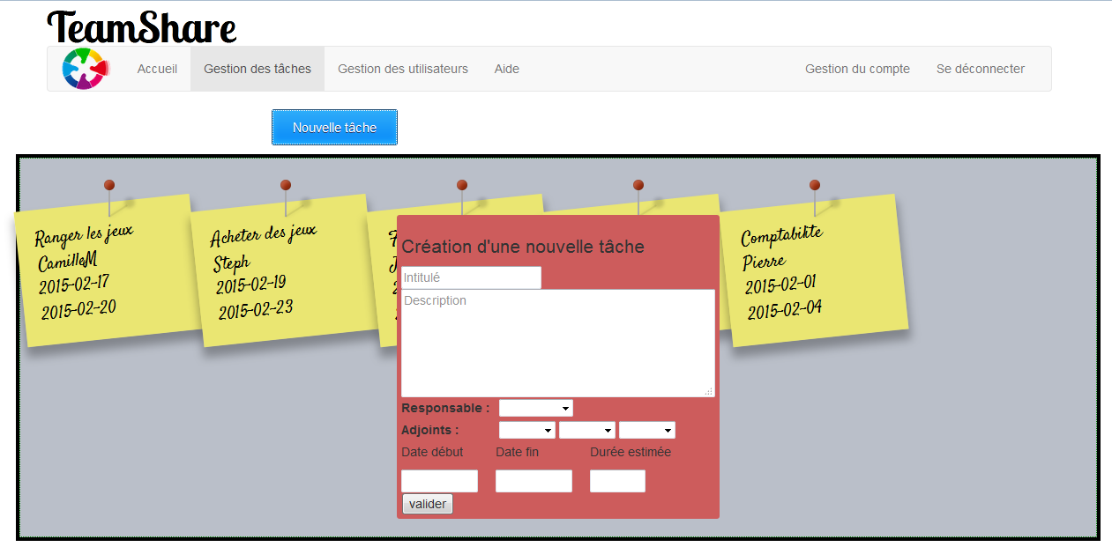
creating tasks
Required fields:
called
start date
end date
Once validated, the task is recorded in the database and will be posted on the calendar.

Slide 11
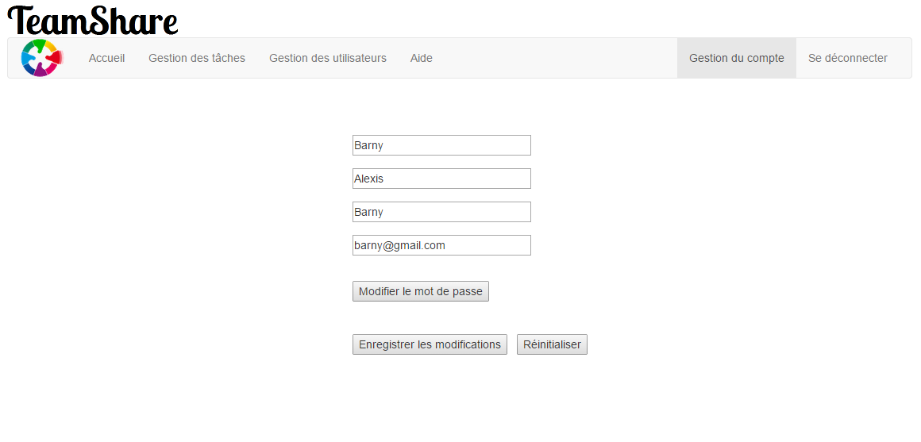
Account management
Account management allows a user to change himself his account information.

Slide 12
Registration for a task

Slide 13
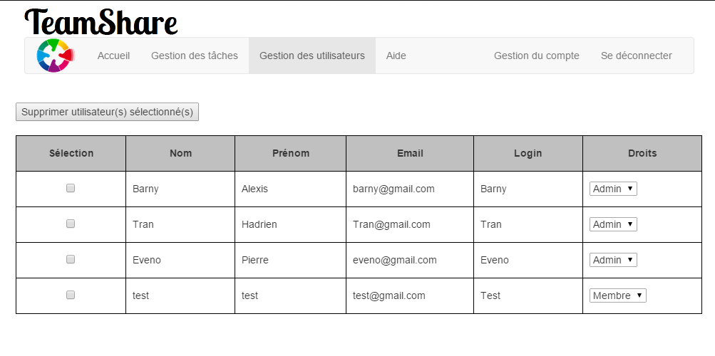
user management
User management is accessible only from an administrator account and allows to delete an user account or change its rights.

Slide 14
Improvements
Task merge system
Editing tasks
deleting tasks
email alerts

Slide 15
difficulties
Drag and drop system
Bad estimate of task durations
Lack of time
Difficult to reach customer

Slide 16
results
Team work experience with a professional client
Discovery of new API
Improving skills in PHP and jQuery

Slide 17
Thank you for your attention

