Slide 1
Anna Barou
“The Battle of Athens’s Neighborhoods, Greece”

Slide 2
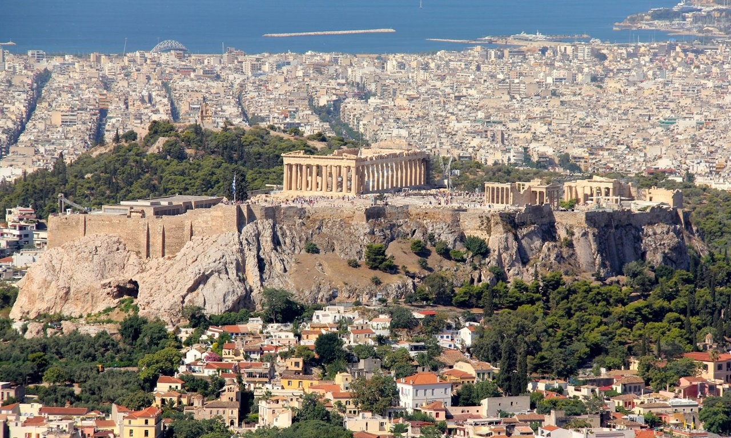
ATHENS, Greece

Slide 3
Background
A Friend of mine which is Pharmacist is looking to set up new “Pharmacy” store in a neighborhood of Athens, Greece.
He needs his pharmacy’s location to be near his home location, so specific municipalities of Athens (24 different municipalities of Athens) are investigated.
To be sure that his new pharmacy store will have good profit, he requires to:
set up his business to a municipality that live lot of people (so, we examine each municipality population)
to be as near as possible to a Hospital
to be as far as possible to other competitors’ Pharmacy stores

Slide 4
Available Data
First of all, I need a list of Athens (Attica, Greece) Municipalities with their population figure. According to “General Secretariat of National Statistical Service of Greece” there is a table that shows population (latest figures from year 2011) per Municipality. So, I use below page to extract required information:
http://www.citypopulation.de/php/greece-attiki.php
Then, I prepared a csv file that lists all above municipalities and their coordination:
https://github.com/abarou12/Coursera_Capstone/blob/master/coordinates.csv

Slide 5
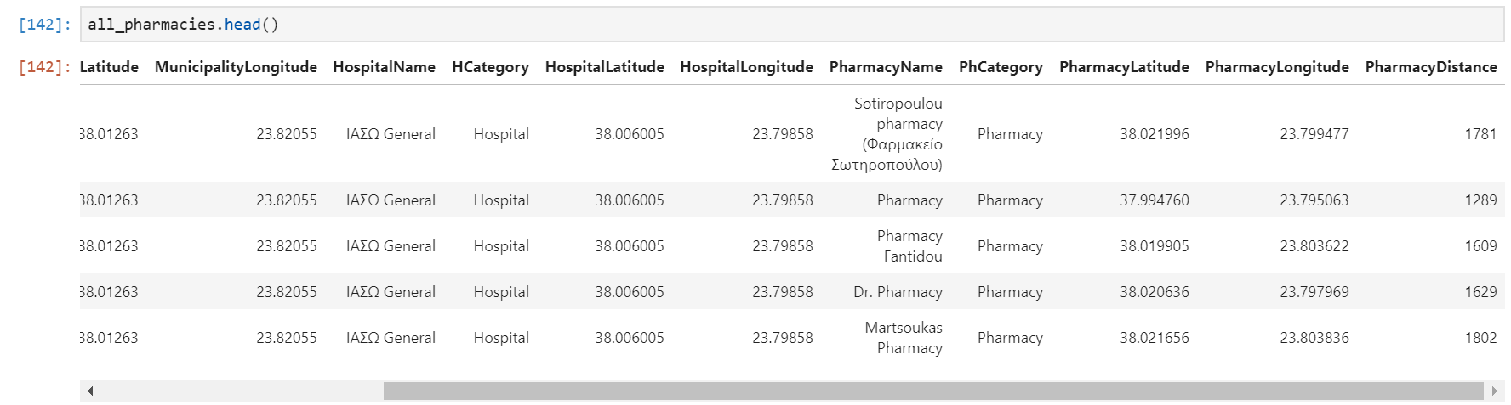
Methodology
Dataframe is created that contains several columns as:
Municipality name, its population, its coordination
Every hospital belonging in each municipality with its coordination too
Every Pharmacy near to each Hospital, with its Distance from the Hospital and its coordination

Slide 6
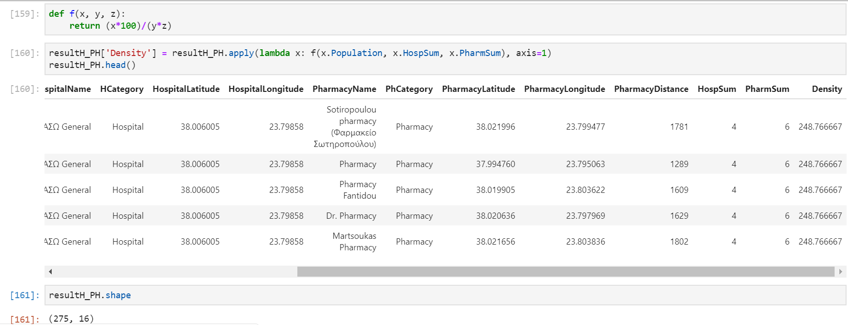
Methodology
Then, the percentage of Density population is calculated as:
“Density%” per Municipality is defined as:
(“Municipality’s Population”*100%)/(HospSum*PharmSum)
Where
HospSum is sum of Hospital for specific Municipality
PharmSum is sum of competitors pharmacies for specific Hospital

Slide 7
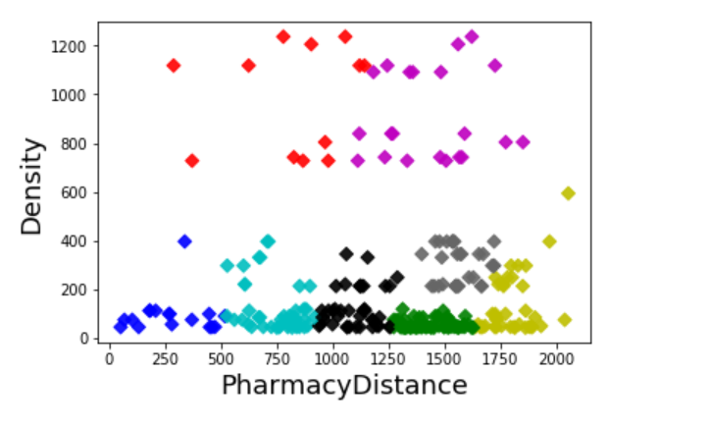
Methodology
Then, using machine learning algorithm data are grouped to 8 clusters with similar factors of “PharmacyDistance” and “Density”.
Now, it is easy to conclude that red cluster and magenta one contain the most interested location to open new Pharmacy store.

Slide 8
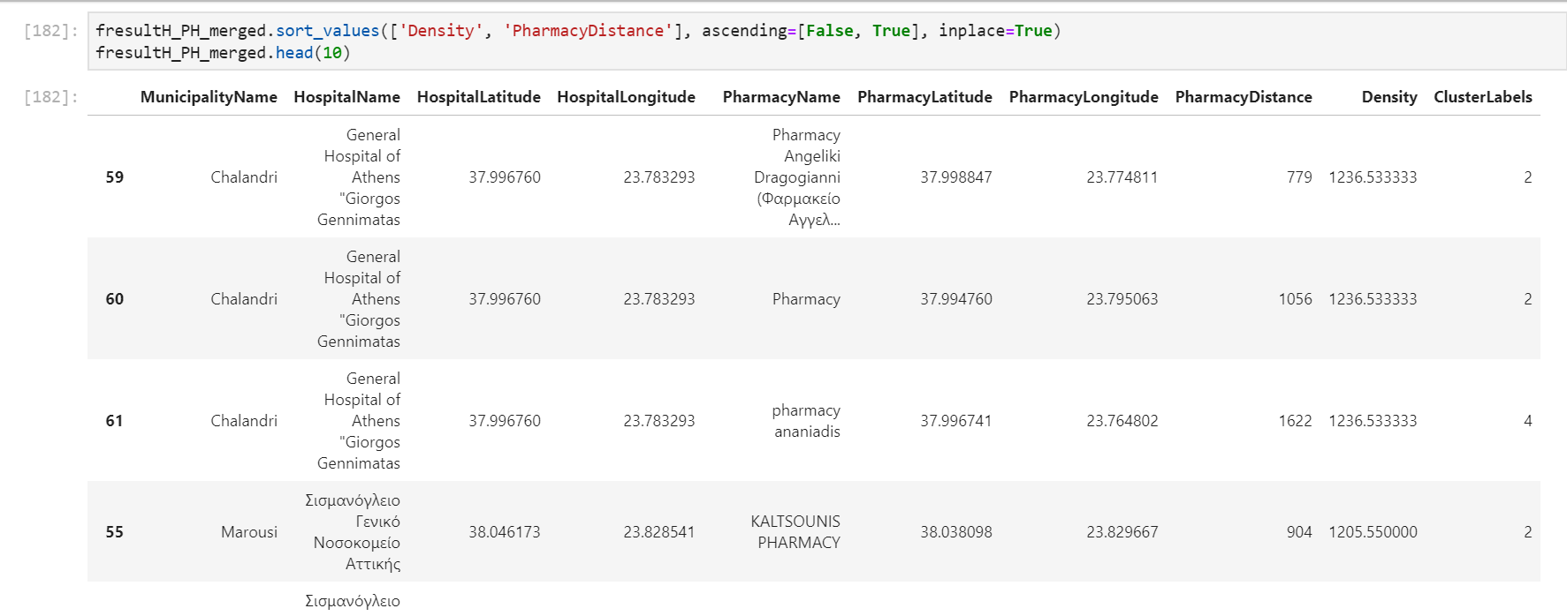
Methodology
Above finding is confirmed by just sorting our dataframe.:
cluster 4: Magenta” and “cluster 2: Red” are the best classifiers for our problem.

Slide 9
Conclusion
My proposal to my friend Pharmacist to which location to open new Pharmacy store so to be near to Hospital but far away from other pharmacies competitors and in a Municipality with big Density population is to be:
In “Chalandri” Municipality, near hospital
“General Hospital of Athens "Giorgos Gennimatas”!

Slide 10
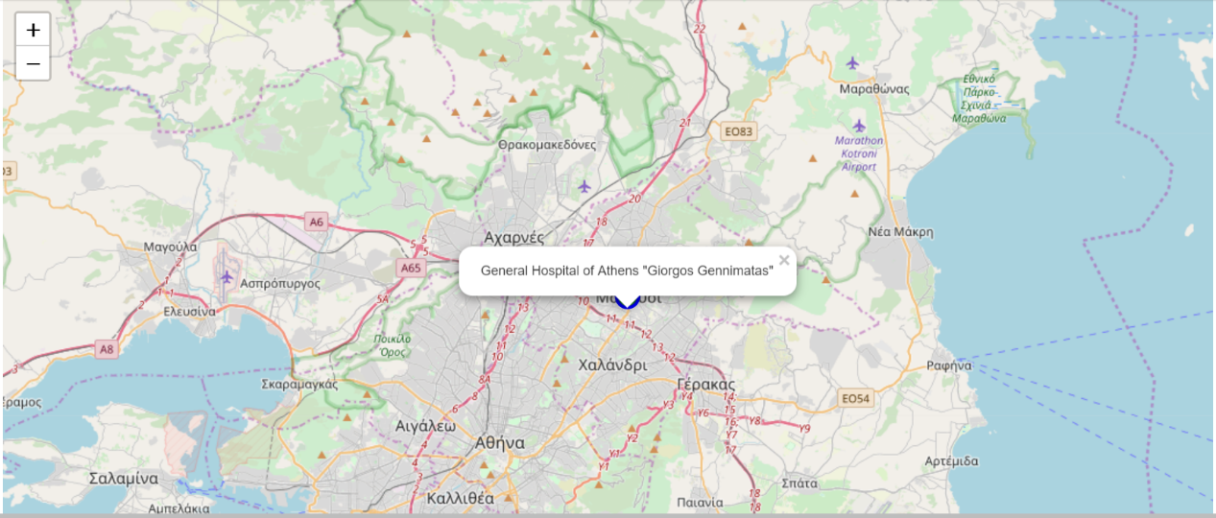
Conclusion

