Slide 1
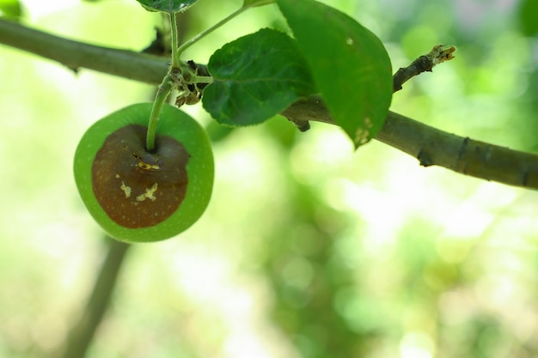
MROOT
Plant disease
classification
Armen
ACA Machine Learning Engineering
October 2026
Learning from photos and testing what helps
Notes:
Hi, I’m Armen. MROOT is my plant disease image classification project. I will explain how a model learns from photos, why I tried different training methods, and how I chose the final system. The result is a web app that suggests disease categories from an uploaded photo.
Sources: Original student-supplied MROOT handover, including the clean ViT baseline, EVA Small seeds, previous failed experiments, historical Base results, data manifests, and V1 evaluation. Rounded historical scores are approximate. Reasons for old runs are reconstructed from the recorded setup where no original proposal exists.

Slide 2
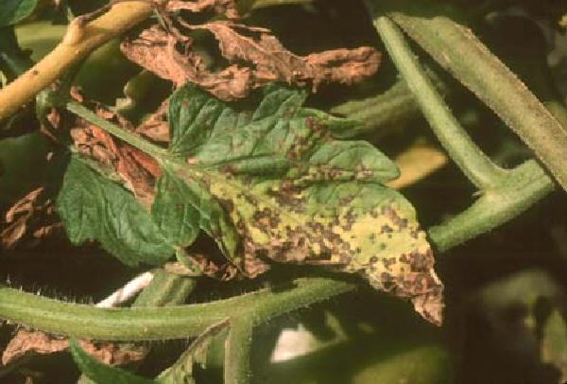
A photo becomes a disease suggestion
Classification means assigning a photo to a category.
MROOT has 39 disease categories.
A label is the known category attached to a training photo.
The app ranks five suggestions.
Dataset example: septoria leaf spot
MROOT 02
Notes:
The task is image classification: assigning a picture to one of a fixed set of categories. MROOT has 39 disease labels. A label is the name attached to a training photo, such as rust or septoria leaf spot. The app ranks five suggestions. It predicts the disease category, independently of the plant species. It has no healthy category, so it cannot reliably answer the broader question of whether any plant is healthy.
Sources: Original student-supplied MROOT handover, including the clean ViT baseline, EVA Small seeds, previous failed experiments, historical Base results, data manifests, and V1 evaluation. Rounded historical scores are approximate. Reasons for old runs are reconstructed from the recorded setup where no original proposal exists. The photo is an original validation example labeled septoria_leaf_spot. It is not a newly generated image or a new model prediction.

Slide 3
What training a model means
Model
A program with learned numerical settings that turn image pixels into disease scores.
Training
Show labeled examples, measure mistakes, and adjust those settings.
Prediction
Use the trained settings on a new photo. This step is also called inference.
MROOT 03
Notes:
A neural network is a model whose connected layers transform an image into scores. Its parameters, often called weights, are the internal numbers learned during training. A loss is a numerical penalty for a wrong or poor prediction. Training adjusts the parameters to reduce that penalty. Prediction uses the trained parameters to score a new photo. The app does not learn a new model every time someone uploads an image.
Sources: Project training configuration and original recorded recipes. General training terminology: https://docs.pytorch.org/tutorials/beginner/basics/optimization_tutorial.html.

Slide 4
Why I kept separate photo sets
Photos | Purpose | Final count
Training | Teach the model | 6,790
Validation | Choose between approaches | 388
Final report / holdout | Report the chosen system | 623
Final model comparisons used 368 of the 388 validation photos.
The holdout had already been evaluated earlier.
MROOT 04
Notes:
Training photos teach the model. Validation photos help me compare training choices without directly training on those photos. A test or holdout set is normally reserved for reporting after choices are fixed. Our final paired experiment used 6,790 training and 388 validation photos. Comparisons with older checkpoints also used a shared 368-image subset of validation. The final report used 623 held-out photos. That holdout had already been evaluated earlier, so it is not a completely new blind test. The original clean split had 6,870 training and 390 validation photos; I keep those counts with the earlier results.
Sources: Project reports/raw/class_support.csv, eda_summary.json, split_summary.json, and exact data/manifests CSVs. Original handover explains the source-folder versus manifest distinction. Project reports/raw/FINAL_HOLDOUT_20261024T103253_167194Z/FINAL_HOLDOUT_RESULT.json and FROZEN_SELECTION.json. Comparison with the previous four-model result uses the same 623 images. This holdout was previously evaluated.

Slide 5
What Top-1 and Top-5 accuracy mean
Top-1
The first suggestion is the correct disease.
Top-5
The correct disease appears anywhere in the five suggestions.
Example
If the correct disease is second, Top-1 counts a mistake and Top-5 counts a success.
MROOT 05
Notes:
These measures answer a direct user question. Did the model’s first answer match the label, or was the label at least included among its five suggestions? The example is only an illustration. A model can have strong Top-5 and still make noticeably more first-choice errors. That pattern motivated checking which diseases the model confused and whether combining models improved their ranking.
Sources: Original student-supplied MROOT handover, including the clean ViT baseline, EVA Small seeds, previous failed experiments, historical Base results, data manifests, and V1 evaluation. Rounded historical scores are approximate. Reasons for old runs are reconstructed from the recorded setup where no original proposal exists. Definitions follow the project evaluation code. The second-place example is illustrative.

Slide 6
Macro mAP gives each disease equal importance
AP means average precision. It measures ranking quality for one disease.
Ranked photo | Rust score | Actual label
A | 0.90 | Rust
B | 0.80 | Another disease
C | 0.70 | Rust
At A: 1 of 1 is rust. At C: 2 of 3 are rust.
Rust AP averages these: (100% + 66.7%) / 2 = 83.3%.
Macro mAP averages all 39 disease AP scores equally.
Toy example only. These are not MROOT predictions.
MROOT 06
Notes:
Average precision, or AP, measures ranking quality for one disease. Macro mAP averages AP over all 39 diseases with equal importance. In the toy table, a non-rust photo ranks above a rust photo, reducing the rust AP. This metric is not the fraction of photos with a correct first suggestion. I chose it because common classes should not dominate the score.
Sources: Project metric code uses sklearn.metrics.average_precision_score. Definition: https://scikit-learn.org/stable/modules/generated/sklearn.metrics.average_precision_score.html. Any three-photo example in this presentation is invented only to explain the metric.

Slide 7
Some diseases had far fewer training examples
Class imbalance means unequal training counts across categories.
Selected classes from the final training split.
MROOT 07
Notes:
A class is one of the categories the model can predict. In our final training data, powdery mildew had 755 photos while berry blotch had 68. A model could pay much more attention to common classes unless the training method accounts for this difference. That is called class imbalance. It explains why I used a metric that treats classes equally and tested different ways of balancing training. The chart shows a few examples from all 39 classes.
Sources: Project reports/raw/class_support.csv, eda_summary.json, split_summary.json, and exact data/manifests CSVs. Original handover explains the source-folder versus manifest distinction.

Slide 8
Related photos can make an evaluation too easy
Near duplicate
A resized, cropped, or compressed version of the same underlying photo.
Leakage
Information from evaluation examples reaches training, making the check less independent.
Our response
Review related images and conflicting labels, then exclude detected groups using new file lists.
MROOT 08
Notes:
Matching file hashes finds identical bytes, but a resized copy can have a different hash. If a training photo and its close copy appear in validation, the score may look better than performance on genuinely new photos. Review also found a related photo with conflicting disease labels. We used new manifests, meaning CSV lists of the files allowed in each split, to quarantine detected groups. The final pair used 80 fewer training rows and two fewer validation rows. The original files remained intact. The checks reduced detected overlap; they cannot prove that every possible relationship was removed.
Sources: Project reports/raw/class_support.csv, eda_summary.json, split_summary.json, and exact data/manifests CSVs. Original handover explains the source-folder versus manifest distinction. Initial and reviewed audit findings in docs/experiments.md.

Slide 9
I adapted models that already knew visual patterns
Pretraining
Learn general visual patterns from another large image dataset first.
Fine-tuning
Adjust that pretrained model using MROOT’s labeled plant photos.
EVA-02
The pretrained model family I used. It is a Vision Transformer (ViT), which combines information from image patches.
MROOT 09
Notes:
I did not train a large image model from zero using only a few thousand photos. I started with pretrained models and fine-tuned them. ViT stands for Vision Transformer. It represents an image through patches and combines information across those patches. EVA-02 is the particular pretrained Transformer family used in MROOT. Small and Base are different model sizes. A larger model has more learned parameters and costs more to run, but it still needs a measured benefit on our task.
Sources: Project handover and model identifiers. ViT: https://arxiv.org/abs/2010.11929. EVA-02: https://arxiv.org/abs/2303.11331.

Slide 10
Why combining models helped at first
An ensemble averages several models’ disease scores. A seed controls random choices in training.
Original validation: 390 photos. Historical rounded scores are approximate.
MROOT 10
Notes:
An ensemble combines predictions from several trained models. A random seed controls random choices in training, so the same general recipe can produce models with different errors. The original project trained three separate EVA Small models. Their disease probabilities were averaged. The historical clean ViT baseline was about 90.64% macro mAP, two EVA models reached about 93.53%, and the three-model result was 94.72% on the original 390 validation photos. I reproduced that saved reference before trying changes. Averaging helps only when the predictions combine usefully.
Sources: Original student-supplied MROOT handover, including the clean ViT baseline, EVA Small seeds, previous failed experiments, historical Base results, data manifests, and V1 evaluation. Rounded historical scores are approximate. Reasons for old runs are reconstructed from the recorded setup where no original proposal exists.

Slide 11
More training and more models did not always help
What I tried | Why I tried it | What happened
Another seed | See if another training run corrects different mistakes | The ensemble got worse
Continue training | Check whether more training still improves the first model | No improvement over its saved version
ConvNeXt V2 Tiny | Try another type of model for a different set of mistakes | Did not help the EVA combination
Each test checked whether the new predictions improved the result on other photos.
MROOT 11
Notes:
A fourth Small model used the same general recipe with different training randomness, but it lowered the ensemble score to about 94.49%. Continuing the first model’s training did not beat its earlier saved result. ConvNeXt V2 Tiny was another image-model architecture, using learned local visual filters instead of the Transformer approach. It reached about 90.54% alone and hurt the EVA combination. These failures kept me from treating more training or more models as automatic progress. The motivations for these historical runs are reconstructed from the setup in the handover.
Sources: Original student-supplied MROOT handover, including the clean ViT baseline, EVA Small seeds, previous failed experiments, historical Base results, data manifests, and V1 evaluation. Rounded historical scores are approximate. Reasons for old runs are reconstructed from the recorded setup where no original proposal exists.

Slide 12
Two ways to give rare diseases more attention
Sampling
Choose which photos appear during training. Balanced sampling shows rare classes more often.
Weighted loss
Give rare-class mistakes a larger penalty while adjusting the model.
Experiment
Use a normal shuffled pass through the photos with a weighted loss. The ensemble rose slightly: 94.72% to 94.85%.
MROOT 12
Notes:
The sampler decides which training examples are drawn. With replacement sampling, the same rare photo may appear several times while another photo is skipped in that round. A loss tells training how costly its mistakes are. I tested ordinary shuffled sampling and moved the class balancing into the loss penalty. This was a combined sampling-and-loss change, not two separately isolated effects. The new Small model added only about 0.13 percentage points to the original ensemble on the same 390 validation photos. That was a small candidate improvement, not evidence that balancing was solved.
Sources: docs/experiments.md and the saved natural-sampling experiment. Original 390-photo validation.

Slide 13
Could a larger model use finer image detail?
Resolution
Pixels are the image’s tiny colored dots. I used 448 × 448 instead of 336 × 336 to retain finer detail.
Model size
I also changed from EVA Small to the larger EVA Base model.
Result
A combination including the new Small and Base models reached 95.07% mAP on the original validation set.
Both the model size and input resolution changed.
MROOT 13
Notes:
Resolution is the number of input pixels across and down. Increasing it may preserve detail that was harder to see at a smaller input size. I also changed the model size, so this experiment cannot identify a resolution-only effect. Earlier parts of the pretrained model received smaller updates than later parts, to limit how much previous learning was disturbed. This is called layer-wise learning-rate decay. The larger Base contributed usefully in some combinations. Its cost and its contribution both mattered, rather than its size alone.
Sources: docs/experiments.md and original Base configuration. EVA-02: https://arxiv.org/abs/2303.11331.

Slide 14
Smaller training adjustments helped one model
Learning rate
A setting that controls the size of each training adjustment.
Experiment
Start from the same pretrained model and use learning rates three times smaller.
Lesson
The model improved alone, from 94.22% to 94.66% mAP, but its planned ensemble replacement got worse.
MROOT 14
Notes:
A learning rate controls how large an adjustment training makes to its parameters. Large adjustments may move a useful pretrained solution too much, while smaller ones can adapt more gently. I tested smaller rates rather than assuming they would help. The gentler Base improved by itself under the recorded three-view prediction recipe. However, replacing the earlier Base in a predefined ensemble reduced that combination from about 95.12% to 94.92% on the same 390 validation photos. I therefore kept checking how predictions worked together, not just which model had the highest individual score.
Sources: reports/raw/gentler_base_result.json and docs/experiments.md. The standalone scores shown use the recorded three-view prediction recipe.

Slide 15
A fair comparison needs a matched reference
Control
Reference training run used to judge the proposed change.
Matched setup
The same photos, starting model, training randomness, and ordinary training settings.
One policy change
Add the combined image-mixing policy while retaining the same recipe.
MROOT 15
Notes:
After the image-group review changed the split, I needed a fresh reference trained on that same split. Otherwise, a difference could come from cleaner data rather than the proposed training method. A control is the matched reference for this comparison. Both final models used the same 6,790 training and 388 validation photos and the same saved starting parameters. The candidate added MixUp and CutMix as one policy. I can compare that combined policy with the control, but I cannot claim which mixing method caused the difference on its own. I ran one seed per arm, so repeated-seed variation remains unknown.
Sources: Project reports/raw/COMPLETED_COMPARISON.json, control/experiment_config.json, mixup_cutmix/experiment_config.json, paired_validation_intervals.json, and docs/experiments.md. These are saved results, not new evaluations.

Slide 16
Augmentation creates varied training examples
Meaning
Change a training photo to provide another view without collecting a new photo.
Examples
Small crops, flips, and modest color changes. The disease label should remain useful.
Why try more?
A model that relies on one exact photo or background may struggle with new photos.
MROOT 16
Notes:
Data augmentation changes training inputs so the model sees variation. A flip or a modest crop can change the picture while keeping the labeled disease visible. The changes need care: an aggressive crop can remove a lesion, and large color changes can remove useful symptoms. Our ordinary augmentations were already in the shared recipe. The last experiment added a mixing policy to test whether stronger variation could help. It did not prove that the model stopped using backgrounds or memorizing photos; that was the hypothesis being tested.
Sources: Recorded original and final augmentation configurations. MixUp/CutMix motivation: Zhang et al., https://arxiv.org/abs/1710.09412; Yun et al., https://arxiv.org/abs/1905.04899. Actual MROOT outcome is from the saved final controlled comparison.

Slide 17
MixUp blends two examples and their labels
Image
Blend two training photos, such as a rust photo and a scab photo.
Target example
A 70/30 image blend uses a target of 70% rust and 30% scab.
Why try it?
Test whether varied image combinations improve predictions on other photos.
Illustrative example. Mixing happens during training.
MROOT 17
Notes:
MixUp uses a blended pair of images and correspondingly blended targets. The 70/30 example is invented to explain the idea, not an actual evaluation result. The model must learn from combinations instead of relying only on complete familiar photos. During normal prediction, the user still uploads an ordinary photo. The public app does not blend the user’s photo with another image.
Sources: Zhang et al., https://arxiv.org/abs/1710.09412; Yun et al., https://arxiv.org/abs/1905.04899. Actual MROOT outcome is from the saved final controlled comparison.

Slide 18
CutMix replaces a region with part of another photo
Image
Paste a region from a second training photo into the first.
Target example
A patch covering 25% of the image contributes 25% of its label to the target.
Why try it?
Test whether varied local patterns help the model recognize disease symptoms.
MROOT 18
Notes:
CutMix changes a region rather than blending every pixel. Its targets are mixed according to patch area. For disease photos this might encourage the model to use more than one local cue, but it can also hide important symptom detail. That is why it needed a validation comparison. Our experiment tested a combined MixUp/CutMix policy. It was not a separate proof of MixUp’s effect and another proof of CutMix’s effect.
Sources: Zhang et al., https://arxiv.org/abs/1710.09412; Yun et al., https://arxiv.org/abs/1905.04899. Actual MROOT outcome is from the saved final controlled comparison.

Slide 19
Results of the matched comparison
Same 388 validation photos | Macro mAP
Matched reference model: control | 94.81%
Candidate with MixUp/CutMix | 96.07%
The combined mixing policy had the higher observed score in this matched comparison.
Same 388 validation photos and standard single-view prediction.
MROOT 19
Notes:
On the same 388 validation photos, the control scored 94.81% macro mAP and the mixed-image candidate scored 96.07% with one standard prediction view. This was an observed result from a matched comparison. Both models trained only on the training split. I saved the best version using validation rather than simply using the last training version. The result supports keeping the candidate for ensemble checks. It does not prove that the policy will improve every seed or a completely new data source.
Sources: Project reports/raw/COMPLETED_COMPARISON.json, control/experiment_config.json, mixup_cutmix/experiment_config.json, paired_validation_intervals.json, and docs/experiments.md. These are saved results, not new evaluations.

Slide 20
At prediction time, I also average several views
Three views
A resized photo, a mirrored view, and the whole photo with a plain border so it fits a square.
One model
Average its disease scores over these views. This is test-time augmentation, or TTA.
Two models
Average the two models’ resulting scores equally to obtain the final ranking.
MROOT 20
Notes:
Inference means using a trained model to make a prediction. Test-time augmentation repeats inference for different versions of the same input. It is separate from creating varied examples during training. The padded view preserves the full image and adds a plain border to make it square. We used the recorded normal, flipped, and padded recipe so the deployment matched evaluation. It can help some models, but it did not improve every metric in every comparison. The exact view weights are in the implementation rather than on the public slides.
Sources: ensemble.json; src/mroot/inference.py; saved normal-view and fixed-view comparisons.

Slide 21
Why I chose a two-model ensemble
Same 368 validation photos. The pair led on mAP; a single model led on first-choice accuracy.
MROOT 21
Notes:
For comparison with older models, I used the same shared 368-photo subset of validation. The mixed-image model alone scored 96.03% macro mAP with the recorded multiple-view recipe. Combining it with the clean control scored 96.48%. Adding an earlier Base or a newer Small did not beat that pair. I chose by macro mAP, the primary metric. A single mixed model with standard single-view prediction had higher Top-1, so the pair was not best on every metric. An uncertainty range estimated by resampling these validation photos includes no improvement, so the small pair-versus-single advantage is uncertain. This is the highest observed mAP among the final comparisons, not a guarantee of an improvement on unseen sources.
Sources: Project reports/raw/COMPLETED_COMPARISON.json, control/experiment_config.json, mixup_cutmix/experiment_config.json, paired_validation_intervals.json, and docs/experiments.md. These are saved results, not new evaluations.

Slide 22
Final reporting on 623 held-out photos
89.41%
99.36% Top-5
557 of 623 correct first suggestions
619 of 623 within five suggestions
Macro mAP: 92.99%
Same 623 photos | Correct first suggestions
Previous four-model system | 549
Final two-model system | 557
This holdout had been evaluated before. A new external set is still needed for an independent final estimate.
MROOT 22
Notes:
The final pair classified 557 of 623 photos correctly on its first choice, which is 89.41% Top-1 accuracy. It included the true disease in the first five suggestions for 619 photos, or 99.36% Top-5. Its macro mAP was 92.99%. On the same 623 photos, the previous four-model system had 549 correct first choices, so the final pair added eight. This holdout had already been evaluated earlier. We froze the final selection before its last evaluation, but that does not make it a completely new independent test. It also cannot be compared directly with the old V1 score on 670 photos as if the sample sets were identical.
Sources: Project reports/raw/FINAL_HOLDOUT_20261024T103253_167194Z/FINAL_HOLDOUT_RESULT.json and FROZEN_SELECTION.json. Comparison with the previous four-model result uses the same 623 images. This holdout was previously evaluated.

Slide 23
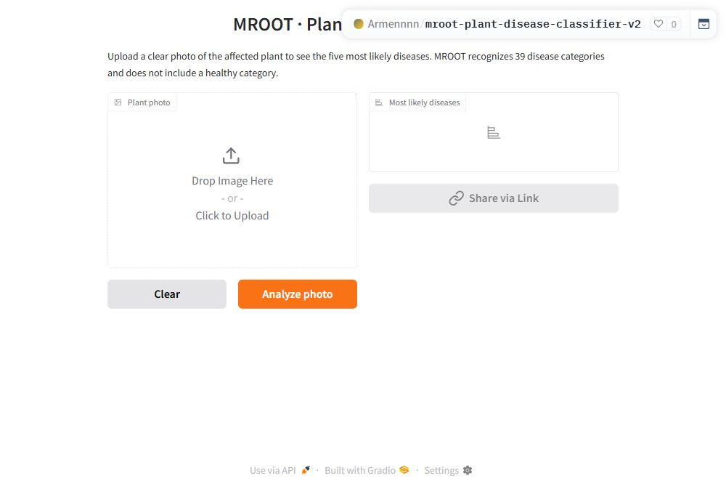
Using the trained model in a web app
Deployment means putting the trained model into a usable application.
Upload a photo
Click Analyze photo
Read the suggestions
Open MROOT V2
MROOT 23
Notes:
Deployment means putting the trained model into an application other people can use. In the V2 Hugging Face Space, the user uploads a plant photo and clicks Analyze photo. The app returns the five ranked disease scores. The original V1 app remains available. The V2 model files and prediction recipe were checked against the saved versions. If the online service is unavailable during the demonstration, I can show the interface and saved verification, while saying clearly that the live request did not complete.
Sources: https://huggingface.co/spaces/Armennnn/mroot-plant-disease-classifier-v2 and reports/live_deployment_verification.json.

Slide 24
What these results still cannot establish
New photos
Generalization means working on photos beyond the examples used to develop the system.
Memorization risk
Overfitting means fitting familiar examples too closely and performing worse on new ones.
Product limits
The validation set is small and reused. The model has no healthy or unknown category, and a high score can still be wrong.
MROOT 24
Notes:
Generalization is the ability to work on new examples from the intended use setting. Overfitting is one way that ability can fail. Our validation set is small, and repeated experiment decisions can adapt to its quirks even when validation photos are not used in gradient updates. The old holdout was also exposed earlier. Some class labels overlap visually or remain ambiguous. The model’s output score is not a verified probability that a diagnosis is correct. These limitations are why I would next collect independently reviewed external photos and add healthy or unrelated examples before considering a rejection rule.
Sources: Project evaluation history and limitations in docs/evaluation.md and original handover.

Slide 25
What I learned from the project
Data first
A score is useful only when the labels and the separation of photos make sense.
Useful changes
An extra model helps only if its predictions improve the combination.
Next step
Collect a new independent photo set and review healthy and unknown examples before expanding the demo.
MROOT 25
Notes:
My main lesson was to turn each training idea into a question I could actually test. Balancing rare classes, increasing the model and image size, reducing adjustment size, and mixing training examples were different hypotheses. Some helped a model alone but not the ensemble. Some failed. The final result is a working app and a recorded experiment history. The next useful improvement is stronger evaluation evidence, rather than simply making the ensemble larger.
Sources: Project experiment record. Proposed future work is not completed work.

Slide 26
Earlier experiments from the project history
Historical model | Individual mAP | Combined result
Three original Small runs | about 92.00%, 92.38%, 91.09% with one view | Three-model recipe: 94.72%
Historical Base 448 | about 93.55% | With Small models: about 94.82%
Later Base rebuild | about 93.12% | With Small models: about 94.54%
A checkpoint is a saved model file. The exact stronger historical Base file was lost, so its score was not reproduced.
Optional 26
Notes:
This slide keeps the earlier history available for questions. It separates measured historical outcomes from possible explanations. The original successful Base checkpoint was lost, and a later rebuild did not reproduce its score. A checkpoint is simply a file containing a saved model state. The loss of that file means the old score cannot serve as a currently reloadable final model. The present selected checkpoints are backed up. None of these historical figures are new reproductions in this presentation.
Sources: Original student-supplied MROOT handover, including the clean ViT baseline, EVA Small seeds, previous failed experiments, historical Base results, data manifests, and V1 evaluation. Rounded historical scores are approximate. Reasons for old runs are reconstructed from the recorded setup where no original proposal exists.

Slide 27
A small test of ensemble voting weights
Voting weights
Decide how much each trained model contributes to the averaged prediction.
Safer check
Choose weights using part of validation, then check them on another part. Repeat across five parts.
Result
The pooled check scored 94.51% mAP, below 94.72% with equal weights. I kept equal weights.
Optional 27
Notes:
These voting weights are different from a model’s learned internal weights. I tried only four choices: equal thirds and each model getting half while the others got one quarter. Five-fold cross-fitting means choosing a candidate using four validation parts and evaluating it on the fifth, then rotating that held-out part. It reused saved predictions and did not train five neural networks. The pooled score was worse than equal weights. Broadly searching 103 subsets of an earlier prediction pool was also exploratory, and cross-fitting that selection was unstable. A favorable full-validation search result is not automatically an independent improvement.
Sources: configs/ensemble_weight_grid.json; scripts/crossfit_weights.py; docs/experiments.md. Original 390-photo validation.

Slide 28
Averaging parameters is different from averaging predictions
EMA
Exponential moving average keeps a running average of a model’s learned parameters during training.
Hypothesis
Smoothing those parameters might reduce the effect of noisy training adjustments.
Outcome
In the matched check, the averaged version scored 94.05% mAP versus 94.66% for the ordinary saved model.
Optional 28
Notes:
EMA is an average of parameters within a training run. A prediction ensemble combines outputs from trained models. They are different operations. I checked the EMA version at the same validation-selected training point as the raw gentler Base model. It did not beat the raw model in that check, so it was not used in the final pair. This applies to the tested setup and does not establish that EMA always fails.
Sources: reports/raw/gentler_base_result.json; docs/experiments.md. Method implementation: https://github.com/huggingface/pytorch-image-models/blob/main/timm/utils/model_ema.py.

Slide 29
The new training comparisons in one place
New training approach | Validation photos | One view mAP | Multiple views mAP
Natural sampling + weighted loss | 390 | 92.37% | 92.72%
New Base at 448 | 390 | 93.86% | 94.22%
Gentler Base adjustments | 390 | 94.47% | 94.66%
Clean control | 388 | 94.81% | 94.97%
MixUp/CutMix candidate | 388 | 96.07% | 96.05%
Keep the validation set and prediction recipe the same when comparing scores.
Optional 29
Notes:
The validation count is essential when comparing these values. The first three candidates use the original 390-photo validation set. The last pair uses 388. The single-view column uses one standard input view. The multiple-view column uses the recorded normal, flipped, and padded prediction average. These scores refer to each selected model, not the final ensemble. Exact training steps, optimizer settings, and saved file identifiers remain in the reports. Only measured completed experiments appear here. Other proposed methods remain future ideas.
Sources: Project reports/raw/COMPLETED_COMPARISON.json, control/experiment_config.json, mixup_cutmix/experiment_config.json, paired_validation_intervals.json, and docs/experiments.md. These are saved results, not new evaluations. docs/experiments.md.

Slide 30
Project evidence and method sources
Project experiment reports and original handover
Vision Transformer and EVA-02
MixUp
CutMix
Project repository
Live application
Optional 30
Notes:
The experiment outcomes come from the original project handover and saved MROOT reports. The method references explain the model family and training ideas. Their published results do not replace our own measurements. The supplied ACA guidelines shaped the data exploration, experimentation, deployment, repository, and presentation coverage.
Sources: Original MROOT handover; ML Engineer Project Guidelines.pdf; linked primary references and project artifacts.

