Slide 1
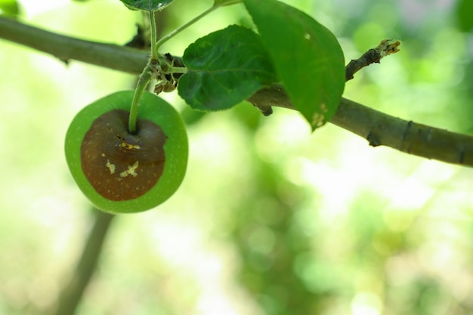
MROOT
Plant disease
classification
Armen
ACA Machine Learning Engineering
October 2026
A photo from the project validation set
Notes:
Hi, I’m Armen. This is MROOT, my plant disease classification project. I’ll explain how I prepared the data, compared models, and chose the final ensemble. Then I’ll show the app. The model predicts a disease category from a photo. I’ll also point out the limits of the evaluation, because the score only makes sense if the split and the metric are clear.
Source: supplied ACA guidelines, pp. 1-3. Cover photo: original project validation example, black_rot. No ownership claim for the source photo.

Slide 2
The problem I chose
One plant photo.
Five likely disease categories.
39 disease labels, independent of plant species
A working web demo, with the model and experiment history behind it
The label set does not include healthy plants.
MROOT 02
Notes:
I wanted to build a small tool that someone can actually try, rather than finish with a notebook score. The input is a plant photo, and the output is a disease category. I kept the disease labels independent of the plant species, so the task has 39 labels. It is still a closed-set classifier. There is no healthy class, so I would not present this as a tool that can decide whether any plant is healthy or sick.
Sources: Original project label definition and class_mapping.json.

Slide 3
The data and the final split
Stage | Training | Validation
Original clean split | 6,870 | 390
Final paired experiment | 6,790 | 388
Shared model comparison | depends on the model | 368 of the 388
80 training rows and 2 validation rows quarantined after image-group review
Original images and manifests remain unchanged.
MROOT 03
Notes:
The original clean split had 6,870 training images and 390 validation images. Exact overlap checks had already run, but a later review found related photographs and one group with conflicting labels. For the final comparison, I used new manifests with 6,790 training images and 388 validation images. I quarantined rows in the experimental manifests and kept the original files. A 368-image subset helped compare the newer models with older models that had seen copies of some validation photos. It is part of the 388, not a separate test set.
Sources: reports/raw/split_summary.json; exact CSVs in data/manifests; reports/raw/eda_summary.json.

Slide 4
What I found in the data
7,178 files checked. No missing disease labels or unreadable files.
MROOT 04
Notes:
The classes are not equally represented. In the final training split, the smallest class has 68 images and the largest has 755. The validation set mostly has ten images per class, so individual photos matter a lot. I also checked image sizes, aspect ratios, missing labels, and file integrity. The read-only audit checked all 7,178 train and validation files and found no missing or unreadable files. That does not prove the labels are correct. It tells me which problems the basic checks did and did not find.
Sources: reports/raw/class_support.csv; image_metadata.csv; eda_summary.json; notebooks/01_eda.ipynb. The chart shows selected classes, not all 39.

Slide 5
The starting model
System on original validation | Macro mAP
Clean ViT baseline | about 90.64%
Two EVA Small models | about 93.53%
Three EVA Small models, reproduced | 94.72%
Three independent Small models at 336 × 336 pixels
Macro mAP 94.72% Top-1 accuracy 88.72% 390 images
MROOT 05
Notes:
Before trying a new idea, I reproduced the three saved EVA Small models. The fixed-view ensemble reached 94.72 percent macro mAP on the original 390 validation images, which matched the previous result. I used macro mAP as the main metric because every disease should contribute equally, even when training counts differ. Top-1 accuracy was 88.72 percent. Those two numbers answer different questions, so I keep both labels visible throughout the presentation.
Sources: Supplied MROOT handover text and the verified project experiment log in docs/experiments.md. Historical rounded numbers are approximate. Reproduced reference: macro mAP 0.9471792916, Top-1 0.8871794872, Top-5 0.9948717949 on 390 images.

Slide 6
The experiments before the final pair
Change | What I learned
Global ensemble weight grid | Cross-fitted result got worse
Natural sampling and weighted loss | Only a small ensemble gain
Base model at 448 pixels | Useful in some combinations
Learning rates divided by three | Better alone did not mean a better ensemble
I kept the failed runs in the experiment log.
MROOT 06
Notes:
I did not assume that another model would improve the result. First, I tried a small weight grid for the three saved models. Cross-fitting did worse than equal weights, so I kept equal weights. Natural sampling with weighted loss gave only a small ensemble gain. Base models at 448 pixels helped, but a lower learning rate improved the individual model more than its predefined ensemble. That is why I checked how errors combined instead of choosing models only by their standalone scores. The appendix and repository keep the numbers for each run.
Sources: Supplied MROOT handover text and the verified project experiment log in docs/experiments.md. Historical rounded numbers are approximate. Detailed LR run: reports/raw/gentler_base_result.json.

Slide 7
The final controlled comparison
Control
MixUp/CutMix
EVA-02 Base 448
Standard recorded augmentation
Same setup
Mixed images and soft targets
Same initial weights and seed. Same 6,790 training and 388 validation images.
This tests the combined policy, not MixUp and CutMix separately.
MROOT 07
Notes:
For the last experiment, I wanted a comparison I could explain clearly. Both runs started from the same saved weights and used the same seed, clean split, optimizer, learning rates, sampler, and ordinary augmentations. The candidate added a combined MixUp/CutMix policy. MixUp blends two examples and their labels. CutMix replaces a region and adjusts the target labels. The idea was to reduce memorization. Because I tested the combined policy, I cannot say which augmentation helped on its own.
Sources: reports/raw/control/experiment_config.json; mixup_cutmix/experiment_config.json. MixUp: https://arxiv.org/abs/1710.09412. CutMix: https://arxiv.org/abs/1905.04899.

Slide 8
Validation after every complete epoch
Selected: control epoch 7 at 94.81% mAP, mixed epoch 11 at 96.07% mAP
MROOT 08
Notes:
The control reached its best normal-view mAP at epoch 7, and the mixed run at epoch 11. The control completed 15 epochs and the mixed run 19, because both used early stopping with patience eight. I did not just use the final epoch. Each improved checkpoint had its own filename. The mixed model's best normal validation mAP was 96.07 percent, compared with 94.81 percent for the control. These are scores on the same 388 validation images.
Sources: Project artifacts: reports/raw/COMPLETED_COMPARISON.json, control/training_history.csv, mixup_cutmix/training_history.csv.

Slide 9
Why I kept two models
Same 368 validation images. The final pair had the highest observed mAP.
The paired uncertainty intervals include zero.
MROOT 09
Notes:
I compared the candidates on the same 368-image subset. The mixed model plus the clean control had the highest observed macro mAP at 96.48 percent. Adding a different Base or a Small model did not beat that pair. A single mixed model with normal inference had higher Top-1 accuracy on this subset, so this choice does not maximize every metric. I kept the predefined primary metric, macro mAP. The uncertainty intervals include zero, so I would not describe the small differences as a proven generalization gain.
Sources: Project artifacts: reports/raw/COMPLETED_COMPARISON.json, control/training_history.csv, mixup_cutmix/training_history.csv. Bootstrap caveats: reports/raw/paired_validation_intervals.json and docs/evaluation.md.

Slide 10
The final holdout report
92.99%
89.41% Top-1 accuracy
99.36% Top-5 accuracy
Macro mAP on 623 images
Same 623 images | Correct Top-1 | Macro mAP
Previous four models | 549 | 92.5852%
Final two models | 557 | 92.9896%
The holdout was previously evaluated. This is not a new untouched-test estimate.
MROOT 10
Notes:
After choosing the model and freezing its inference recipe, I ran the final report on the fixed 623-image subset. Macro mAP was 92.99 percent, Top-1 accuracy was 89.41 percent, and Top-5 was 99.36 percent. That means 557 correct first predictions out of 623. The preceding four-model system had 549 correct first predictions on the same images, so the final pair added eight. This holdout had already been evaluated earlier in the project. I am not calling it a fresh blind test, and I stopped experimentation after this report.
Sources: reports/raw/FINAL_HOLDOUT_20261024T103253_167194Z/FINAL_HOLDOUT_RESULT.json and the previously saved four-model result on the same fixed 623-image subset. The holdout was previously evaluated.

Slide 11
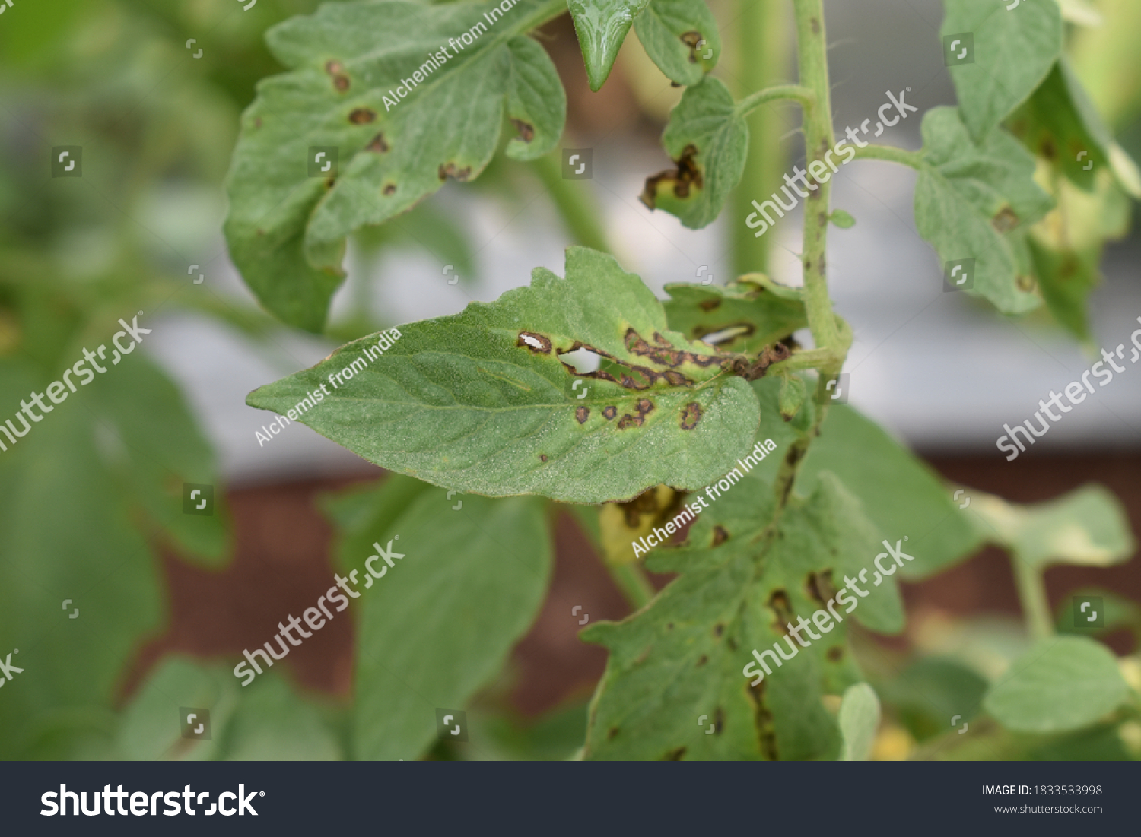
The limitations I would keep visible
Small, reused validation set
Ambiguous disease labels
Watermarks and source differences
No healthy or unknown category
A source image can carry cues unrelated to the disease.
MROOT 11
Notes:
There are still issues I would not hide behind the aggregate score. The validation set is small and has been reused. Similar disease labels can be hard to separate, and some source photos contain watermarks or other distracting information. The example here is an actual validation photo. There is also no healthy or unknown class, so an unrelated image can receive a confident disease prediction. Before using this outside a demo, I would collect new external images with reviewed labels and test the model once on that new set.
Sources: Original project validation example bacterial_leaf_spot, with its Shutterstock/Alchemist from India watermark left intact. Displayed to discuss dataset quality, not as original photography. Evaluation limits: docs/evaluation.md.

Slide 12
How the final app makes a prediction
1 Convert the uploaded photo to RGB
2 Create the normal, flipped, and whole-image padded views
3 Combine each model’s probabilities: 0.375, 0.375, 0.25
4 Average the two models equally and show the top five
The saved class order and transforms stay fixed.
MROOT 12
Notes:
The app loads the two exported models and the fixed class mapping. Each model gets three views: the saved normal resize, its horizontal flip, and a full-image padded view. The view probabilities use weights 0.375, 0.375, and 0.25. Then I average the two models equally. The app returns the five largest disease scores. I kept the exact saved preprocessing, including the squash resize setting, because changing that during deployment would change what I evaluated.
Sources: ensemble.json; src/mroot/inference.py; reports/live_deployment_verification.json.

Slide 13
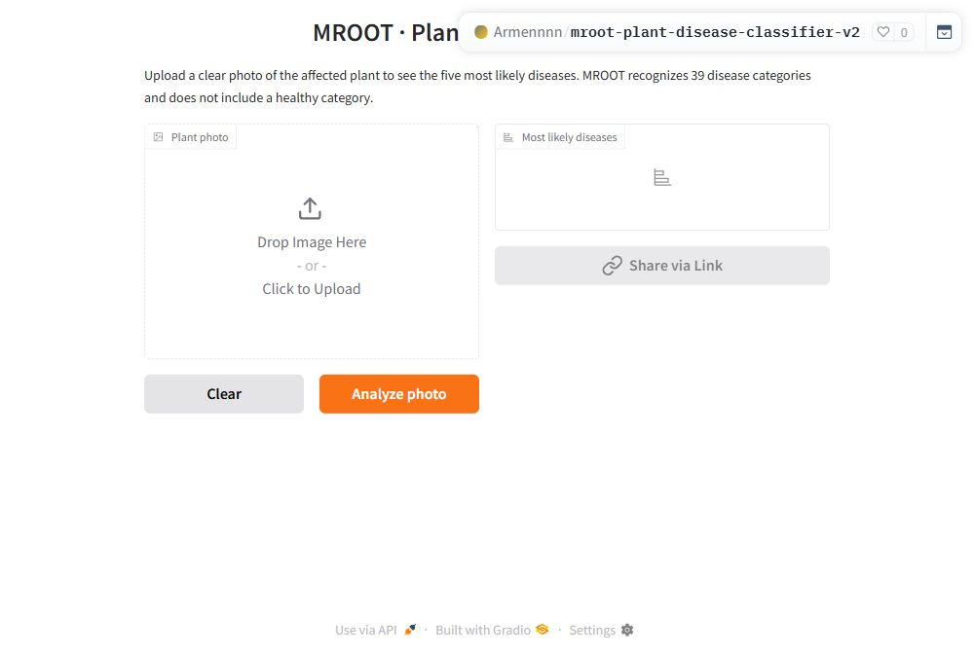
Live demonstration
Upload a photo
Click Analyze photo
Read the top five
Open MROOT V2
Original V1 app remains available.
MROOT 13
Notes:
I’ll open the V2 Space, upload a plant photo, and click Analyze photo. The interface shows the five likely disease labels. I would explain that these are model scores rather than guaranteed diagnoses. The published checkpoint hashes match the verified local exports, and a live prediction matched the local GPU result within about one millionth in probability. That request took about three seconds including its queue, but it is only a smoke test. If the connection or ZeroGPU queue is unavailable during the talk, I can show this interface and the saved verification record.
Sources: Live app: https://huggingface.co/spaces/Armennnn/mroot-plant-disease-classifier-v2. reports/live_deployment_verification.json. Screenshot taken from the running app.

Slide 14
What I learned
I check the data before trusting a score.
I keep a model when it helps the ensemble.
I save enough evidence to explain the result later.
Next: reviewed external photos and a healthy/unknown option
MROOT 14
Notes:
The main lesson for me was that adding a model is not enough. I had to check whether its predictions helped the ensemble, and whether the data comparison was fair. I also learned to keep the training records and checkpoints together so I can explain and reproduce a result later. The final result is a working app with a smaller ensemble, but the next useful step would be new external validation and a healthy or unknown option. I would do that before treating the project as more than a demonstration.
Sources: Project experiment log and evaluation limitations. Future steps are proposals, not completed experiments.

Slide 15
Earlier experiments
Run | Observed result | Status
ViT baseline | about 0.9064 mAP | Historical baseline
Extra Small seed | ensemble about 0.9449 | Hurt the three-model reference
ConvNeXt V2 Tiny 384 | about 0.9054 mAP | Hurt the EVA ensemble
Seed 1 continuation | No improvement | Did not repeat unchanged
Historical Base 448 | ensemble about 0.9482 | Exact checkpoint lost
Rebuilt historical Base | ensemble about 0.9454 | Did not reproduce the lost run
Historical approximate results are not new reproductions.
Appendix 15
Notes:
These are rounded historical figures from the handover. I did not retrain them during the final update. The successful historical Base checkpoint was lost, so I explicitly separate an observed historical score from the saved reproducible models. The current final checkpoints are backed up and their export hashes are verified.
Sources: Supplied MROOT handover text and the verified project experiment log in docs/experiments.md. Historical rounded numbers are approximate.

Slide 16
New training runs and selected epochs
Model | Val images | Best epoch | Normal mAP | Fixed TTA mAP
Natural-sampling Small | 390 | 13 | 0.923738 | 0.927203
Base 448 | 390 | 4 | 0.938581 | 0.942226
Gentler Base 448 | 390 | 4 | 0.944735 | 0.946558
Clean control Base | 388 | 7 | 0.948053 | 0.949691
MixUp/CutMix Base | 388 | 11 | 0.960699 | 0.960542
The canceled queued proposal was not a trained experiment.
Appendix 16
Notes:
The split column matters. The first three new candidates used the original 390-image validation set. The last pair used 388 cleaned validation images. Each selected checkpoint came from normal-view validation mAP. The fixed-TTA score was measured after loading that same selected checkpoint. The natural-sampling Small completed 21 epochs, the first Base and gentler Base completed 12 each, and the clean pair completed 15 and 19.
Sources: Project artifacts: reports/raw/COMPLETED_COMPARISON.json, control/training_history.csv, mixup_cutmix/training_history.csv. Earlier runs: docs/experiments.md and reports/raw/gentler_base_result.json.

Slide 17
The shared final training recipe
Setting | Value
Architecture and input | EVA-02 Base, 448 × 448, 39 classes
Seed and batch | 27182, effective batch 16, two T4 GPUs
Optimizer | AdamW, weight decay 0.05
Head and last-backbone LR | 3.333e-5 and 6.667e-6, layer decay 0.8
Schedule and stopping | 3 warmup epochs, cosine, max 20, patience 8
Loss and precision | Smoothing 0.05, FP16 AMP, clipping 1.0
Mixed candidate | MixUp 0.2, CutMix 1.0, probability 0.5
No EMA in the final pair. Mixing switch probability: 0.5.
Appendix 17
Notes:
The exact configuration files and original training core are in the repository. Both arms used seed 27182, the same archived starting weights, class-balanced replacement sampling, and an effective batch of 16. AdamW used head learning rate one times ten to the minus four divided by three and final-backbone learning rate two times ten to the minus five divided by three. Earlier layers used decay 0.8. Both used warmup, cosine decay, label smoothing, AMP, and gradient clipping. The added combined mixing policy is the candidate difference.
Sources: reports/raw/control/experiment_config.json and mixup_cutmix/experiment_config.json; configs/final_training.json.

Slide 18
Which split each result uses
Images | Role | Interpretation
390 | Original validation | V1 and early V2 development
388 | Final epoch selection | Same validation for both final arms
368 | Shared model comparison | Subset of 388, not a new test
670 | Historical holdout pool | Already evaluated earlier
623 | Fixed final reporting subset | Previously used subset, not pristine
A new unseen external set would give a stronger generalization check.
Appendix 18
Notes:
I would use this table if asked why there are several validation counts. The 368 subset is inside 388, and epoch selection still used the 388. The 623-image reporting mask came from the earlier 670 holdout pool after excluding detected related images. It had been evaluated before. I do not describe it as a new external test. These distinctions keep the scores comparable within a row and avoid treating every number as an independent result.
Sources: reports/raw/split_summary.json; exact CSVs in data/manifests; reports/raw/eda_summary.json. reports/raw/FINAL_HOLDOUT_20261024T103253_167194Z/FINAL_HOLDOUT_RESULT.json and the previously saved four-model result on the same fixed 623-image subset. The holdout was previously evaluated.

Slide 19
Uncertainty and model selection
Comparison | Conditional 95% interval for mAP difference
Mixed minus control, normal view, 388 | [-0.00070, 0.02538]
Final pair minus mixed alone, 368 | [-0.00272, 0.01234]
Both intervals include zero.
Repeated validation and best-epoch selection add uncertainty beyond these intervals.
Appendix 19
Notes:
The bootstrap resamples the saved validation predictions. It does not redo training or checkpoint selection, and one seed per arm does not measure training variation. Both intervals shown here include zero. The scores helped me choose a bounded final system, but they do not prove a small improvement will repeat on new data. The three-model weighting test also used cross-fitting on cached predictions, not five independently retrained neural models.
Sources: reports/raw/COMPLETED_COMPARISON.json, intervals; configs/ensemble_weight_grid.json; docs/evaluation.md.

Slide 20
Sources and project links
EVA-02
MixUp
CutMix
Project repository
Final live app
Full experiment records and source references are in the repository.
Appendix 20
Notes:
The project builds on publicly released EVA-02 models and the timm implementation. The MixUp and CutMix papers motivated the final policy, but the MROOT experiment is the evidence for its observed behavior here. The repository includes the saved configuration and metric artifacts. The supplied ACA guidelines shaped the EDA, deployment, repository structure, and presentation coverage.
Sources: Supplied ML Engineer Project Guidelines.pdf, Armenian Code Academy, pp. 1-3. Other references are the linked primary sources.

