Slide 1
Hawaii Travel Restrictions During COVID-19: Results & Impact on Tourism
Adriana Bartlett Gray
November 5, 2021

Slide 2
Or… How to shut down a $17,750,000,000/year Tourism Industry overnight?

Slide 3
Who and Why?
Audience
Objectives
Hawaii Government
Hawaii Residents
Investors in Hawaii’s Tourism Industry
Former Residents and Friends of Hawaii
Visualize the cost/benefit of Hawaii Travel Restrictions during COVID.
Were some measures more effective than others?
Yes…
Fast implementation of 14-Day Quarantine
Negative Test Exception Process
What measures might be optimized for future variants?
Negative Test Exception & Vaccine Exceptions Earlier
Help to answer the question… ‘Did Hawaii go too far?’
This can’t be proven by the data. However,…
Recommendations after mandates can be problematic in a multitude of ways.
Oahu and Maui Safe Access Pass Programs may prove to be too late and ultimately unnecessary.

Slide 4
Context of Hawaii
01. Tourism 2019
02. Characteristics
Daily Census of Visitors: 249,000
Daily Visitor Spending: $56,000,000
Jobs Supported: 216,000
Population: 1,420,000
Ranks Highest of All States in Percentage of:
Multi-Gen Households
Ethnic/Racial Diversity
03. COVID-19
04. Vaccination Rate
05. Current Mandated State Entry Requirements
Ranks #2 of All States in Lowest COVID-19 Related Deaths/Mil Population: 658 (second only to Vermont)
Ranks #2 of All States in Highest Percentage of Population Vaccinated: 71.5% (second only to Vermont)
Hawaii continues to have the strictest travel requirements of all US states with a 10-day quarantine (with exceptions if a Hawaii approved negative test or vaccination record is uploaded to the Hawaii Safe Travels website prior to arrival and meets all requirements).
Visitors in quarantine status are prohibited from renting vehicles, utilizing car-share programs, or using a short-term rental as their quarantine location. Hotels may issue one-use-only key cards to guests in quarantine status.

Slide 5
Data Overview
Travel Entry & Access
Daily COVID-19 Cases Added
Passenger Arrivals and Incoming Tourism Dollars
Dates for:
State Entry Mandates
Vaccine/Test Pass required for Restaurants and Other Businesses consider high risk for transmission of COVID-19
Governor Requests
Categorized by:
Travel-Related (non-resident)
Travel-Related (resident)
Community (not travel-related)
Unknown/Pending (contact-tracing not completed yet)
Travel-Related includes
State-Entry Only (not Inter-Island travel)
The Traveler PLUS Cases Related to the traveler through contact-tracing
Daily Passenger Arrival Data Includes:
Number of Returning Residents and Non-Residents combined from 3/1/20 - 10/27/21
Number from 2019 for the same month and day (for comparison)
Monthly Tourism Dollars Data Includes:
Dollars (in Millions) per Month from 3/20 – 9/21
Tourism dollars are not available for the period from 4/20 – 10/20 (reported empty) and have been set to zero. This covers the period of no exception to quarantine.
Dollars (in Millions) from 2019 for the same month (for comparison)
By definition, Tourism Dollars come from Non-Resident Passengers only.

Slide 6
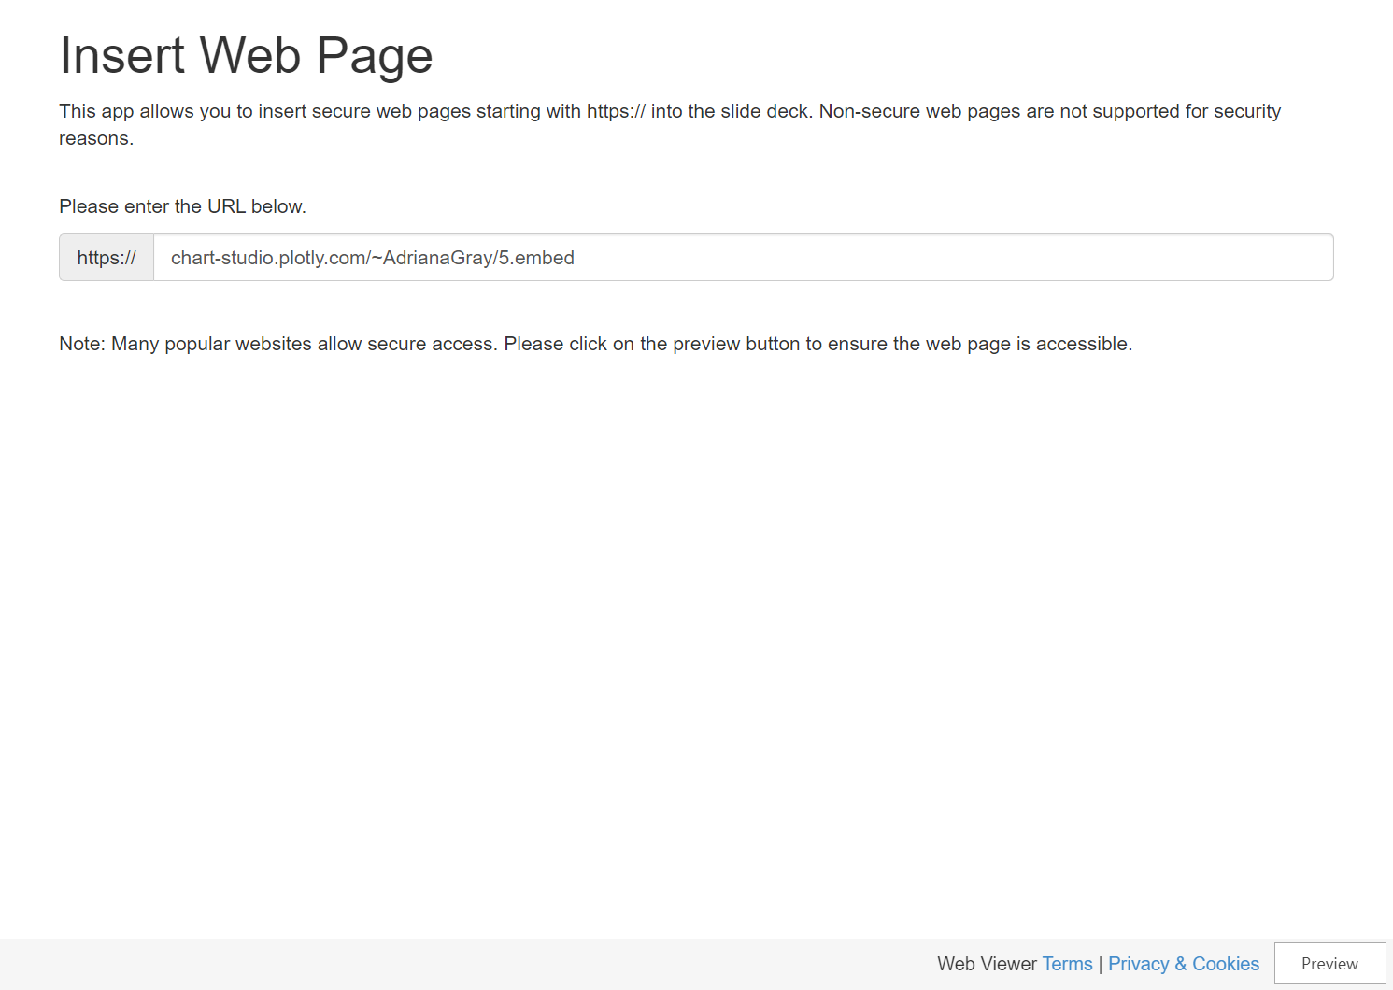
Notes:
Lost Tourism $ in the white space… currently at $17,549,400,000
14-Day Quarantine effectively shuts down Tourism.
Negative Test Exception starts recovery.
Governor’s request to ‘Avoid Hawaii’ is followed by a re-widening of the gap.
Seasonality maintains its shape.

Slide 7
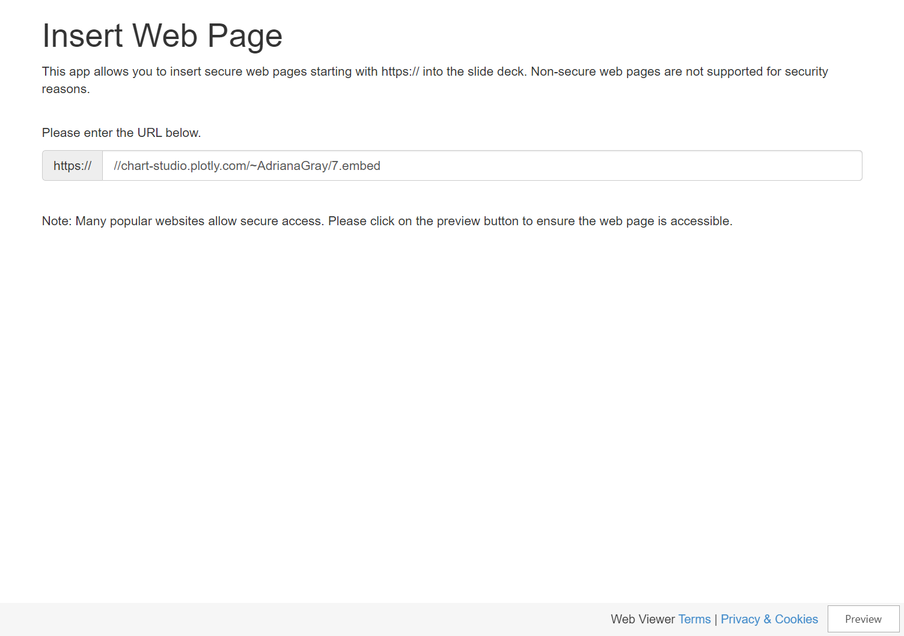
Notes:
Hawaii is hit hard by the Delta Variant
Travel-Related COVID Cases remain low throughout.
Possible reasons why returning residents have higher numbers.
Governor’s request to ‘Avoid Hawaii’ may not have been necessary given the low numbers of travel-related cases.
Community spread takes on a much higher percentage of new cases w/the Delta Variant.

Slide 8
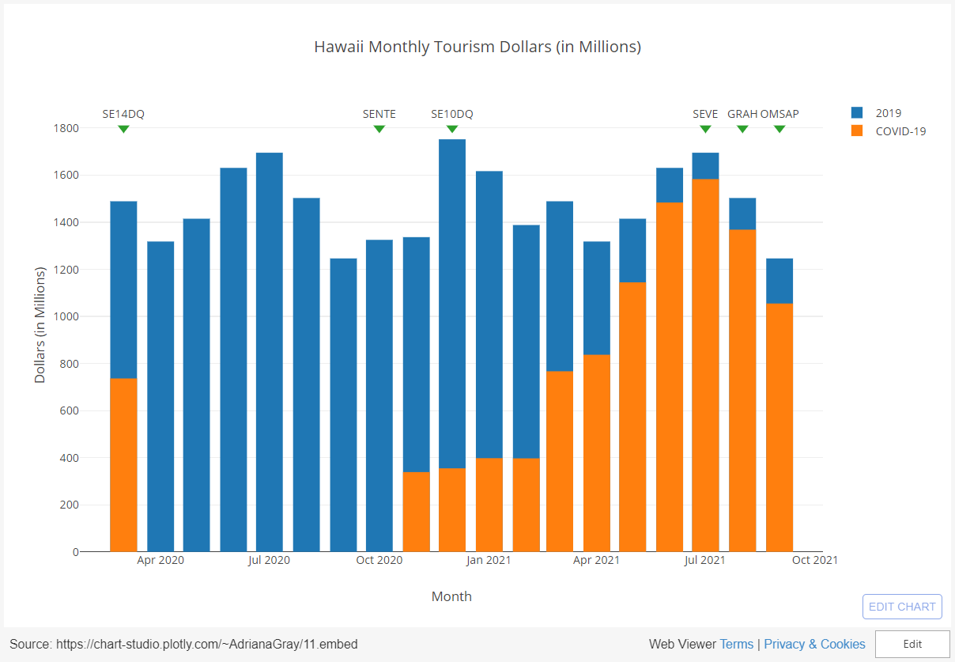
Notes:
Return of Tourism dollars as travelers become familiar with the negative test exception process.
Trend reverses slightly after Governor’s request to ‘Avoid Hawaii’.
Vaccine exception does not seem to have much impact, but this is difficult to evaluate given factors changing simultaneously.
It’s likely that most travelers who would get the vaccine were already willing to get a pre-travel test.

Slide 9
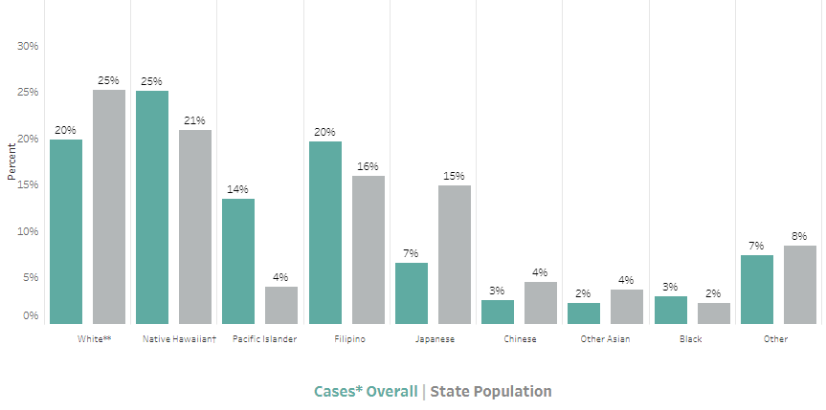
Were the cards stacked against Hawaii?
Multi-Generational Households
Cultural/Ethnic Characteristics
7.72% of Households in Hawaii are Multi-Generational.
The National average is 3.82%.
Pacific Islanders (including Native Hawaiians) are also more likely to have not just two, but more than two generations in the same multi-generational household.
Large gatherings, parties, and households are part of Hawaii’s Cultural Norm.

Slide 10
Recommendation for the Future
Hawaii Safe Travels Program
The technology and processes behind this program are planned for shutdown in the imminent future as Hawaii has reached its target vaccination rate (over 70%) and is well underway of getting the Delta Variant under control.
During this first round of COVID-19, the development of this technology and the processes behind it became the major bottleneck to providing a test exemption and vaccination exemption for travelers.
Rather than considering this a time to dismantle the Hawaii Safe Travels Program, I recommend that it be transitioned as part of a ‘Disaster Recovery Plan’ of sorts for if/when another major health crisis occurs.
This will involve ongoing costs to keep the system and processes current even though it is not actively in use and may involve technical infrastructure costs as well, but will assure a more secure future for Hawaii’s most valuable industry.
Last year we supported thousands of customers and
sold 60,000 units

Slide 11

Thank you
Adriana Bartlett Gray
abartlettg@gmail.com
https://github.com/abartlettg/hawaiitourismcovid19

