Slide 1
ABARVA · MOVES
COSTED BUSINESS-CASE PACK
AI-enabled Population Health & Clinical Performance Command Center
Meridian Health System · healthcare-provider · Population health & value-based care
Base-case net return is not positive — the Move does not pay back on current assumptions.
KERNEL VERDICT STOP
Generated 2026-06-06 · synthetic, inspired-by context — not confidential client data

Slide 2
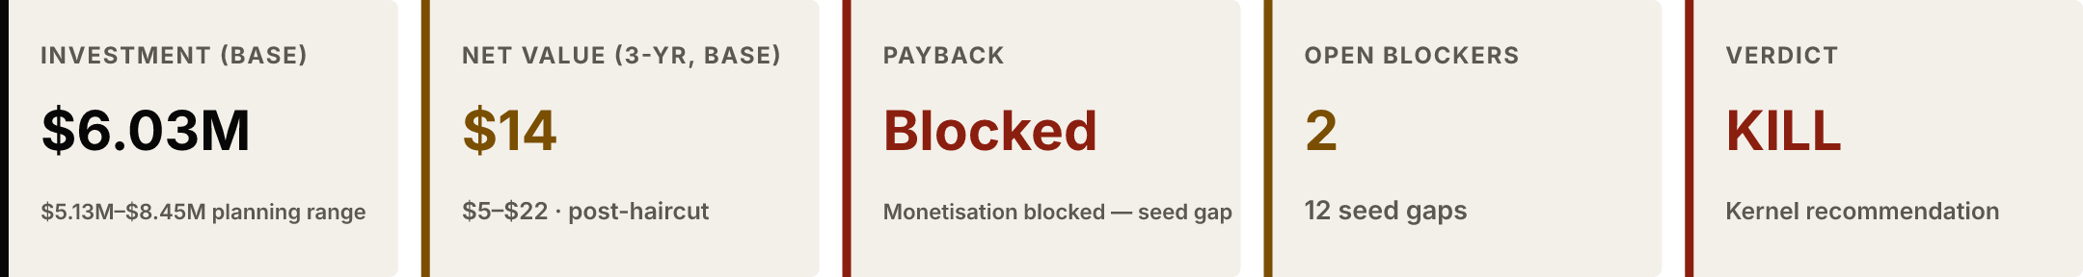
ABARVA · MOVES
SLIDE 2 / 8
SECTION 1 · BOARD ANSWER
KILL — the Move does not pay back on current assumptions.
KILL — do not fund — Base-case net return is not positive — the Move does not pay back on current assumptions.
DECISION ROLE
Read the kernel verdict and the headline economics before any funding decision.
OWNER
Move sponsor (to be confirmed with the tenant)
EVIDENCE
2 sources · as of 2026-06-06 · confidence Blocked · 12 open gaps
NEXT GATE
The next phase gate for this Move

Slide 3
ABARVA · MOVES
SLIDE 3 / 8
SECTION 2 · INHERITED OUTLINE
This deck inherits the curated Population health & value-based care business-case outline — 8 sections, structure not improvised.
Executive answer — State the funding ask, the headline value separated into cost-trend, RAF, and quality components, the time-to-cash band, and the go / hold recommendation.
Baseline economics model — Anchor every value claim to a measured baseline metric and to the actual contract terms. Where a baseline is a seed gap, say so and state what closing it requires before funding.
Value forecast and haircuts — Build the forecast from the value-model benchmark ranges, then apply each dominant haircut — contract structure, attribution stability, data readiness, quality-gate risk — explicitly, with the math shown. Keep cost, RAF, and quality value separate.
Cost, effort, and cash timing — Cost the build and integration, and state when value actually lands — shared-savings reconciliation lags the performance year, so the cash-timing curve is part of the case.
Sensitivity and downside — Show the case under a missed quality gate, high attribution churn, and a weaker benchmark outcome. State the downside the CFO is underwriting, including any two-sided-risk exposure.
Compliance and audit posture — For any RAF-capture component, state the coding-compliance control and the RADV-audit posture — accuracy, not maximisation, is the objective.
Kill criteria and conditions to proceed — Name the conditions under which the Move should not be funded and the evidence required before the gate.
Tower measurement plan — State which operating metrics Tower will track to prove the forecast, and the cadence — including the lagged settlement metrics.
DECISION ROLE
Confirm the deck follows the curated, function-calibrated structure.
OWNER
Domain Function Pack (curated)
EVIDENCE
1 source · as of 2026-06-06 · confidence High · No open gaps
NEXT GATE
Each curated section is answered against the Move’s data

Slide 4
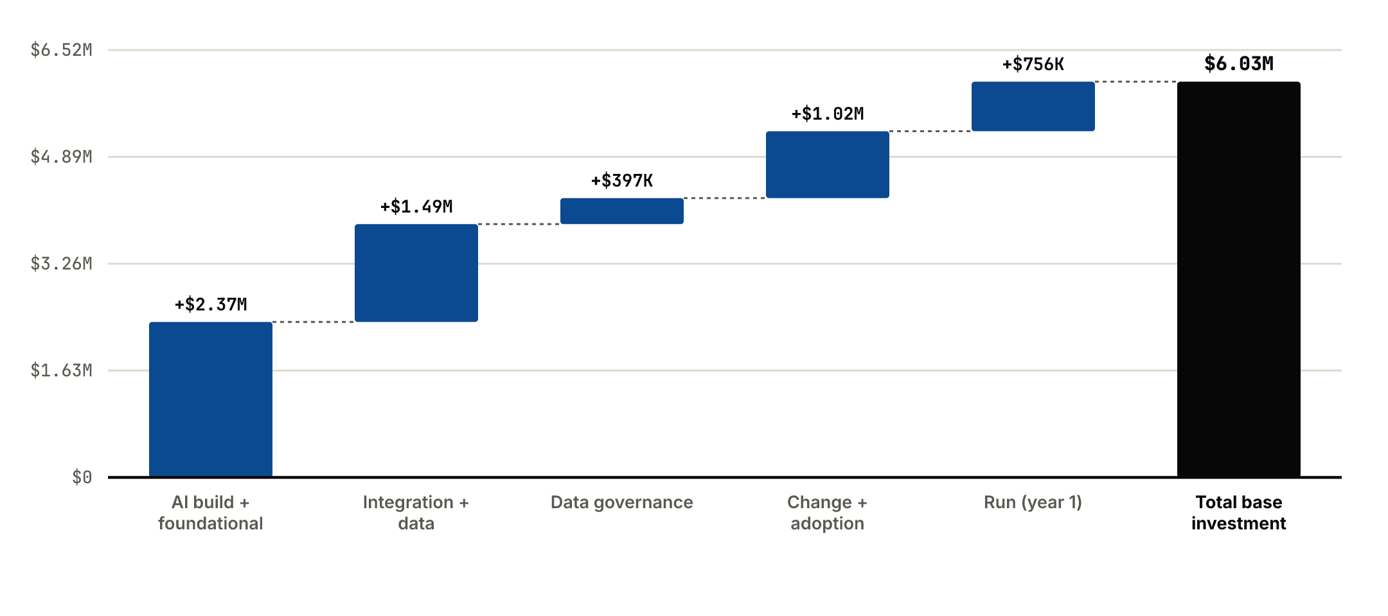
ABARVA · MOVES
SLIDE 4 / 8
SECTION 3 · INVESTMENT CASE
The build is a $6.03M base planning estimate — a range, derived from the Function Pack archetypes, NOT a quote.
Business change is 23% of effort — a credible build-vs-change balance for an AI Move where value depends on people changing how they work.
DECISION ROLE
See the investment envelope and where the money goes.
OWNER
Move sponsor (to be confirmed with the tenant)
EVIDENCE
2 sources · as of 2026-06-06 · confidence Medium · 1 open gap
NEXT GATE
A client-specific estimate before any funding commitment

Slide 5
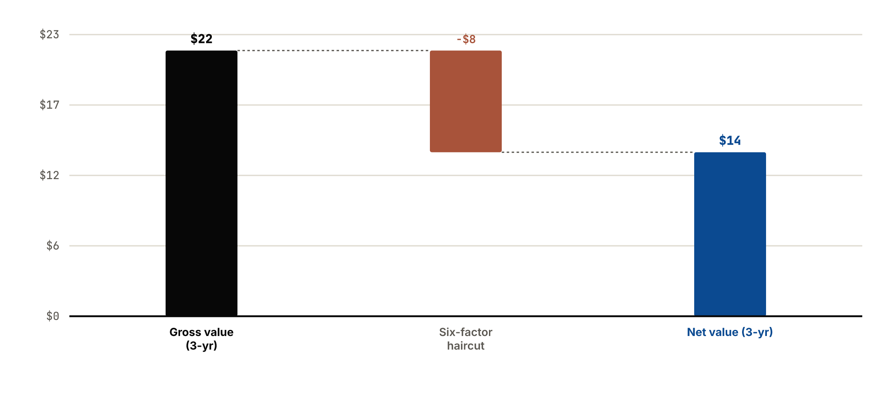
ABARVA · MOVES
SLIDE 5 / 8
SECTION 4 · VALUE CASE
Value is a planning range built on curated benchmark proxies — the kernel honestly blocks a claimable dollar payback.
DECISION ROLE
Confirm the value is honestly discounted, not optimistic.
OWNER
Move sponsor (to be confirmed with the tenant)
EVIDENCE
2 sources · as of 2026-06-06 · confidence Low · 1 open gap
NEXT GATE
Close the seed-gapped metrics that ground the forecast

Slide 6
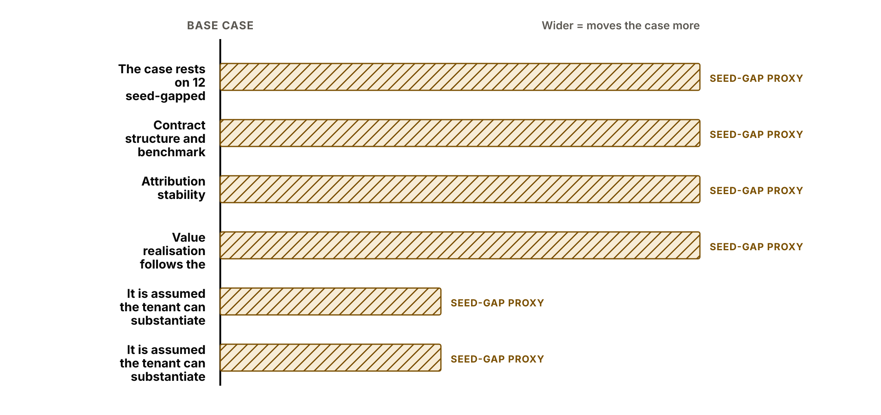
ABARVA · MOVES
SLIDE 6 / 8
SECTION 5 · SENSITIVITY
The case is shown as a range — base, conservative, upside — never a single point. The widest movers are the evidence asks.
What breaks the case: The case breaks if the baseline seed gap is not closed — without the missing unit economics the value range is a proxy, not a forecast.
DECISION ROLE
See what breaks the case before funding it.
OWNER
Move sponsor (to be confirmed with the tenant)
EVIDENCE
2 sources · as of 2026-06-06 · confidence Medium · 3 open gaps
NEXT GATE
Validate the case-moving assumptions before funding

Slide 7
ABARVA · MOVES
SLIDE 7 / 8
SECTION 6 · EVIDENCE AND GAPS
Baseline coverage is 0% — 0 metrics recorded, 12 declared seed gaps. None are invented.
0 recorded · 12 seed gaps · 0% coverage.
Medical loss ratio (MLR) — "Medical loss ratio (MLR)" is not recorded — this function expects it; it is sourced from Payer settlement and premium data reconciled against the claims feed.; its absence blocks the baseline and the value forecast. (Payer settlement and premium data reconciled against the claims feed.)
Shared-savings achievement rate — "Shared-savings achievement rate" is not recorded — this function expects it; it is sourced from CMS or payer benchmark-and-settlement report for the contract.; its absence blocks the baseline and the value forecast. (CMS or payer benchmark-and-settlement report for the contract.)
RAF score capture / accuracy — "RAF score capture / accuracy" is not recorded — this function expects it; it is sourced from HCC coding from EHR encounters reconciled against claims and the risk-adjustment submission.; its absence blocks the baseline and the value forecast. (HCC coding from EHR encounters reconciled against claims and the risk-adjustment submission.)
Quality composite / Star rating — "Quality composite / Star rating" is not recorded — this function expects it; it is sourced from Claims-based and EHR-based quality-measure calculation reconciled against the payer or CMS quality report.; its absence blocks the baseline and the value forecast. (Claims-based and EHR-based quality-measure calculation reconciled against the payer or CMS quality report.)
Attribution stability / retention — "Attribution stability / retention" is not recorded — this function expects it; it is sourced from Period-over-period payer attribution files.; its absence blocks the baseline and the value forecast. (Period-over-period payer attribution files.)
Per-member-per-month cost trend — "Per-member-per-month cost trend" is not recorded — this function expects it; it is sourced from Payer claims feed, risk-normalised, compared period over period.; its absence blocks the baseline and the value forecast. (Payer claims feed, risk-normalised, compared period over period.)
DECISION ROLE
Audit every claim back to a source or a declared gap.
OWNER
Move sponsor (to be confirmed with the tenant)
EVIDENCE
2 sources · as of 2026-06-06 · confidence Low · 12 open gaps
NEXT GATE
Close the seed gaps before build funding

Slide 8
ABARVA · MOVES
SLIDE 8 / 8
SECTION 7 · RECOMMENDATION
KILL — the Move does not pay back on current assumptions.
KILL — do not fund — Base-case net return is not positive — the Move does not pay back on current assumptions.
Kill trigger: Net return is negative in the conservative case (-8447828.15). Kill or re-shape if the downside cannot be lifted above zero.
Kill trigger: The baseline seed gap that blocks monetisation is not closed before the gate — without it the return is unverifiable.
Kill trigger: Baseline coverage stays below acceptable level — 12 seed gap(s) remain unresolved at the gate.
Tower will measure: Medical loss ratio (MLR) (baseline Seed gap — not measurable yet)
Tower will measure: Shared-savings achievement rate (baseline Seed gap — not measurable yet)
Tower will measure: RAF score capture / accuracy (baseline Seed gap — not measurable yet)
DECISION ROLE
Make the funding decision the kernel’s verdict supports.
OWNER
Move sponsor (to be confirmed with the tenant)
EVIDENCE
2 sources · as of 2026-06-06 · confidence Blocked · 12 open gaps
NEXT GATE
Re-present once the named kill triggers are cleared

