Slide 1
ABARVA · MOVES
COSTED BUSINESS-CASE PACK · BOARD-GRADE REFERENCE ARTIFACT
Contact Center AI Routing
Apex Retail · apex-retail
A board deck in 12 slides. Every figure is produced by the Moves Expert Kernel from Apex’s audited substrate. Where data is not recorded it is declared a seed gap — never invented. The honest verdict is shape: fund the next shaping gate, not the full build. The words on every slide are editable; the exhibits match the reference deck.
VERDICT
SHAPE
PAYBACK
Blocked — seed gap
SLIDES
12
GENERATED
2026-06-06

Slide 2
CONTACT CENTER AI ROUTING · BOARD ANSWER
SLIDE 2 / 12
SECTION 1 · BOARD ANSWER
Approve shaping spend only — full autonomy is not yet fundable until the cost-per-contact gap is closed.
BOARD DECISION SHAPE — fund the next gate, do not fund the full build yet
EXHIBIT 1 — HEADLINE ECONOMICS AT A GLANCE
INVESTMENT (BASE)
$2.20M
$1.87M–$3.09M range
NET VALUE (3-YR, BASE)
$11.3M
$8.28M–$14.3M · post-haircut
PAYBACK
Blocked
Seed gap — not computable
OPEN BLOCKERS
1
4 seed gaps
NEXT GATE
Shaping
Charter → Design
FUND NOW
DO NOT FUND YET
The cost-per-contact baseline capture — the single gate-closing item.
Phase 0 data and platform foundation shaping (intent / transcript unification design, model-gateway scoping).
The transcript-use privacy review through to a cleared verdict.
The full AI-routing build and scale-out — the value range is a proxy until the cost-per-contact baseline lands.
Any commitment that assumes the $11.3M base net value as a hard return.
IVR-replacement scope — the WFM lead is on record for agent-assist; autonomy beyond assist is unfunded and unproven.
DECISION ROLE
Approve the next shaping gate — not full build funding.
OWNER
CIO (Executive Sponsor)
EVIDENCE
2 sources · as of 2026-06-06 · confidence Blocked · 4 open gaps
NEXT GATE
Charter-to-Design shaping gate

Slide 3
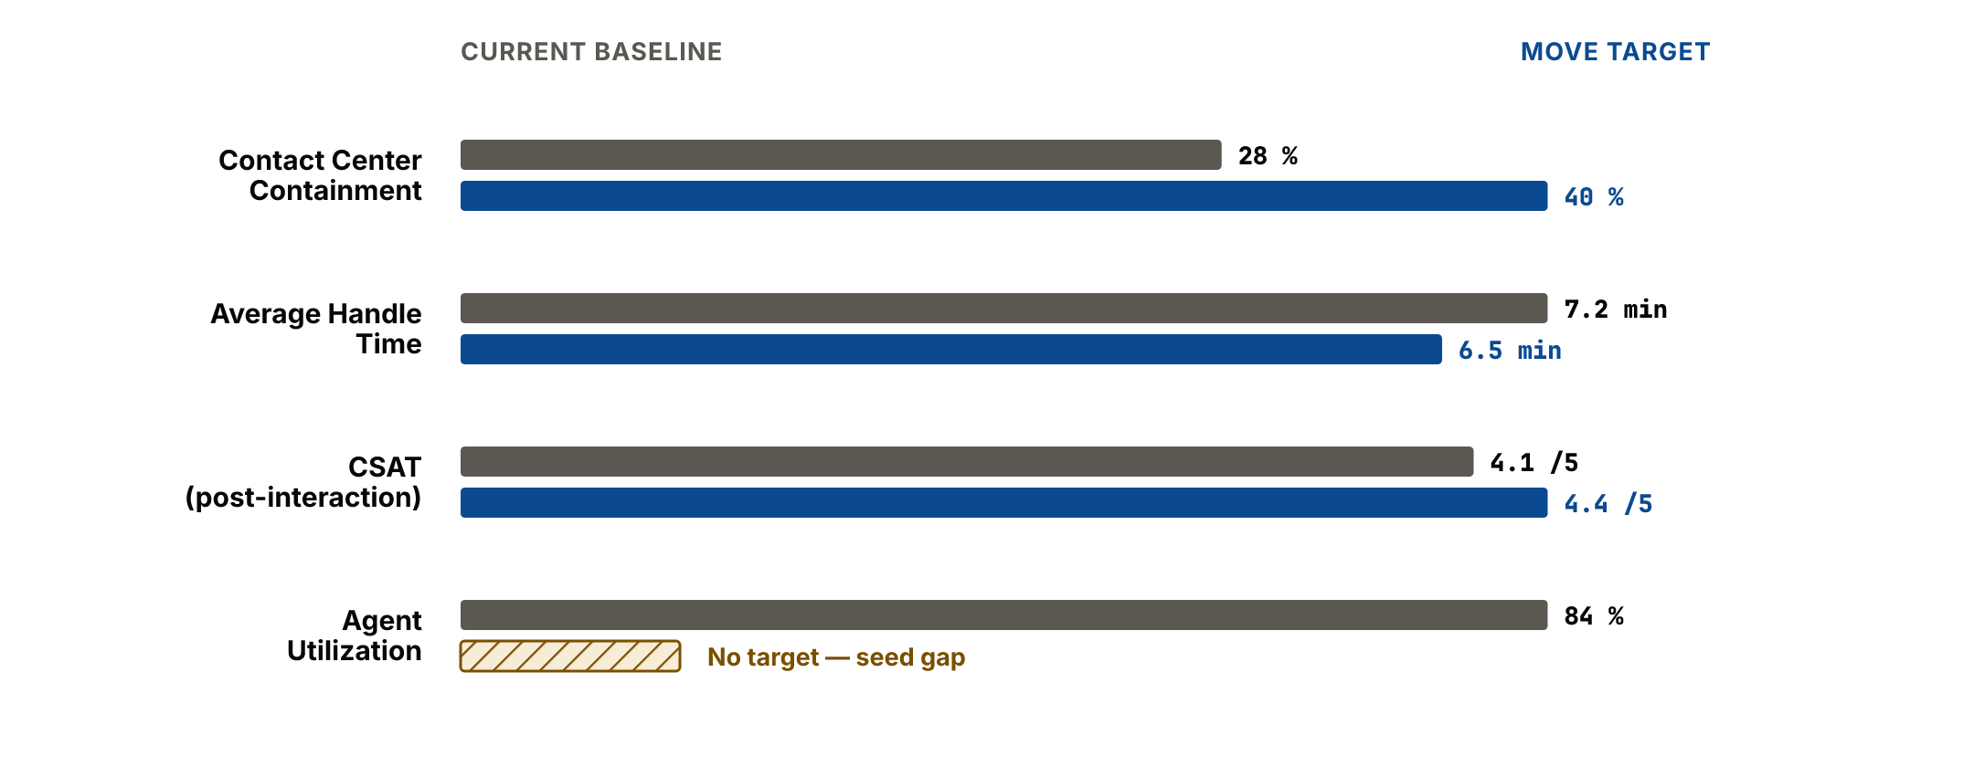
CONTACT CENTER AI ROUTING · WHY NOW
SLIDE 3 / 12
SECTION 2 · WHY NOW
Containment is stuck at 28% while handle time rises and agents run hot — the routing problem is structural, not seasonal.
Containment is plateaued and agents run hot. Containment has plateaued at 28% against a stated 40% KPI target while Average Handle Time is rising — easy contacts are deflected, so the calls that reach agents are harder. Repeat transfers and CSAT both read as mis-routing — the problem is now capacity-bound, not a tooling preference.
EXHIBIT 2 — CURRENT-STATE BASELINE AGAINST THE MOVE TARGET
DECISION ROLE
Confirm the problem is real and time-sensitive.
OWNER
VP Customer Care
EVIDENCE
3 sources · as of 2026-04-30 · confidence Medium · 2 open gaps
NEXT GATE
Containment reconciliation (James Wright, due 2026-05-08)

Slide 4
CONTACT CENTER AI ROUTING · WHAT WE ARE FUNDING
SLIDE 4 / 12
SECTION 3 · WHAT WE ARE FUNDING
We are funding an agent-assist routing layer over NICE CXone — not an IVR replacement and not autonomous customer-facing inference.
We are funding an agent-assist routing layer over NICE CXone — not an IVR replacement, and not autonomous customer-facing inference. The three lists below are the funded boundary.
IN SCOPE
EXCLUDED
RETAINED ACCOUNTABILITIES
AI routing model and agent-assist layer over NICE CXone (8 workstreams).
Phase 0 data foundation — intent / transcript unification and a model gateway.
Process redesign of the Customer Care routing workflow.
Change, adoption and a 6-week hypercare window.
Year-1 run and operations.
IVR replacement — the chosen shape is agent-assist, not deflection.
Autonomous, customer-facing inference without human accountability.
Non-Customer-Care queues (sales, retention) — out of this Move.
Funding, scope, go-live and kill decisions stay human-accountable (RACI §7).
The WFM lead retains operating-model accountability after go-live.
AI Governance retains accountability for the transcript-use review.
DECISION ROLE
Confirm the scope boundary before costing it.
OWNER
Solution Architect
EVIDENCE
3 sources · as of 2026-06-06 · confidence Medium · 1 open gap
NEXT GATE
Architecture sign-off at the Design gate

Slide 5
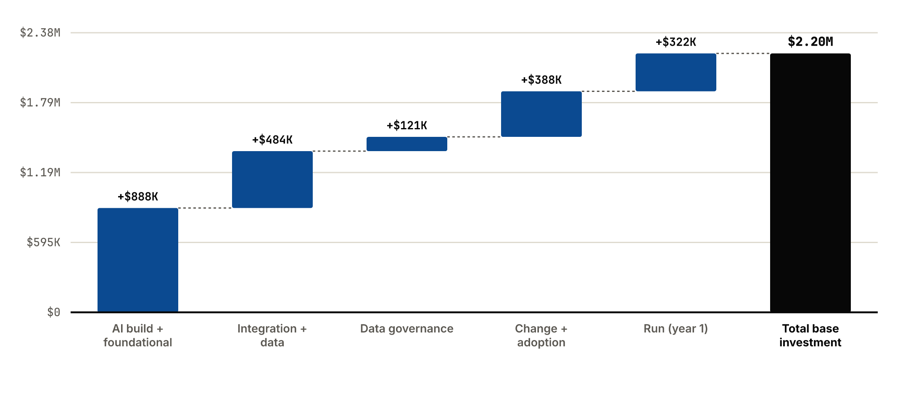
CONTACT CENTER AI ROUTING · INVESTMENT CASE
SLIDE 5 / 12
SECTION 4 · INVESTMENT CASE
The build is a $2.2M base bet — but 23% of it is business change, and that is the half that must not be cut to flatter the number.
The build is a $2.20M base bet — range $1.87M to $3.09M. The waterfall shows where the money goes; the change lane is the execution risk to protect, not trim.
EXHIBIT 4 — INVESTMENT WATERFALL: WHERE THE $2.20M BASE GOES
EIGHT-WORKSTREAM BREAKDOWN
WORKSTREAM | BASE | DUR. | AI
AI build | $800K | 9 mo | 35%
Integration | $290K | 6 mo | 20%
Data | $194K | 5 mo | 30%
Foundational | $88K | 4 mo | 15%
Data governance | $121K | 6 mo | 10%
Process redesign | $131K | 5 mo | 10%
Change & adoption | $257K | 9 mo | 5%
Run (year-1 operations) | $322K | 12 mo | 40%
Total — base | $2.20M
Business change is 23% of effort — a credible build-vs-change balance for an AI Move where value depends on people changing how they work.
DECISION ROLE
Confirm the investment envelope and where the money goes.
OWNER
Priya Iyer (Program Lead)
EVIDENCE
2 sources · as of 2026-06-06 · confidence Medium · 1 open gap
NEXT GATE
Estimate sign-off before build funding

Slide 6
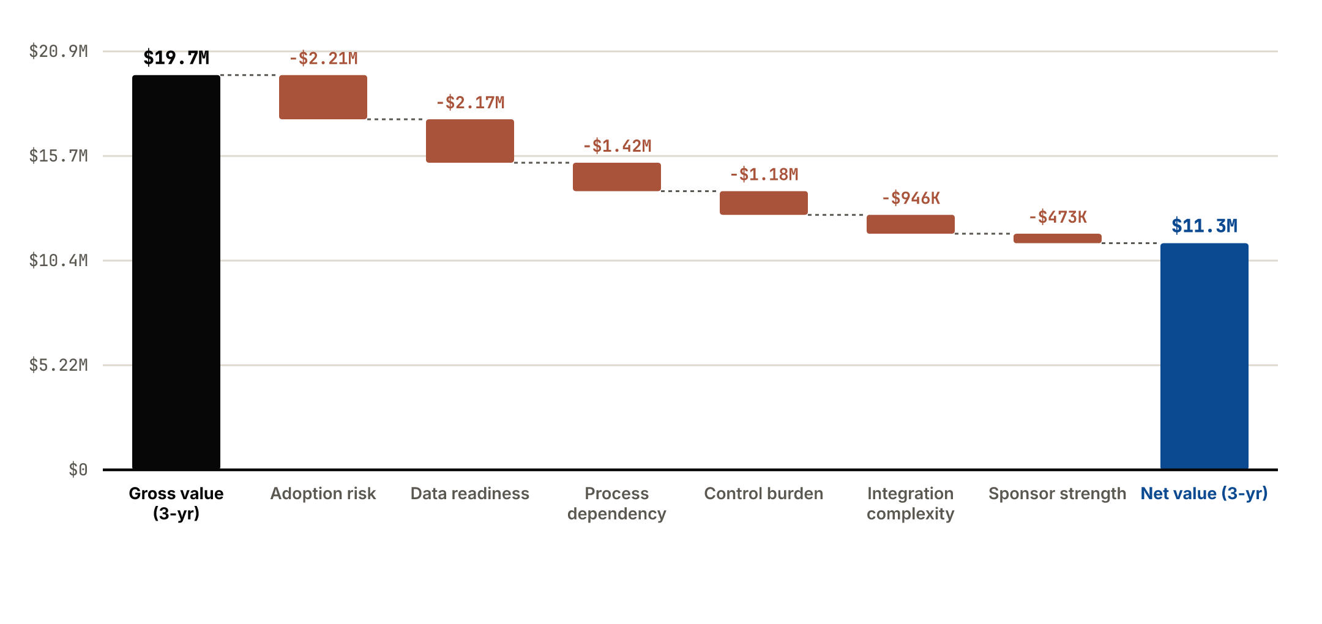
CONTACT CENTER AI ROUTING · VALUE CASE
SLIDE 6 / 12
SECTION 5 · VALUE CASE
Gross value is discounted 43% before it is claimed — adoption and data readiness take the two largest cuts.
Gross 3-year value of $19.7M is discounted 43% by the mandatory six-factor haircut, landing at a net $11.3M. Adoption and data readiness take the two largest cuts.
EXHIBIT 5 — GROSS-TO-NET VALUE BRIDGE: EVERY HAIRCUT, IN DOLLARS
SIX-FACTOR HAIRCUT DETAIL
HAIRCUT FACTOR | SCORE | WEIGHT | DISCOUNT
Adoption risk | 0.60 | 28% | 11.2%
Data readiness | 0.45 | 20% | 11%
Process dependency | 0.55 | 16% | 7.2%
Integration complexity | 0.60 | 12% | 4.8%
Control burden | 0.50 | 12% | 6%
Sponsor strength | 0.80 | 12% | 2.4%
DECISION ROLE
Confirm the value is honestly discounted, not optimistic.
OWNER
Priya Iyer (Program Lead)
EVIDENCE
2 sources · as of 2026-06-06 · confidence Low · 1 open gap
NEXT GATE
Cost-per-contact baseline capture (2026-05-15)

Slide 7
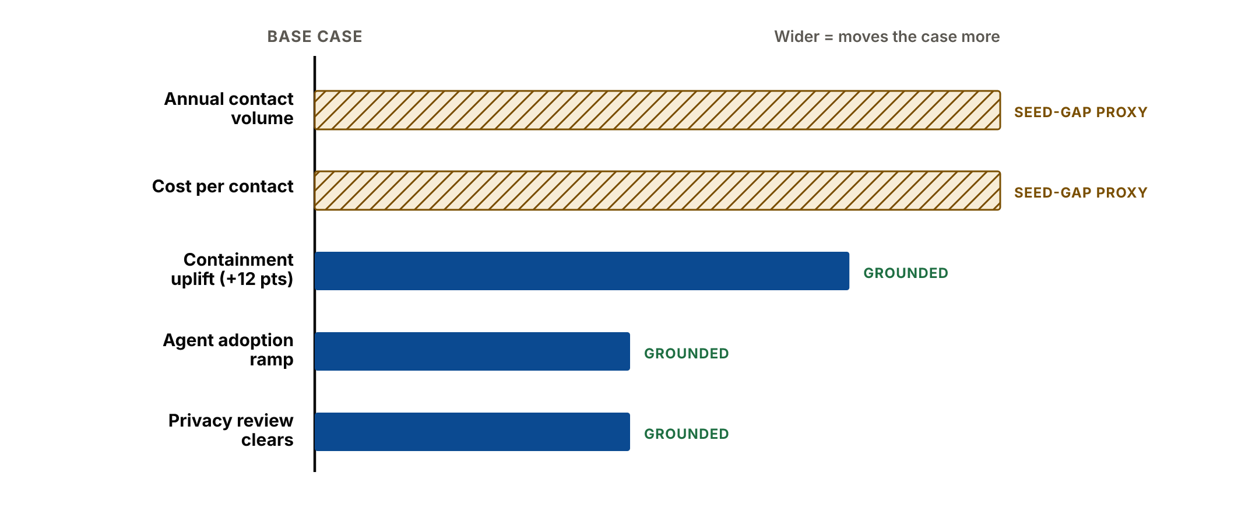
CONTACT CENTER AI ROUTING · PAYBACK AND SENSITIVITY
SLIDE 7 / 12
SECTION 6 · PAYBACK AND SENSITIVITY
Payback is not computable — and that is the honest answer; the case breaks on the cost-per-contact seed gap, not on the model.
PAYBACK Not computable — monetisation is blocked by the cost-per-contact seed gap. This pack shows no payback number rather than a fabricated one.
EXHIBIT 6 — SENSITIVITY TORNADO: WHAT MOVES THE CASE MOST
THREE-SCENARIO RANGE
SCENARIO | INVESTMENT | NET VALUE | PAYBACK
Base | $2.20M | $11.3M | Blocked
Conservative | $3.09M | $8.28M | Blocked
Upside | $1.87M | $14.3M | Blocked
WHAT BREAKS THE CASE
The case breaks if the baseline seed gap is not closed — without the missing unit economics the value range is a proxy, not a forecast.
DECISION ROLE
See what breaks the case before funding the build.
OWNER
Brendan Fox (CS Ops)
EVIDENCE
2 sources · as of 2026-06-06 · confidence Blocked · 1 open gap
NEXT GATE
Cost-per-contact baseline (2026-05-15)

Slide 8
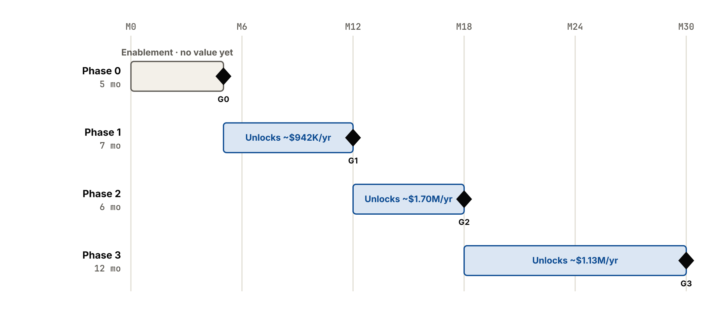
CONTACT CENTER AI ROUTING · ROADMAP
SLIDE 8 / 12
SECTION 7 · ROADMAP
Every phase ends on a gate where the board can kill — Phase 1 is the first place value is verifiable, and the first place to stop.
30 months across four phases, each ending on a gate. Phase 0 is foundational and unlocks no value; Phase 1 is the first place value is verifiable — and the first place the board can stop.
EXHIBIT 7 — PHASED ROADMAP: 30 MONTHS, FOUR GATES
GATE DECISIONS — WHAT IS DECIDED AT EACH GATE
GATE | NAME | DECISION AT THE GATE | KILL POINT
G0 | Foundation complete | Confirm intent / transcript data unified and the model gateway stood up before any build spend. | Killable
G1 | Pilot value verified | Verify containment +4 pts and AHT down on pilot queues — kill if the pilot does not move the metric. | Killable
G2 | Scale-out approved | Approve scale-out only if the redesigned routing process holds toward the 40% containment target. | Killable
G3 | Steady-state handoff | Confirm ~70% adoption and hand the value loop to Tower. | Handoff
DECISION ROLE
Confirm value and risk are sequenced with kill gates.
OWNER
Priya Iyer (Program Lead)
EVIDENCE
2 sources · as of 2026-06-06 · confidence Medium · No open gaps
NEXT GATE
Gate G1 — pilot value verification

Slide 9
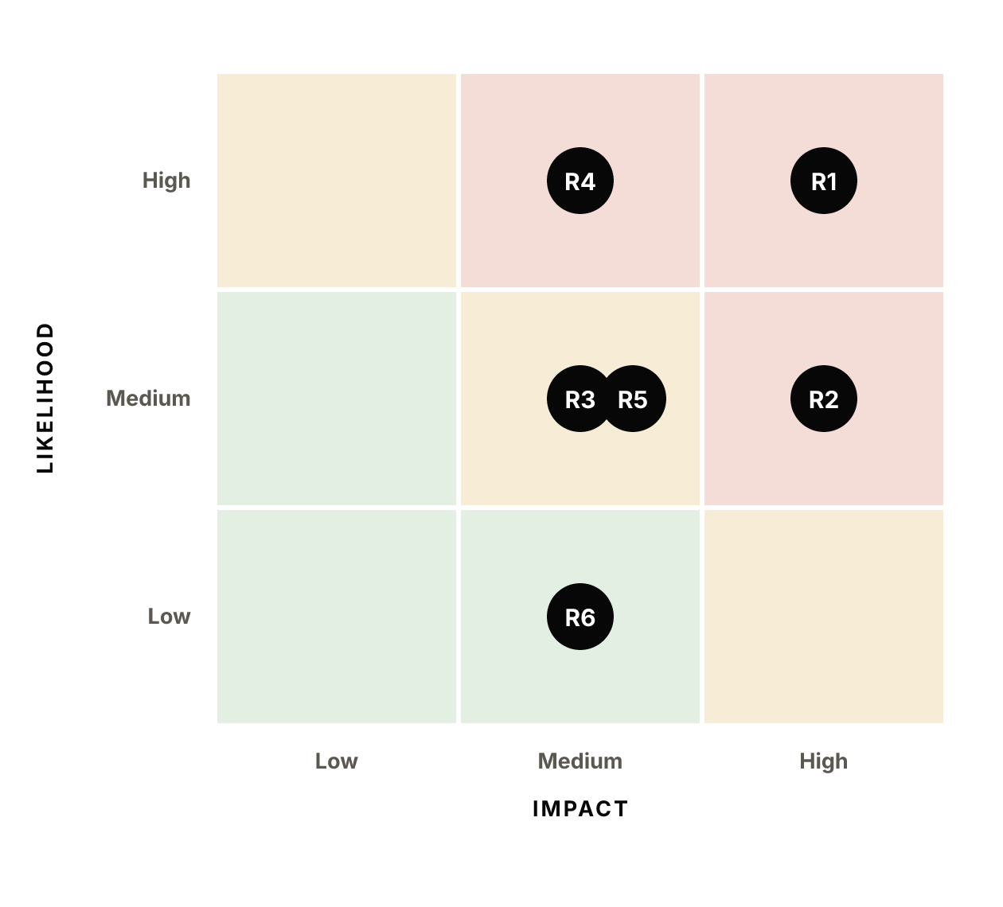
CONTACT CENTER AI ROUTING · RISKS AND CONTROLS
SLIDE 9 / 12
SECTION 8 · RISKS AND CONTROLS
The monetisation seed gap and the transcript-privacy review are the two risks that can block approval — both have owners and dates.
The monetisation seed gap (R1) and the transcript-privacy review (R2) are the two risks that can block approval. Both sit in the high-impact band, both have a named owner and a dated control.
EXHIBIT 8 — RISK HEATMAP: LIKELIHOOD × IMPACT
RISK REGISTER — ALL SIX RISKS, CONTROLS AND OWNERS
RISK | L | I | CONTROL / MITIGATION | OWNER
R1 Cost-per-contact baseline is not captured — value stays a proxy and monetisation cannot be verified. | High | High | Tenant action item with a dated owner; build funding gated on it. | Brendan Fox (CS Ops)
R2 Transcript-use privacy review fails and removes agent-assist features — the value mechanism is lost. | Medium | High | Privacy review run ahead of the Design gate (milestone 2026-05-17). | Elena Fischer (AI Governance)
R3 Agent adoption falls short of the modelled curve — net value erodes from the 30/70/85% ramp. | Medium | Medium | Staged rollout by team, manager-enablement track, incentive re-pointing away from raw handle time. | Mariana Rojas (WFM Lead)
R4 CDP consolidation slips — intent / transcript data is not unified for Phase 0. | High | Medium | Phase 0 is foundational and gated (G0); build cannot start until data is unified. | CDO (Data Sponsor)
R5 NICE-vs-IT containment measurement discrepancy is not reconciled — the Tower baseline is wrong. | Medium | Medium | Reconciliation owned and dated (James Wright, due 2026-05-08). | James Wright
R6 NICE CXone integration is more brittle than scoped — integration effort overruns. | Low | Medium | Conservative effort multiplier carried; Salesforce / AWS connectors are well understood. | Solution Architect
DECISION ROLE
See what could fail or block the funding decision.
OWNER
Elena Fischer (AI Governance)
EVIDENCE
3 sources · as of 2026-06-06 · confidence Medium · 1 open gap
NEXT GATE
Transcript-use privacy review (2026-05-17)

Slide 10
CONTACT CENTER AI ROUTING · ASSUMPTION LEDGER
SLIDE 10 / 12
SECTION 9 · ASSUMPTION LEDGER
Two of the three case-moving assumptions are seed-gap proxies — validating them is the highest-leverage next step.
Assumptions are ranked by how much the case moves if they are wrong. The two highest-ranked are seed-gap proxies — they stand in for absent tenant data and are the evidence asks that gate funding.
FULL ASSUMPTION LEDGER — ALL 6 RANKED ENTRIES
# | ASSUMPTION | OWNER | CONFIDENCE | SENSITIVITY | SOURCE
1 | Annual agent-handled contact volume is ~9.0M (benchmark for an $80B retailer) — used only to express value in operational hours. [seed-gap proxy] | Priya Iyer (Program Lead) | low | high | Benchmark proxy — seed gap
2 | Fully-loaded cost per contact is ~$6.50 (benchmark proxy) until the tenant baseline due 2026-05-15 lands. [seed-gap proxy] | Brendan Fox (CS Ops) | low | high | Benchmark proxy — seed gap (tenant baseline pending)
3 | AI routing lifts containment ~12 points (28% → 40% target) — the KPI dictionary states this uplift target explicitly. | Priya Iyer (Program Lead) | medium | high | KPI kpi:apex:018 stated target
4 | Customer Care agents reach 70% steady-state adoption by year 2; the WFM lead is on record preferring agent-assist over IVR replacement. | Mariana Rojas (WFM Lead) | medium | medium | Operating telemetry — CC working group notes
5 | The transcript-use privacy review (2026-05-17 milestone) clears without scope cuts that remove agent-assist features. | Elena Fischer (AI Governance) | medium | medium | Move milestone + AI Governance Council notes
6 | Blended delivery rate card reflects market rates for AI build and integration roles. | David Okafor (Program Lead) | medium | low | Benchmark rate card
DECISION ROLE
Confirm every case-moving assumption has an owner.
OWNER
Priya Iyer (Program Lead)
EVIDENCE
1 source · as of 2026-06-06 · confidence Low · 2 open gaps
NEXT GATE
Assumption validation before the Design gate

Slide 11
CONTACT CENTER AI ROUTING · EVIDENCE APPENDIX
SLIDE 11 / 12
SECTION 10 · EVIDENCE APPENDIX
Baseline coverage is 60% — six metrics are measured, four are declared seed gaps, none are invented.
Baseline coverage is 60% — 6 metrics are measured, sourced and dated; 4 are declared seed gaps. None are invented. The case is auditable end to end.
RECORDED METRICS — MEASURED, SOURCED, DATED
METRIC | VALUE | SOURCE | AS OF | CONFIDENCE
Average Handle Time | 7.2 minutes | KPI kpi:apex:019 (NICE CXone) | 2026-04-30 | high
Contact Center Containment | 28 percent | KPI kpi:apex:018 (NICE CXone) | 2026-04-30 | medium
First Call Resolution | 68 percent | KPI kpi:apex:020 (NICE CXone) | 2026-04-30 | medium
Agent Utilization | 84 percent | KPI kpi:apex:021 (NICE CXone) | 2026-04-30 | high
CSAT (post-interaction) | 4.1 score_out_of_5 | KPI kpi:apex:012 (Zendesk survey) | 2026-04-30 | medium
Repeat transfer rate | 18.4 percent | Move P2 baseline deliverable (Genesys routing export) | 2026-05-03 | medium
SEED GAPS — DECLARED, NEVER BLANK, NEVER INVENTED
METRIC | WHY IT IS MISSING | OWNER | DECISION IMPACT
Cost per contact (labour) [seed gap] | Not recorded. Tenant action item "Capture cost-per-contact baseline" (owner Brendan Fox) is due 2026-05-15 — see operating telemetry. | Brendan Fox (CS Ops) | Blocks monetisation — without it the value range is a proxy, not a forecast. This is the gate-closing gap.
Annual contact volume [seed gap] | Not recorded in the KPI dictionary, telemetry, or the Move baseline. Needed to convert AHT/containment deltas into FTE-hours and dollars. | Priya Iyer (Program Lead) | Cannot convert AHT / containment deltas into FTE-hours and dollars — value is expressed in operational hours until closed.
Channel mix (voice/chat/IVR split) [seed gap] | Containment note references "IVR + chatbot" but no structured split is seeded. | Priya Iyer (Program Lead) | Routing value differs by channel; the split bounds how the pilot is scoped.
QA error rate [seed gap] | No contact-centre quality-defect metric is seeded for Apex. | Priya Iyer (Program Lead) | No quality-defect baseline — a secondary value lever cannot be sized.
DECISION ROLE
Audit every claim back to a source or a declared gap.
OWNER
Priya Iyer (Program Lead)
EVIDENCE
1 source · as of 2026-04-30 · confidence Medium · 4 open gaps
NEXT GATE
Close seed gaps before build funding

Slide 12
CONTACT CENTER AI ROUTING · RECOMMENDATION AND ASKS
SLIDE 12 / 12
SECTION 11 · RECOMMENDATION AND ASKS
Approve shaping spend and the cost-per-contact baseline capture — hold the full build until the gap closes.
RECOMMENDATION Approve shaping spend only — full autonomy is not yet fundable until the cost-per-contact gap is closed.
EXHIBIT 11 — DECISION CHECKLIST: WHAT IS REQUESTED AT THIS GATE
DECISION ITEM | STATE | DETAIL
Shaping spend for Phase 0 design | Approve now | Fund intent / transcript unification design and model-gateway scoping — the foundational, no-regret work.
Cost-per-contact baseline capture | Approve now | Confirm Brendan Fox as owner, due 2026-05-15 — the single gate-closing evidence ask.
Transcript-use privacy review | Condition | Must clear (milestone 2026-05-17) without cutting agent-assist features before the Design gate.
Full AI-routing build funding | Hold | Hold until the cost-per-contact baseline lands and the value range is no longer a proxy.
IVR-replacement / autonomous scope | Hold | Not funded — the chosen shape is agent-assist with human accountability retained.
REQUESTED SPEND Shaping spend only — the full build investment range ($1.87M–$3.09M) is NOT requested at this gate.
DECISION ROLE
Make the funding decision requested now.
OWNER
CIO (Executive Sponsor)
EVIDENCE
2 sources · as of 2026-06-06 · confidence Blocked · 4 open gaps
NEXT GATE
Re-present for build funding once the seed gap closes

